Slide 1
Postsecondary Education Expenses

Slide 2
Answers Revealed!
Louis Vuitton Purse: $1,000: Cost of Transportation $1,300
Used Car: $11,000: Room and Board $11,200
High End Car stereo $1000: Books and Supplies $950
iPhone $750: 2 in state community college courses & fees $740
Eating Out $150/ month: Parking Fees for the year $160
Smartwatch & High- End Wireless Headphones $600: Dorm room decoration and supplies $600+. Some reports have it as high as over $900 because of a trend called “Glam Dorm Room”
Notes:
The point of this activity is for students to have a perspective of how some things they can do with out or purchase at a less expensive cost can lead to savings for college expenses.

Slide 3
Think About This!
If your parents would be willing to, ask then to help you save for college by setting the cost of buying an item?
Can you live without the items in the previous activity?
Your friend would like some advice about the financial benefit of buying a used cell phone. What advice would you give him or her?
Is it possible to purchase a reliable used car that costs less than $11,000?
List 3 advantages for eating meals out, and 3 advantages of eating meals at home? Which do you do more of?

Slide 4
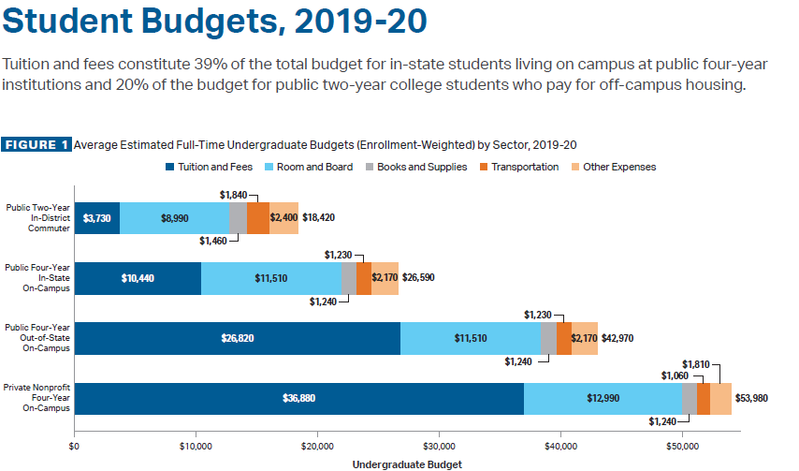
Student Budgets, 2019-2020
Source: Trends in College Pricing 2019

Slide 5
Vocational, Trade, and Technical Schools
There are many high paying jobs that don’t require a 4 year college degree.
Working in a skilled trade is a preferred choice for many people
The schools may offer a faster track into the workforce.
Vocational Schools
Completion of certificate program can be done in under two years
A shortage of skilled workers in these fields means the job market & pay are favorable
Examples: Paralegal, hair stylist, medical assistant
Trade Schools
These jobs are physically demanding and very specific skills training are required
Very good job market
Examples: Welder, Tile Setter, Electrician, Carpenter
Technical Schools
These schools teach trade careers, and may involve mentors, and apprenticeships. Also very skill specific
Courses do not include certain academic subjects usually required in colleges
Examples: Nursing, HVAC, Automotive Technician, Plumbing
Notes:
Source:https://www.rwm.org/

Slide 6
Vocational, Trade, and Technical Schools
There are for- profit schools that promise a fast track completion program for various vocational degrees. These schools may have a higher cost of attendance.
Some community colleges have started to offer vocational programs as well. These may cost less than a for -profit vocational, trade or technical school.
Seek out the best options in regards to time and cost of the program.
But again, try to save what you can to offset some of the costs just as you would save to offset the costs of college!
Notes:
Sources:

Slide 7
Careers
Hairstylist
Childcare worker
Mechanic
Accountant
Engineer
FBI Agent
Pilot
Teacher
Pharmacist
Conservation Scientist
News reporter
Carpenter
Computer and office equipment repair
Lawyer
Dentist
Professor
Psychologist
Underwater welder
Dental Hygienist
Bookkeeper

Slide 8
Vocational/ Trade/ Technical School | Two – Year College | Four- Year College | Graduate School (2-4 years in addition to bachelor degree)
Hairstylist | Childcare worker | Accountant | Pharmacist
Mechanic | Computer and Office Equipment Repair | Engineer | Lawyer
Carpenter | Dental Hygienist | FBI Agent | Dentist
Underwater Welder | Bookkeeper | Pilot | Professor
 |  | Teacher | Psychologist
 |  | News Reporter
 |  | Conservation Scientist
Would that smart watch, restaurant dinners, or iPhone give you options like these?

Slide 9
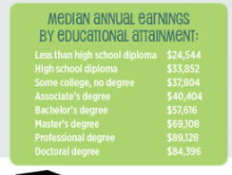
Source: College 101 infographic. (n.d.). Federal Reserve Bank of St. Louis | Economic Data, Monetary Rates, Economic Education. https://www.stlouisfed.org/education/college-101-infographic

Slide 10
Who Would You Rather Be?
Scenario One:
  Becky is a welder. She went to school for two years. Becky went to buy groceries yesterday for the whole week. With her income, she earns enough money to buy her weekly groceries with one day’s earnings.
  Adam is a salesperson at a mattress store. He has a high school diploma. With his income, it takes three days earnings.
Scenario Two:
  Sima is an engineer with a masters degree. She really wants to buy a new gaming PC. It would take her less than one weeks pay.
  Kyle is a food server at the local skating rink. He would also like to buy a gaming PC. It would take him about six weeks pay to purchase the same gaming PC.

Slide 11
How Can a Middle and High School Student Start Saving for College?
Start saving early! Put aside some money from earnings, allowance, and birthday.
  While you may not save the full cost of college, saving can help cover the cost of books, a laptop, parking fees, supplies, transportation fees, and maybe some classes.
  Doing so will lower your need to depend on loans to pay for every college expense.
8th Grade
Keep doing your best in school—study hard, earn good grades, and participate in class.
Ask your counselor about challenging and interesting courses you can take in high school.
Continue to explore different career options.
Start saving money now to help pay for college.
Continue taking advanced courses such as Algebra II and an intermediate foreign language class.

Slide 12
5 Ways High School Students Can Start Saving for College
Open a Savings Account: There is no bad time to open a savings account. If you have something in particular you're saving up for, like going to college, then there's no reason not to start one.
Get a Job: While the options for high school students are limited, there are still jobs out there. Check local supermarkets and retail stores to see if there are any places nearby that are willing to work with a student's schedule.

Slide 13
5 Ways High School Students Can Start Saving for College
Get Your Grades Up: This may not be a direct way to save money, but it will put a dent in those college costs. Nowadays, there are so many scholarships around that there's almost one for everybody. But getting one is much easier if you have a good GPA.
Sell Off Old Stuff Most high school students are past the stage of needing G.I. Joes or stuffed animals, but chances are they are still sitting around the house. Take advantage of those toys, clothes and other items that you no longer need and turn them into cash.

Slide 14
Applying for Scholarships
Scholarship application tips
As you get ready to apply for scholarships, keep in mind that different scholarships have their own qualifying criteria and require certain documents. These criteria may help as you choose which scholarships to apply for.
Be organized. Stay on top of deadlines, gather all documents, and make copies of everything you submit. It’s a good idea to send your applications by certified mail to make sure they’re received.
Be honest. Don't exaggerate your grades, memberships, skills, or qualifications. You’re more likely to receive scholarships if you focus on the ones that match your interests and skills.
Follow instructions carefully. Some scholarships require you to write an essay while others may want letters of recommendation. Send in what’s requested and proofread everything. Typos and missing materials can cost you a scholarship.

Slide 15
What are some sources for scholarship information and scholarships?
Community Organizations
University Foundations
School Guidance Counselors
Reliable College Scholarship Search Sites
School Sponsors ( Food and beverage suppliers, Banks)

Slide 16
Show Me You Know It!!
The next best alternative that is given up when a decision is made is the ______________ _____ of a decision.
Opportunity Cost

Slide 17
Show Me You Know It!!
There is no bad time to open a __________ ______. Especially if you have something in particular, you're saving up for.
Savings Account

Slide 18
Show Me You Know It!!
To have a career as a dental hygienist or a paralegal you will need to attend a ____________ ____________ college.
Two Year

Slide 19
Show Me You Know It!
People with a postsecondary education of some type, typically earn ____________ income during a shorter span of time.
More

Slide 20
Show Me You Know It!
These types of loans are for undergraduate and graduate students, the borrower is responsible for all interest while in school; student must be enrolled at least half time; financial need is not required.
Unsubsidized Loan

