Slide 1
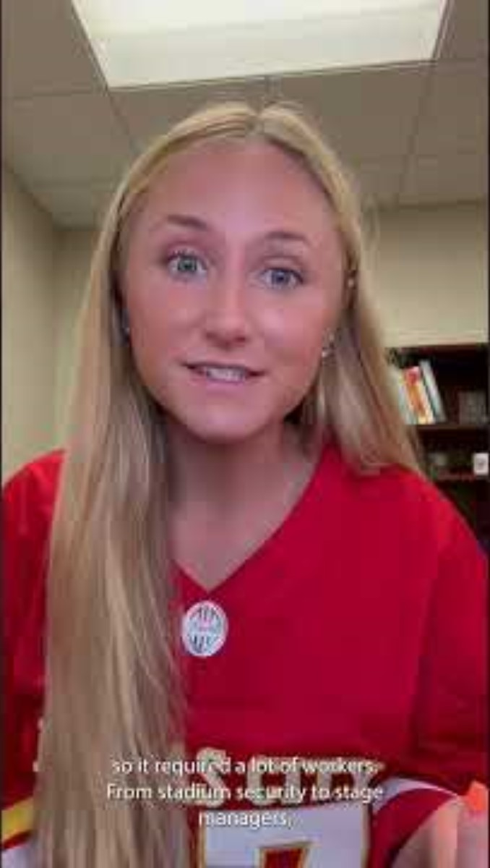
Video Shorts
Swiftonomics
What is derived demand?
How do Taylor Swift concerts mimic international relations?
Notes:
ANSWERS
Derived demand is when the need for workers is based off of the demand for the product that the workers produce.
In Taylor Swift concerts, fans trade friendship bracelets for mutual benefit, which is similar to how countries interact with one another to trade goods that benefit both nations.
Video link: https://www.youtube.com/shorts/RZ5QbBk6RRc?feature=share

