Slide 1

The Information Creation Process:
Data Sources and Data Aggregators
Federal Reserve Bank of St. Louis
© 2023, Federal Reserve Bank of St. Louis. Permission is granted to reprint or photocopy this presentation in its entirety for educational purposes provided the user credits the Federal Reserve Bank of St. Louis, www.stlouisfed.org/education.

Slide 2

Data Aggregator (FRED)
Collects economic data series from many different sources
Makes data series searchable
Organizes the aggregated data
Provide tools for user formatting and analysis
Data Source (BEA)
Original creator of an economic data series
Gathers data, conducts research and analysis, and develops methodologies
Often provides regular releases to distribute new data
© 2023, Federal Reserve Bank of St. Louis. Permission is granted to reprint or photocopy this presentation in its entirety for educational purposes provided the user credits the Federal Reserve Bank of St. Louis, www.stlouisfed.org/education.

Slide 3
Compelling Question
How do economic data aggregators differ from economic data sources?
© 2023, Federal Reserve Bank of St. Louis. Permission is granted to reprint or photocopy this presentation in its entirety for educational purposes provided the user credits the Federal Reserve Bank of St. Louis, www.stlouisfed.org/education.

Slide 4
Data Sources
Capabilities
  Original source of the full dataset
  Often provides additional context and explanation, including methodologies
Constraints
  Do not easily connect with other economic data sources
  Data releases often only present the most recent data
  Researchers would have to do the extra work of cleaning and formatting the data
© 2023, Federal Reserve Bank of St. Louis. Permission is granted to reprint or photocopy this presentation in its entirety for educational purposes provided the user credits the Federal Reserve Bank of St. Louis, www.stlouisfed.org/education.

Slide 5
Data Aggregators
Capabilities
  Search data from multiple sources in one location
  Data has been standardized or organized
  Some analysis or formatting tools may be available
Constraints
  Data analysis tools available may be limited and not suitable for advanced research
  Less documentation on the data creation and methodology on an aggregator website
© 2023, Federal Reserve Bank of St. Louis. Permission is granted to reprint or photocopy this presentation in its entirety for educational purposes provided the user credits the Federal Reserve Bank of St. Louis, www.stlouisfed.org/education.

Slide 6
True/False Activity
“Thumbs up” = True
“Thumbs down” = False
Statement 1: FRED is the original source of U.S. GDP data.
© 2023, Federal Reserve Bank of St. Louis. Permission is granted to reprint or photocopy this presentation in its entirety for educational purposes provided the user credits the Federal Reserve Bank of St. Louis, www.stlouisfed.org/education.

Slide 7
True/False Activity
Answer 1: FALSE (The BEA is the original data source.)
Statement 2: An organization that uses original methods to gather data and conduct research and analysis is an example of a data source.
© 2023, Federal Reserve Bank of St. Louis. Permission is granted to reprint or photocopy this presentation in its entirety for educational purposes provided the user credits the Federal Reserve Bank of St. Louis, www.stlouisfed.org/education.

Slide 8
True/False Activity
Answer 2: TRUE
Statement 3: An organization that collects, organizes, and makes available data from many different sources in one location is an example of a data aggregator.
© 2023, Federal Reserve Bank of St. Louis. Permission is granted to reprint or photocopy this presentation in its entirety for educational purposes provided the user credits the Federal Reserve Bank of St. Louis, www.stlouisfed.org/education.

Slide 9
True/False Activity
Answer 3: TRUE
Statement 4: A capability of a data aggregator is that it often provides more context and details on how the data are produced, gathered, and calculated.
© 2023, Federal Reserve Bank of St. Louis. Permission is granted to reprint or photocopy this presentation in its entirety for educational purposes provided the user credits the Federal Reserve Bank of St. Louis, www.stlouisfed.org/education.

Slide 10
True/False Activity
Answer 4: FALSE (This is a capability of a data source.)
Statement 5: A constraint of a data source is that it is difficult to connect with data series produced by other organizations or researchers.
© 2023, Federal Reserve Bank of St. Louis. Permission is granted to reprint or photocopy this presentation in its entirety for educational purposes provided the user credits the Federal Reserve Bank of St. Louis, www.stlouisfed.org/education.

Slide 11
True/False Activity
Answer 4: TRUE
How did you do?
© 2023, Federal Reserve Bank of St. Louis. Permission is granted to reprint or photocopy this presentation in its entirety for educational purposes provided the user credits the Federal Reserve Bank of St. Louis, www.stlouisfed.org/education.

Slide 12
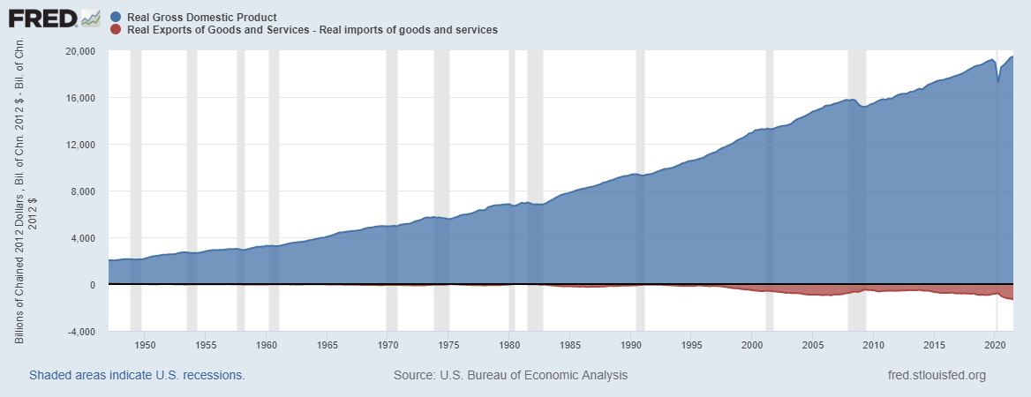
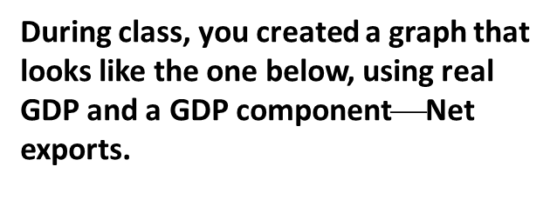
Handout: Real GDP Components
During class, you created a graph that looks like the one below, using real GDP and a GDP component$$Net exports.
For the handout, add to your stacking area graph the following GDP components:
Real Personal Consumption Expenditures [PCECC96]
Real Gross Private Domestic Investment [GPDIC1]
Real Government Consumption Expenditures and Gross Investment [GCEC1]
© 2020, Federal Reserve Bank of St. Louis. Permission is granted to reprint or photocopy this presentation in its entirety for educational purposes provided the user credits the Federal Reserve Bank of St. Louis, www.stlouisfed.org/education.

Slide 13
Compelling Question
How do economic data aggregators differ from economic data sources?
© 2023, Federal Reserve Bank of St. Louis. Permission is granted to reprint or photocopy this presentation in its entirety for educational purposes provided the user credits the Federal Reserve Bank of St. Louis, www.stlouisfed.org/education.

