Slide 1

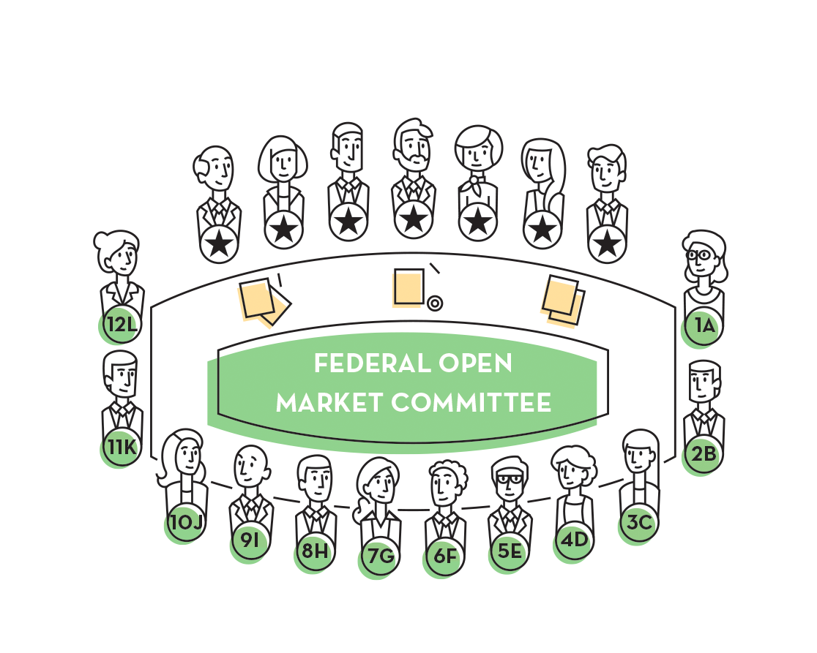


Slide 2

Students will:
Identify the role of the FOMC in formulating monetary policy.
Identify the legislative origins of the structure and goals of the FOMC.
Analyze anecdotal information from the Beige Book to assess the risk that the economy will not meet the national economic goals.
Create an FOMC statement that contains a policy recommendation.

Slide 3


The actions of a central bank to influence the availability and cost of money and credit to achieve the national economic goals.

Slide 4
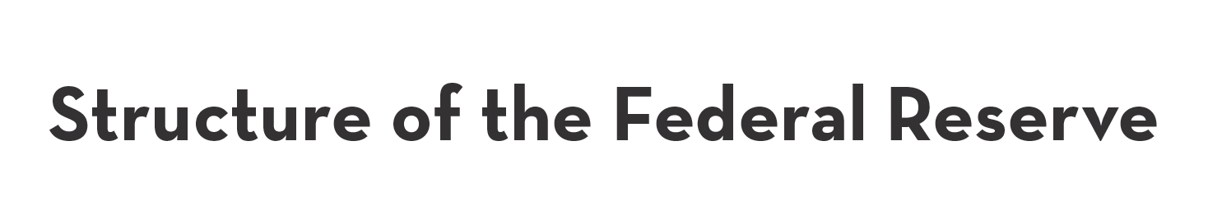
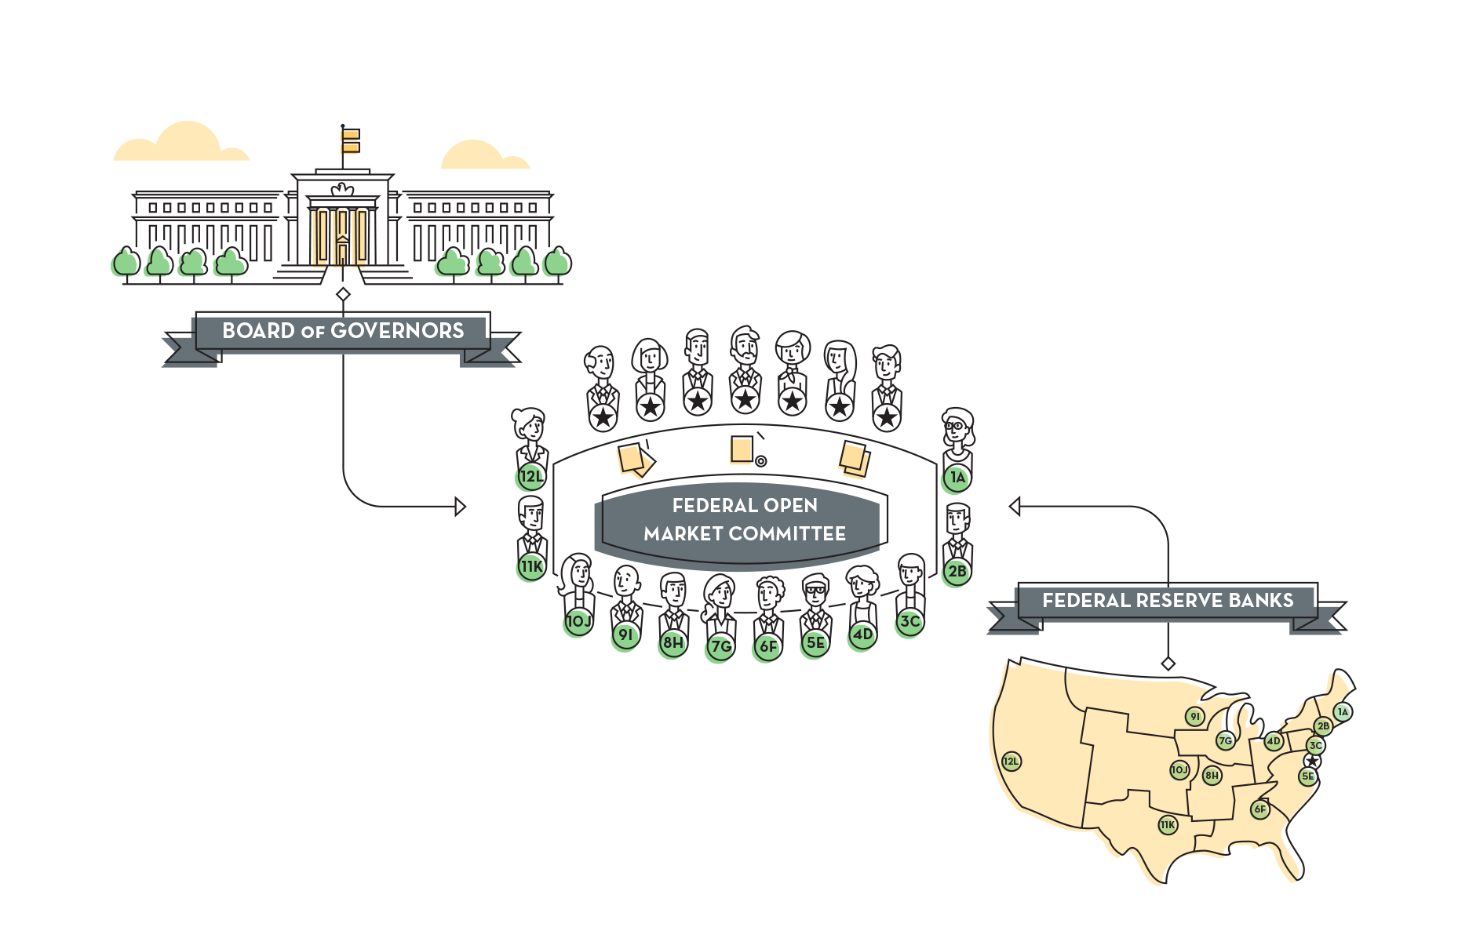

Slide 5
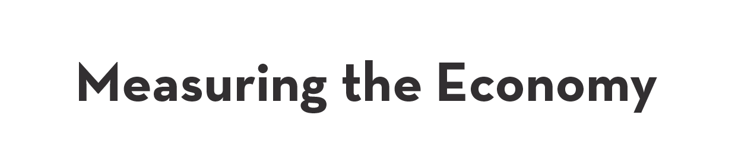
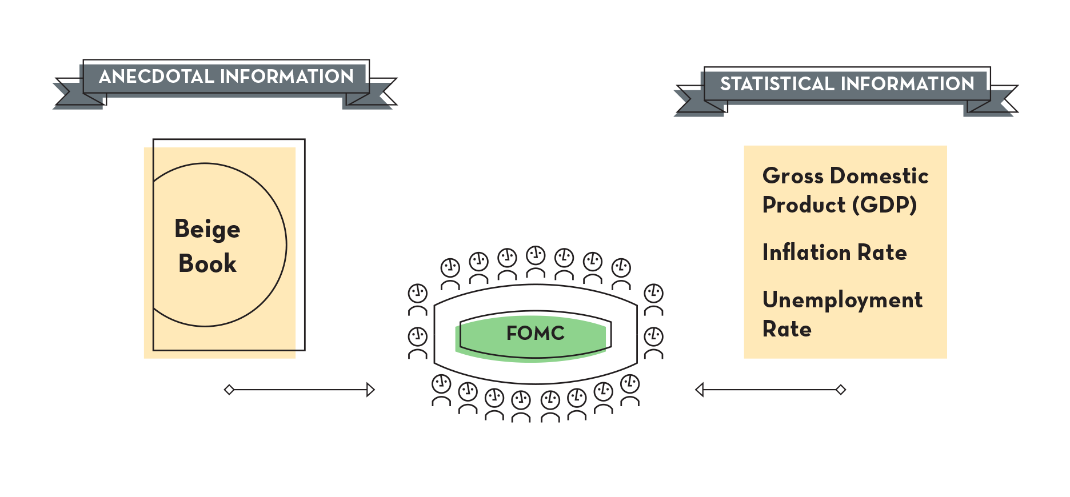

Slide 6

Upside Risks
What could happen in the economy that could cause overall prices to rise?
Downside Risks
What could happen in the economy that could cause overall employment to fall?

Slide 7
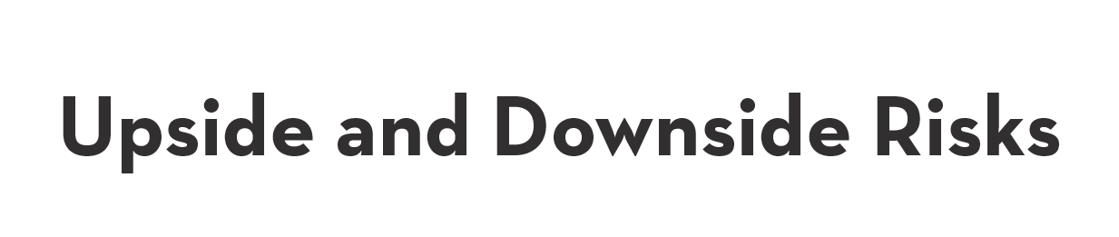
Threats to stable prices (Upside Risks) | Threats to maximum employment (Downside Risks)
Increased sales | Sales are down
Spending remains strong | Consumer spending weakened
Occupancy at high levels | Manufacturing declined
Operating at full capacity | Orders were soft
Increased prices for inputs | Lending contracted
Loan demand is brisk | Activity was slowing
Activity continues to advance | Demand for hires decreased
Labor markets are tightening | Real estate markets deteriorated
Pickup in wages | Reports were negative
Construction is robust | Hiring freeze

Slide 8

Hello. I am the president of the Federal Reserve Bank of .
Our Bank believes that the balance of risk is weighted to the:
Upside
Downside
Both upside and downside
We do not see significant economic risks.
We made this risk assessment based on the following information from our Beige Book:
1. 2. 3.
Thank you.

Slide 9

Hello. I am the president of the Federal Reserve Bank of .
After hearing from all 12 districts, I believe that the nation’s economic risk is weighted to the:
Upside
Downside
Both upside and downside
We do not see significant economic risks.
I would:
Raise
Lower
Make no change to the Federal Funds target rate.
Thank you.

Slide 10

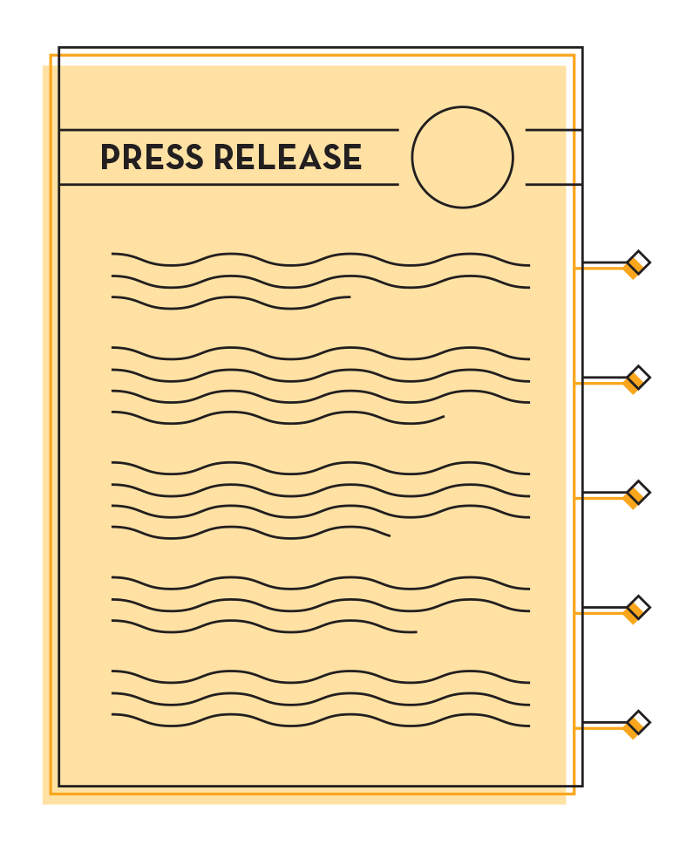
A summary of the committee’s view of economic conditions
An assessment of the risks to stable prices and maximum employment observed in the economy
A specific target for the federal funds rate, along with any change from the previous target
Information about the factors that could cause the committee to make future changes to the target rate
A record of the vote of the committee, along with information about any dissenting votes

Slide 11


