Slide 1
Using a Structured Minimum Wage Debate in the Economics Classroom
What are the economic costs and benefits of a higher minimum wage?

Slide 2
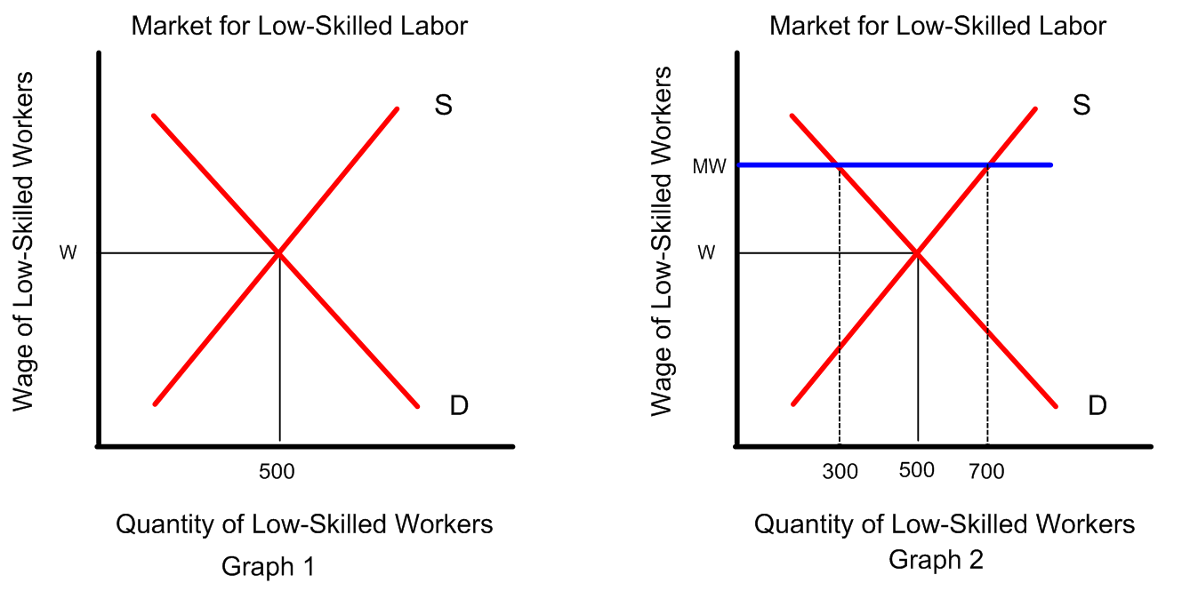
Visual 1: Supply and Demand

Slide 3
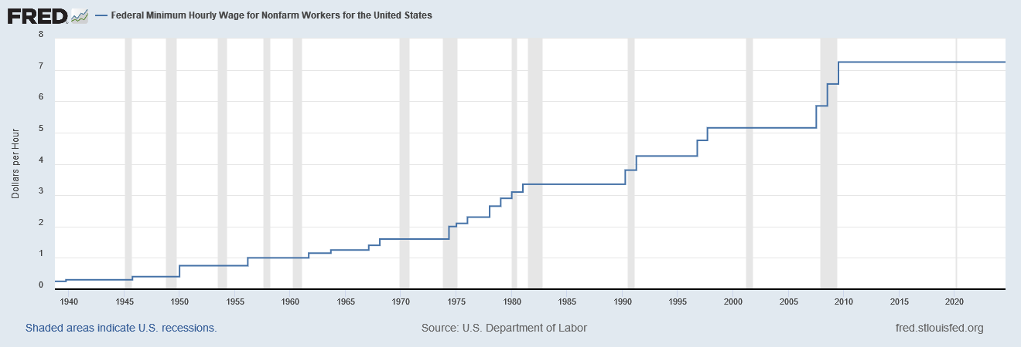
Visual 2: Historical Minimum Wage Data
SOURCE: Federal Reserve Bank of St. Louis, Federal Reserve Economic Data (FRED); https://fred.stlouisfed.org/graph/?g=m2cm.

Slide 4
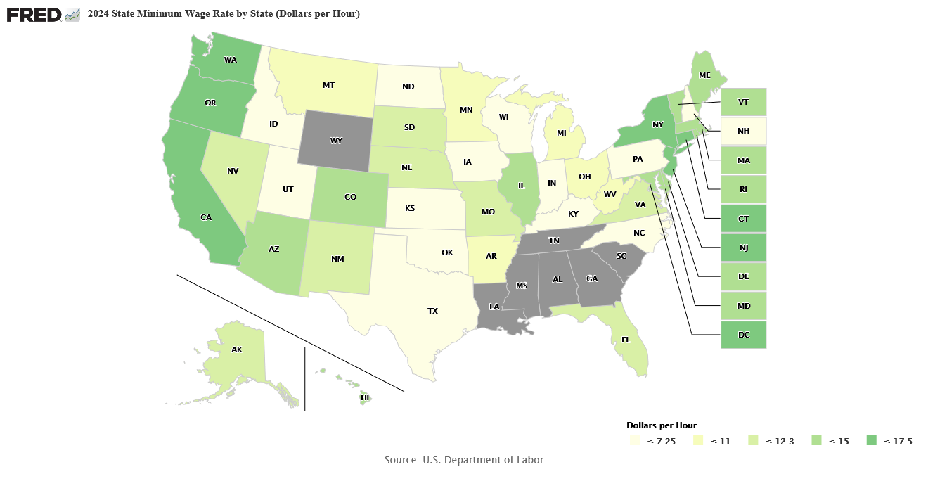
Visual 3: Map of State Minimum Wages
SOURCE: Federal Reserve Bank of St. Louis, Federal Reserve Economic Data (FRED); https://fred.stlouisfed.org/graph/?m=1rWwy.

Slide 5
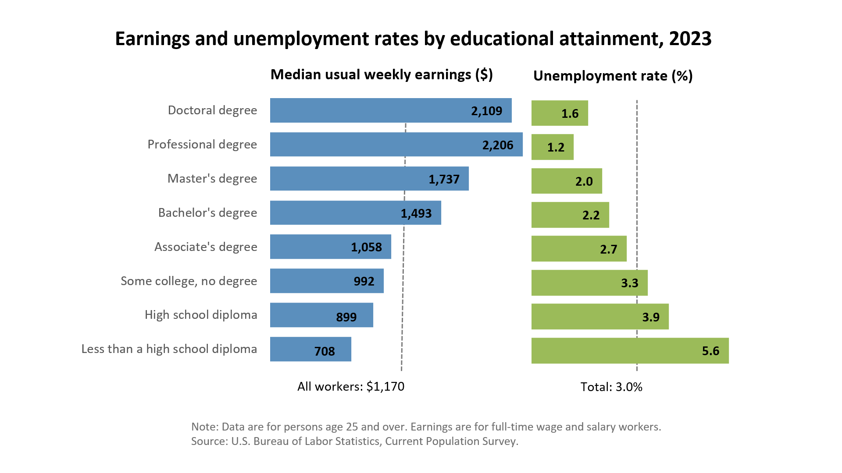
Visual 4: Unemployment Rates and Earnings by Educational Attainment
SOURCE: Bureau of Labor Statistics; https://www.bls.gov/emp/chart-unemployment-earnings-education.htm.

Slide 6
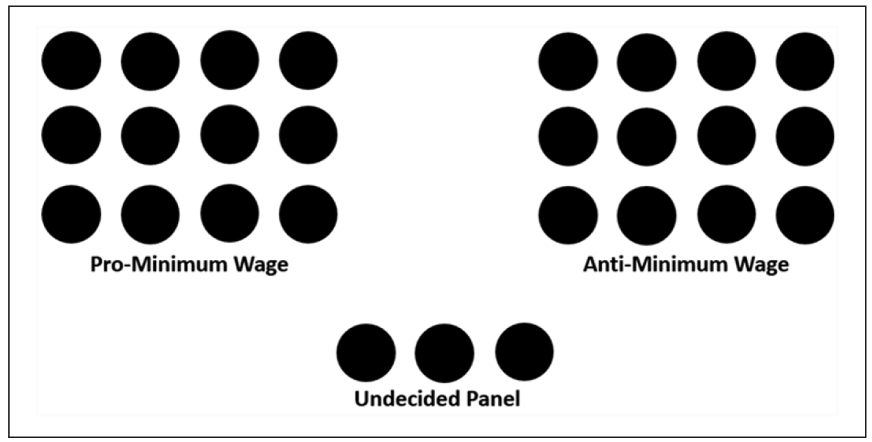
Visual 5: Classroom Layout

