Slide 1
Saving the Environment with Economic Ideas
Lesson 6: Green Is the New Gold

Slide 2
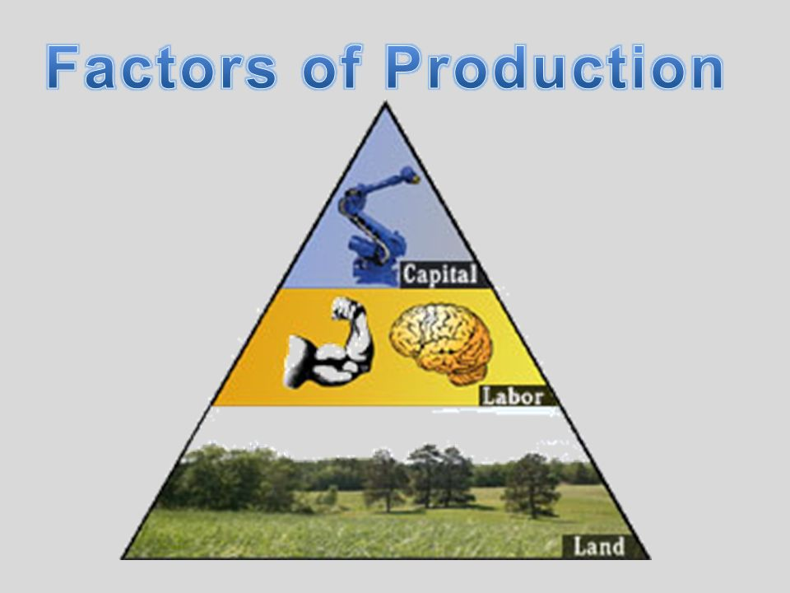
Resources: The basic kinds of resources used to produce goods and services: land or natural resources, human resources (including labor and entrepreneurship), and capital.

Slide 3
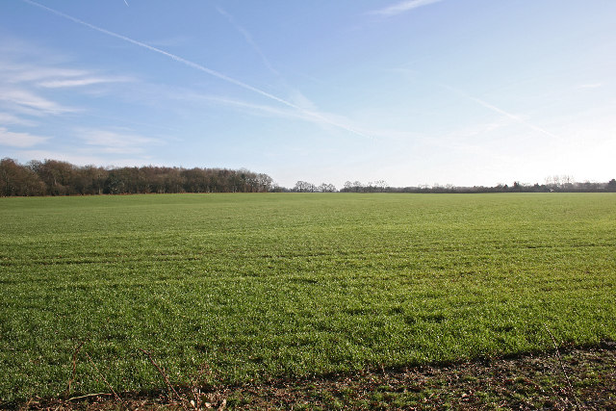
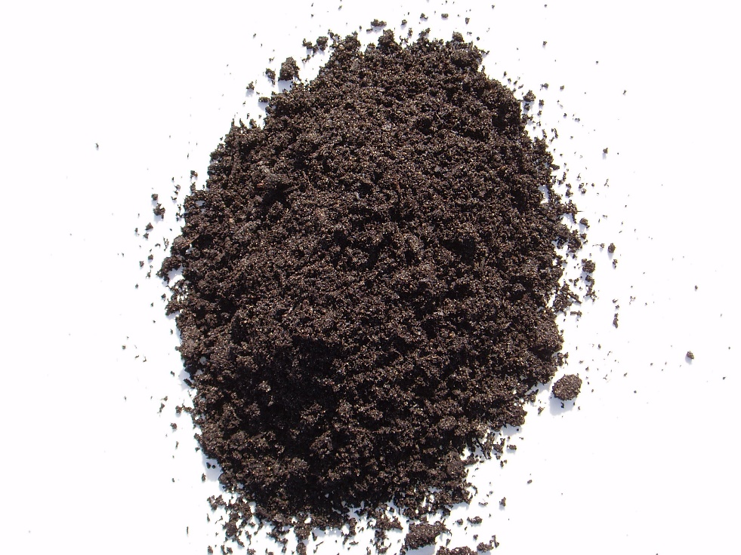
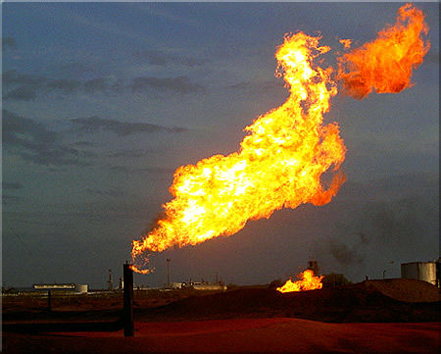
Land: Things that occur naturally in and on the earth that are used to produce goods and services. Examples include oceans, air, mineral deposits, virgin forests and actual fields of land. Land resources are also called natural resources. When investments are made to improve fields of land or other natural resources, those resources become, in part, capital resources.
This Photo by Unknown Author is licensed under CC BY-SA
This Photo by Unknown Author is licensed under CC BY-SA
This Photo by Unknown Author is licensed under CC BY-SA

Slide 4


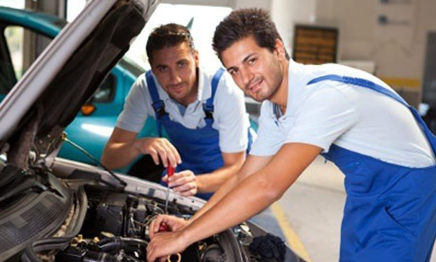
Labor: The quantity and quality of human effort available to produce goods and services.
This Photo by Unknown Author is licensed under CC BY-NC-SA
This Photo by Unknown Author is licensed under CC BY-ND
This Photo by Unknown Author is licensed under CC BY-SA

Slide 5
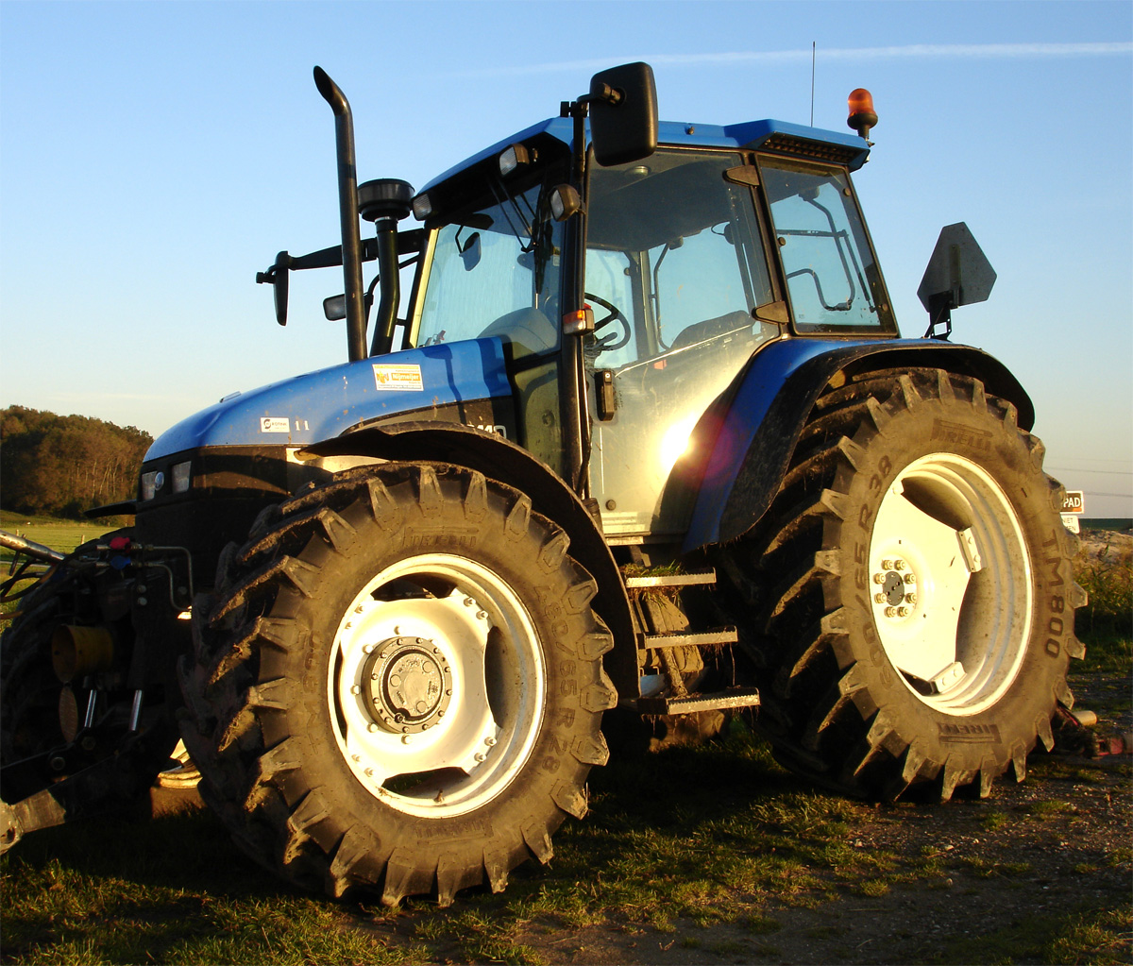
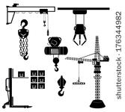
Capital: Resources and goods made and used to produce other goods and services. Examples include buildings, machinery, tools, and equipment.
This Photo by Unknown Author is licensed under CC BY-SA

Slide 6
Payments for the factors of production
  Land: Rent
  Labor: Wages
  Capital: Interest

Slide 7
Fixed costs: Costs of production that do not change as a firm’s output level changes; costs that must be paid whether the firm produces or not.
  Examples: Salaries, rent, insurance, interest, utilities
Variable costs: Costs of those factors of production that vary as production changes.
  Examples: Workers’ hourly wages, raw materials
Fixed costs + Variable costs = Total costs

Slide 8
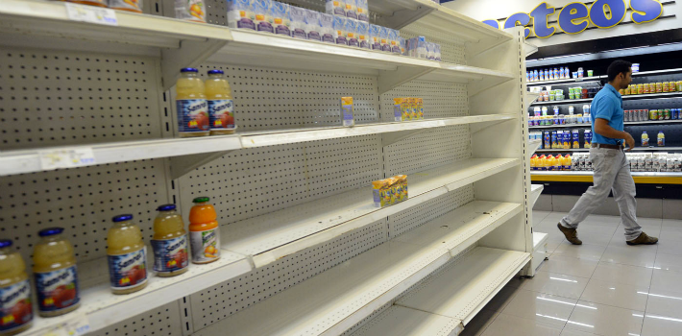
Scarcity: The condition that exists because human wants exceed the capacity of available resources to satisfy those wants; also a situation in which a resource has more than one valuable use. The problem of scarcity faces all individuals and organizations, including firms and government agencies.
This Photo by Unknown Author is licensed under CC BY-ND

Slide 9
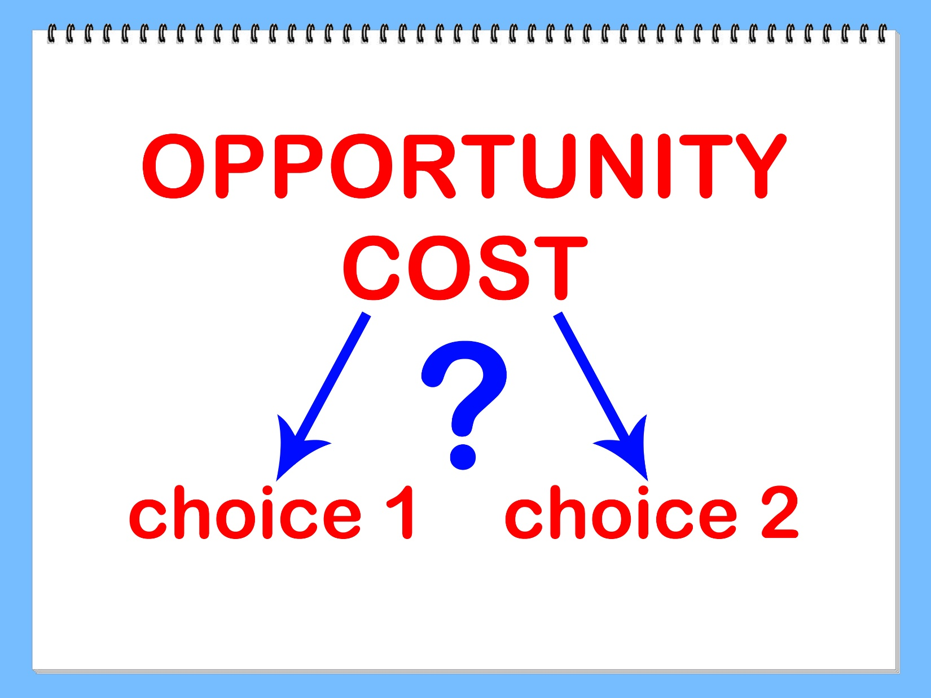
Opportunity cost: The second-best alternative (or the value of that alternative) that must be given up when scarce resources are used for one purpose instead of another.

Slide 10
Revenue: The money a business receives from customers who buy its goods and services. Not to be confused with profit.
  Formula: Selling price of good x Number of units sold = Revenue
    Example: $10 x 100 = $1,000
Profit: The surplus remaining after total costs are deducted from total revenue.
  Formula: Revenue ‒ Total costs = Profit
    Example: $1,000 (Revenue) ‒ $500 (Total costs) = $500 (Profit)

Slide 11
The average cost of tipping a ton of waste into a U.S. landfill increased to nearly $49 at the end of 2016, up 1.5 percent from $48 at the same point in 2015, according to the Solid Waste Environmental Excellence Protocol.
Regional trends remained the same, with the highest costs in the Northeast and the lowest in the West. Approximate average tip fees at the end of 2016 were $78 in the Northeast, $57 in Pacific states, $48 in the Midwest, $41 in the Southeast, and $35 in the West.
Average landfill costs for construction and demolition debris increased from approximately $38 to $40 over the same period, which is seen as a reflection of a growing real estate market and new construction.
SOURCE: Rosengren, Cole. “SWEEP: Average landfill tip fees increased in 2016.” Waste Dive, January 12, 2017; www.wastedive.com/news/sweep-average-landfill-tip-fees-increased-in-2016/433932/.

Slide 12
Companies making sustainability profitable
  Tesla
  Chipotle
  Toyota
  GE’s Ecomagination
  Patagonia

Slide 13
What do these companies do that stands out from the rest?
Disruptive innovation: The increased revenues are not just a result of producing more efficiently, but rather of innovating something that disrupts a whole category.
  Example: Tesla
A higher purpose: Businesses that have an outlook beyond profit tend to outperform the competition on profit itself. Since 2011, publicly traded sustainability-focused companies have outperformed by an average of 11.7 percent.

Slide 14
Built in, not bolted: These companies do not have just two people worrying about greener production, they have entire departments dedicated to it.
A new behavioral contract: With increasing scrutiny from the public in the world of social media, companies now have to be more aware, transparent, responsible, and collaborative. Innovations in waste management and the overall production process are now shared more than ever with consumers to prove that companies are responding to their social responsibilities.

