Slide 1
Saving the Environment with Economic Ideas
Lesson 4: Supply and Demand of Pollution

Slide 2
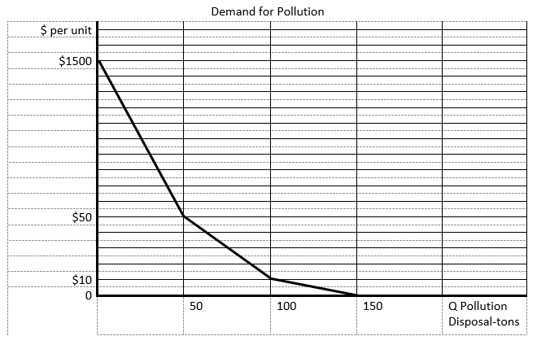
Demand for Pollution Disposal

Slide 3
Cap and Trade System
Cap and trade: The government issues a fixed amount of permits. Each permit allows businesses to dispose of their waste into the environment (a set amount per permit). Businesses can buy and sell permits in a market.
Advantages of cap and trade system include the following:
The quantity of pollution emitted is known and equal to the amount given by the permits.
Firms whose cost of controlling pollution is high can buy permits from firms whose cost of controlling pollution is low. This means high-cost firms don’t have to spend a lot to control pollution and low-cost firms are rewarded by being able to sell permits.
A firm is free to choose whichever method or technology it finds best to meet its cap. Firms have an incentive to reduce pollution by adopting new technologies because this would allow them to sell their excess permits.
The government can earn revenue if the permits are initially sold at auction. (However, many times existing firms are given allocations of permits for free.)

Slide 4
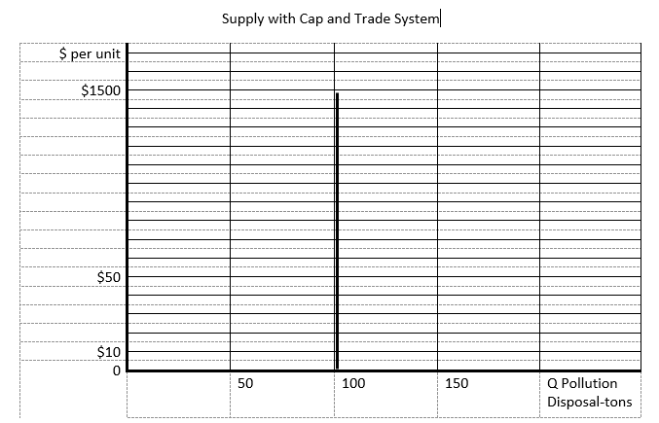
Supply of Pollution Disposal with Cap and Trade

Slide 5
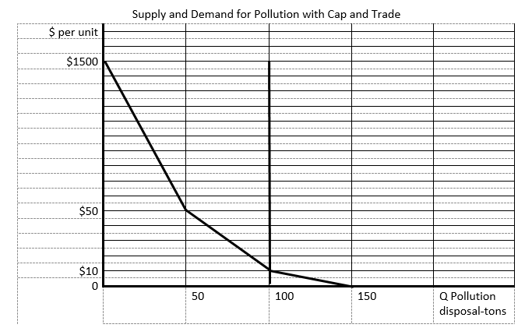
Supply and Demand for Pollution Disposal with Cap and Trade

Slide 6
Emissions Tax
Emissions tax: A charge levied on businesses that pollute. For every unit of pollution the firm disposes of into the environment, a tax is paid.
Advantages of an emissions tax include the following:
The cost of pollution disposal (the amount of the tax) is known to businesses, and it provides some security in planning for the costs of doing business in the future.
Firms whose cost of controlling pollution is high can pay the tax and pollute. Low-cost firms can control their emissions and avoid paying the tax for pollution disposal.
Firms are free to choose whichever method or technology they find best to avoid paying the tax. Firms have an incentive to adopt new technologies to reduce pollution and avoid paying the tax.
The government will earn revenue from the tax. From an efficiency standpoint, implementing an emissions tax, if done properly, will improve efficiency. If the government uses the revenue to lower taxes that might cause inefficiencies (for example, lowering income taxes to encourage working), then overall efficiency can be improved. This is called the “double dividend” of fixing pollution problems.

Slide 7
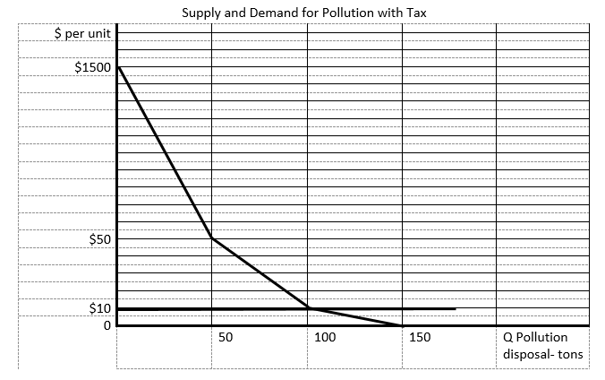
Supply and Demand for Pollution Disposal with Emissions Tax

Slide 8
Examples of Cap and Trade
U.S. Acid Rain Program, SO₂ trading (https://www.epa.gov/airmarkets/acid-rain-program); SO₂ levels are now low, so prices are almost zero.
California’s Cap-and-Trade Program for carbon (https://www.arb.ca.gov/cc/capandtrade/capandtrade.htm)
European Union Emissions Trading System for many pollutants (https://ec.europa.eu/clima/policies/ets_en)

Slide 9
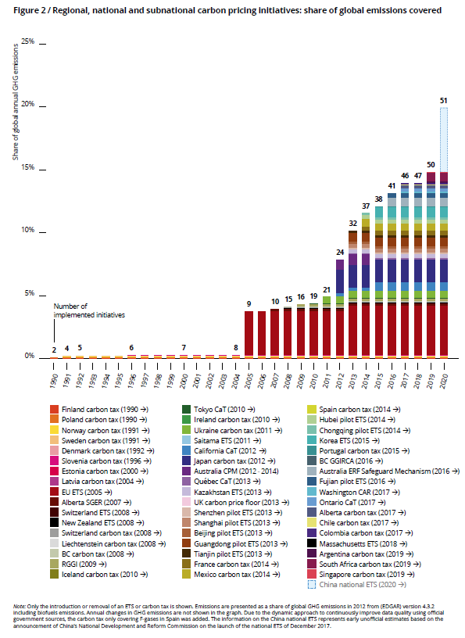
SOURCE: World Bank and Ecofys. “State and Trends of Carbon Pricing 2018 (May).” World Bank, Washington, DC, 2018; doi: 10.1596/978-1-4648-1292-7.

Slide 10
