Slide 1

Saving the Environment with Economic Ideas
Lesson 1: Water Rights: Managing the Colorado River System

Slide 2
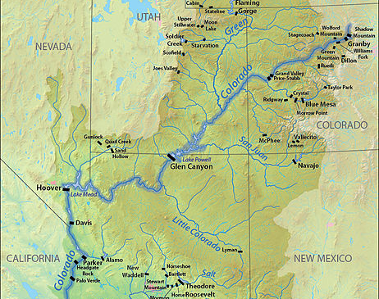
Today, one in eight Americans depend on the water from the Colorado River system, and about 15% of the nation’s crops are grown with it.
SOURCE: https://www.watercalculator.org/water-news-events/colorado-river-drying-up/.

Slide 3
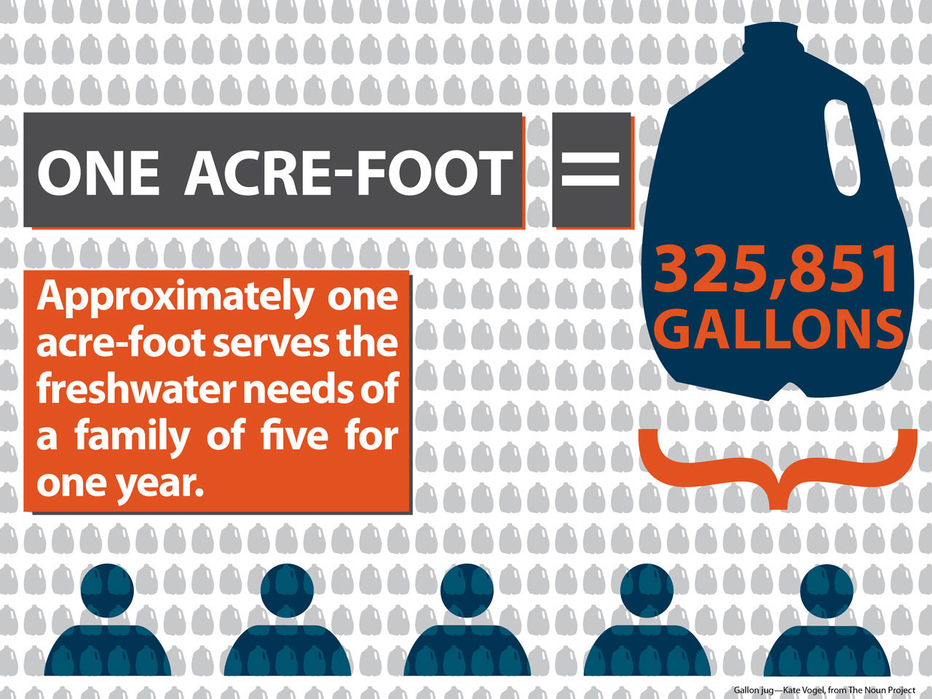
Colorado River Compact of 1922
The compact apportioned 7.5 million acre-feet per year to both the Upper and Lower Basins.
The average annual natural flow in the Upper Basin was about 18.0 million acre-feet (1906-1921).
The current average annual natural flow in the Upper Basin is about 14.8 million acre-feet (1906-2015).
SOURCE: https://wrrc.arizona.edu/publications/arroyo-newsletter/sharing-colorado-river-water-history-public-policy-and-colorado-river.

Slide 4
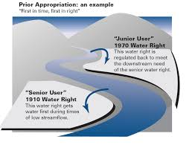
“First In Time, First In Right”
The use of water in many of the states in the western U.S. is governed by the doctrine of prior appropriation.
The first consumer to use water acquires the right to its future use, as opposed to later users.
The loss of senior water rights occurs if all the water allocated isn’t used.
SOURCE: https://eplanning.blm.gov.

Slide 5
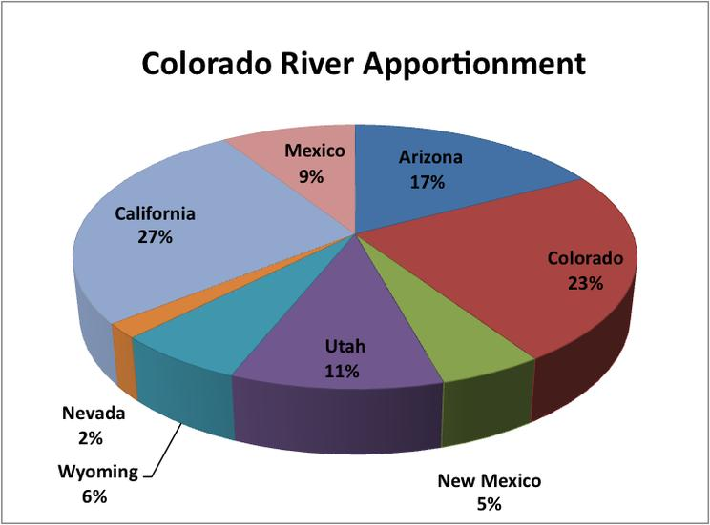
“Straws” In the Colorado River
The following would occur without Colorado River water:
Las Vegas, Nevada, would be a mostly uninhabited desert area.
San Diego, California, which gets 70% of its water from the Colorado River, could not support its present population.
California’s Imperial Valley, which grows a major portion of the nation’s vegetables, would consist mostly of cactus and mesquite plants.
NOTE: Shows the 2007 water apportionment by state.
SOURCE: Massachusetts Institute of Technology.

Slide 6
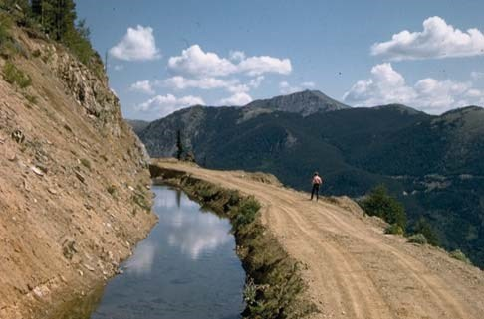
The Grand Ditch
The ditch is an aqueduct that sends river water to eastern Colorado.
It captures 40% of the snow melt that would otherwise feed the river.
About 80% of Colorado rain is in the western half of the state, and around 85% of the population lives in the eastern half.
SOURCE: http://friendsoftheyampa.com/wp-content/uploads/2017/10/not10-29-Wayne-Vanderschuere-2.pdf; nps.gov.

Slide 7
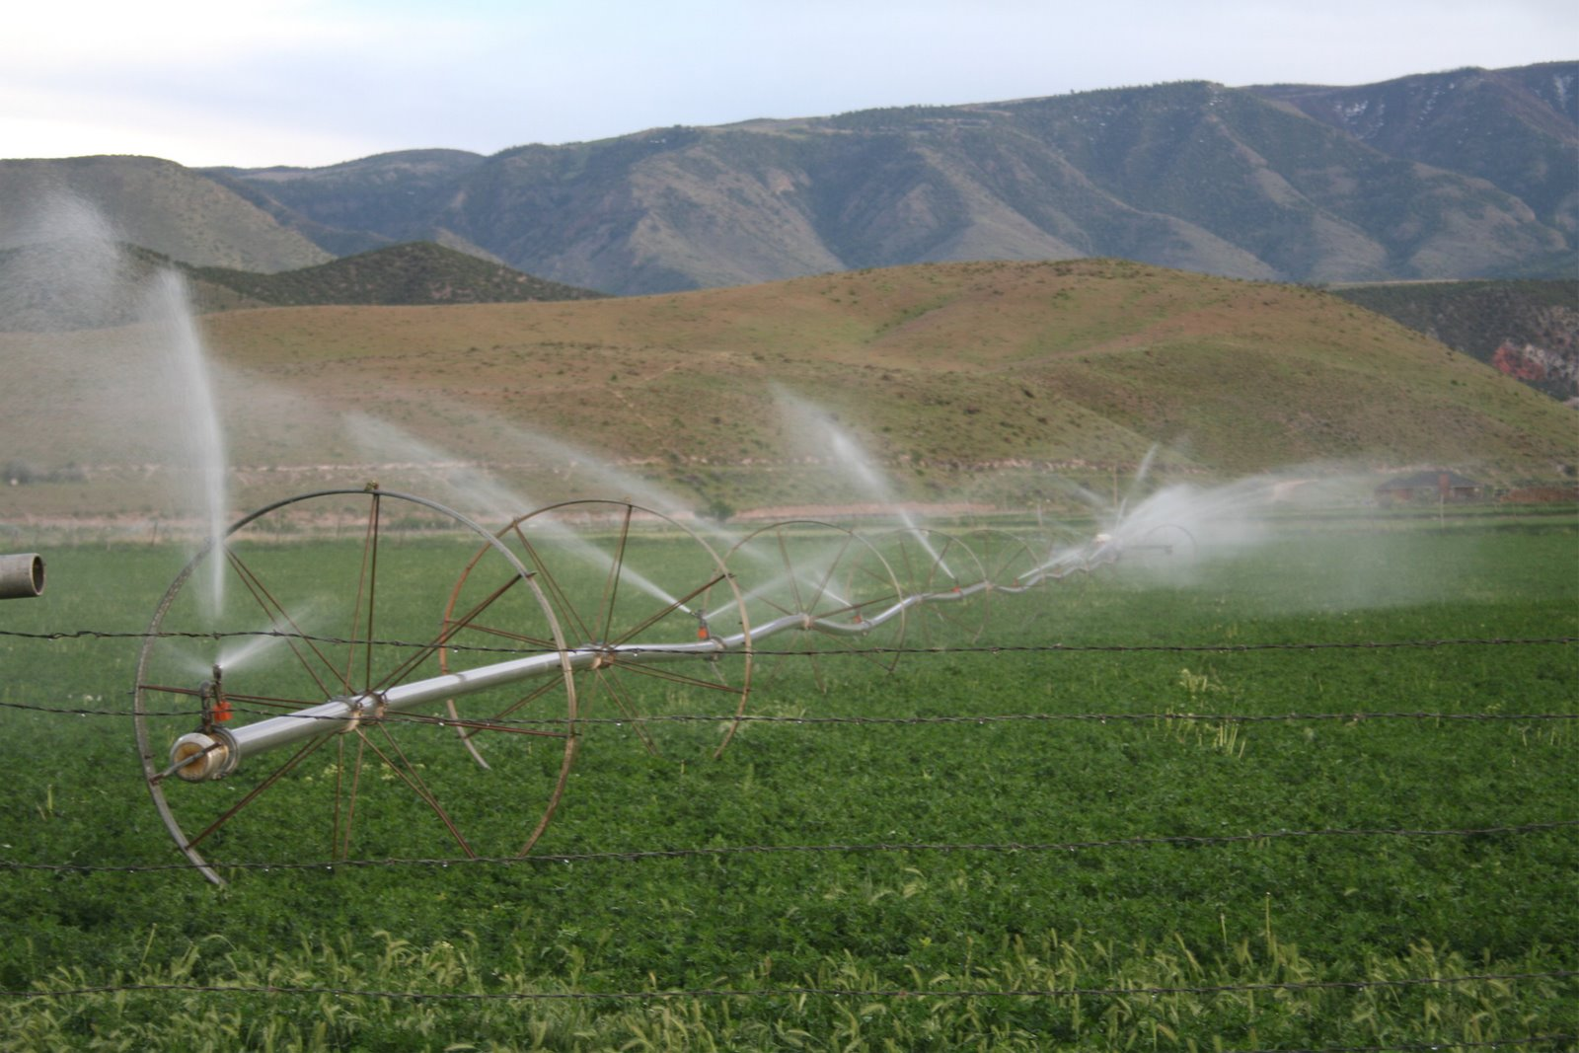
Western Farming
Agriculture accounts for close to 80% of all Colorado River water consumption.
Farmers use the water to irrigate 6 million acres of farm land.
SOURCE: https://www.crwua.org/colorado-river/uses/agriculture.

Slide 8
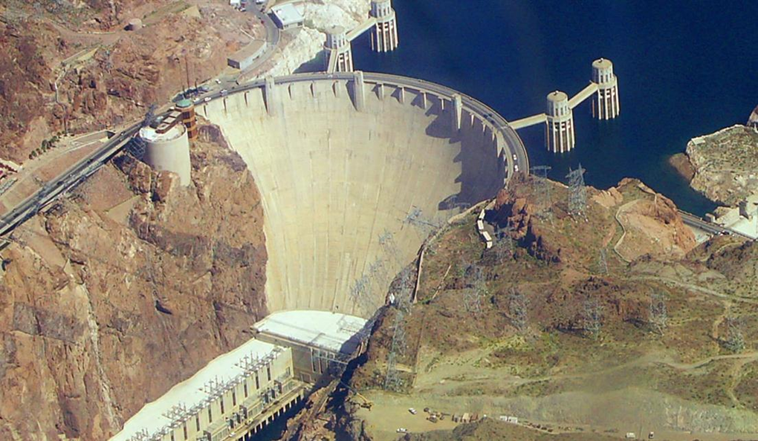
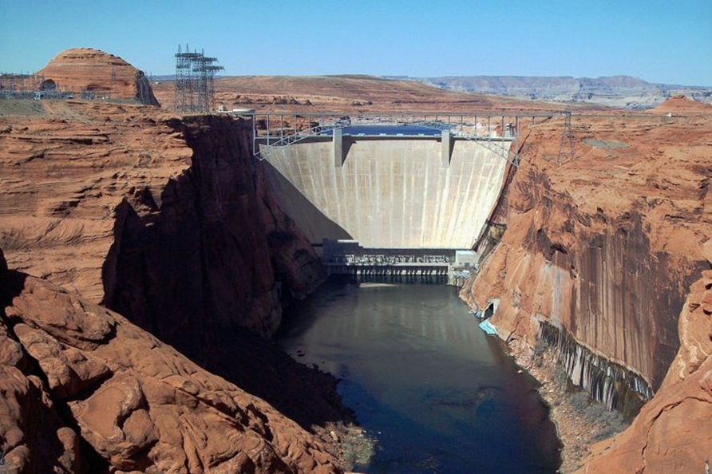
Economic Driver
The Colorado River powers hydroelectric facilities at these two dams.
The reservoirs formed by the dams provide recreational opportunities that pump $26 billion into the region.
It is estimated that for every 1% drop in the reservoir level, there is a 5% drop in visits to Lake Powell.
Hoover Dam Creating Lake Mead
Glen Canyon Dam Creating Lake Powell
SOURCE: https://www.usbr.gov/uc/rm/crsp/gc/.

Slide 9
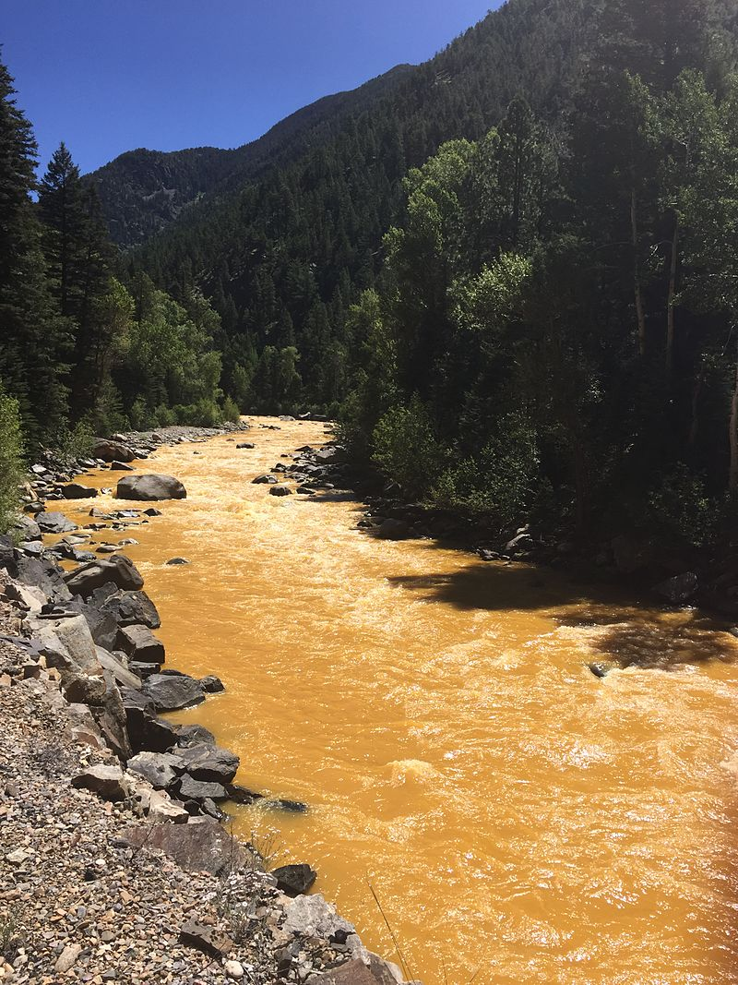
Western Mining
Western mining operations use a lot of water for extraction of minerals and precious metals.
The chemicals used in the blasting return to the water source through run-off, compromising wildlife and water quality.
2015 Gold King Mine Waste Water Spill In the Animas River
SOURCE: https://commons.wikimedia.org/wiki/File:Animas_River_spill_2015-08-06.JPG.

Slide 10
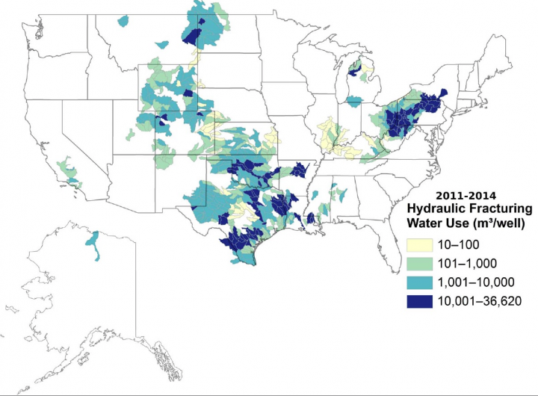
Fracking Has Put Added Pressure on
Short Supplies
The use of fracking water varies from well to well.
Well operation correlates to the price of natural gas.
Some of the most thirsty projects put an additional strain on the parched western U.S.
NOTE: USGS map of water use from hydraulic fracturing between 2011 and 2014. One cubic meter of water is 264.172 gallons. SOURCE: United States Geological Survey (USGS).

Slide 11
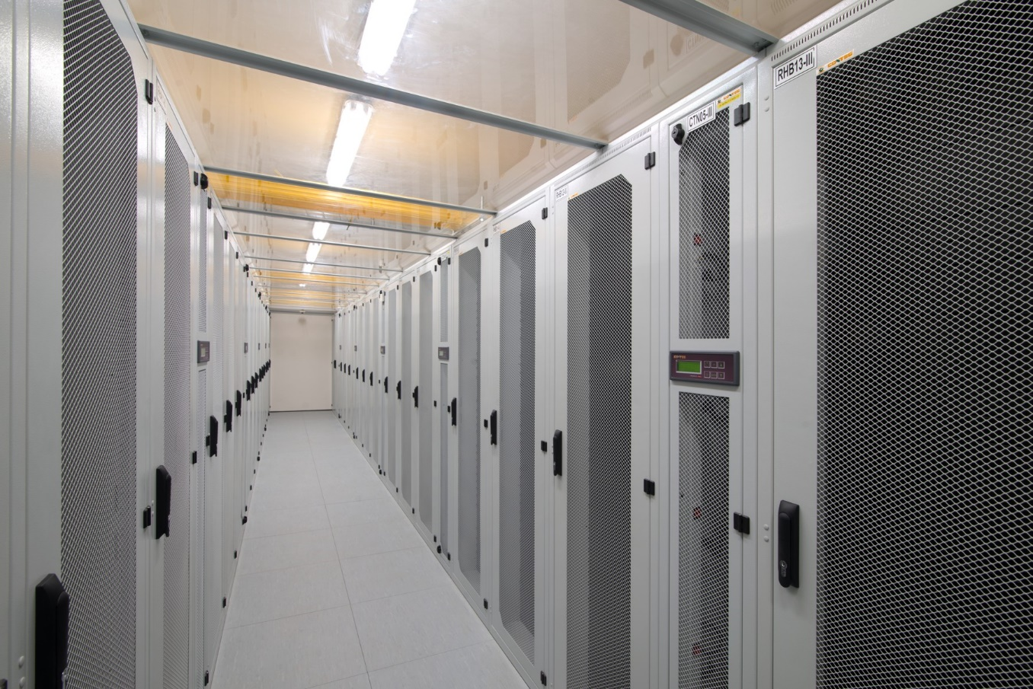
Data Storage Centers Compete for Water
Water is the primary method of cooling servers in these massive facilities.
Water-cooled data storage centers use an estimated 3.5 million gallons per megawatt (MW) each year.
Major centers can range in scale from 5 MW to 30 MW.
There are an estimated 800 data storage centers in California.
SOURCE: https://www.theguardian.com/sustainable-business/2015/jul/20/water-california-drought-tech-gaints-data-centres.

Slide 12
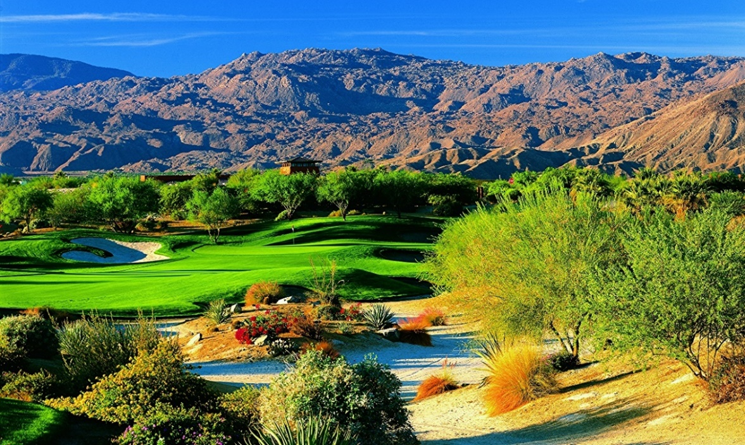
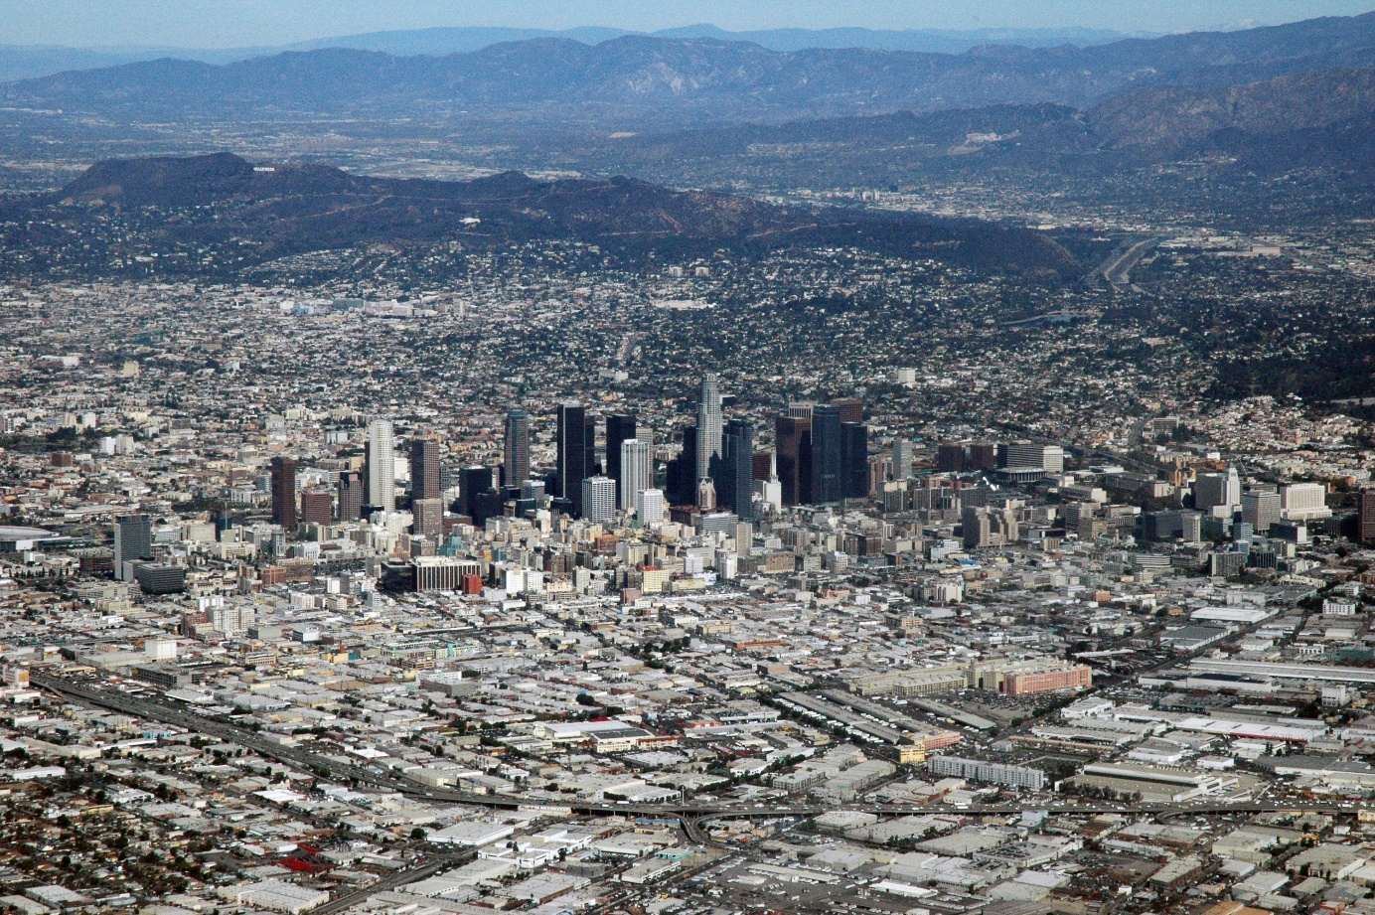
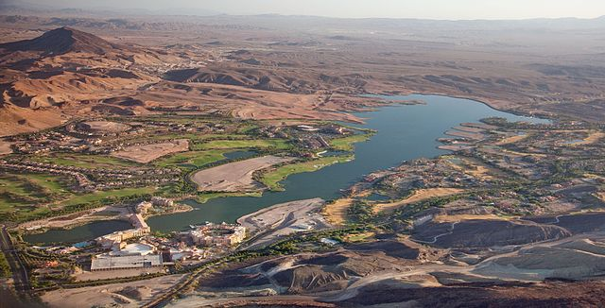
Urban Sprawl and Golf Courses
SOURCE: Carol M. Highsmith; https://www.loc.gov/pictures/item/2010630567/. Public Domain; https://commons.wikimedia.org/w/index.php?curid=16661095.

Slide 13
Some of the Driest Places Have the
Cheapest Water
CITY | GALLONS/$1 | ANNUAL RAIN
SALT LAKE CITY | 325 | 19”
FRESNO | 301 | 11.5”
PHOENIX | 254 | 8”
DENVER | 246 | 15”
LAS VEGAS | 237 | 4”
TUCSON | 200 | 12”
SANTA FE | 165 | 14”
LOS ANGELES | 155 | 15”
SAN JOSE | 150 | 15”
SAN DIEGO | 116 | 12”
SAN FRANCISCO | 96 | 24”
SEATTLE | 94 | 37”
SOURCE: CircleofBlue.org.

Slide 14
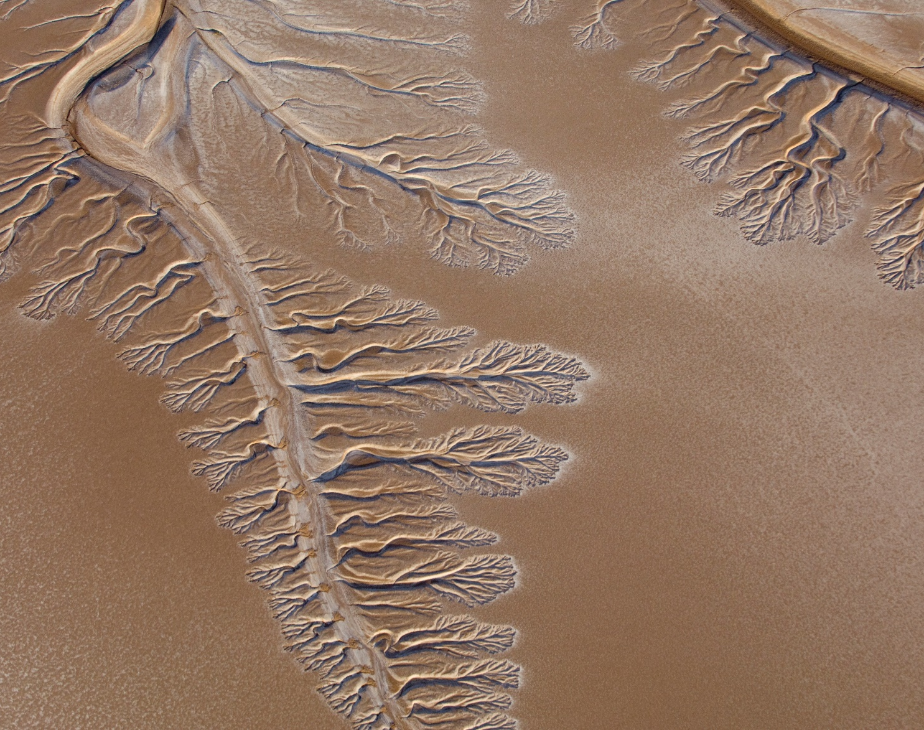
Water diversions in the U.S. and Mexico mean that the mighty Colorado River peters out before it reaches Mexico’s Gulf of California.
SOURCE: https://commons.wikimedia.org/wiki/File:Colorado_River_Dry_Delta.jpg.

