Slide 1
Role of Prices: How Does the Price of Sugar Affect Carrots?
© 2025 Federal Reserve Bank of St. Louis. Permission is granted to reprint or photocopy this lesson in its entirety for educational purposes, provided the user credits the Federal Reserve Bank of St. Louis, https://www.federalreserveeducation.org.

Slide 2
Price Increases and Decreases
Price is the amount of money, determined by the interaction of buyers and sellers, that a buyer must pay to acquire a good, service, or resource.
When more people buy a good or service the price increases. When fewer people buy a good or service the price decreases.
Similarly, if more of a good is available in the market, then the price will decrease because the supply of the good has increased. If less of the good is available or supply has decreased, then the price will increase.

Slide 3
Is there a relationship between sugar and carrots?

Slide 4
Markets
Places where buyers and sellers come together to exchange goods, services, and/or resources.
Markets are related, and an event that happens in one market can affect another market.

Slide 5
Hurricane Gloria Hits Florida and Destroys Majority of Sugarcane Crops
What effect would this have on the supply of sugar?
How will this change the price of sugar? Show using the arrow cards.
$

Slide 6
The price of sugar has increased.
How might this affect the price of cupcakes? Show with your arrow cards.
Why do you think the price of cupcakes will increase?
Sugar is an ingredient or input in cupcakes.
Inputs are materials and resources used to produce goods and services.
What other goods might be affected by this price increase if sugar is an input for those goods?
$

Slide 7
Cupcakes are more expensive than potato chips.
You are hungry and looking for a snack at the store. The price of cupcakes, your favorite snack, has increased. They are now more expensive than potato chips, your second favorite snack, and you have limited money. Are you going to choose cupcakes or potato chips?
You and many other people will probably start buying the less-expensive snack. When more people start buying a good, the price of that good increases.

Slide 8
Cupcakes are more expensive than potato chips.
What do you think will happen to the price of potato chips if more students start buying them instead of the cupcakes? Show with your arrow cards.
$

Slide 9
Substitutes
You chose to purchase the potato chips instead of the cupcakes.
Potato chips are a substitute for cupcakes.
Substitutes are goods that we buy in place of other goods.
Substitutes are similar goods or goods that serve a similar purpose. In this case, potato chips and cupcakes are similar in that both are snacks.
With substitutes, a change in the price of one and the demand for the other tend to move in the same direction.

Slide 10
Examples of Substitutes
For example, pencils and pens are substitutes.
If the price of pens goes up, will people buy more or fewer pencils?
If people buy more pencils, what will happen to the price of pencils?
Other examples of substitutes are chicken and beef, and sneakers and sandals.
Give other examples of substitutes for cupcakes besides potato chips.

Slide 11
When you have chips what else do you like to eat with those chips?
Sometimes there are goods that you buy to use together.
These goods are called complements.
With complements, a change in the price of one and the demand for the other tend to move in the opposite direction.
Other examples of complements are milk and cookies, and socks and shoes.
One example of a complement to chips is dip.

Slide 12
The price of potato chips has increased.
If the price of potato chips has increased, will you buy more or fewer bags of chips?
If you usually buy chips and dip together, will you buy more dip or less?
What will happen to the price of dip now that people are buying fewer bags of potato chips? Show with your arrow cards.
$

Slide 13
Hummus
How are dip and hummus related?
If the price of dip increases and people buy more hummus, a substitute for dip, what will happen?
$

Slide 14
Carrots
How are hummus and carrots related?
If the price of hummus decreases, will you buy more hummus or less?
Because people eat carrots and hummus together, will you buy more or fewer carrots?
What will happen to the price of carrots? Show on your arrow cards.
$

Slide 15
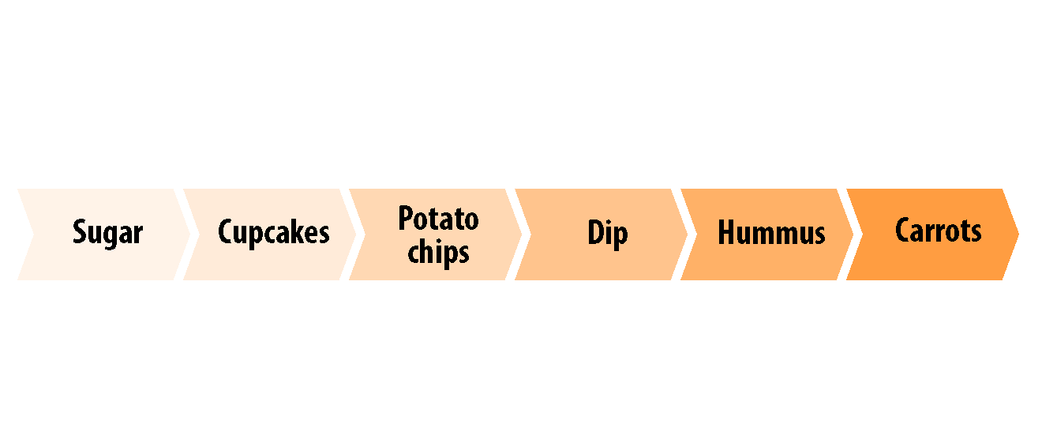
Market Connections

Slide 16
Markets are interrelated!
Markets may not seem to be interconnected.
However, when the price of one good changes, it serves as a signal to consumers.
If the price of a good increases, consumers will buy less of it.
They will buy more related goods that are substitutes with lower prices.
They will buy fewer related goods that are complements.

Slide 17
Debrief
What happened to the price of sugar when Hurricane Gloria destroyed the sugarcane crop?
What happened to the price of cupcakes because the price of sugar increased?
What happened to the price of potato chips because the price of cupcakes increased?
What happened to the price of dip because the price of potato chips increased?
What happened to the price of hummus because the price of dip decreased?
What happened to the price of carrots because the price of hummus decreased?

Slide 18
Closure
What are inputs?
Which of the goods from the activity is an input good?
What are input goods for potato chips?

Slide 19
Closure
What are substitutes?
Which of the goods from the activity are substitutes?

Slide 20
Closure
What are complements?
Which of the goods from the activity are complements?

Slide 21
Name some examples of goods that are complements to cupcakes and explain how a change in the price of one affects the other.

Slide 22
Name some examples of goods that are substitutes for carrots and explain how the change in the price of one affects the other.

Slide 23
Assessment
Group of Colonists Destroy Large British Tea Shipment in Boston Harbor
December 16, 1773
Read the directions on the handout and fill in the chart.

