Slide 1

Production Possibilities Frontier
Download the lesson,
Production Possibilities Frontier.
The procedure steps explain when each slide should be presented.
Notes:
Scientific method – observation and theory
However, economists cannot conduct experiments to observe and from which to draw theories in the usual scientific fashion.
A chemist who mixes chemical A with chemical B and causes an explosion, can safely theorize that every time he mixes those two chemicals, he will get the same results.

Slide 2



Production Possibilities Frontier
Production Possibilities Frontier
We’re conducting an experiment so I’m firing 20% of you.
Keep in touch. We want to watch your behavior.
Write if you get work. Really!

Slide 3
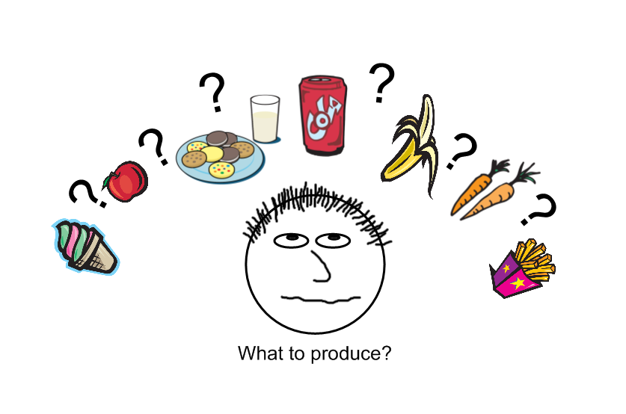
Production Possibilities Frontier
Production Possibilities Frontier

Slide 4
Production Possibilities Frontier
Production Possibilities Frontier
Introducing…
The Production Possibilities Frontier
Featuring the following simplifying assumptions…
a society that produces only two goods
the efficient use and full employment of resources
fixed technology
a single snapshot in time

Slide 5
Production Possibilities Frontier
Production Possibilities Frontier
Production Possibilities Frontier
 | A | B | C | D | E | F | G
units of potatoes | 6 | 5 | 4 | 3 | 2 | 1 | 0
units of apples | 0 | 1 | 2 | 3 | 4 | 5 | 6

Slide 6
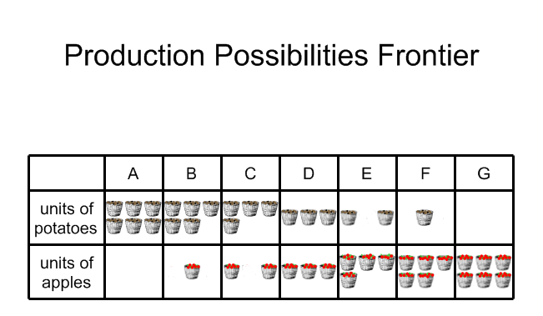
Production Possibilities Frontier
Production Possibilities Frontier
Production Possibilities Frontier

Slide 7
Production Possibilities Frontier
Production Possibilities Frontier
units of potatoes
6
5
4
3
2
1
A
B
C
D
E
F
G
units of
apples
1 2 3 4 5 6
 | A | B | C | D | E | F | G
units of potatoes | 6 | 5 | 4 | 3 | 2 | 1 | 0
units of apples | 0 | 1 | 2 | 3 | 4 | 5 | 6

Slide 8
Production Possibilities Frontier
Production Possibilities Frontier
units of potatoes
6
5
4
3
2
1
A
B
C
D
E
F
G
units of
apples
1 2 3 4 5 6
 | A | B | C | D | E | F | G
units of potatoes | 6 | 5 | 4 | 3 | 2 | 1 | 0
units of apples | 0 | 1 | 2 | 3 | 4 | 5 | 6

Slide 9
Production Possibilities Frontier
Production Possibilities Frontier
units of potatoes
6
5
4
3
2
1
A
Constant Cost
B
C
D
E
F
G
units of
apples
1 2 3 4 5 6
One unit of apples costs one unit of potatoes.
One unit of potatoes costs one unit of apples.

Slide 10
Production Possibilities Frontier
Production Possibilities Frontier
units of potatoes
12
10
8
6
4
2
A
Constant Cost
B
C
D
E
F
G
units of
apples
1 2 3 4 5 6
One unit of apples costs two units of potatoes.
One unit of potatoes costs one-half unit of apples.

Slide 11
Production Possibilities Frontier
Production Possibilities Frontier
units of potatoes
6
5
4
3
2
1
Constant Cost
A
B
C
D
E
F
G
units of
apples
1 2 3 4 5 6

Slide 12
Production Possibilities Frontier
Production Possibilities Frontier
units of potatoes
6
5
4
3
2
1
Constant Cost
A
B
C
D
E
F
G
units of
apples
1 2 3 4 5 6
One unit of apples costs one-half unit of potatoes.
One unit of potatoes costs two units of apples.

Slide 13
Production Possibilities Frontier
Production Possibilities Frontier
units of potatoes
6
5
4
3
2
1
A
B
C
I
D
E
F
G
units of
apples
1 2 3 4 5 6
Can this society produce at production combination I?

Slide 14
Production Possibilities Frontier
Production Possibilities Frontier
units of potatoes
6
5
4
3
2
1
A
B
C
I
D
H
E
F
G
units of
apples
1 2 3 4 5 6
Can this society produce at production combination H?

Slide 15
Production Possibilities Frontier
Production Possibilities Frontier
Events that can expand production possibilities outward…
A technological advance
  rail cars
  refrigeration
  computers
An increase in human or natural resources
  population increase
  new discoveries
Capital investment
  new factories
  new infrastructure
Notes:
Tell island story – coconuts and baskets

Slide 16
Production Possibilities Frontier
Production Possibilities Frontier
Once upon a time on the tiny island of Nor, all of the people were involved in their daily labor - knocking coconuts out of trees, carrying them to a pick-up point, and delivering them from the pick-up point to the market. All of the people, except Frick and Frack, that is. Frick and Frack weren't feeling well on this day and were sitting, listless, under a palm tree. As they sat, Frick was, almost subconsciously, picking up palm leaves and weaving them together, in and out, in and out. Frack glanced down at Frick's work and asked, "What are you makin' there?" Frick looked down and puzzled, "I'm not really makin' nothin'."
Notes:
Tell island story – coconuts and baskets

Slide 17
Production Possibilities Frontier
Production Possibilities Frontier
But, actually, he had made something. It was a small mat. Frack said, "Keep going," and, pretty soon, the mat was about a square foot. The two of them pondered what could be done with this collection of palm leaves when, suddenly, Frack said, "Keep going, but start weaving the leaves tighter." As Frick progressed, the sides of the mat began to turn up, and the mat was slowly turning into a large basket. When the mat got to be about two foot in diameter, Frack said, "That should be enough." And, with that said, he began to place coconuts onto the mat - it held 18. Frack said, "Can you imagine how much easier it will be to carry coconuts with this?" Frick could imagine it!
Notes:
Tell island story – coconuts and baskets

Slide 18
Production Possibilities Frontier
Production Possibilities Frontier
Frick and Frack took their good idea to their supervisor, Frock, who immediately ordered that they remain under the tree and continue to make mats.
Notes:
Tell island story – coconuts and baskets

Slide 19
Production Possibilities Frontier
Production Possibilities Frontier
units of capital goods
(mats)
6
5
4
3
2
1
A
B
C
D
E
F
G
units of
consumer goods
(coconuts)
1 2 3 4 5 6

Slide 20
Production Possibilities Frontier
Production Possibilities Frontier
units of capital goods
(mats)
6
5
4
3
2
1
A
B
C
I
D
E
F
G
units of
consumer goods
(coconuts)
1 2 3 4 5 6

Slide 21
Production Possibilities Frontier
Production Possibilities Frontier
units of
potatoes
6
5
4
3
2
1
1 2 3 4 5 6
units of apples

Slide 22
Production Possibilities Frontier
Production Possibilities Frontier
units of capital goods
Production Possibilities Frontier
6
5
4
3
2
1
A
B
C
D
E
F
G
units of
consumer goods
1 2 3 4 5 6
One unit of capital goods costs one unit of consumer goods.
One unit of consumer goods costs one unit of capital goods.

