Slide 1
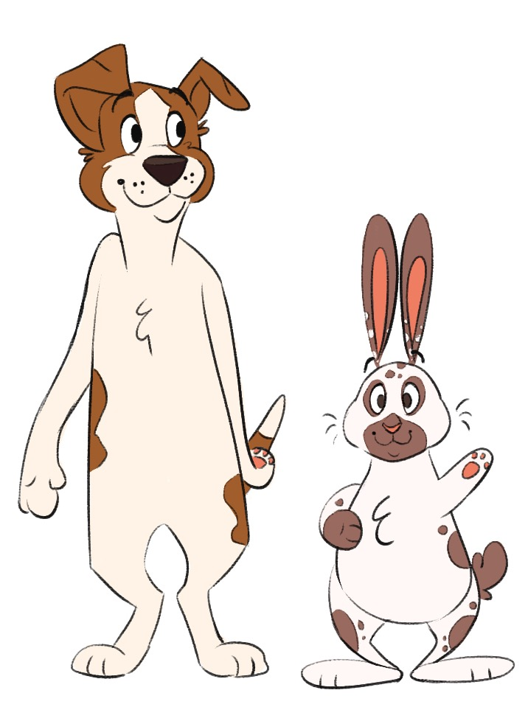
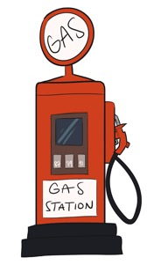
ABC Adventure
Nizzy and Cooper’s

Slide 2
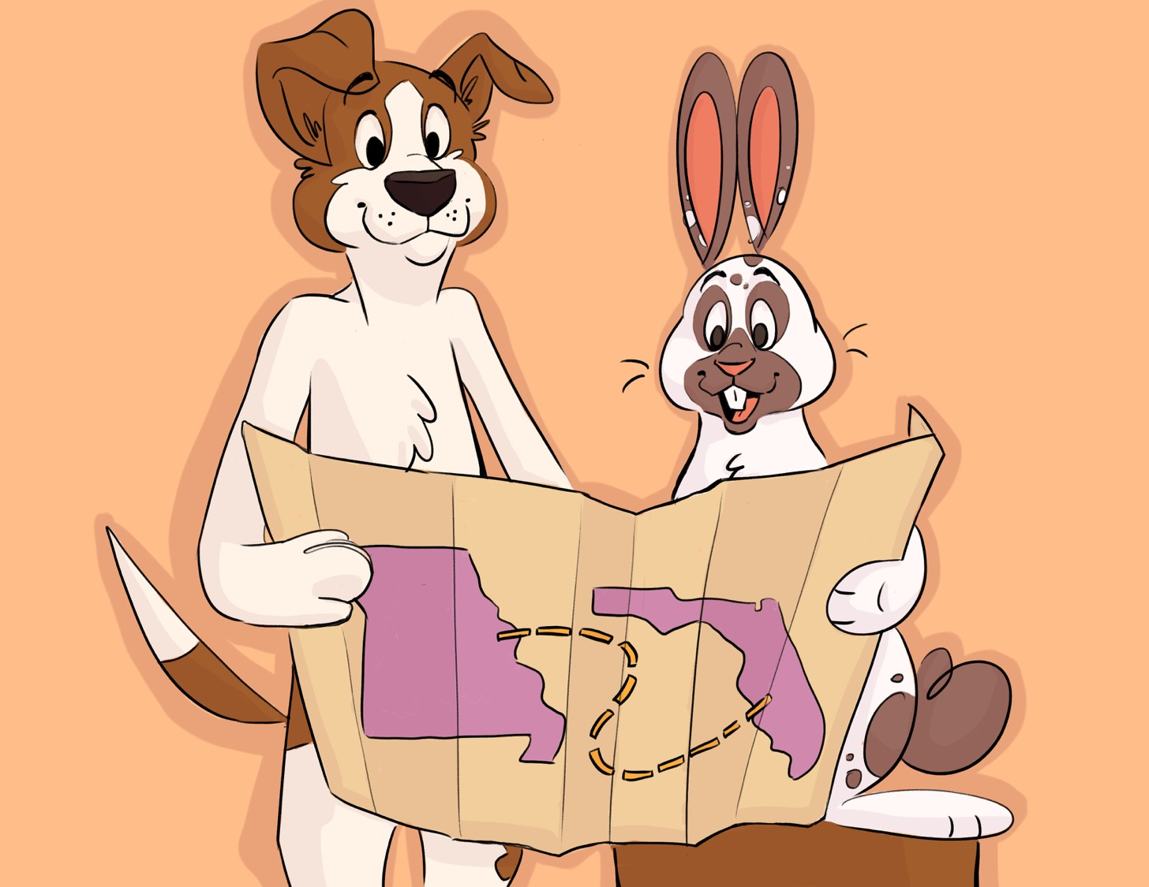
This is Nizzy and Cooper. Nizzy and Cooper are going on a camping adventure from their home in sunny Florida to see the Gateway Arch in St. Louis, Missouri.

Slide 3
Nizzy and Cooper are travelling in an RV. Nizzy drives and Cooper helps with directions.

Slide 4
Nizzy and Cooper have a book they will use to keep track of things they want to take with them and things they will see and do along the road from A to Z.

Slide 5
As they get ready to get on the road, they add things to their book that they want to take. They stop by the store and get apples for Cooper. It is his favorite snack. “Apple slices will be a delicious treat for me, so I will write apples next to A,” says Cooper. Nizzy likes freshly baked treats, so they add baker next to B. “Felipe the baker will have some fresh cookies for me,” says Nizzy.
Their friend Mookey is a cashier at the store. They add cashier next to C so that they are sure to stop by to pay and say hi.

Slide 6
They go into the store with their list in hand and get the apples. Nizzy chooses some freshly baked cookies. Nizzy remembers that they need to keep their dishes clean, so he adds dish soap to the list next to D. Mookey is helpful and sweet, and she tells them, “Good luck on your trip, my friends!”

Slide 7
Back at the RV, Cooper writes eggs next to E and flashlight next to F in the book. He checks the fridge for eggs. They have 12. He also checks the drawer for his flashlight, and he sees one for him and another for Nizzy.

Slide 8
Nizzy reminds Cooper that it is time to get some gas. Cooper adds gas next to G in the book. They drive to Rudee’s Gas Station. Rudee helps them fill up the RV. They write her name in their book as well, next to G. She is a friendly helper who they want to remember.

Slide 9
They start their drive out of Florida. It takes a few hours for them to arrive in the state of Georgia. There they find a great RV park where they can spend the night. They drive up and are greeted by the RV park host, Ruffles. “Welcome, friends!” says Ruffles. Ruffles helps them check in, find a spot to park, and plug in the RV. Ruffles is so helpful. They were glad to meet him, so they write host next to H.

Slide 10
The sun rises. Today they want to visit Nashville, Tennessee. It is about a 4-hour drive. Nizzy and Cooper have a delicious breakfast and then hit the road! After driving for a while, Nizzy asks Cooper, “How about we stop for some delicious ice cream and take a break?” “Well that sounds like a great idea. I will write ice cream on our list next to I,” answers Cooper. Nizzy and Cooper stop at a rest area where there is a gas station and an ice cream shop.

Slide 11
There are so many flavors! Nizzy is torn between an ice cream cookie sandwich and a cone of bacon-flavored ice cream. Cooper wants either a banana split or a cone of carrot-flavored ice cream. They make a careful choice because they know they can each have only one. Nizzy says, “I choose the cone of bacon-flavored ice cream, please.” “I choose the banana split,” says Cooper.

Slide 12
As they are leaving the store, Nizzy accidentally drops his ice cream cone. Mack the janitor comes right away to help clean it up. He says, “No worries, I can clean it up.” “Thank you very much for your help,” says Nizzy.
While Nizzy goes back to get another cone, Cooper takes out the notebook. He writes Mack the janitor next to J so that they always remember how kind Mack was and what a good janitor he was.

Slide 13
They are back on the road for a while when Cooper takes out the notebook. He writes lunch next to L because it is almost that time. They stop for lunch and visit some small shops. They meet a cat who knits and a turtle who is a musician and plays the drums and harmonica. Cooper writes knitter next to K because he bought some knitted socks. Nizzy asks him to add musician next to M so that they do not forget the great music the musician turtle played.

Slide 14
Nizzy and Cooper arrive in Nashville, Tennessee! It is well known for being the “capital of country music.” Nizzy and Cooper decide to sightsee. Nizzy takes out the notebook. “Let’s take a bus tour of the city with a narrator who can tell us about all the sites we will see,” says Nizzy. He writes narrator next to N. They see a sign for Bailey’s Narrated Bus Tours. “This looks like a great tour. Let’s pay and go!” says Cooper.

Slide 15
After a long day of touring the city, Nizzy and Cooper head to the RV park, ready to cook a yummy dinner. Cooper writes onion next to O. “I want to use the onion in the fridge to make onion soup,” says Cooper.

Slide 16
While Cooper makes dinner, Nizzy visits two friendly ducks. One is making a quilt, and the other is painting a picture. “Hi there. What are you doing?” asks Nizzy. “I am a quilter, and I am making a quilt for our sister for her birthday,” answers one duck. “And I am a painter, so I am painting her a picture of the lake,” answers the other duck. “Well those are going to be lovely gifts. I am sure she will really like them,” says Nizzy.

Slide 17
Back at the RV, Nizzy takes out the notebook and writes painter next to P and quilter next to Q. He had never met a painter or a quilter before.

Slide 18
The next morning, Nizzy and Cooper are extra excited because today they drive all the way to St. Louis, Missouri to see the Gateway Arch! Before they leave, Cooper notices that one of the tires on the RV is flat. He takes out his notebook and writes repair next to R. “I will call a tire repair shop we passed by called Bella’s Tire Repair Service,” says Cooper. Cooper calls and Bella picks up the phone. “I am happy to come to the campground and replace your tire with a new one. I will be there in 10 minutes,” says Bella.
As they wait for Bella, Cooper takes out the notebook. “I am going to write souvenirs next to S. That way we won’t forget to stop by the gift shop when we get to the Arch,” says Cooper.

Slide 19
Once the tire is fixed, Nizzy and Cooper hit the road. Cooper takes out the notebook and writes tire for the letter T so that they do not forget they replaced one on the RV.
They should be in St. Louis by the afternoon and just in time to visit the Gateway Arch. As they make the drive and get closer, Nizzy asks Cooper to write something in the notebook. “Can you please write umbrella for the letter U. I would like to buy one at the gift shop, just in case. I heard that St. Louis weather can be unpredictable,” says Nizzy.

Slide 20
Nizzy and Cooper arrive at the Gateway Arch! They cannot believe how tall and shiny the Arch is. As they walk toward the entrance, they hear beautiful music from a cat playing the violin under a tree in the park.

Slide 21
As they enter the museum, Nizzy declares that he would like to stop by the café. “I see they sell waffle fries. Those are my favorite!” But before stopping by the café, they go to the gift shop.

Slide 22
Nizzy sees the umbrella he wants. It has a beautiful picture of the Arch on it. Then Nizzy spots a section with toy souvenirs. He likes the small xylophone and a yo-yo. “These are great souvenirs because they are a shiny silver color just like the Arch, but I can choose only one,” says Nizzy. Cooper has an idea! “What if you buy the yo-yo, and I get the xylophone. Then we can take turns using them,” he says.

Slide 23
They pay for their souvenirs and then stop by the café for Nizzy to enjoy waffle fries and for Cooper to try zucchini fries. As they finish their food, Nizzy writes in the notebook the things that they have enjoyed so far while visiting the Arch.

Slide 24
For the letter V, he writes violinist for the cat who played sweet music in the park. For the letter W, he writes waffle fries. He writes xylophone next to X, yo-yo next to Y, and zucchini fries next to Z. “Now I’m ready to learn more about the history of Missouri and how they built the Arch,” says Nizzy. “And I’m ready for the best part—riding the elevator to the top!” says Cooper.

Slide 25
As they finish their day, Cooper and Nizzy look at the list in their notebook. They are happy about everything and everyone they saw and enjoyed from A to Z on their great journey to see the St. Louis Arch!

