Slide 1
Understanding the Financial Aid Process
Slides for Keys to Financial Success Lesson 8.4

Slide 2
Introduction
Make a prediction!
What percentage of families use loans to pay for college?
What percentage of college costs come from scholarships or grants?
What is the largest source of funding for most families for postsecondary education?

Slide 3
Introduction (Answers)
Make a prediction!
What percentage of families use loans to pay for college? (48%)
What percentage of college costs come from scholarships or grants? (27%)
What is the largest source of funding for most families for postsecondary education? (Family income/savings – 48%)

Slide 4
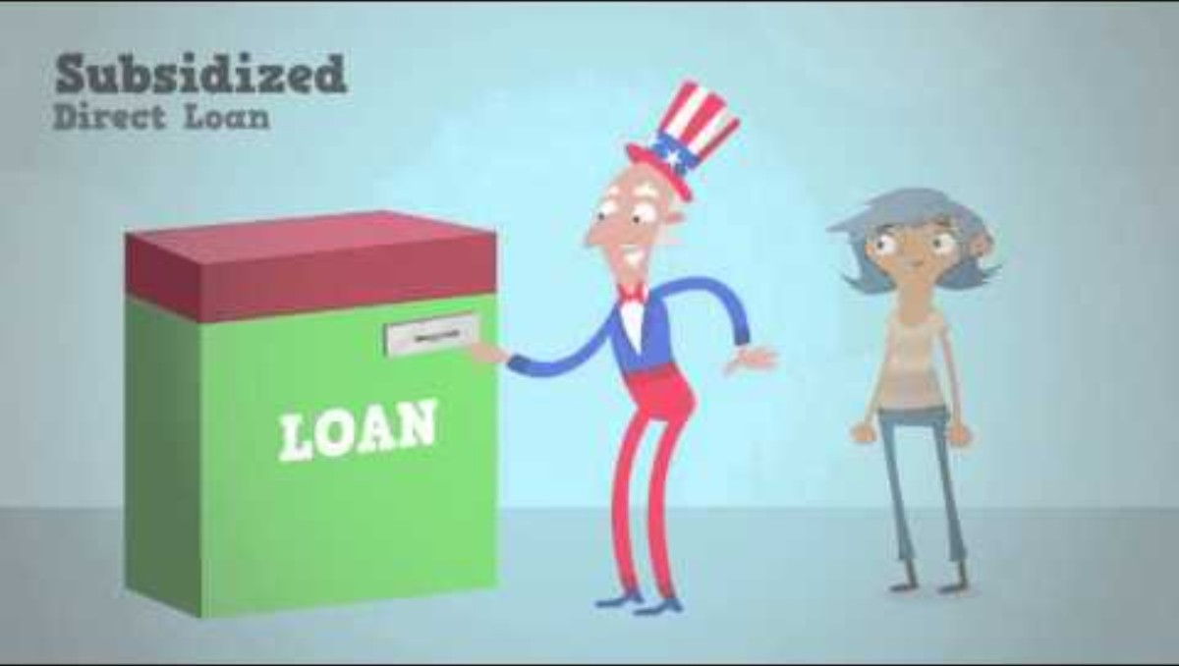
The Different Types of Federal Student Loans Video

Slide 5
The Different Types of Federal Student Loans
All three loan types are fixed-interest loans. What is a benefit of having a fixed-interest loan?
What is a Subsidized Direct Loan?
What is an Unsubsidized Direct Loan?
If you have an Unsubsidized Direct Loan, why might making interest payments during college be a good strategy?
What is the benefit of the Direct PLUS Loans?

Slide 6
Federal v. Private
Student Loans

Slide 7
How to Repay
Federal Loans | Private Loans
6-month grace period for loans made to undergraduates. Flexible monthly payments available, baked on income or financial hardship. Possible debt forgiveness for certain periods of teaching, military service, and other public service work. | 6-month grace period for most loans Very limited flexibility for those with financial need or hardship.

Slide 8
Interest Rates
Federal Loans | Private Loans
Rates are fixed. The federal government pays the interest payments for Subsidized Direct Loans while students are in school. The student is responsible for paying for all of the interest on an Unsubsidized Direct Loan. Interest rates are set based on the loan program and do not depend on the student’s credit history. There are fees associated with Direct Loans, which are a percentage of the loan amount. Fees tend to be lower than private lenders. | Rates are often variable - they can change over time, causing the monthly payments to change. Fixed rate loans may be available at higher interest rates. Students are responsible for paying all of the interest. Interest rates vary depending on the student’s credit history and other factors. Lenders may charge various fees.

Slide 9
Who is Eligible?
Federal Loans | Private Loans
Almost everyone is eligible for federal loans. | Lenders decide eligibility based on the student’s credit history and other factors. Undergraduate students typically need a cosigner to qualify or obtain better terms.

Slide 10
Loan Limits
Federal Loans | Private Loans
First year dependent undergraduates can borrow no more than $5,500, but the annual maximum increases each year they are in school and may increase if they become an independent student. Your borrowed amount cannot exceed the cost of attendance minus any other federal aid you receive. | How much a student can borrow varies, depending on your credit and other factors. Most lenders require a cosigner.

Slide 11
Interest rates are often variable.

Slide 12
Interest rates are often variable.
(Private Loan)

Slide 13
There is interest on the loan.

Slide 14
There is interest on the loan. (Both)

Slide 15
Almost everyone is eligible.

Slide 16
Almost everyone is eligible.
(Federal)

Slide 17
Interest rates are fixed.

Slide 18
Interest rates are fixed.
(Federal)

Slide 19
Loan forgiveness is not available.

Slide 20
Loan forgiveness is not available.
(Private)

Slide 21
Six-month grace period for loans after graduation.

Slide 22
Six-month grace period for loans after graduation.
(Both)

Slide 23
Higher interest rates

Slide 24
Higher interest rates
(Private)

Slide 25
Loan forgiveness is possible in some cases depending on your location and profession.

Slide 26
Loan forgiveness is possible in some cases depending on your location and profession.
(Federal)

Slide 27
The federal government may pay interest on your loan while you’re in school (subsidized loan).

Slide 28
The federal government may pay interest on your loan while you’re in school (subsidized loan).
(Federal)

Slide 29
Lenders decide eligibility based on your credit history and other factors.

Slide 30
Lenders decide eligibility based on your credit history and other factors.
(Private)

Slide 31
Lower interest rates

Slide 32
Lower interest rates
(Federal)

Slide 33
You’re charged interest while still in school.

Slide 34
You’re charged interest while still in school.
(Private)

Slide 35
Closure
Explain the basic steps in applying for federal financial aid.
What are three major differences between federal and private student loans?
Why should students explore federal student loan options before private loan options?

