Slide 1
Paying for Postsecondary Education
Slides for Keys to Financial Success Lesson 8.3

Slide 2
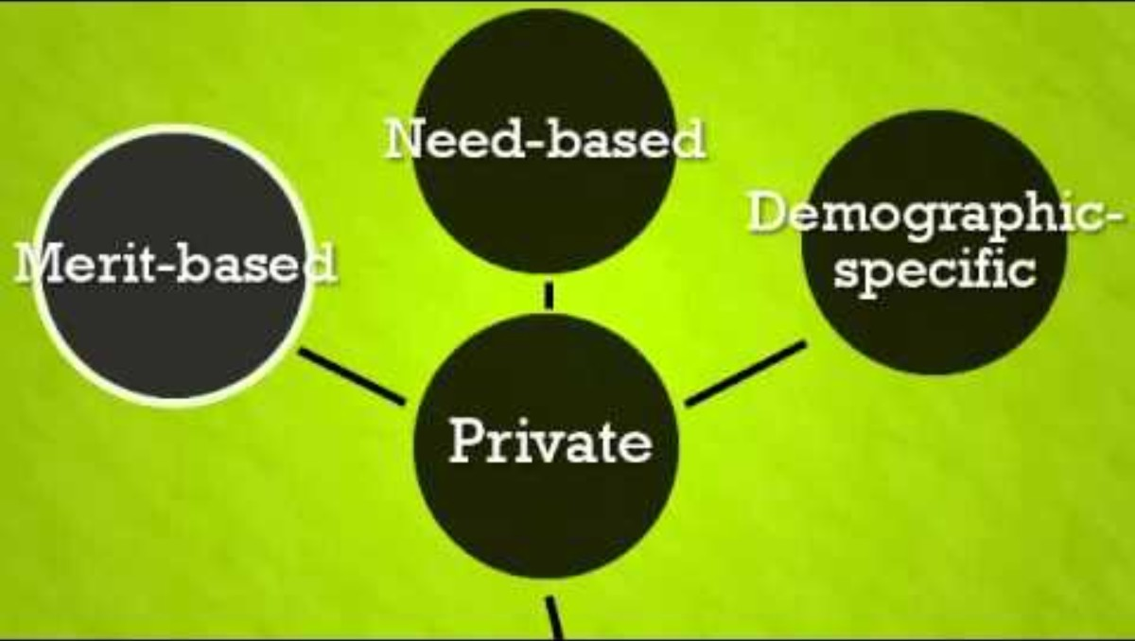
College Choice 101: Financial Aid Video

Slide 3
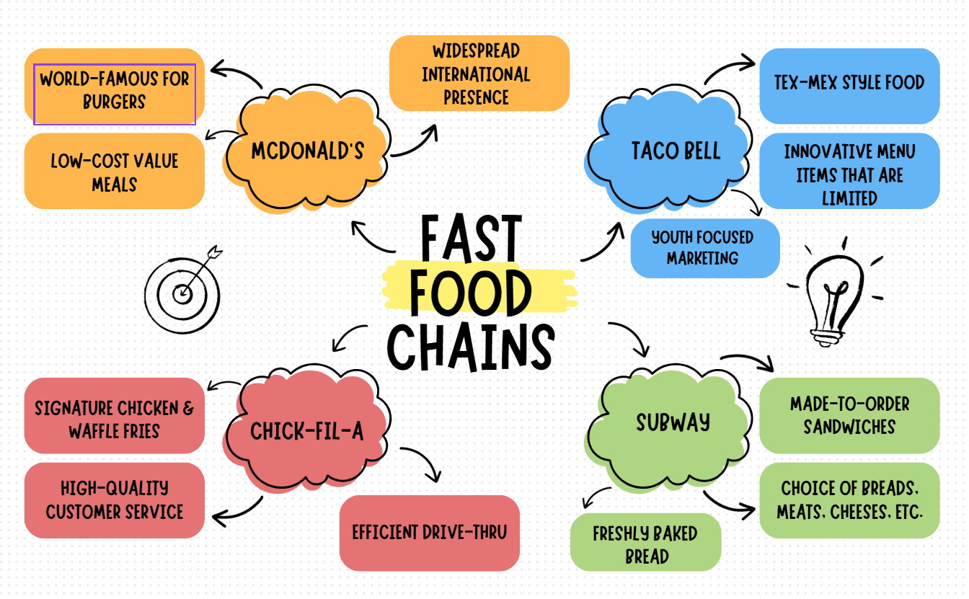
Information Web: Example

Slide 4
Financial Aid Quiz: #1
You are an education major, and part of your financial aid is the money you earn as a tutor.

Slide 5
Financial Aid Quiz: #1 - Answer
You are an education major, and part of your financial aid is the money you earn as a tutor. (Work Study)

Slide 6
Financial Aid Quiz: #2
You are majoring in chemistry and entering your third year of college. You receive money from the federal government through a program that awards financial aid to students majoring in science, technology, engineering or math.

Slide 7
Financial Aid Quiz: #2 - Answer
You are majoring in chemistry and entering your third year of college. You receive money from the federal government through a program that awards financial aid to students majoring in science, technology, engineering or math.
(Grant)

Slide 8
Financial Aid Quiz: #3
You receive $500 from the local cultural society.

Slide 9
Financial Aid Quiz: #3 - Answer
You receive $500 from the local cultural society.
(Scholarship)

Slide 10
Financial Aid Quiz: #4
Your father lost his job and the family’s income became much lower. You received money from the government to pay for college.

Slide 11
Financial Aid Quiz: #4 - Answer
Your father lost his job and the family’s income became much lower. You received money from the government to pay for college.
(Grant)

Slide 12
Financial Aid Quiz: #5
You borrowed money through a federal program to pay for your education this year.

Slide 13
Financial Aid Quiz: #5 - Answer
You borrowed money through a federal program to pay for your education this year.
(Loan)

Slide 14
Financial Aid Quiz: #6
You entered your painting in a contest and won $750 to pay for your college expenses.

Slide 15
Financial Aid Quiz: #6 - Answer
You entered your painting in a contest and won $750 to pay for your college expenses.
(Scholarship)

Slide 16
Financial Aid Quiz: #7
You work in an office on campus after class every day.

Slide 17
Financial Aid Quiz: #7 - Answer
You work in an office on campus after class every day.
(Work Study)

Slide 18
Financial Aid Quiz: #8
You received $3,000 per year from the lottery funds in your state. Every high school graduate can receive this aid if they attend an in-state college.

Slide 19
Financial Aid Quiz: #8 - Answer
You received $3,000 per year from the lottery funds in your state. Every high school graduate can receive this aid if they attend an in-state college. (Grant)

Slide 20
Financial Aid Quiz: #9
You received $4,000 from the federal government because you promised to teach in a school that serves low-income students after graduation. If you change your mind, you will have to repay the full amount.

Slide 21
Financial Aid Quiz: #9 - Answer
You received $4,000 from the federal government because you promised to teach in a school that serves low-income students after graduation. If you change your mind, you will have to repay the full amount.
(Grant)

Slide 22
Financial Aid Quiz: #10
You were a high school athlete. The university is paying your tuition while you play on the college team.

Slide 23
Financial Aid Quiz: #10 - Answer
You were a high school athlete. The university is paying your tuition while you play on the college team.
(Scholarship)

Slide 24
Financial Aid Quiz: #11
Your parents borrowed money through a U.S. government program for parents of college students.

Slide 25
Financial Aid Quiz: #11 - Answer
Your parents borrowed money through a U.S. government program for parents of college students.
(Loan)

Slide 26
Financial Aid Quiz: #12
You were raised by a single parent. Your family income qualified you to receive a need-based award from the U.S. government.

Slide 27
Financial Aid Quiz: #12 - Answer
You were raised by a single parent. Your family income qualified you to receive a need-based award from the U.S. government.
(Grant)

Slide 28
Financial Aid Quiz: #13
You are going to school to study voice performance, and you receive $1,000 per semester because you sing in the college choir.

Slide 29
Financial Aid Quiz: #13 - Answer
You are going to school to study voice performance, and you receive $1,000 per semester because you sing in the college choir.
(Scholarship)

Slide 30
Financial Aid Quiz: #14
You work 20 hours per week in the library at your college.

Slide 31
Financial Aid Quiz: #14 - Answer
You work 20 hours per week in the library at your college.
(Work Study)

Slide 32
Financial Aid Quiz: #15
Your family qualified for a federal government program that reduced the interest on the money you borrowed to pay for college.

Slide 33
Financial Aid Quiz: #15 - Answer
Your family qualified for a federal government program that reduced the interest on the money you borrowed to pay for college.
(Loan)

Slide 34
Financial Aid Quiz: #16
Your mom works for a company that will pay 50 percent of your tuition at any in-state public college.

Slide 35
Financial Aid Quiz: #16 - Answer
Your mom works for a company that will pay 50 percent of your tuition at any in-state public college.
(Scholarship)

Slide 36
Financial Aid Quiz: #17
You receive a $1,000 award to help pay for college from a local community organization in recognition of your volunteer activities.

Slide 37
Financial Aid Quiz: #17 - Answer
You receive a $1,000 award to help pay for college from a local community organization in recognition of your volunteer activities.
(Scholarship)

Slide 38
Financial Aid Quiz: #18
Your other financial aid did not cover all of your college costs, so you borrowed money from a private lender.

Slide 39
Financial Aid Quiz: #18 - Answer
Your other financial aid did not cover all of your college costs, so you borrowed money from a private lender.
(Loan)

Slide 40
Financial Aid Quiz: #19
You work in the college’s computer lab three days per week.

Slide 41
Financial Aid Quiz: #19 - Answer
You work in the college’s computer lab three days per week.
(Work Study)

Slide 42
Financial Aid Quiz: #20
Your PSAT scores qualified you as a National Merit Scholar. Several schools have offered you free tuition.

Slide 43
Financial Aid Quiz: #20 - Answer
Your PSAT scores qualified you as a National Merit Scholar. Several schools have offered you free tuition.
(Scholarship)

Slide 44
More Financial Aid = More Options
Public Two-Year College (in-state students) = $4,150
Public Four-Year College (in-state students) = $11,950
Public Four-Year College (out-of-state students) = $31,880
Private Four-Year College = $45,000
*Costs are for ‘25-’26; tuition for one year
Source: https://trends.collegeboard.org/college-pricing

