Slide 1
Why Renter’s Insurance?
Slides for Keys to Financial Success Lesson 7.6

Slide 2
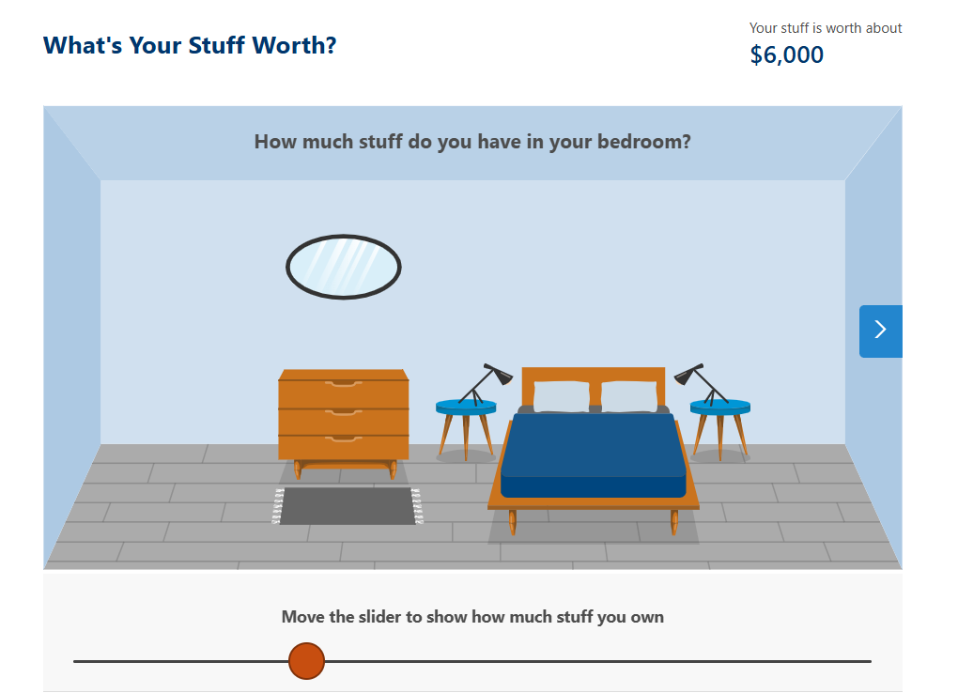
What’s Your Stuff Worth? Exercise
Imagine you are a young adult living in your first apartment.
Visualize what your apartment would look like.
Go to the Interactive activity: What’s Your Stuff Worth?
Complete the interactive activity, and take note of the value of your belongings.

Slide 3
What’s Your Stuff Worth?
What was the value of the belongings in your apartment?
Did this dollar amount surprise you? Why or why not?

Slide 4
Scenario
On the third day of your new job, you leave your apartment in a hurry and forget to lock the door. While you’re at work, someone steals almost everything of value.
What financial impact will this theft have on you and why?

Slide 5
Liable or Not? (#1)
A fire breaks out, destroying your possessions. An investigation clearly determines that faulty wiring was the cause.

Slide 6
Liable or Not? (#2)
A nearby explosion causes your building to catch fire, destroying many of your possessions.

Slide 7
Liable or Not? (#3)
A friend of your is seriously injured when she trips on a rug in your apartment and falls down.

Slide 8
Liable or Not? (#4)
The weight of ice on the roof of the building causes the ceiling to leak, ruining some of your furniture.

Slide 9
Liable or Not? (#5)
A pipe freezes in your apartment during very cold weather, causing flooding that destroys a lot of your furniture.

Slide 10
Liable or Not? Overview
As you saw in these examples, landlords are often not liable for perils that ruin your possessions.
It is difficult in many cases to prove that the landlord was negligent.
Renter’s choose to transfer part of this risk to an in insurance company by purchasing renter’s insurance.
Renter’s Insurance = a policy that protects your possessions when you rent an apartment/home in the event that your belongings are damaged, destroyed, or stolen.

Slide 11
Types of Coverage
Renter’s Insurance is written with the provision that damaged, destroyed, or stolen possessions are reimbursed at either:
Replacement Cost Coverage = based on the cost to replace the item with a comparable new item
OR
Cash Value Coverage = reimburses for damages according to what the item was worth at the time it was damaged, destroyed, or stolen. Cash value coverage takes into consideration depreciation on the item (how much it has decreased in value over the years).

Slide 12
How Much Would You Receive?
Refer back to the value of your belongings in our introduction activity.
What would your insurance company pay you if you are covered with replacement cost coverage?
What would your insurance company pay you if you are covered with cash value coverage? (Imagine that your items are now valued at ¾ of the replacement cost due to depreciation.)
  a. How could you replace the items you lost if you only received ¾ of the replacement cost?

Slide 13
Closure
Why do many renters not bother with renter’s insurance?
Why is knowing the value of your belongings important to both the consumer and the insurance company?
Name at least three types of coverages generally included in a renter’s policy.
What is the difference between replacement cost coverage and cash value coverage? Which type of coverage is more expensive?

