Slide 1
Life Insurance, POAs, and Wills, Oh My!
Slides for Keys to Financial Success Lesson 7.4

Slide 2
Would you buy it? Why or why not?
You just graduated high school. You’re working part-time and heading to college. Someone tries to sell you a $100,000 life insurance policy for $30/month and tells you it’s also a great way to build savings.

Slide 3
Life Insurance
A promise between a company that provides insurance and the individual. The individual promises to pay premiums to the company in exchange for the company paying a specific sum of money to the designated beneficiary (or beneficiaries) when the insured individual dies.

Slide 4
Key Terms
A premium is the fee paid for insurance protection.
A beneficiary is the person designated to receive benefits

Slide 5

Life Insurance 101: Life Happens
Why do people buy life insurance?
What types of expenses can the beneficiary pay for with the life insurance benefit?

Slide 6
Would you buy it? Why or why not? (Part 2)
You just graduated high school. You’re working part-time and heading to college. Someone tries to sell you a $100,000 life insurance policy for $30/month and tells you it’s also a great way to build savings.

Slide 7
Discussion Questions
Why do you think premiums for term life insurance tend to increase over time, while many permanent life insurance premiums stay the same?
How can insurance companies earn a profit while still paying out large death benefits?
Why might someone consider the financial strength ratings of an insurance company before buying a policy?

Slide 8
Estate Planning
Estate planning is making a plan for what happens to your money, belongings, and decisions if you can’t make them yourself or after you die.
Will
Power of Attorney

Slide 9
Will
A will is a legal document that provides instructions about how an individual’s property and custody of minor children (if any) should be handled after death. The individual expresses their wishes and names an executor to manage the process.
This document becomes effective after the individual’s death.

Slide 10
Power of Attorney (POA)
A power of attorney is a legal document that lets you choose someone you trust to make decisions for you if you can’t. This could include handling your money, legal matters, or medical decisions. It helps make sure your wishes are followed without needing a court to step in.
This document is only effective while the individual is alive and incapacitated.

Slide 11
Two Main Types of POA
The financial power of attorney gives the trusted person (agent) authority to manage your finances and other legal affairs for you if you cannot manage them yourself. This includes paying your bills, filing taxes, and managing investments.
The medical power of attorney allows the agent you designate to make healthcare decisions on your behalf if you are unable to do so. These decisions might also include a plan for end-of-life care such as a living will that clearly states your wishes regarding artificial life support.

Slide 12
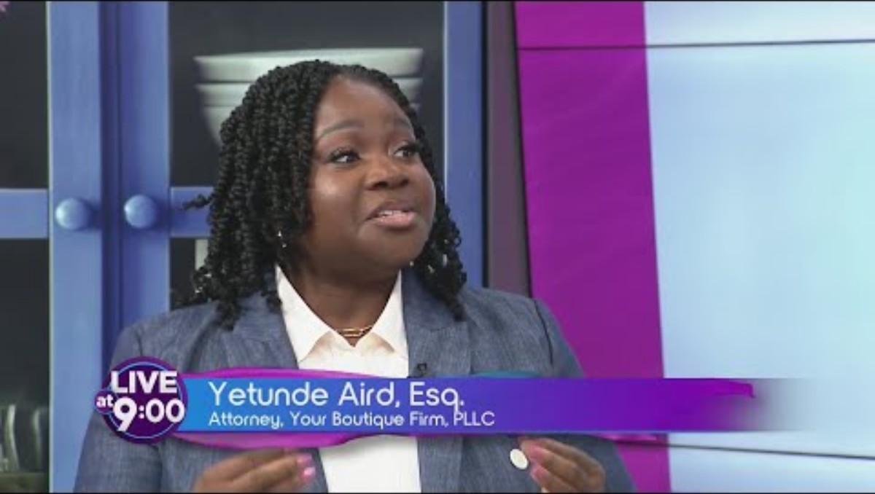
Estate Planning: Why Everyone
Needs a Will & Power of Attorney
Why did the presenter, Dr. Yetunde Aird, argue that every adult should have an estate plan that includes the will and power of attorney?
Why did Dr. Aird say that a power of attorney (POA) is “a love letter” to their loved ones?
Why should young adults over 18 also consider having an estate plan?

Slide 13
Which document applies?
Will
Financial POA
Medical POA

Slide 14
Will, Financial POA, or Medical POA?
Scenario A
A parent wants to decide who will receive their home, savings, and personal belongings after they die.
Scenario B
An adult is in a coma, and doctors need someone to make medical decisions on their behalf.
Scenario C
An individual wants to choose a guardian for their minor children if something happens to them.
Scenario D
A person is recovering from surgery and needs someone to temporarily manage their bills & bank accounts.
Scenario E
A couple wants to name who will make healthcare decisions for them if they are unable to communicate.

Slide 15
Closure
What is the primary purpose of life insurance?
What are two key differences between term life insurance and permanent life insurance?
Why is an estate plan important to think about even as young adults?
Explain how a will protects a person’s assets and family and when the document is effective (during life vs. after death).
Explain how a power of attorney protects a person’s assets and family and when the document is effective (during life vs. after death).
Explain the consequences of dying without a will or becoming incapacitated without a POA, especially after turning 18.

