Slide 1
Credit Cards – Total Frenemy?
Title Slide
Slides for Keys to Financial Success Lesson 6.5

Slide 2
Credit v. Credit Card
Credit
  The granting of money or something else of value in exchange for a promise of future repayment.
Credit Card
  A card that represents an agreement between a lender - the institution issuing the card - and the cardholder. It is a convenient form of borrowing with a revolving line of credit.

Slide 3
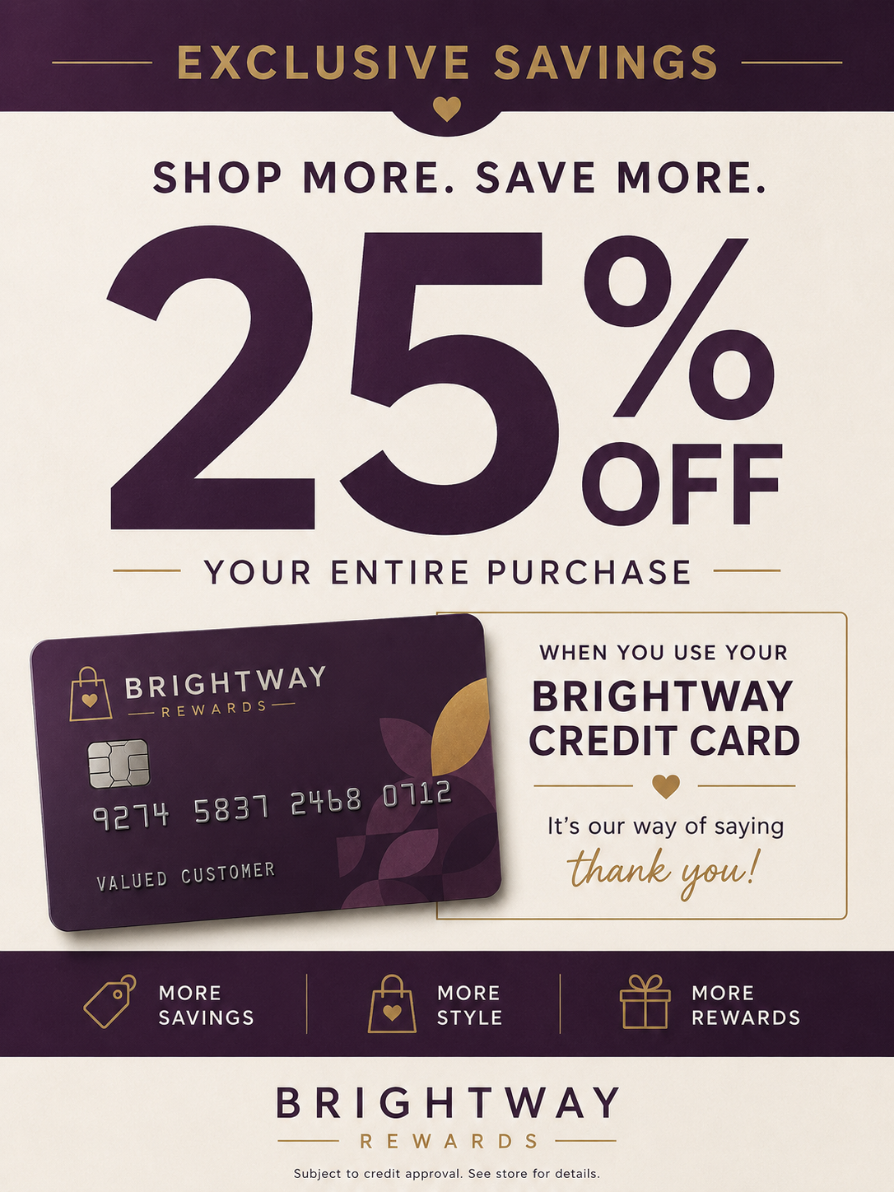
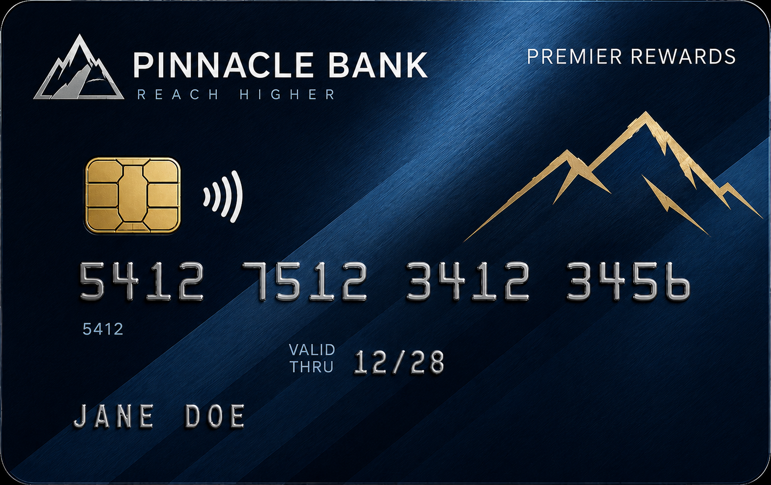
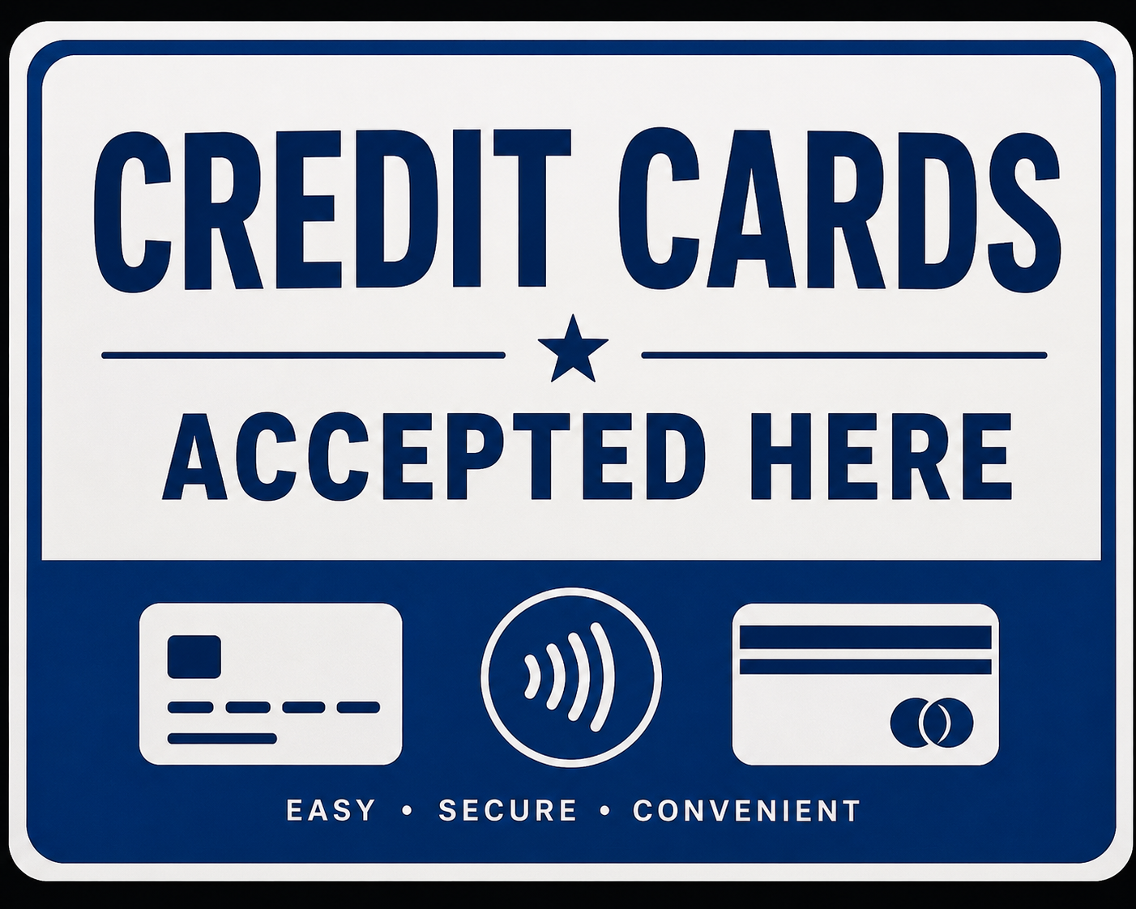
Bank-Issued v. Store-Branded

Slide 4
All About Interest
Interest Rate
  The price of using someone else’s money (or the price of credit)
  An additional payment for the right to use someone else’s money
APR
  Annual Percentage Rate
  The rate you pay in a single year on the money you borrow
  The total cost of credit to the consumer

Slide 5

Agree or Disagree Title Slide
Agree
Disagree

Slide 6
Credit card interest rates are usually much higher than car loan rates.
Agree
Disagree

Slide 7
Agree
Agree or Disagree #1 Answer
As of early 2026, the average credit card APR on interest-bearing accounts was 21.52%.
Auto loan rates are far lower (single digits for many borrowers).
This is because credit cards are unsecured debt. In other words, it is a loan that is not backed with collateral. Since nothing is promised as security for the loan, the lender takes on more risk and charges a higher interest rate.
Source: https://www.federalreserve.gov/releases/g19/current/#fn5a

Slide 8
Making the minimum payment each month is a smart way to manage credit card debt.
Agree
Disagree

Slide 9
Disagree
Agree or Disagree #2 Answer
Making the minimum payment is far better than missing a payment, but it can keep you in debt for years and significantly increase the total cost of borrowing.
For example, a $1,000 purchase at today’s average credit card APR could take nearly 10 years to pay off and cost more than $1,100 in interest if only minimum payments are made.
Source: https://www.bankrate.com/credit-cards/tools/minimum-payment-calculator/

Slide 10
If you pay your credit card bill in full each month, you can usually avoid paying interest.
Agree
Disagree

Slide 11
Agree
Agree or Disagree #3 Answer
Most credit cards offer a grace period, meaning no interest on purchases if the statement balance is paid in full.
Source: https://www.consumerfinance.gov/consumer-tools/credit-cards/answers/basics/

Slide 12
Americans owe more than 1 trillion dollars in revolving credit card debt.
Agree
Disagree

Slide 13
Agree
Agree or Disagree #4 Answer
Americans added $8.5 billion to their credit card balances in February 2026, bringing the total amount owed to over $1.3 trillion.
Source: https://www.federalreserve.gov/releases/g19/current/#fn5a

Slide 14
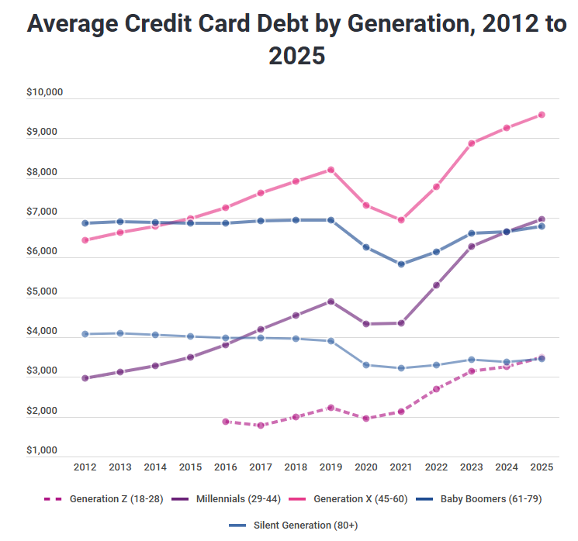
Average Credit Card Debt by Generation, 2012 to 2025
Agree or Disagree #4 Answer (continued)
Source: https://infogram.com/1p5lzng7n7jy6zsp0rpj51qm5gu39qldgr3

Slide 15
Millions of new credit cards are opened in the U.S. every month.
Agree
Disagree

Slide 16
Agree
Agree or Disagree #5 Answer
In just one month, Americans opened 8.3 million new credit card accounts, and lenders approved over $45 billion in spending power on those new cards (July 2025).
This shows that credit cards are one of the fastest and easiest ways for consumers to access credit.
Source: https://www.consumerfinance.gov/data-research/consumer-credit-trends/credit-cards/origination-activity/

Slide 17
Credit card fraud can leave cardholders responsible for every dollar stolen.
Agree
Disagree

Slide 18
Disagree
Agree or Disagree #6 Answer
The FTC received hundreds of thousands of reports of credit card-related identity theft, including stolen card information and new accounts opened in someone else’s name.
While fraud is common, federal law limits how much cardholders are responsible for unauthorized charges, which is one reason many consumers feel safer using credit cards for purchases.
Source: https://www.ftc.gov/reports/consumer-sentinel-network-data-book-2024

Slide 19
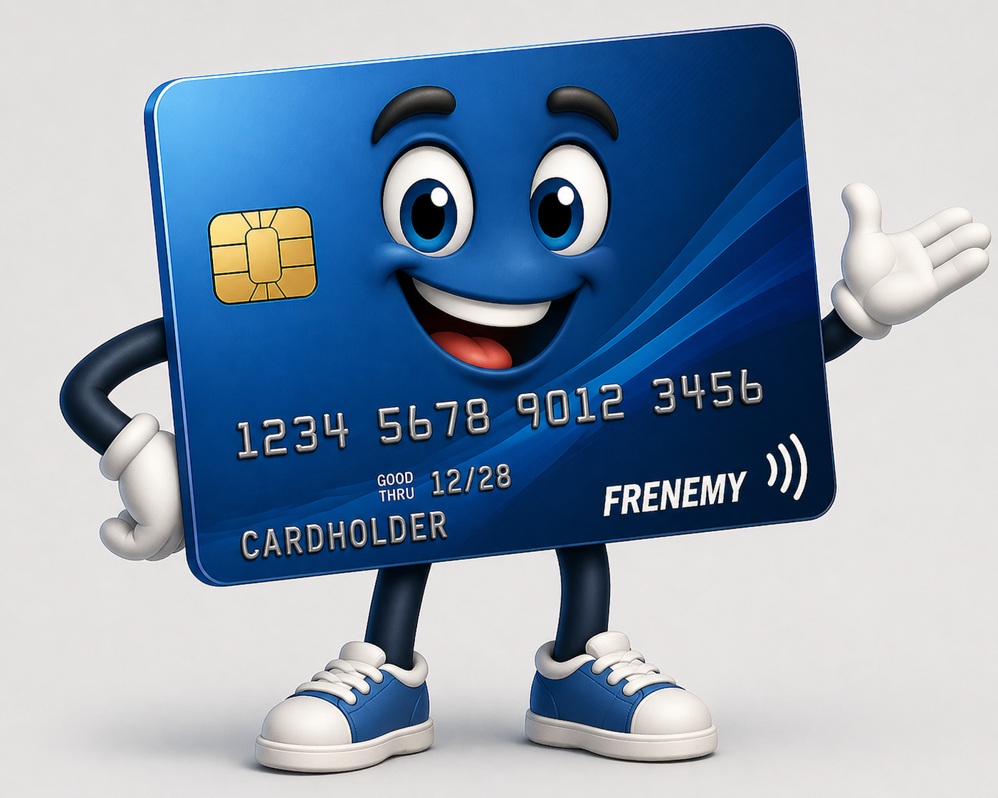
Credit Cards – Total Frenemy?
Frenemy: Someone or something that can be helpful in some situations by harmful in others.
Like a frenemy, credit cards have both benefits and risks. The key is knowing when – and how – to use them wisely.

Slide 20
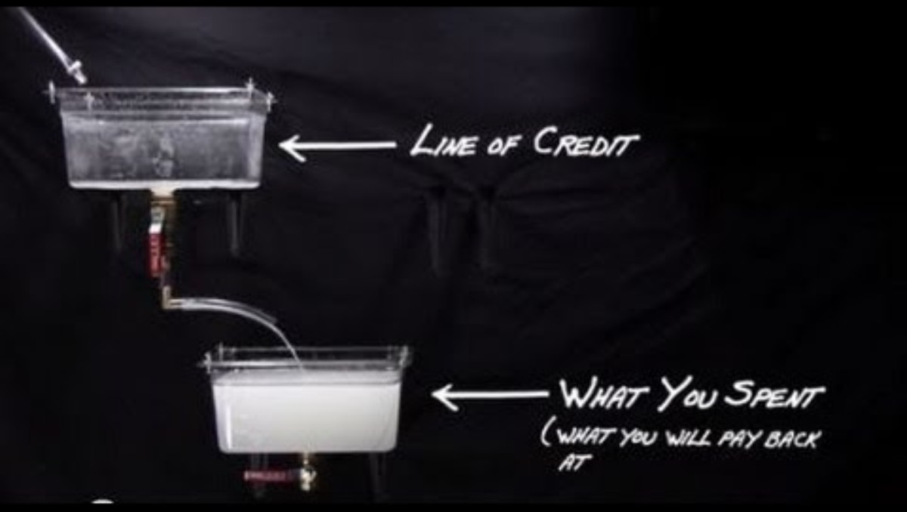
Credit Card Debt Explained

Slide 21
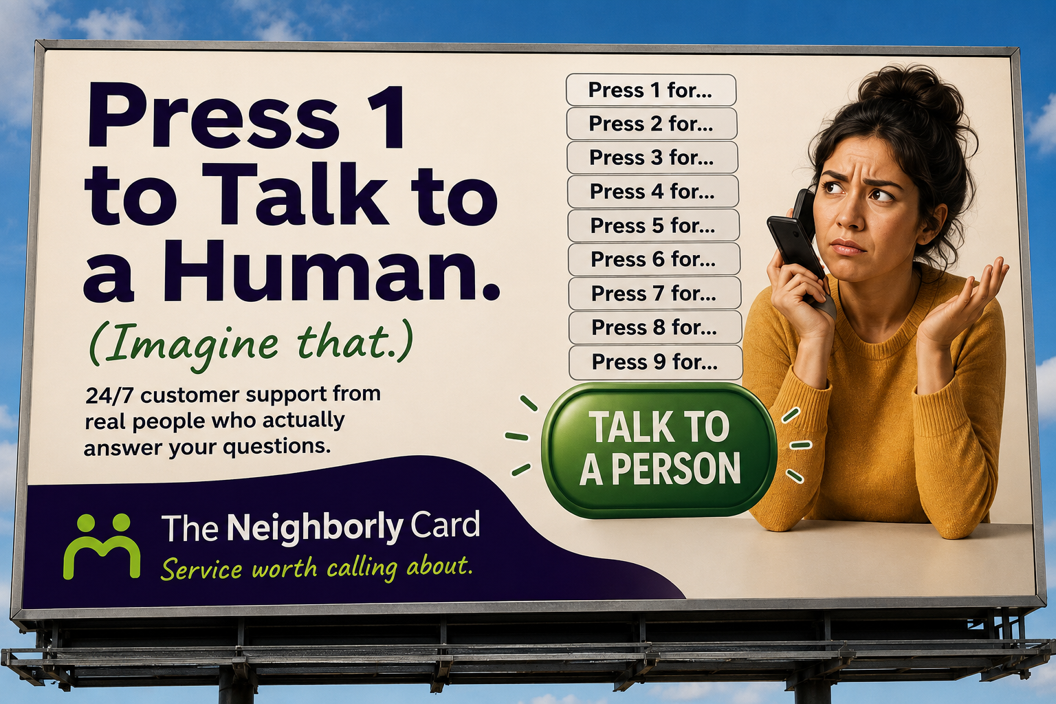
Billboard 1

Slide 22
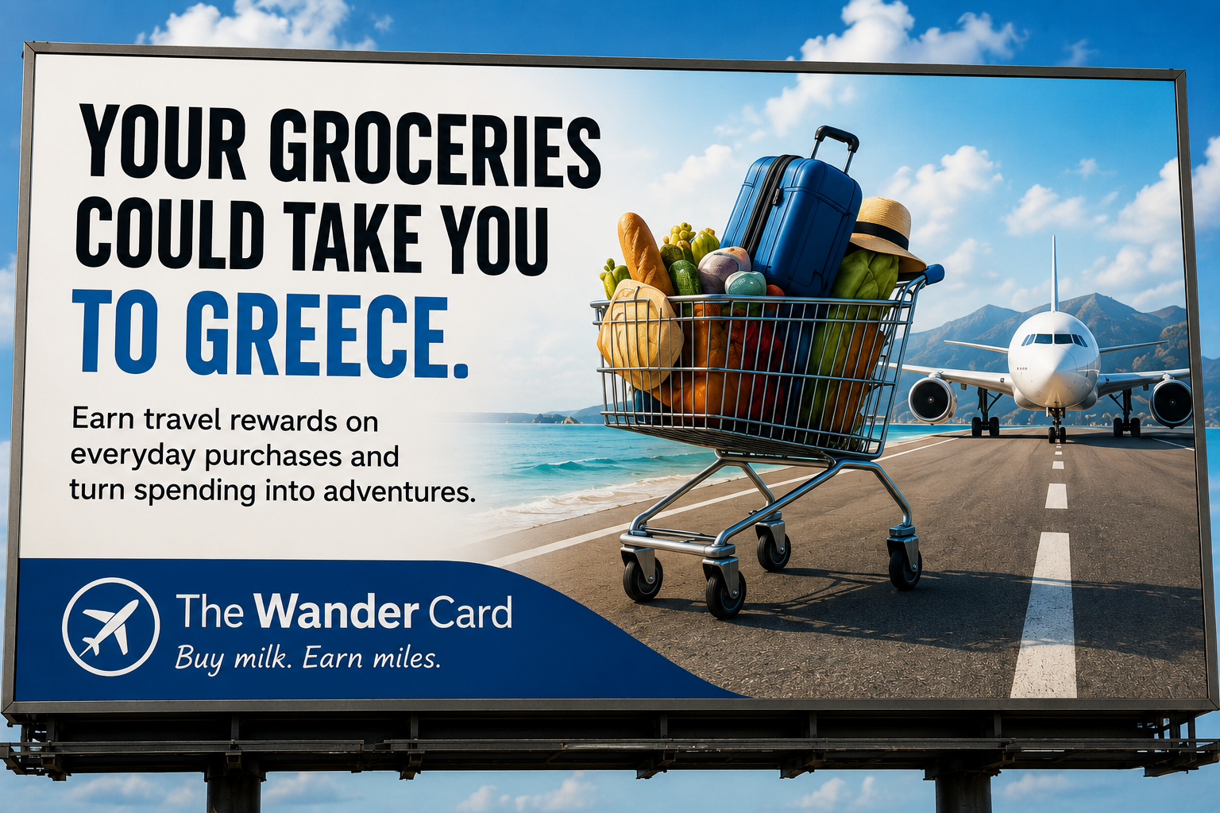
Billboard 2

Slide 23
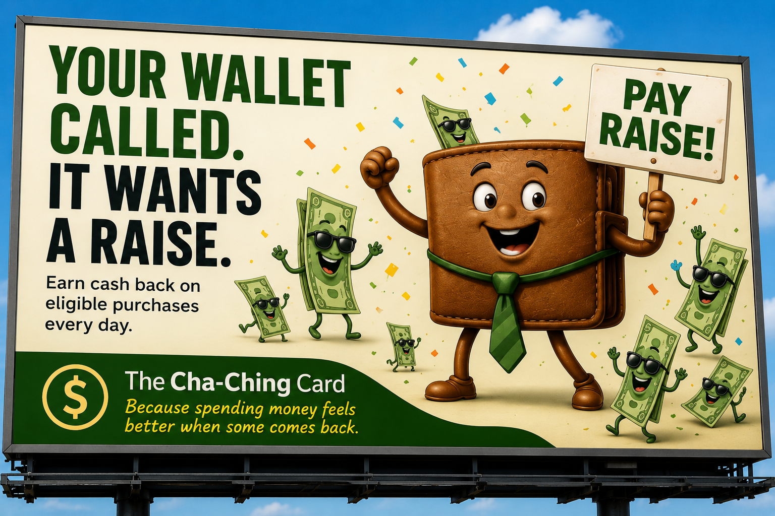
Billboard 3

Slide 24
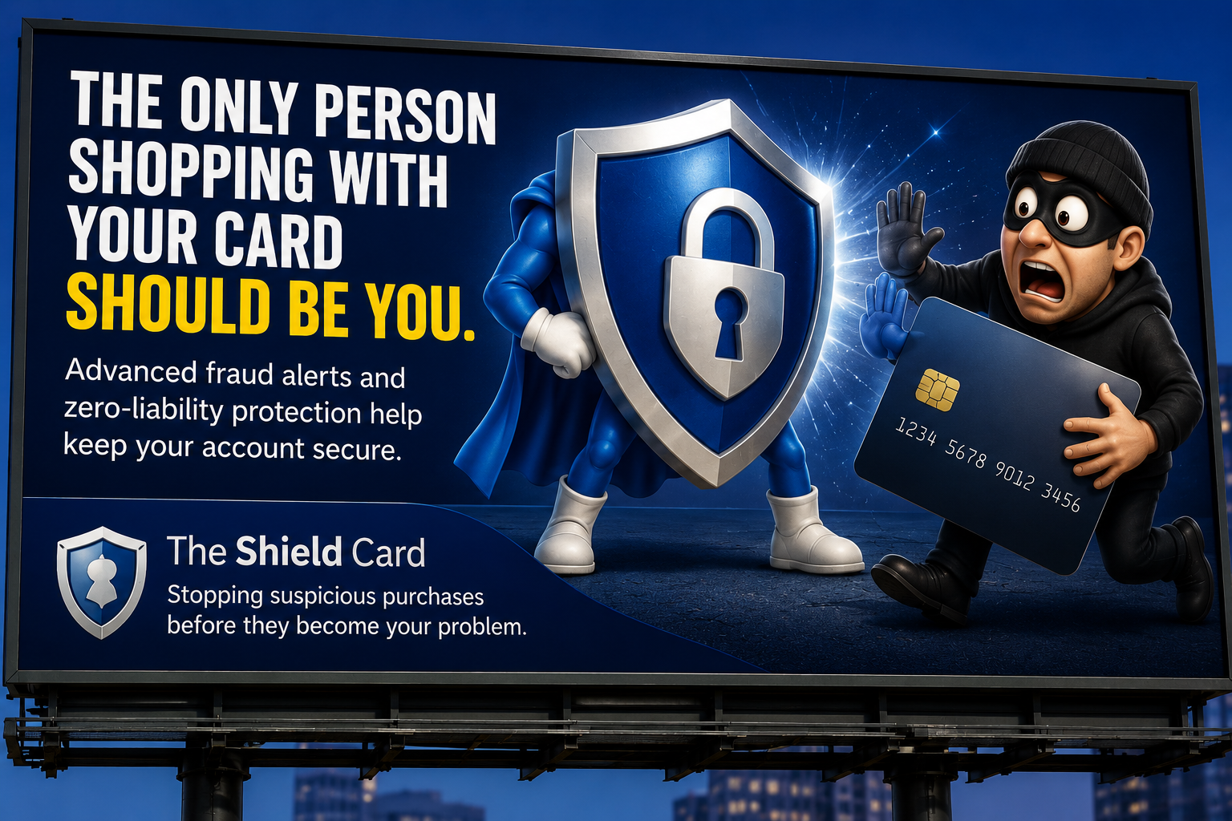
Billboard 4

Slide 25
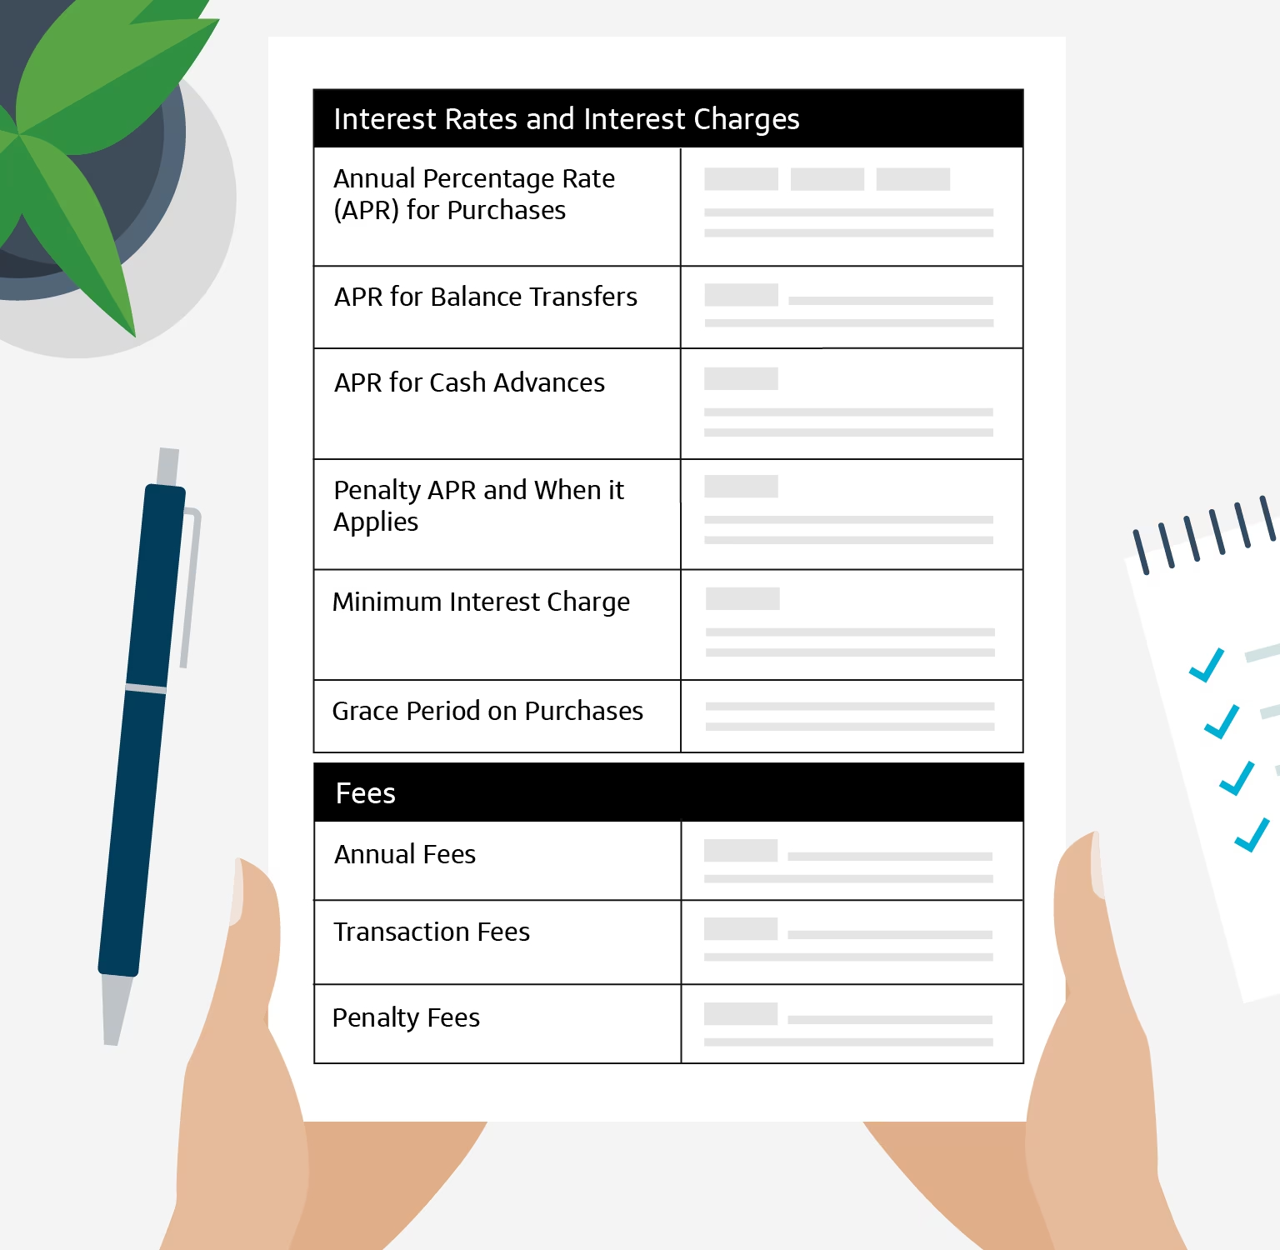
Schumer Box
Provides a clear, standardized summary of the most important borrowing terms and costs
Legally required in credit card applications and account-opening disclosures
Helps consumers compare credit cards more easily and fairly
Image source: https://www.capitalone.com/learn-grow/money-management/schumer-box/

Slide 26
For each scenario, is using a credit card a smart financial choice?
YES
IT DEPENDS
NO

Slide 27
Yes, No, or It Depends? (#1)
You need a new laptop for college and have enough money in your checking account to pay for it in full. Your credit card offers purchase protection and 2% cash back.

Slide 28
Yes, No, or It Depends? (#2)
You see tickets for your favorite artist but don’t have enough money saved. You are able to make the minimum payment and could worry about the rest later.

Slide 29
Yes, No, or It Depends? (#3)
You want extra spending money for the weekend and could use your credit card to take out cash from an ATM.

Slide 30
Yes, No, or It Depends? (#4)
Your car needs a $700 repair so you can get to work. You don’t have enough in savings, but you could use your credit card and pay it off over the next two months.

Slide 31
Yes, No, or It Depends? (#5)
You have an important job interview next week and want to buy a new professional outfit. You have a credit card but don’t have enough money in your bank account right now to pay for it in full. You believe looking professional could improve your chances of getting the job.

Slide 32
Closure
How do credit card companies use incentives to encourage people to open an account, and why is it important for consumers to look beyond those incentives?
What are two important terms or conditions in a Schumer Box that consumers should compare before choosing a credit card? Why do they matter?
What information on a credit card statement can help cardholders avoid unnecessary interest or fees?
What habits are most important for using a credit card responsibly?

