Slide 1
Credit Reports and Credit Scores
Slides for Keys to Financial Success Lesson 6.4

Slide 2
What do these have in common?
Credit card company
Lender (bank, credit union, etc.)
Landlord
Cell phone provider
Insurance company
Utility company
Employer

Slide 3
Credit and Creditworthiness
Credit refers to an individual's financial track record and borrowing history.
Creditworthiness is a measure of how likely you are to reliably repay borrowed money without defaulting on the loan.

Slide 4

What’s the Difference Between a Credit Report and a Credit Score? Video
How would you explain the difference between a credit report and a credit score to a friend?

Slide 5
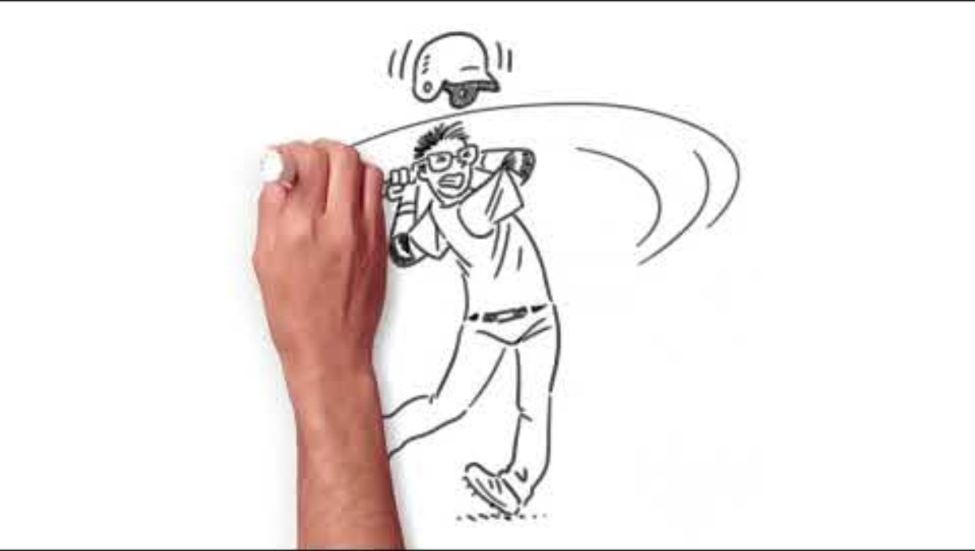
How to Build Credit from Scratch Video
What strategies can be used to build your credit from scratch?

Slide 6
Predict: Helps, Hurts, or No Impact on your Credit Score?
Missing a payment
Checking your own credit score
Using cash or a debit card fo most purchases
Keeping credit card balances low
Using a mix of credit types (credit card, auto loan, student loan, etc.)
Receiving a raise at work
Applying for several credit cards in a short amount of time
Having no credit history
Closing older credit card accounts

Slide 7
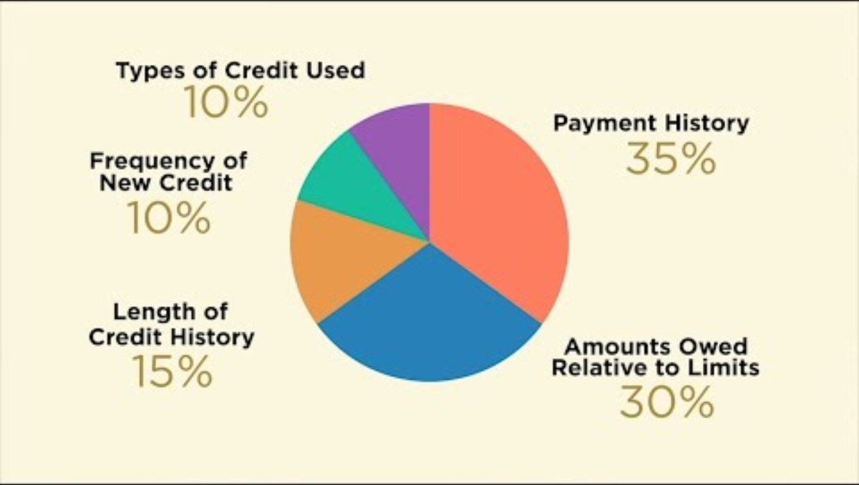
How a FICO Credit Score is Determined Video

Slide 8
Capacity
Capacity is a borrower’s ability to repay debt.
Lenders compare a person’s income to their existing debt when deciding whether to approve credit.

Slide 9
Factors related to capacity include:
Amount and sources of income
Steadiness of income
Amount of monthly living expenses
Number of dependents
Level of education and training

Slide 10
Character
Character is a borrower's reputation for paying bills and debts based on past behavior.
It tells a lender whether a person will be reliable in repaying the loan.

Slide 11
Factors related to character include:
Credit score and/or credit report
Years living at the same address

Slide 12
Collateral
Collateral is property or financial assets a borrower offers as a guarantee for a loan.
If the borrower fails to repay the debt, the lender may use the collateral to repay the loan.

Slide 13
Factors related to collateral include:
Amount of financial assets (e.g., savings and stock and bond holdings)
Market value of real assets (e.g., land, home(s), car(s), and jewelry)

Slide 14
Closure
How can a person’s credit history affect future financial opportunities?
How do the 3 Cs of Credit reflect a person’s creditworthiness?
Based on what you learned today, what advice would you give someone who is trying to build or improve their creditworthiness?

