Slide 1
Save, Invest, or Both?
Slides for Keys to Financial Success Lesson 5.2

Slide 2

Take the Risk?
Jump off a 30-foot cliff into water or stay on shore?
Flip a coin for a chance to win $60 or take a guaranteed $25?
Buy event tickets hoping to resell them for twice the price or keep your money?
Eat at a new restaurant with zero reviews or choose one you’ve already visited?
Drive to a new destination without planning your route or map it out before you leave?

Slide 3
Saving, Investing, and Financial Risk
Saving involves giving up some current consumption for future consumption.
Investing involves purchasing an asset with the hope that it will gain value and provide a financial return.
Financial Risk: the possibility that an asset will fail to produce a return or will lose value over time.

Slide 4
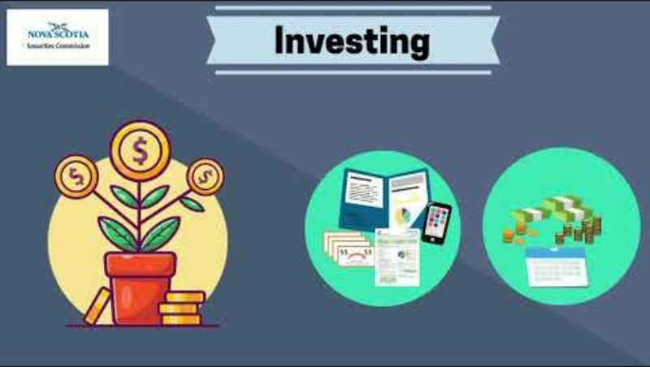
Video 1
What are the biggest tradeoffs between saving and investing?

Slide 5
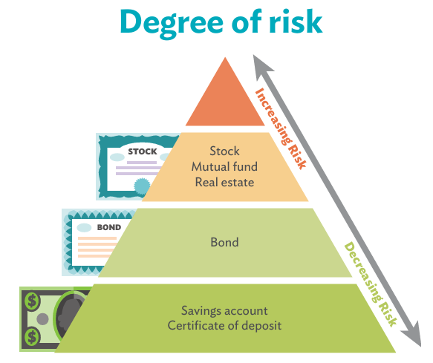
Risk Pyramid
Source: FRE Building Wealth, Lesson 7 “Risk and Return”, Federal Reserve Bank of Dallas

Slide 6
Factors to Consider
Financial Goals: What am I hoping to achieve by saving or investing?
Risk Tolerance: How comfortable are you with the possibility of losing money?
Time Horizon: When will you need the money?

Slide 7

Video 2
According to the video, why might the best investment choice be different for different people?
Why is it important to diversify your investments?

Slide 8
Three Rules for Long-Term Investing
Start early: Starting early gives your money more time to grow.
Buy and hold: Keeping your investments for the long term helps you ride out short-term market ups and downs.
Diversify: Spreading your money across different investments helps to reduce risk.

Slide 9
Closure
  How are risk and potential return related when investing?
  What advice would you give someone who is trying to decide whether to save or invest their money?

