Slide 1
Financial Technology (Fintech)
Slides for Keys to Financial Success Lesson 4.4

Slide 2
News Headlines
How Mobile Payments Are Changing Spending Habits
Why We’re Spending More through Digital Payments
The Growth of Buy Now, Pay Later Services
Are Digital Wallets Replacing Traditional Cash?
Why Young Adults Are Turning to Investing Apps
More Consumers Are Using Budgeting Apps

Slide 3
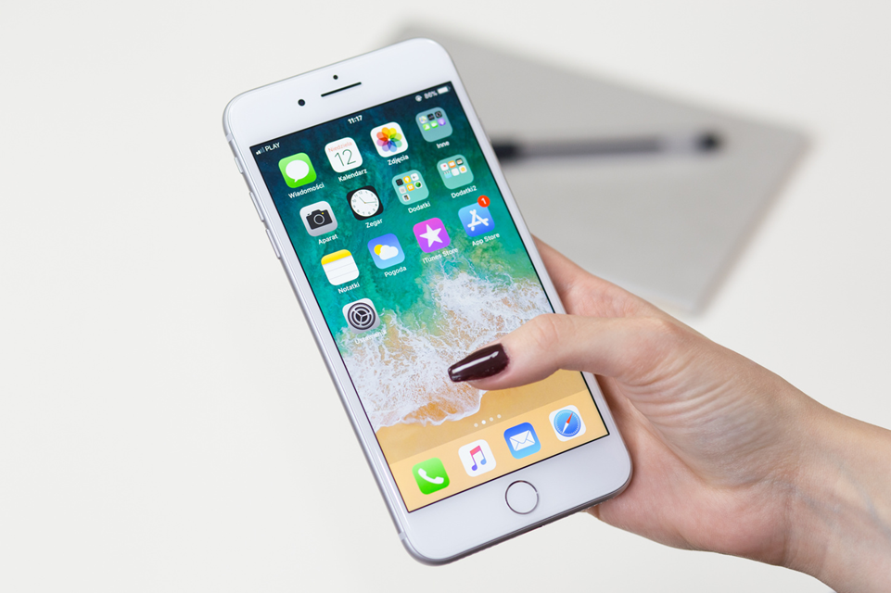
Financial Technology (Fintech)
The use of technology, such as apps and websites, to deliver financial services and products to consumers

Slide 4
Buy Now, Pay Later (BNPL)
A digital payment option (like Klarna) that lets you split a purchase into smaller payments over time, acting as a short-term loan, often carrying no finance charge

Slide 5
Peer-to-Peer (P2P) payments
P2P payments allow money to be instantly transferred between two people using a smartphone app (like Venmo or PayPal) or computer. The app is linked to your bank account or credit card.

Slide 6
Robo-advisor
A digital platform that uses algorithms (step-by-step computer rules) to help you plan and invest your money automatically, based on your goals, timeline, and risk level

Slide 7
Types of Financial Services
Deposit Services help people store money safely and access it for payments or withdrawals.
Credit Services allow people to borrow money that must be repaid over time.
Investment Services help people grow their money to meet future financial goals.

Slide 8
Fintech Scavenger Hunt
For each financial service:
Identify a fintech tool that provides that service.
Explain what it does.
Explain what makes it useful or appealing.
Explain what might be challenging or require caution when using it.

Slide 9
Sample Response for Scavanger Hunt
Name of the app or tool: Venmo
What it does: Venmo allows users to send and receive money instantly using a mobile app. It is often used to split bills, pay friends, or make small payments.
What makes it useful or appealing: Venmo is fast and convenient, allowing users to quickly send money without needing cash.
What might be challenging or require caution: Payments are often not reversible if money is sent to the wrong person or if a user is scammed. There may also be fees for instant transfers, and it can be easy to send money quickly without thinking. Money stored on the app is not FDIC insured.

Slide 10
Debrief
Which tools seem the most useful or appealing? What makes them stand out?
Which tools might require the most caution? What makes them riskier or more challenging to use?
Which pros and cons matter the most to you and why?

Slide 11
Would You Rather? Fintech Edition
For each scenario:
Partner 1 chooses A or B and defends their choice.
Partner 2 agrees or disagrees then explains why.
Switch roles for each new scenario.

Slide 12
Example Response for Would You Rather
  Use cash and always see how much you’re spending
  Use Apple Pay and pay instantly with your phone
Partner 1: I would choose Apple Pay because it’s faster and more convenient. I don’t like carrying cash, and I can pay instantly. I like that it’s easy and requires Face ID for added security.
Partner 2: I disagree because it’s too easy to overspend since I don’t physically see the cash leaving my wallet, and not every business accepts Apple Pay.

Slide 13
Closure
How has fintech changed the way people access and use financial services?
What are some of the biggest advantages of fintech?
What are the biggest risks or disadvantages of fintech?
What should people consider before choosing to use a fintech tool?

