Slide 1
Reality Check: The Life You Can Afford
Slides for Keys to Financial Success Lesson 3.4

Slide 2

Transportation

Slide 3

Housing

Slide 4
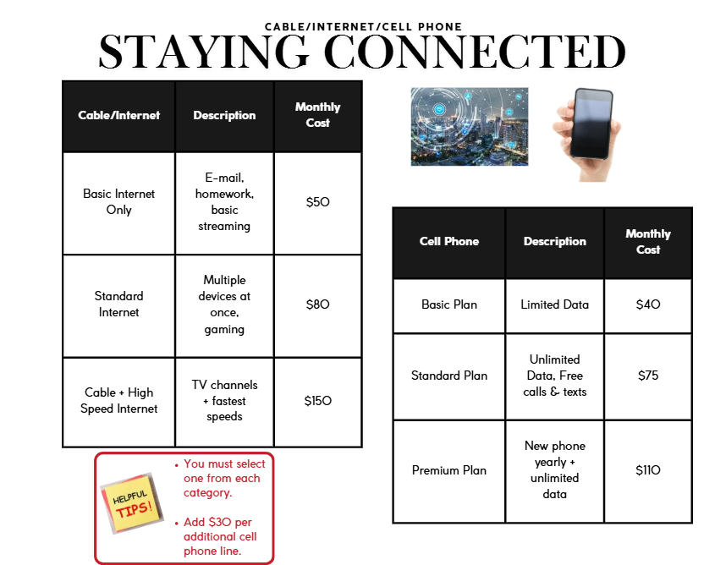
Cable/Internet/Cell Phone

Slide 5
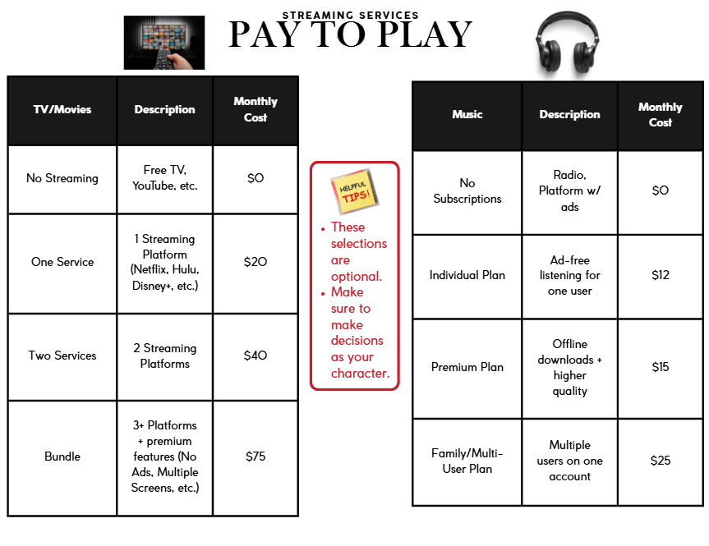
Streaming Services

Slide 6
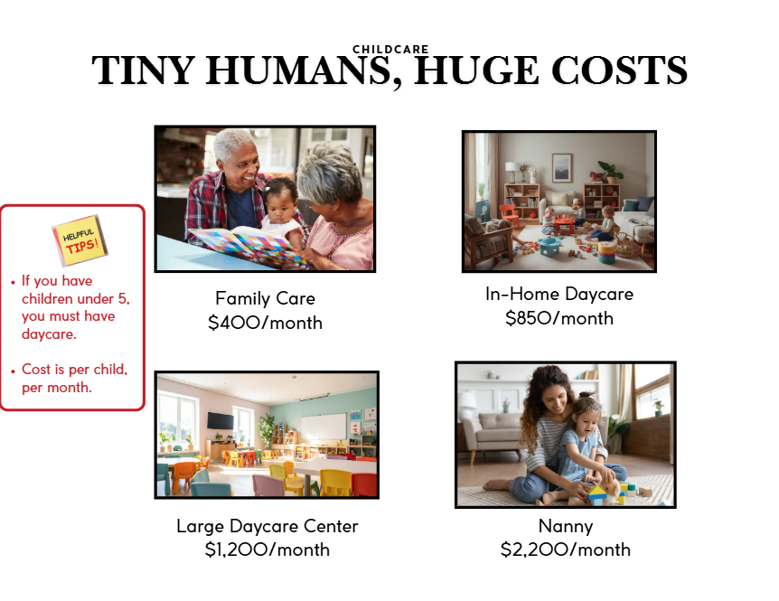
Childcare

Slide 7
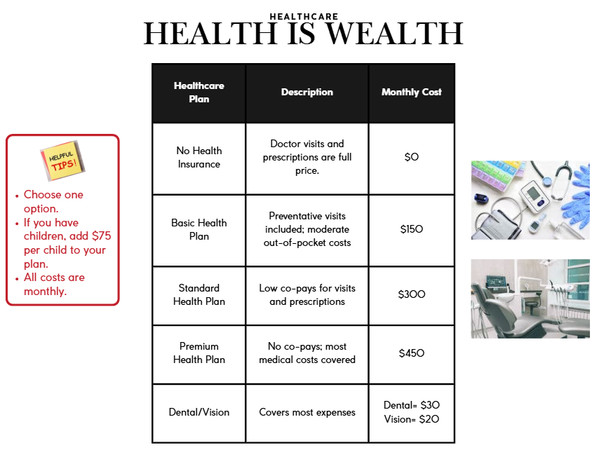
Healthcare

Slide 8
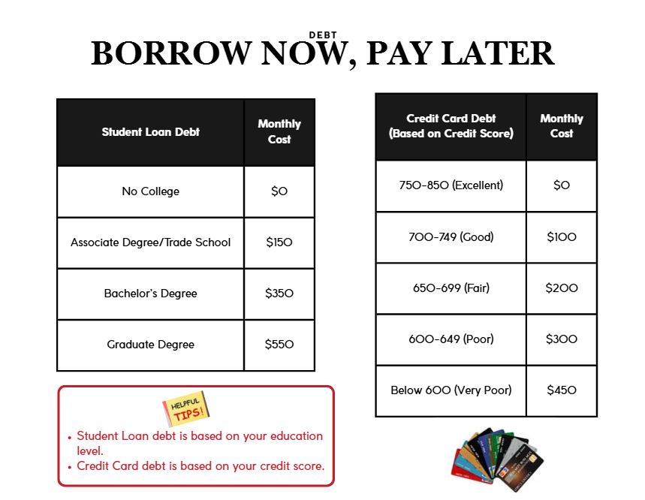
Debt

Slide 9
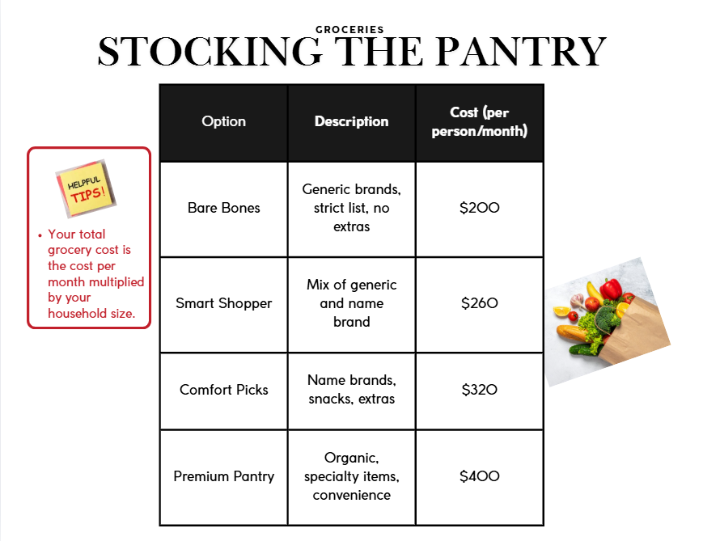
Groceries

Slide 10
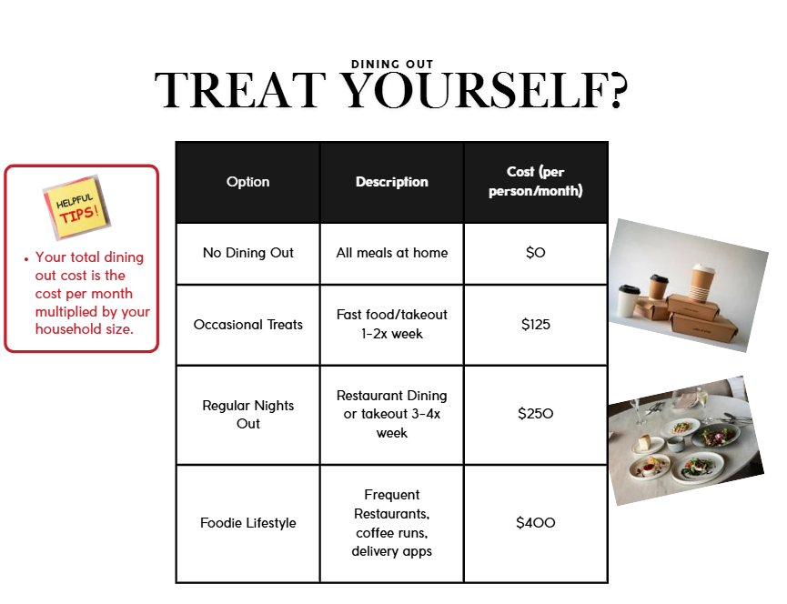
Dining Out

Slide 11
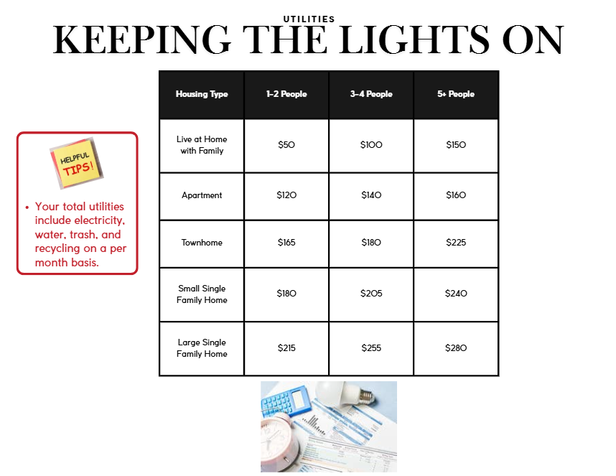
Utilities

Slide 12
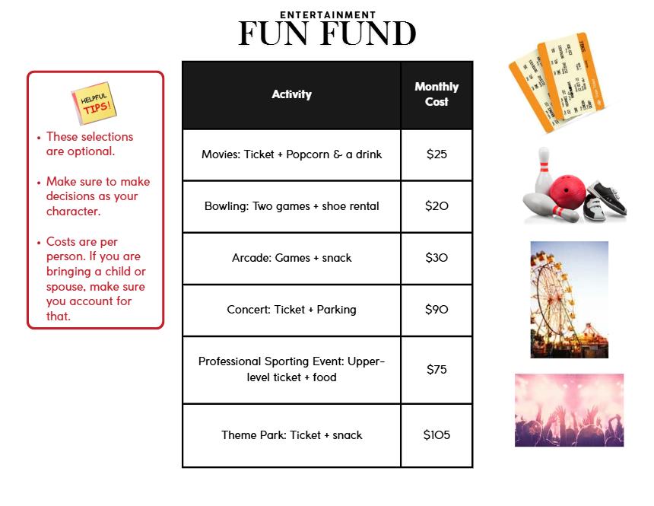
Entertainment

Slide 13
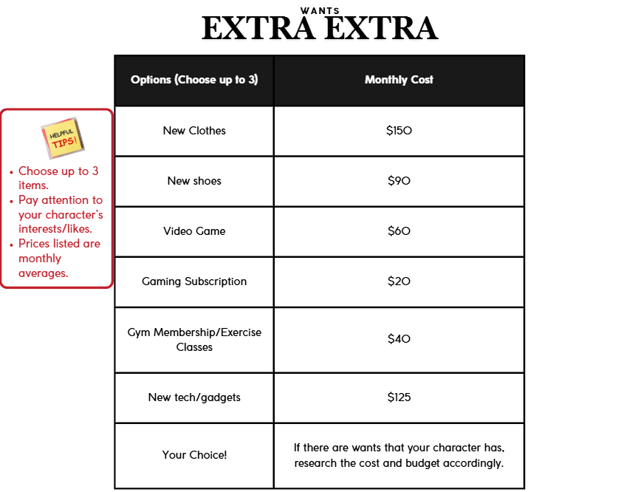
Wants (1 of 2)

Slide 14
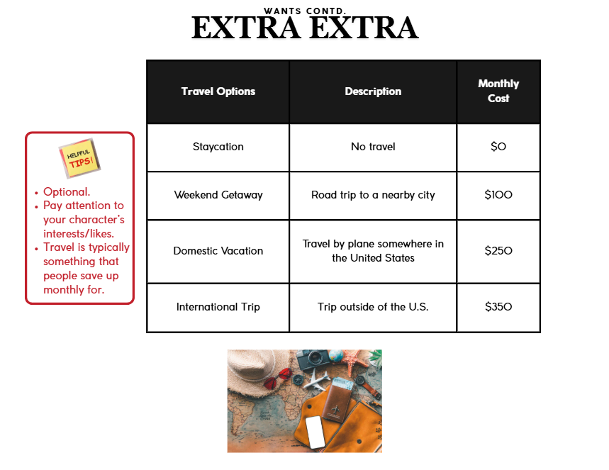
Wants (2 of 2)

