Slide 1
Understanding Cognitive Biases
Slides for Keys to Financial Success Lesson 1.5

Slide 2
Why do people make irrational decisions?
Why do people make irrational decisions?
Irrational decisions go against reasoning, logic, or personal benefit

Slide 3
Cognitive Bias Definition
Cognitive Bias
A systematic error in thinking that affects people’s judgement and decision-making.

Slide 4
Experiment Findings
Experiment #1 | Experiment #2 | Experiment #3

Slide 5
Experiment #1
Most people will take more time and be more inaccurate with the second set of words.
The mind wants to grab onto the first piece of information
  Read and report the word, not the color
Emphasize that the mind often quickly grabs the first piece of information and uses that information in forming responses to other questions.

Slide 6
Experiment #2
Conjunction Fallacy
  People think a more specific event is more likely to occur than a more general event.
  Linking information, jumping to conclusions

Slide 7
Experiment #3
Anchoring Effect
  The tendence for a person to rely heavily on the first piece of information they receive when making decisions.

Slide 8
Relativity Trap
When consumers place lots of importance on the original higher price than evaluate a lower sales price relative to the “original price”
Example of anchoring effect

Slide 9
How do cognitive biases affect personal finance decisions?
How do cognitive biases affect personal finance decisions?

Slide 10
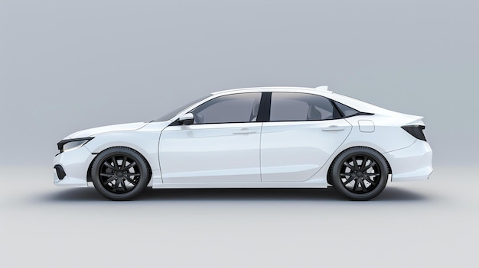
Is this Car Expensive?
$20,000
Brand new white sedan

Slide 11
How about now?
$20,000
MSRP$25,000
Brand new white sedan

Slide 12

And now?
$20,000
MSRP$25,000
Brand new white sedan

Slide 13
How can you avoid being anchored?
How can you avoid being anchored?

