Slide 1

Lesson 4
Back to School
Part 1
Human Capital and Employment

Slide 2
Lesson Objectives
Lesson 4: Back to School
Part 1: HUMAN CAPITAL AND EMPLOYMENT
Students will:
Assess their current and future human capital.
Analyze graphs and charts related to education.
Understand the relationship between human capital and income.
2

Slide 3
Human CAPITAL AND Employment
3

Slide 4

Human Capital: Invest in Yourself
Lesson 4: Back to School
Human capital is the knowledge, skills, and training that people possess.
There is a strong correlation between the level of a person’s human capital and that person’s income.
Invest in human capital by going to school, pursuing additional training, and developing skills.
4

Slide 5
Your Human Capital
Lesson 4: Back to School
 | Current human capital | Future human capital
Areas and subjects in which you have a lot of knowledge
Education
Additional training
Employment
Other skills
REFLECTION QUESTIONS
How does your current human capital differ from your future human capital?
What steps do you need to take to achieve your future human capital? human capital?
5

Slide 6
How Long Will It Take to Earn $1 Million?
Lesson 4: Back to School
 | How much each year? (2015 Median Annual Salary) |  | How many years to earn $1 million?
Level of Education | Estimate | Actual | Estimate | Actual
Less than high school diploma
High school diploma
Some college, no degree
Associate’s degree
Bachelor’s degree
Master’s degree
Professional degree
Doctoral degree
$25,636
39.0
$35,256
28.4
$38,376
26.1
$41,496
24.1
$59,124
16.9
$69,732
14.3
$89,960
11.1
$84,396
11.8
Source: Current Population Survey (U.S. Bureau of Labor Statistics, bls.gov/emp/ep_chart_001.htm)
6

Slide 7
Graph: How Long WILL It Take to Earn $1 Million?
Lesson 4: Back to School
Source: Current Population Survey (U.S. Bureau of Labor Statistics, bls.gov/emp/ep_chart_001.htm )
7

Slide 8
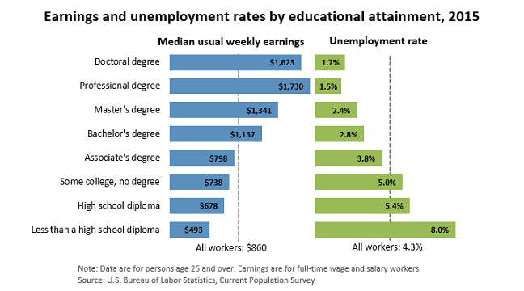
Earnings, Unemployment Rates, and Education
Lesson 4: Back to School
Source: Current Population Survey (U.S. Bureau of Labor Statistics, bls.gov/emp/ep_chart_001.htm)
8

Slide 9
Teen Unemployment Rates
Lesson 4: Back to School
Average Unemployment Rate by Year
Unemployment Rate = Number of unemployed / Labor force
Note: Labor Force = Number of employed + number of unemployed
Source: Employment Situation Historical Data (U.S. Bureau of Labor Statistics, bls.gov/cps/cpsatabs.htm)
9

Slide 10
In Summary
Lesson 4: Back to School
Human capital is the knowledge, talent, and skills that people possess.
Education can increase human capital and earning potential as well as decrease unemployment risk.
10

Slide 11
Katrina’s Classroom was developed by a team of Senior Economic and Financial Education Specialists at the Federal Reserve Bank of Atlanta. Claire Loup, New Orleans Branch • Julie Kornegay, Birmingham Branch • Jackie Morgan, Nashville Branch For additional classroom resources and professional development opportunities, please visit www. frbatlanta.org/education
11

Slide 12
Lesson 4
Back to School
Part 2
EVALUATING
POSTSECONDARY OPPORTUNITIES

Slide 13
Lesson Objectives
Lesson 4: Back to School
Part 2: evaluating postsecondary opportunities
Students will:
Evaluate the opportunities and expenses associated with postsecondary education.
Explain and use the vocabulary associated with postsecondary education,
Identify postsecondary institutions that offer specific programs of study.
13

Slide 14
evaluating postsecondary Opportunities
14

Slide 15

Education Pays… But It Also Costs
Lesson 4: Back to School
$10,556 = Average yearly tuition and fees at a public four-year college
$10,556 x 4 years = $42,224 total
69 percent of college seniors graduated with debt from student loans.
The average debt load was $28,950.
Sources: College Costs FAQ (College Board, bigfuture.collegeboard.org/pay-for-college/college-costs/college-costs-faqs) and the Project on Student Debt (projectonstudentdebt.org/state_by_state-data.php)
15

Slide 16

Student Loan Rule of Thumb
Lesson 4: Back to School
A suggestion: Don’t borrow more money for all the years of your postsecondary education than you anticipate making in your first year of employment.
For a public relations manager:
Requirement: Bachelor’s degree
Starting salary: $40,862
Median salary: $101,510
Sources: Bureau of Labor Statistics Occupational Outlook Handbook (www.bls.gov/ooh/)
16

Slide 17

Paying for College: Do Your Homework
Lesson 4: Back to School
Scholarships
Grants
Work study
Savings
Student loans
17

Slide 18

Planning for Postsecondary Education
Lesson 4: Back to School
Complete an interest inventory.
Identify career goals.
Research postsecondary options.
Research the application process.
Research strategies to finance your education.
18

Slide 19

Activity: Evaluating Postsecondary Opportunities and Expenses
Lesson 4: Back to School
Scenario: You are exploring options for attending college next year to obtain a bachelor’s degree for your chosen career (see the career card).
Cost is a major factor in your decision.
Scholarships, together with help from your parents, will cover half the expenses.
You will pay for the other half with student loans.
You will attend school in your home state.
You have not yet decided whether to live on or off campus.
19

Slide 20
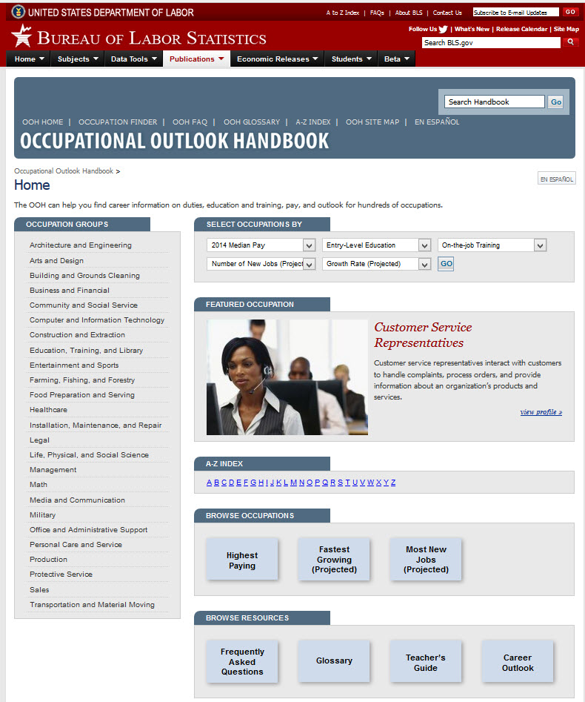
Lesson 4: Back to School
1
1
20

Slide 21
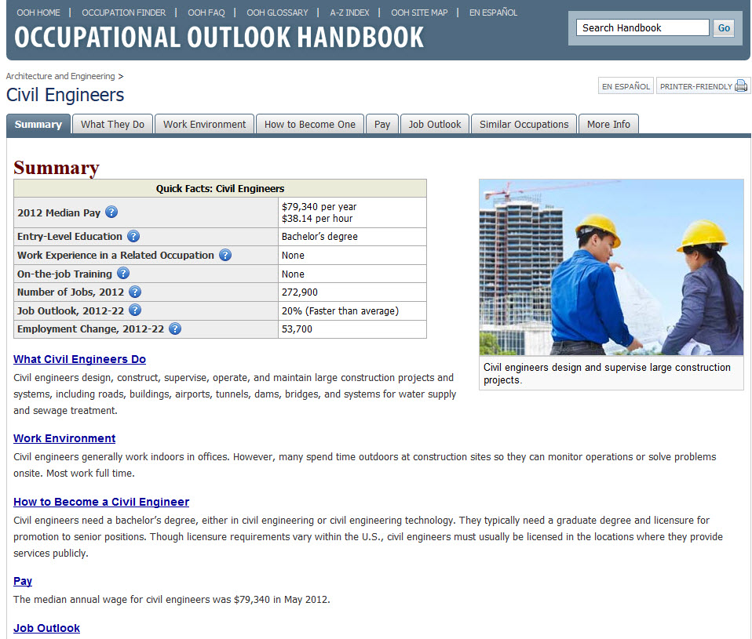
Lesson 4: Back to School
1
2
3
4
21

Slide 22
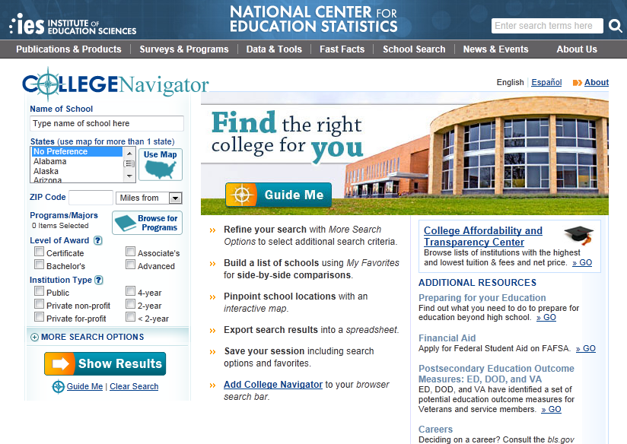
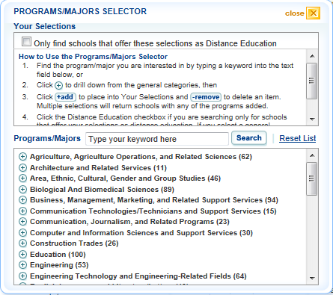
Lesson 4: Back to School
5
1
4
3
2
6
22

Slide 23

Lesson 4: Back to School
1
2
23

Slide 24

Activity: Evaluating Postsecondary Opportunities and Expenses
Lesson 4: Back to School
DEBRIEFING
What career option did you evaluate?
What school was selected as the best alternative for this career and why?
What is the opportunity cost of this decision?
Will the entry-level salary support the estimated student loan payment? Why or why not?
What are some strategies to reduce the amount borrowed to finance postsecondary education?
24

Slide 25
In Summary
Lesson 4: Back to School
Planning for postsecondary education includes considering career goals, postsecondary options, financing strategies, and necessary documentation.
25

Slide 26
Katrina’s Classroom was developed by a team of Senior Economic and Financial Education Specialists at the Federal Reserve Bank of Atlanta. Claire Loup, New Orleans Branch • Julie Kornegay, Birmingham Branch • Jackie Morgan, Nashville Branch For additional classroom resources and professional development opportunities, please visit www. frbatlanta.org/education
26

Slide 27
Lesson 4
Back to School
Lesson 4
Back to School
Part 3
BUDGETING BASICS

Slide 28
Lesson Objectives
Lesson 4: Back to School
Students will:
Explain and use the vocabulary associated with budgeting.
Identify the purpose of a budget.
Implement the budgeting steps.
28

Slide 29
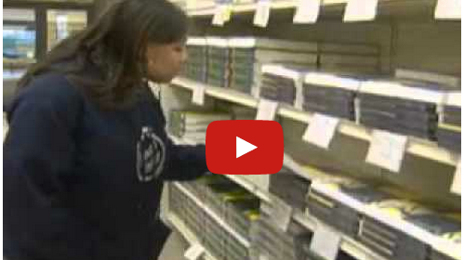
Back to School
Lesson 4: Back to School
5

Slide 30
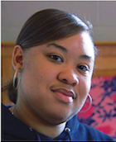
Lesson 4: Back to School
ASSESSING THE IMPACT OF FINANCIAL PREPAREDNESS
What did Jamie’s friends recommend in order to be financially prepared?
How was Jamie able to use the money she had earned and saved?
How might having a budget help you achieve your financial goals?
How might getting a good education help ensure your financial future?
30

Slide 31
Budgeting
31

Slide 32
Managing Your Money: The Budget
Lesson 4: Back to School
What is a budget?
A budget is a plan that helps you manage your money by helping you balance your income with your expenses.
It is an itemized summary of probable income and expenses for a given period.
Why create a budget?
A budget helps you understand where your money goes.
It helps you live within your means and meet your goals.
It helps you find uses for your money that will increase your wealth.
It puts you in control of your money.
32

Slide 33
Managing Your Money: The Budget
Lesson 4: Back to School
Determine
Income
Review & Adjust
Identify Expenses
& Track Spending
Implement
& Track
Develop the
Budget Plan
33

Slide 34
The Budget: Determine Income
Lesson 4: Back to School
Calculate your income.
Identify all income sources.
Wages/salaries
Gifts or allowance
Interest
Scholarships, grants, and student aid
Understand the difference between net and gross income.
Determine
Income
34

Slide 35
Lesson 4: Back to School
The Budget: Identify Expenses And Track Spending
Determining Your Expenses
Consider all expenses.
Determine which are fixed and which are variable expenses.
Expense Considerations
Know what you owe.
Consider your ongoing needs.
Plan other expenditures.
Identify how much money you need to cover expenses.
Expect the unexpected.
Identify Expenses
& Track Spending
35

Slide 36

Lesson 4: Back to School
TRACKING YOUR EXPENSES
WHERE DID YOUR MONEY GO?
Example purchase
On what? A large caramel latte
Where? Specialty coffee store
How much? $4.75
How paid? Cash
36

Slide 37
Activity: Tracking Your Expenses
Lesson 4: Back to School
Track daily expenses for the past two days
Date | Item Purchased/ Expense | Amount | Payment Method Cash, Check, ATM/Debit Card, Credit Card, Autodraft, etc. | Fixed or Variable Expense
10/1 | Car payment | $250 | Autodraft | Fixed
10/1 | Gas | $40 | Debit card | Variable
10/2 | Car insurance | $150 | Check | Fixed
10/2 | Lunch | $5 | Cash | Variable
37

Slide 38
Activity: Tracking Your Expenses
Lesson 4: Back to School
DEBRIEFING
What types of goods and services did you purchase?
What types of payment methods did you use?
Did the way you paid affect how much you spent?
Which expenses were fixed and which were variable?
Any surprises regarding how much you spent?
What income did you have that paid for these expenses?
Did tracking make you rethink any of your purchases?
What influenced your spending—people, situation, emotion?
How did the purchase make you feel? What about now?
38

Slide 39
Lesson 4: Back to School
The Budget: Develop the Budget Plan
Information already gathered:
Income
Fixed and variable expenses
Other considerations:
Pay yourself first—savings
Consider your goals
Budget shortfalls
Develop the
Budget Plan
39

Slide 40
Create a Budget
Lesson 4: Back to School
How much money do you get each month?
Income $2,000
What expenses do you have each month?
Fixed Expenses
Rent $ 600
Cell Phone $ 40
Car insurance ($300/quarter) $ 100
Variable Expenses
Food (estimate) $ 500
Utility bills (estimate) $ 50
Gas $ 50
Total Expenses $1,540
Income
Fixed Expenses
Variable Expenses
40

Slide 41
Activity: Budget Scenarios
Lesson 4: Back to School
In this activity, you will work in groups to allocate $2,000 to a monthly budget estimate.
You will then take turns drawing scenario cards to see how close you came to estimating expenses.
Once you have drawn all of the cards, answer the questions at the bottom of the worksheet.
41

Slide 42
Activity: Budget Scenarios
Lesson 4: Back to School
Income | Estimate | Actual
Net income
Fixed Expenses
Rent
Renter’s insurance
Automobile loan payment
Automobile insurance
Medical insurance
Student loan
Total Fixed Expenses
Variable Expenses
Groceries
Dining out
Utilities
Gasoline
Car maintenance
Clothing and personal upkeep
Gifts
Entertainment
Savings
Total Variable Expenses
Total Expenses
SURPLUS (DEFICIT)
$2,000
$450
$25
$250
$75
$100
$325
$1,225
$200
$75
$125
$75
$75
$25
$100
$10
$75
$760
$1,985
$15
42

Slide 43
Activity: Budget Scenarios
Lesson 4: Back to School
DEBRIEFING
How did your group’s estimates differ from the scenarios?
How much did you estimate as savings each month?
Were there expenses on this budget that were not listed in the categories provided?
If you had to pay for these expenses, where would the money come from?
43

Slide 44

The Budget: Implement and Track
Lesson 4: Back to School
Implement the budget.
Continue to track spending.
Implement
& Track
44

Slide 45
The Budget: Review and Adjust
Lesson 4: Back to School
Review the budget at least monthly.
Make necessary adjustments for your situation.
Consider the following in your review:
Have income sources changed?
Does your income cover your expenses?
Where and when are you spending money?
Are you saving regularly?
Has anything affected your income, spending, and saving?
Are you achieving your personal and financial goals?
Review & Adjust
45

Slide 46
In Summary
Lesson 4: Back to School
Budgeting puts you in control of your money and helps you understand the allocation of your income.
46

Slide 47
Katrina’s Classroom was developed by a team of Senior Economic and Financial Education Specialists at the Federal Reserve Bank of Atlanta. Claire Loup, New Orleans Branch • Julie Kornegay, Birmingham Branch • Jackie Morgan, Nashville Branch For additional classroom resources and professional development opportunities, please visit www. frbatlanta.org/education
47

Slide 48
Lesson 4
Back to School
Lesson 4
Back to School
Part 4
Saving essentials

Slide 49
Lesson Objectives
Lesson 4: Back to School
Students will:
Analyze graphs and charts related to saving.
Articulate reasons and goals for saving.
Explain and use the vocabulary associated with saving.
Perform calculations for growth of funds.
Recognize the need for financial preparedness in the face of a disaster.
49

Slide 50
SAVing
50

Slide 51

Saving versus Investing
Lesson 4: Back to School
What is saving?
Savings = Disposable income – Consumption.
It is the preservation and protection of money from loss.
It helps you meet short-term goals and needs.
It helps you prepare for the unexpected.
What is investing?
It is a long-term commitment to put money away and let it grow.
You are taking a risk with a portion of your savings, such as by buying stocks or bonds, in hopes of realizing higher long-term returns.
51

Slide 52

Reasons for Saving
Lesson 4: Back to School
To build an emergency fund
To cover budget shortfalls
To meet future needs
To achieve personal and financial goals
To keep funds secure while increasing them
52

Slide 53
Your Goals for Saving
Lesson 4: Back to School
List three things you want that may require you to save money in order to buy them.
How much will each item cost?
How long do you estimate it will take you to save for each item?
How much per week/month will you need to save?
How will this impact your budget?
What might you have to give up to attain these items?
53

Slide 54

Tools for Saving
Lesson 4: Back to School
Savings account
Money market account
Certificate of deposit
Savings bond
54

Slide 55
Compound Interest: Daily vs. Monthly vs. Yearly
Lesson 4: Back to School
Principal = $1,000 (year 1 only) ~ Interest Rate = 5% ~ Term = 5 Years
55

Slide 56

Watch it Grow: Rule of 72
Lesson 4: Back to School
With the rule of 72, you can estimate the growth of funds over time with compound interest.
You calculate the length of time (in years) for a principal deposit to double.
You divide 72 by the rate of return.
EXAMPLE:
Say you deposit $5,000 today at an 8% interest rate.
Apply the rule: 72 ÷ 8 = 9
The principal will double every 9 years.
56

Slide 57
Rule of 72 Calculations: Problem #1
Lesson 4: Back to School
If you deposit $50,000, how many years will it take for it to grow to $100,000?
At 4% annual interest
72 ÷ 4 = 18 years
At 6% annual interest
72 ÷ 6 = 12 years
At 9% annual interest
72 ÷ 9 = 8 years
At 12% annual interest
72 ÷ 12 = 6 years
57

Slide 58
Rule of 72 Calculations: Problem #2
Lesson 4: Back to School
What interest rate do you need to grow $50,000 to $100,000?
In 2 years?
72 ÷ 2 = 36%
In 5 years?
72 ÷ 5 = 14.4%
In 10 years?
72 ÷ 10 = 7.2%
In 20 years?
72 ÷ 20 = 3.6%
58

Slide 59
VOCABULARY REVIEW
Lesson 4: Back to School
WORD BANK
Compound Interest
Interest
Interest Rate
Principal
Rule of 72
Simple Interest
Term
WORD
DESCRIPTION
Principal
1. The original amount of money deposited
Interest
2. Money an institution pays you for use of your funds
Interest Rate
3. Expressed as a percentage, what an account will earn if funds are kept on deposit for an agreed-upon term
Simple Interest
4. Interest paid only on the principal amount deposited into the account
5. The method of computing interest where the interest rate is applied to the principal and any earned interest; often referred to as “interest on interest”
Compound Interest
Term
6. Length of time money left on deposit in account
Rule of 72
7. A calculation that estimates growth of funds over time with compound interest
59

Slide 60
In Summary
Lesson 4: Back to School
Saving allows you to meet short-term goals and to prepare for the unexpected.
60

Slide 61
Katrina’s Classroom was developed by a team of Senior Economic and Financial Education Specialists at the Federal Reserve Bank of Atlanta. Claire Loup, New Orleans Branch • Julie Kornegay, Birmingham Branch • Jackie Morgan, Nashville Branch For additional classroom resources and professional development opportunities, please visit www. frbatlanta.org/education
61

