Slide 1

Lesson 1
Katrina Strikes
Part 1
FINANCIAL AND EMERGENCY PREPAREDNESS

Slide 2
Lesson Objectives
Lesson 1: Katrina Strikes
Students will:
Define natural disaster.
Develop an emergency plan for their family.
Recognize the need for EMERGENCY AND financial preparedness in the face of a disaster.
2

Slide 3
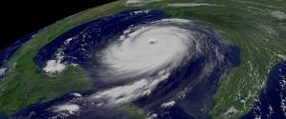
Have You Ever Experienced
A Natural Disaster?
Lesson 1: Katrina Strikes
Natural disasters are naturally occurring events that can cause severe threats to the public health.
—U.S. Department of Health and Human Services
Natural disasters occur all around the world and range in impact.
Tornadoes, hurricanes, volcanoes, and earthquakes each have a classification system developed to gauge the intensity of the event by assessing a number of set factors. These classification methods help researchers study disaster patterns. They also help to educate the public and encourage them to plan and prepare for potential disasters.
3

Slide 4
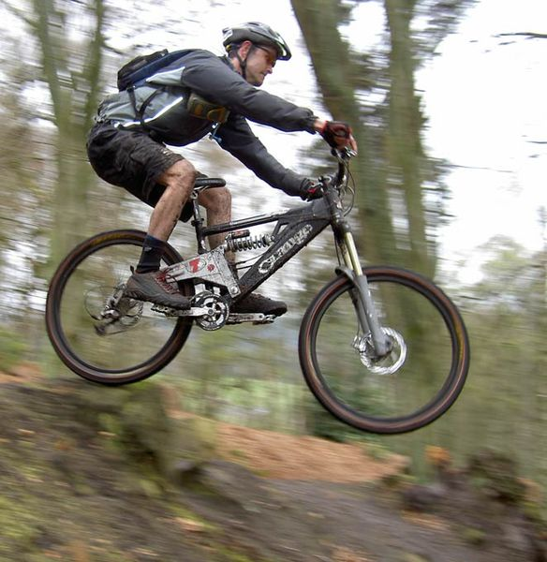
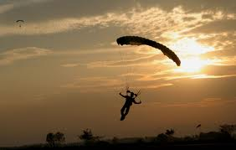
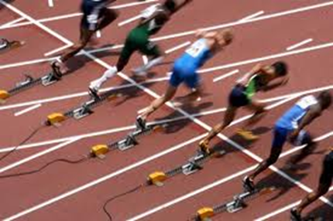
Lesson 1: Katrina Strikes
Financial and Emergency Preparedness
Why is it important to prepare for life events or activities in which you want to be successful?
Are there sports or activities that you have to prepare for before you can participate?
4

Slide 5

Lesson 1: Katrina Strikes
Managing Risk through emergency Preparedness
Risk is the uncertainty about the outcome of a situation or event.
To manage risk you must identify the sources of risk and estimate potential losses.
We take risks every day. The risk from natural disasters, which cannot be eliminated, can in some cases be minimized with adequate planning and preparation.
5

Slide 6
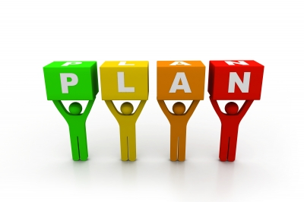
Lesson 1: Katrina Strikes
Planning
Planning helps people make
decisions to accomplish their goals.
Planning includes managing
decisions related to education,
earning income, spending, and saving in order to achieve goals.
Planning also includes keeping yourself safe in an emergency situation. One of the first important decisions you will need to make is whether to stay where you are or evacuate to a safer location. You should understand and plan for both possibilities.
6

Slide 7
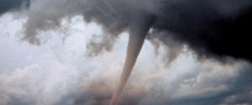
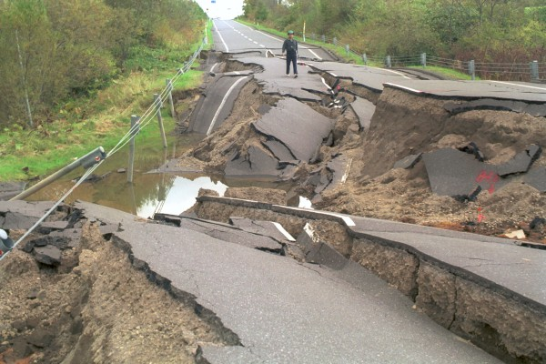
Lesson 1: Katrina Strikes
Why Is it Important To Plan Ahead for an Emergency?
Tornado
Natural disasters give little advance warning.
Hurricane
Earthquake
7

Slide 8
Lesson 1: Katrina Strikes
IN Summary
Natural disasters are naturally occurring events that can cause severe threats to the public health.
In the face of disaster, it is important to take steps for emergency and financial preparedness.
8

Slide 9
Katrina’s Classroom was developed by a team of
Senior Economic and Financial Education Specialists at the Federal Reserve Bank of Atlanta.
Claire Loup, New Orleans Branch • Julie Kornegay, Birmingham Branch • Jackie Morgan, Nashville Branch
For additional classroom resources and professional development opportunities,
please visit www.frbatlanta.org/education
9

Slide 10
Lesson 1
Katrina Strikes
Part 2
GOALS AND DECISION MAKING

Slide 11
Lesson Objectives
Lesson 1: Katrina Strikes
Students will:
Differentiate between needs and wants.
Identify and develop short-, intermediate-, and long-term goals.
Recognize the need for financial preparedness in the face of a disaster.
11

Slide 12
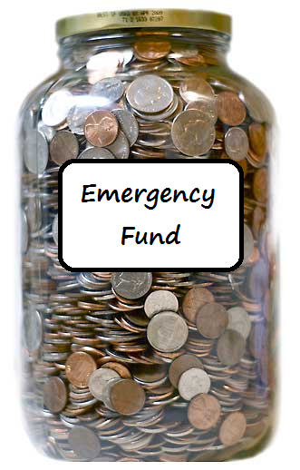
Lesson 1: Katrina Strikes
Emergency and financial Preparedness
Part of being financially prepared for an emergency is having enough savings to tide you over until life goes back to normal.
How much money you will need in an emergency?
You can accomplish having enough savings by setting financial goals.
3

Slide 13

Lesson 1: Katrina Strikes
Goals
Short-term goals
Less than one year
Intermediate-term goals One to five years
Long-term goals
More than five years
4

Slide 14
Lesson 1: Katrina Strikes
Set Goals
Two Types of Goals
  Personal
  Financial
Define Spending & Savings Goals
  Short term
  Intermediate term
  Long term
Be SMART
Specific, Measurable, Attainable, Realistic, Time Bound
Implement, Review, Revise, Repeat
5

Slide 15

Lesson 1: Katrina Strikes
Wants Vs. Needs
A want is something that you desire or would like.
Video games
Phones
iPad
A basic need is something you must have to survive.
Air
Food
Water
Shelter
Clothing
6

Slide 16
Lesson 1: Katrina Strikes
You purchase medicine for a medical condition.
You move into a dorm on campus.
You purchase groceries for the week.
You find a fabulous apartment off campus.
You purchase gas to evacuate in an emergency.
You take a trip to the beach during spring break.
You go to dinner with your friends.
Your favorite music artist releases a new album.
You drink water to stay hydrated.
Your shoes are too small and they hurt your feet
You drop your cell phone and it no longer works.
WANTS VS NEEDS
You stop by a favorite coffee shop for a beverage.
Wants
Needs
You drop your cell phone and it no longer works.
Your shoes are too small and they hurt your feet.
Your favorite music artist releases a new album.
You purchase medicine for a medical condition.
You take a trip to the beach during spring break.
You purchase gas to evacuate in an emergency.
You go to dinner with your friends.
You purchase groceries for the week.
You stop by a favorite coffee shop for a large beverage.
You drink water to stay hydrated.
You find a fabulous apartment off campus.
You move into a dorm on campus.
7

Slide 17
Lesson 1: Katrina Strikes
Scarcity and decision making
Scarcity
You have unlimited wants versus limited resources.
Decision
Making
Prioritize and make decisions.
With every decision you make, you must give up something.
Opportunity cost is the highest-valued alternative that you give up when you make a decision.
Opportunity
Cost
8

Slide 18

Lesson 1: Katrina Strikes
Decision making
People make decisions by weighing the costs and benefits of alternatives.
Costs: The negative outcomes the decision maker identifies
Benefits: The positive outcomes the decision maker identifies
Costs and benefits can be monetary or non-monetary. Cost-benefit analysis involves selecting the alternative for which you perceive the most benefits relative to the costs.
The consequences of the decisions people make lie in the future.
9

Slide 19
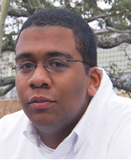
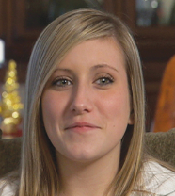
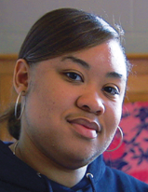
Lesson 1: Katrina Strikes
Learning Through Real-Life Experiences
This video clip provides an overview of the hurricane as well as challenges faced by three students and their families who lived through a natural disaster. They will share what they learned about being financially prepared for an emergency.
Nick
Jacquelyn
Jamie
As you watch the video, identify the needs, wants, and goals of the individuals.
10

Slide 20
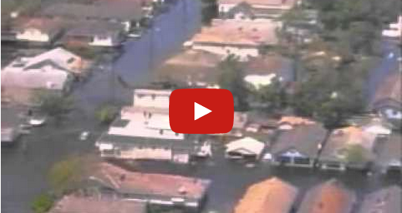
Lesson 1: Katrina Strikes
Katrina Strikes
11
Notes:
Julie—As in the lesson, should we simply link to the video on YouTube, rather than to the web page on the FRB Atlanta site that you said is going away?

Slide 21
Lesson 1: Katrina Strikes
WORD
DESCRIPTION
Natural Disaster
A naturally occurring event that can cause severe threats to the public health
Emergency Preparedness
A plan of action put in place prior to a natural disaster or unforeseen event.
Emergency Fund
A reserve of cash kept available to meet the costs of any unexpected financial emergency
Goals
Things we would like to achieve or purchase in the future.
Want
Something that you desire or would like
Basic Need
Something you must have to survive
Risk
The uncertainty about the outcome of a situation or event
Scarcity
The concept that we have unlimited wants and needs in a world of limited resources
12

Slide 22
Lesson 1: Katrina Strikes
IN Summary
A want is something that you desire or would like.
A basic need is something you must have to survive.
Goals should be specific, measurable, attainable, realistic, and time bound.
Part of being financially prepared for an emergency is having enough savings to tide you over until life goes back to normal.
13

Slide 23
Katrina’s Classroom was developed by a team of
Senior Economic and Financial Education Specialists at the Federal Reserve Bank of Atlanta.
Claire Loup, New Orleans Branch • Julie Kornegay, Birmingham Branch • Jackie Morgan, Nashville Branch
For additional classroom resources and professional development opportunities,
please visit www.frbatlanta.org/education
14

