Slide 1
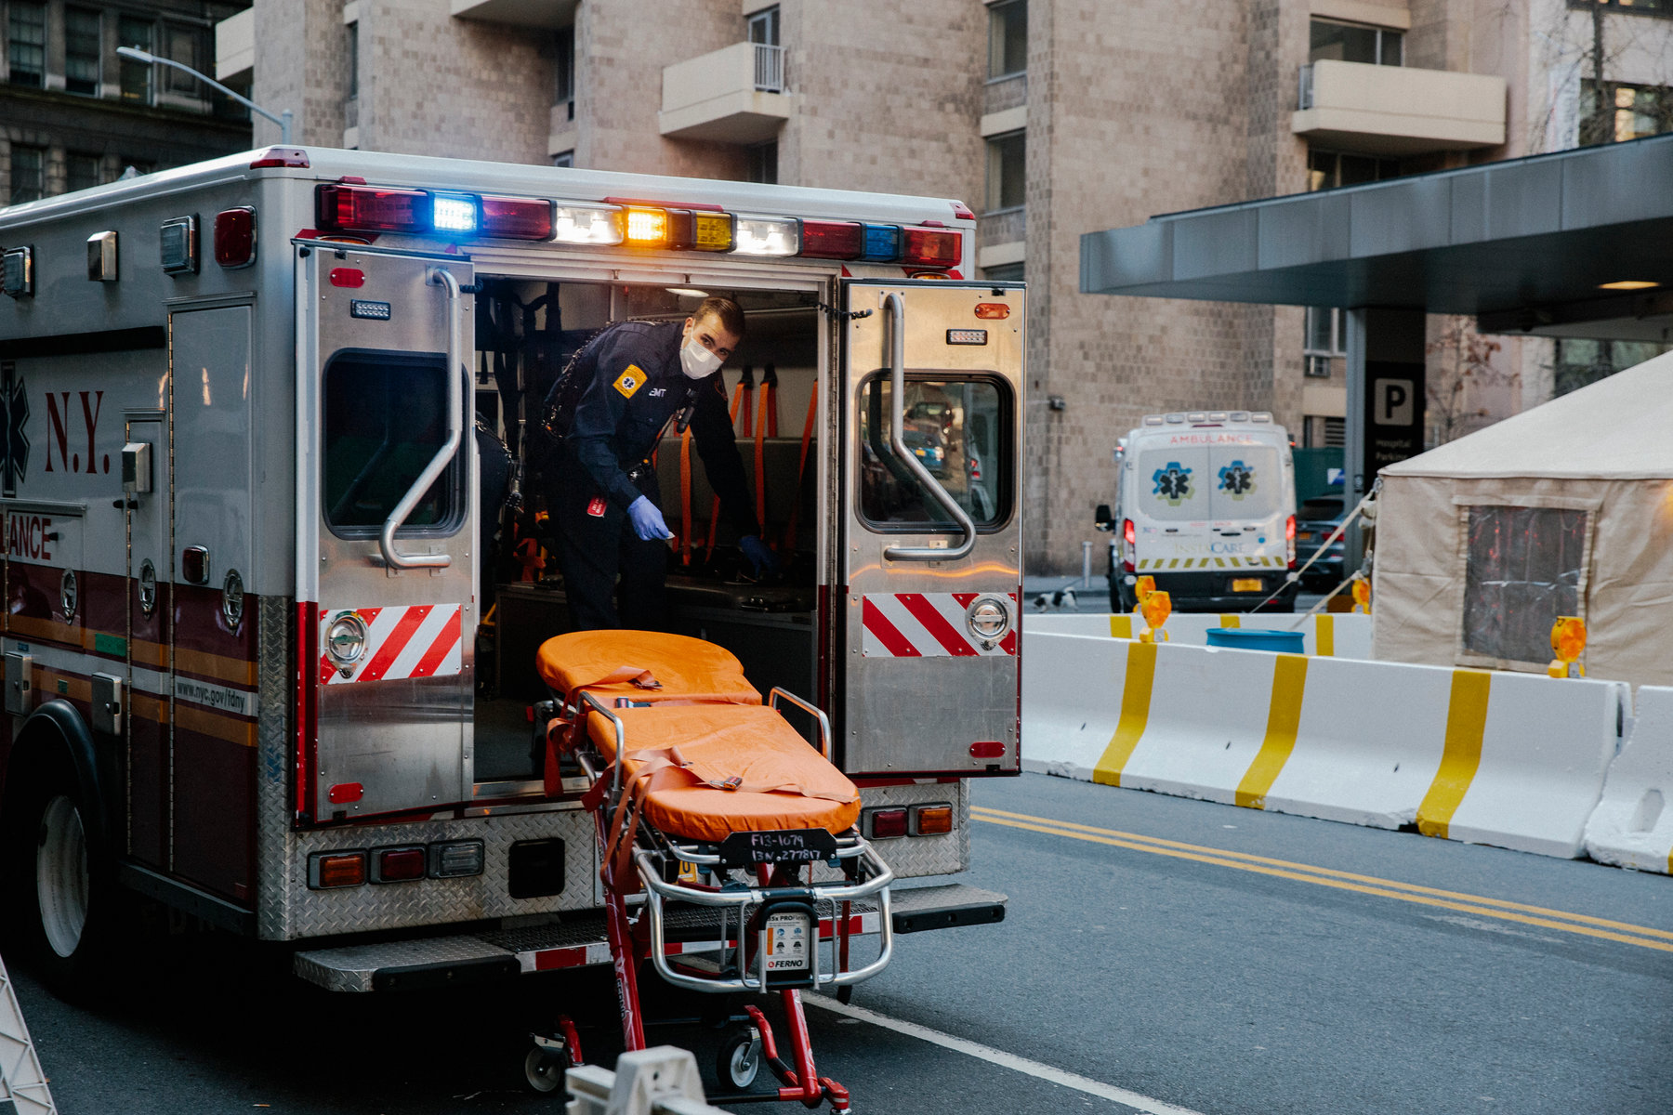
Jobs in My Town
Paramedic
Notes:
This Job…
Take emergency calls
Helps people when they are sick or hurt
Works with medicine
Drives a car with siren and lights

Slide 2
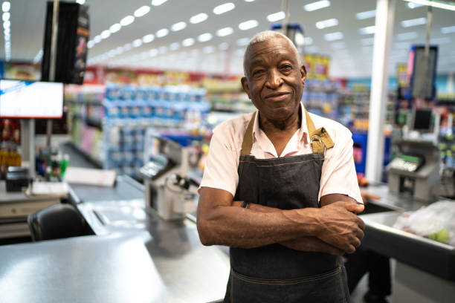
Jobs in My Town
Store Owner
Notes:
This Job…
Works with money such as dollars, coins, and credit cards.
This job works with food such as drinks and snacks.

Slide 3
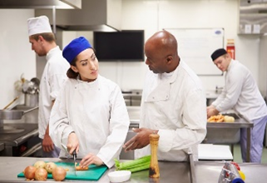
Jobs in My Town
Chef
Notes:
This Job…
Works on a team
Works with food
Works at a restaurant

Slide 4
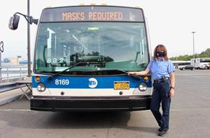
Jobs in My Town
Bus Driver
Notes:
This Job…
Works with money such as dollars, coins and cards.
Travels all over the city
Drives you to where you need to go

Slide 5
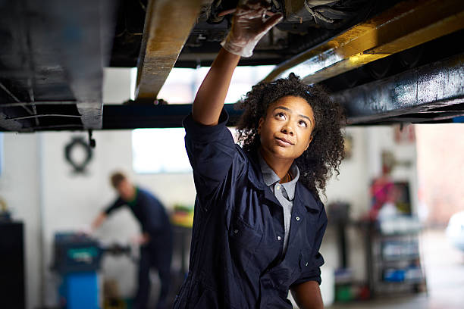
Jobs in My Town
Mechanic
Notes:
This Job…
Uses tools
Inspects your ca
fixes your car

Slide 6

Jobs in My Town
Nurse
Notes:
This Job…
Helps people when they are sick or hurt
Work with medicine
Give you a shot in your arm. OUCH!

Slide 7
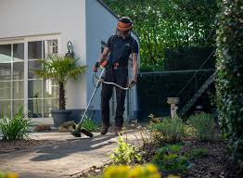
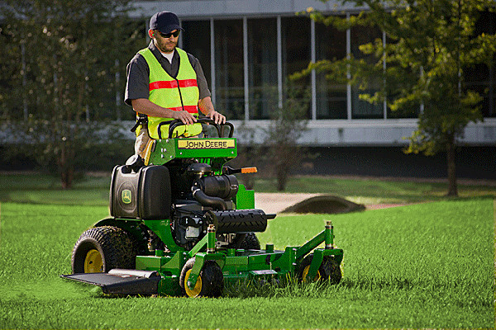
Jobs in My Town
Gardener
Notes:
This Job…
Works outside
Cuts grass
Plants flowers, grass, trees and more.

Slide 8
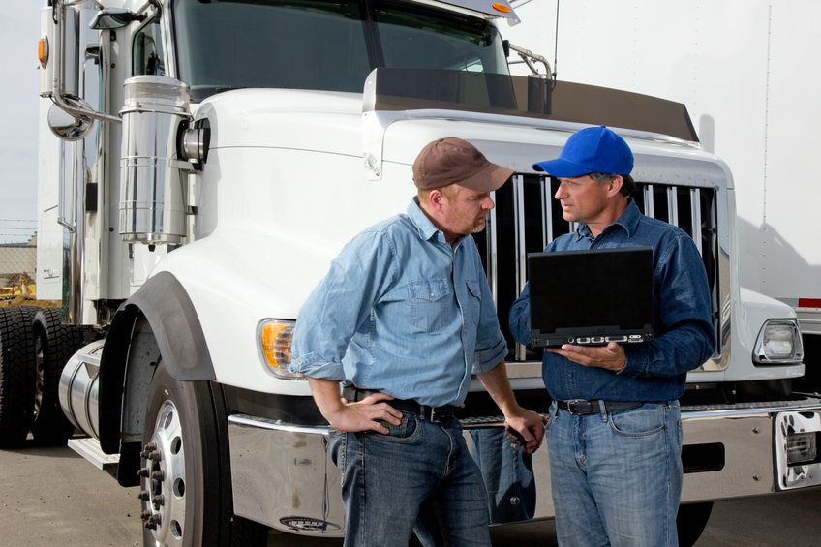
Jobs in My Town
Truck Driver
Notes:
This Job…
Drives a lot
Moves things from place to place.
Drives a BIG car

Slide 9
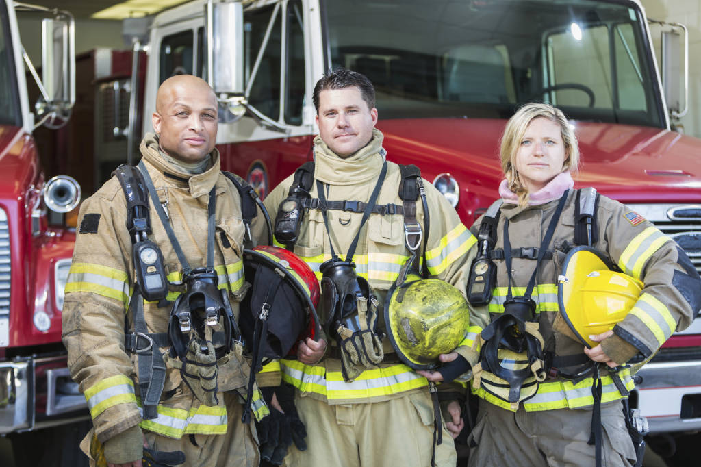
Jobs in My Town
Firefighter
Notes:
This Job…
Helps people
Drives a big truck with lights and a siren
Puts out fires

Slide 10

Jobs in My Town
Librarian
Notes:
This Job..
Helps people to research things
Works with computers
Works with books

Slide 11
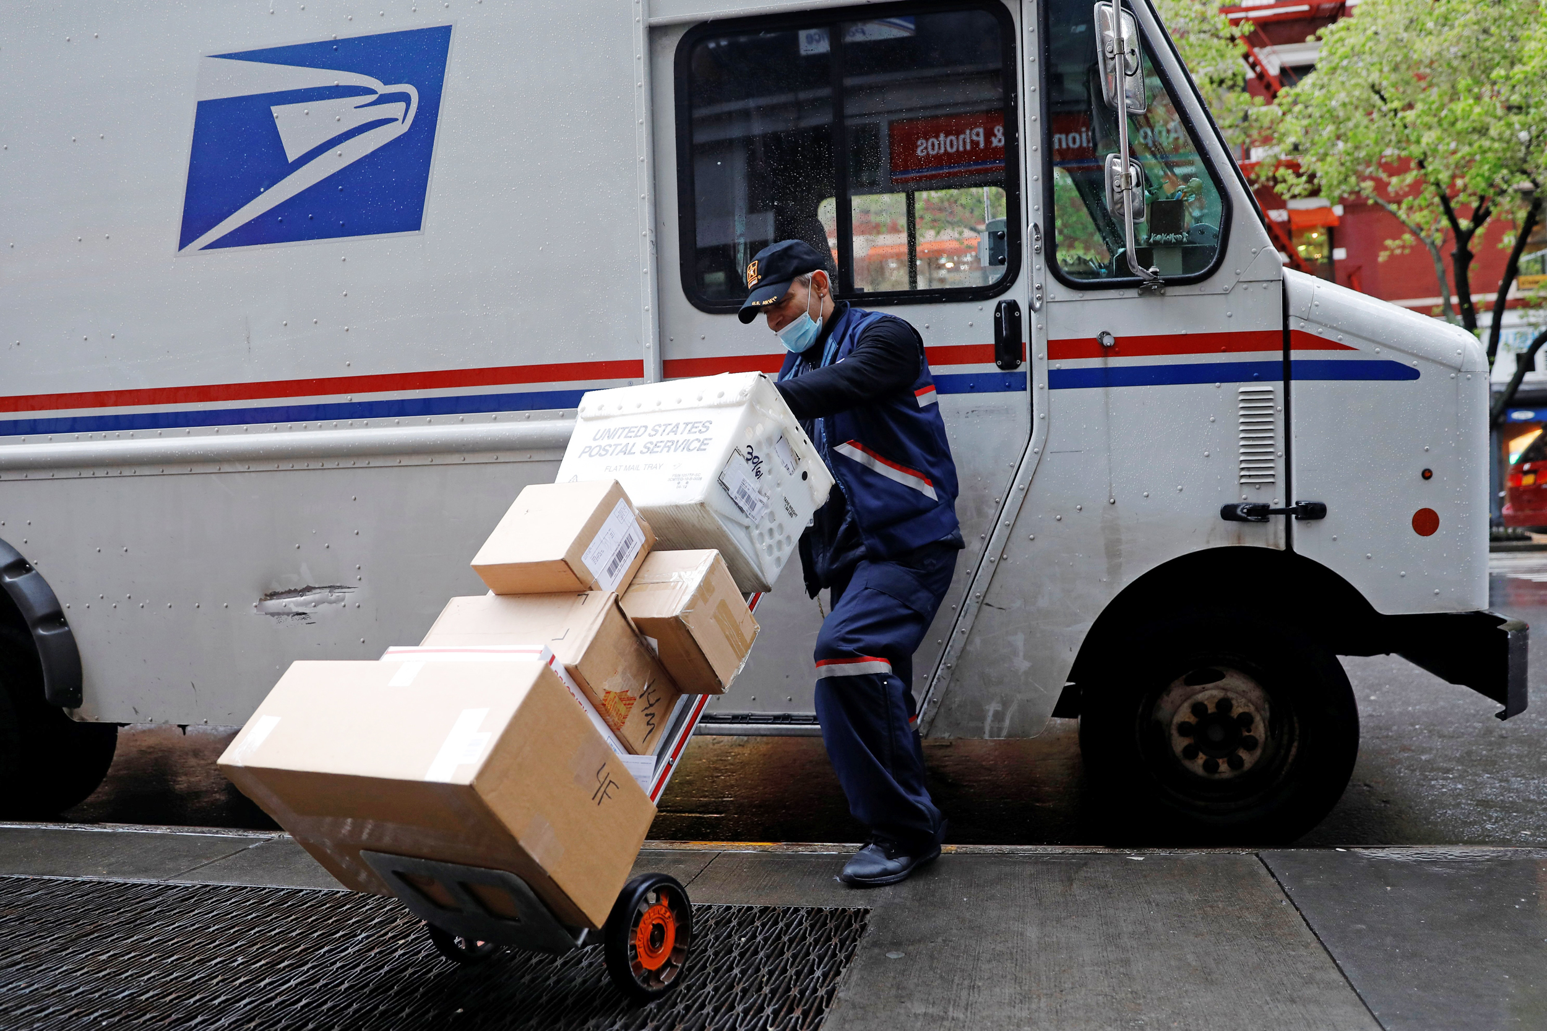
Jobs in My Town
Postal Worker
Notes:
This Job…
Travels around town
Delivers things to you house
Sorts letters and packages

Slide 12
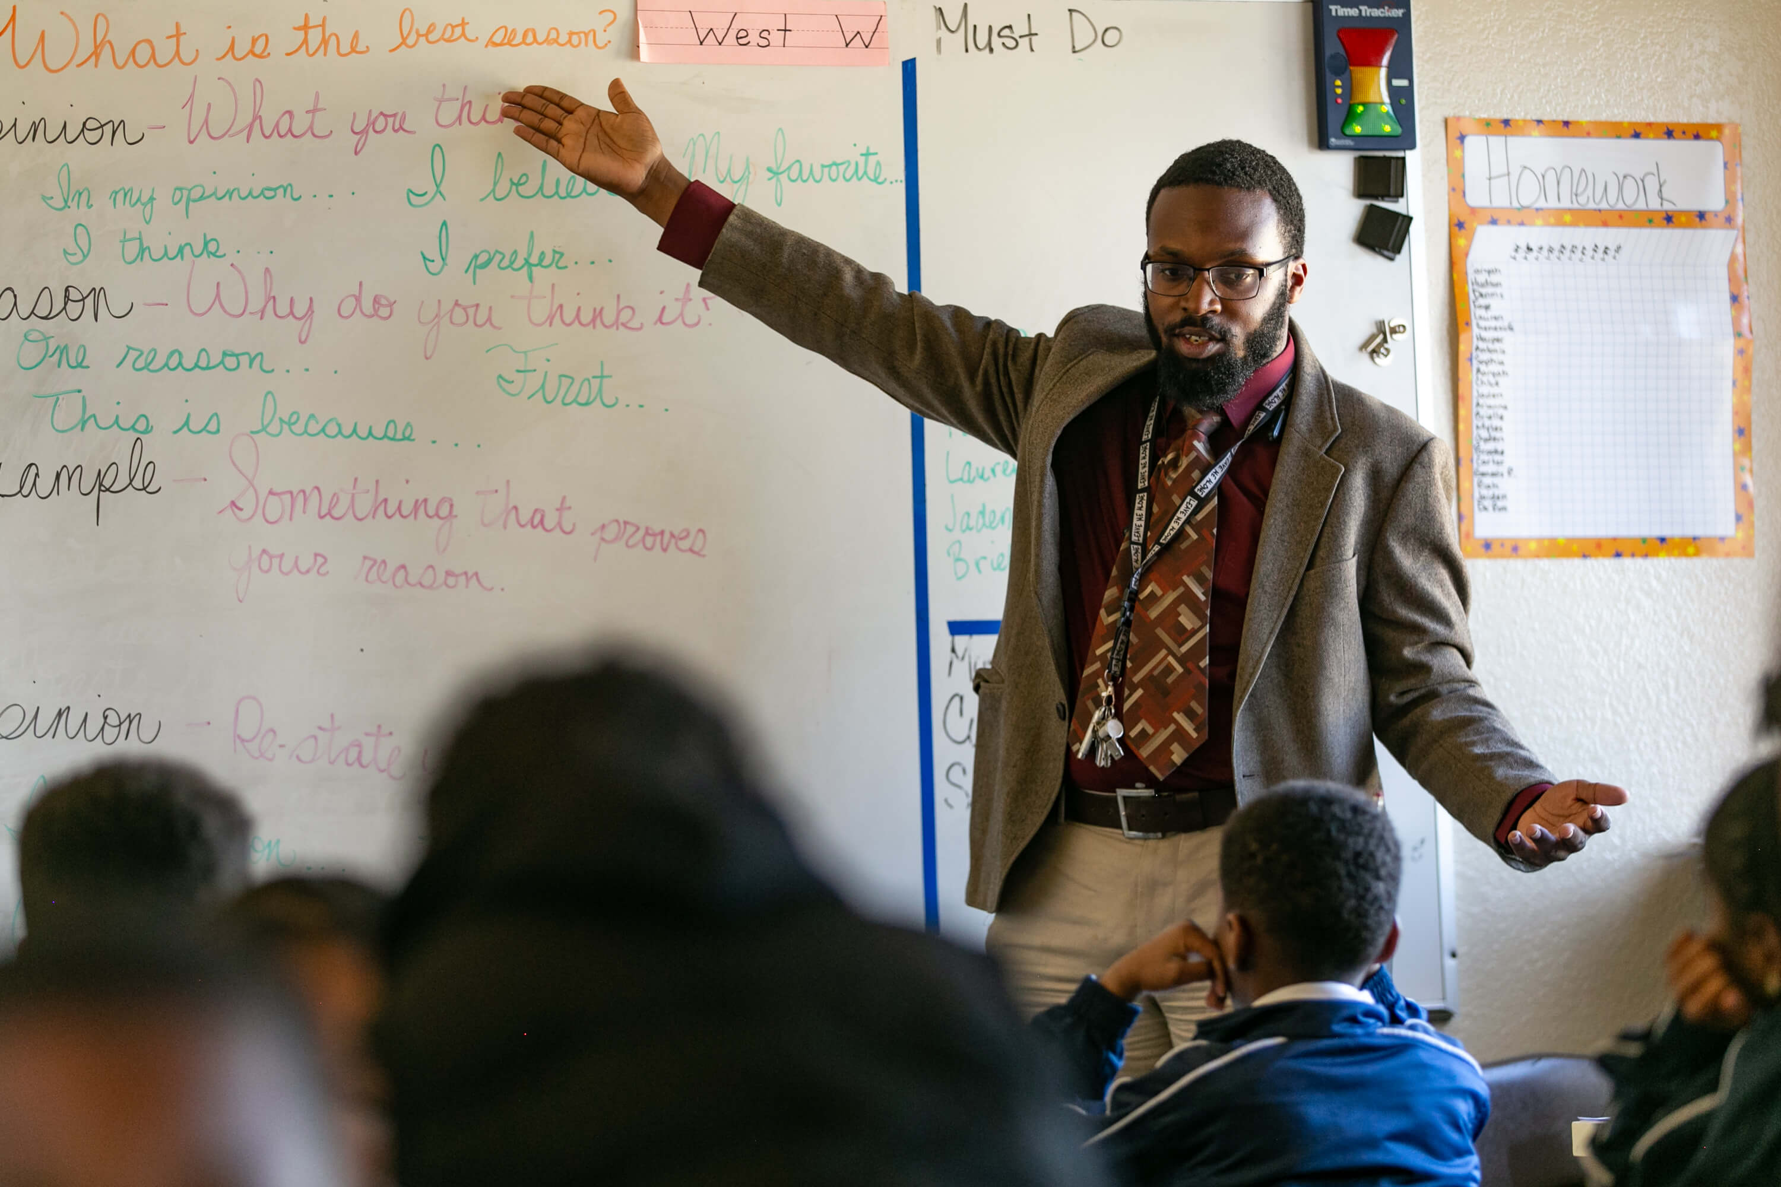
Jobs in My Town
Teacher
Notes:
This Job…
Works with books
Assigns Homework
Works with students just like you

Slide 13

Bus Driver
Gardener
Pharmacist
Restaurant Server
Teacher
Dentist
Nurse
Store Owner
Truck Driver
Librarian
Paramedic
Chef
Firefighter
Postal Worker
Mechanic
Garbage Collectors

Slide 14
Garbage Collectors
Librarian
Teacher
Truck Driver
Gardener
Mechanic
Postal Worker
Store Owner
Bus Driver
Nurse
Chef
Paramedic
Firefighter
Pharmacist
Restaurant Server
Dentist

Slide 15
Dentist
Postal Worker
Chef
Gardener
Bus Driver
Truck Driver
Garbage Collector
Store Owner
Firefighter
Paramedic
Librarian
Restaurant Server
Pharmacist
Mechanic
Nurse
Teacher

Slide 16
Pharmacist
Nurse
Garbage Collector
Store Owner
Dentist
Restaurant Server
Truck Driver
Mechanic
Gardener
Librarian
Postal Worker
Teacher
Bus Driver
Paramedic
Chef
Firefighter

Slide 17
Pharmacist
Nurse
Paramedic
Truck Driver
Librarian
Store Owner
Bus Driver
Teacher
Chef
Mechanic
Gardener
Postal Worker
Dentist
Firefighter
Garbage Collector
Restaurant Server

Slide 18
Garbage Collector
Nurse
Mechanic
Librarian
Chef
Paramedic
Postal Worker
Teacher
Dentist
Bus Driver
Gardener
Firefighter
Pharmacist
Restaurant Owner
Store Owner
Truck Driver

Slide 19
Paramedic
Firefighter
Postal Worker
Truck Driver
Store Owner
Chef
Teacher
Nurse
Mechanic
Pharmacist
Restaurant Server
Garbage Collector
Dentist
Bus Driver
Librarian
Gardener

Slide 20
Pharmacist
Firefighter
Garbage Collector
Paramedic
Store Owner
Nurse
Chef
Mechanic
Librarian
Dentist
Restaurant Server
Postal Worker
Teacher
Bus Driver
Gardener
Truck Driver

Slide 21
Teacher
Truck Driver
Paramedic
Mechanic
Dentist
Bus Driver
Nurse
Librarian
Postal Worker
Gardener
Firefighter
Garbage Collector
Store Owner
Chef
Restaurant Server
Pharmacist

Slide 22
Firefighter
Restaurant Server
Store Owner
Truck Drive
Gardener
Dentist
Teacher
Nurse
Pharmacist
Garbage Collector
Bus Driver
Chef
Mechanic
Postal Worker
Paramedic
Librarian

