Slide 1
Job Market Signaling
How do workers signal their expected productivity to prospective employers?

Slide 2
The Labor Market
Who are the buyers in the labor market?
Who are the sellers in the labor market?
What is the price in the labor market?
Questions to consider
Why might someone want to invest in their education?
How do employers know if they are hiring a productive employee?
How do firms earn profits?
Why is it important to have productive workers?

Slide 3
Why would an employer pay a higher wage?
Productivity: The ratio of output per worker per unit of time.
If a worker produces 2 widgets per hour and each widget sells for $5, the worker generates $10 in revenue.
If a worker produces 5 widgets per hour and each widget sells for $5, the worker generates $25 in revenue.
Key idea: Employers are generally willing to pay higher wages to workers who generate more revenue.
Profit = Revenue generated by worker − Wage paid

Slide 4
Simulation Rules (Round 1)
Job seekers may speak with more than one employer before accepting a job.
Employers may make offers to multiple job seekers.
Once a wage is agreed upon, the match is final for that round.
Each job seeker may accept only one job.
Any unmatched job seekers remain unemployed for that round.
Employers are the buyers of labor.
Job seekers are the sellers of labor.

Slide 5
Two Groups
Employers are the buyers of labor.
Job seekers are the sellers of labor.
Employer Goal: Hire the most-productive workers and pay them the lowest wage to increase the firm's profits.
Job Seeker Goal: Get hired...hopefully at the highest wage you can get.
Wage Range
Minimum wage: $7 per hour
Maximum wage: $23 per hour

Slide 6
Unemployment
According to the Bureau of Labor Statistics (BLS), a person is unemployed if they are
age 16 or older,
not institutionalized,
not currently employed, and
actively seeking work.
In this simulation: Job seekers who wanted a job at the going wage but did not find one represent unemployment in the labor market.

Slide 7
Education as a Signal (Round 2)
Simulation Rules
Employers will have two minutes to hire job seekers.
Employers should bid for employees within a range of $7 to $23.
Some job seekers will be unemployed.
Job seekers: Hold your cards so that employers can see the two-letter code.
Employers: Use the two-letter code and your key to predict worker productivity.

Slide 8
Education as a Signal Round 2
Human Capital: The knowledge and skills that people obtain through education, experience, and training.
Credential Key
DO = High school dropout
HS = High school diploma
AA = Associate’s degree
BA = Bachelor’s degree
MA = Master’s degree
Important: In this simulation, education credentials serve as signals of expected productivity.

Slide 9
Debrief Round 1 vs. Round 2
Why did cards with higher levels of education have higher productivity numbers in this simulation?
Why did employers want to hire job seekers with higher productivity?
Why did some job seekers not secure employment?
What might improve a job seeker’s chances of earning a higher wage?

Slide 10
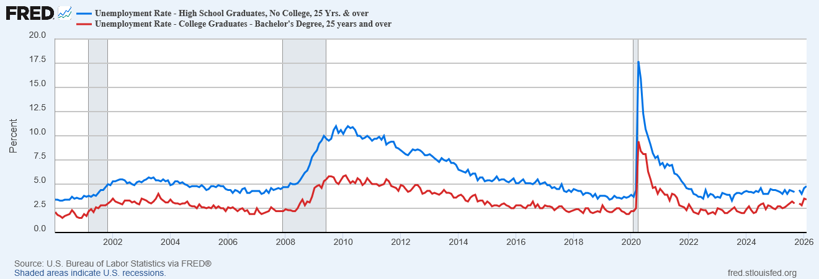
Differences in Unemployment by Education
How does this figure connect to what happened in the simulation?
U.S. Bureau of Labor Statistics, Unemployment Rate - High School Graduates, No College, 25 Yrs. & over [LNS14027660], Unemployment Rate - College Graduates - Bachelor's Degree, 25 years and over [CGBD25O], retrieved from FRED, Federal Reserve Bank of St. Louis; https://fred.stlouisfed.org/graph/?g=1U2Z5.

Slide 11
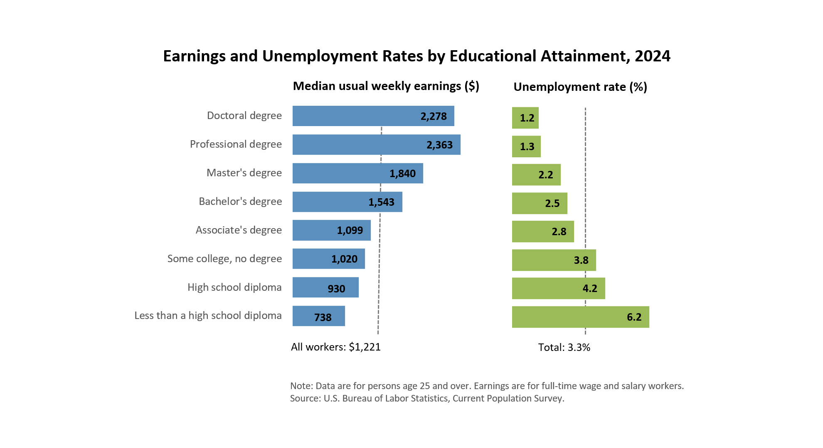
How do these data connect to what happened in the simulation?
https://www.bls.gov/emp/chart-unemployment-earnings-education.htm

Slide 12
Closing
Why were the wages offered in Round 2 more varied (and higher) than in Round 1?
Why might education credentials matter to job seekers in the labor market?
Why were employers more likely to hire job seekers with higher education credentials in Round 2? Why was that signal useful?
Why were some job seekers not hired even when they wanted a job?

