Slide 1
Have you ever borrowed money from someone?
What are some examples of things for which you have borrowed money?
Have you ever lent money to someone?
How did the person who borrowed the money spend it?

Slide 2
Loan – A sum of money provided temporarily on the condition that the amount borrowed be repaid, usually with interest.

Slide 3
Interest – The price of using someone else's money.
Interest rate – The percentage of the amount of a loan that is charged for the loan and must be repaid (in addition to the amount borrowed) over a specified time period.

Slide 4

Annual percentage rate (APR) – The percentage cost of credit on an annual basis. Lenders are required by law to disclose APRs to borrowers.
An APR may differ from the stated interest rate because APR includes the fees and costs related to the loan.
An APR is the total cost of credit a consumer pays per year of a loan.

Slide 5
Annual Percentage Rate (cont.)
The fees and costs vary depending on the type of loan you’re applying for.
Some examples of possible fees are processing fees, underwriting fees, document fees, and appraisal fees.
The APR gives you an easy way to compare loan rates.
Generally, the lower the APR the better.

Slide 6
Annual Percentage Rate (cont.)
When you apply for a loan, you should always be able to see both the interest rate and the APR.
The APR does not affect the monthly payment on a loan. Monthly payments are a function of the interest rate and the length of the loan.

Slide 7
Information Needed To Calculate an APR
The amount of credit—the amount of the loan—to be received
The dollar amount of the credit costs—that is, the dollar amount of fees and interest charges associated with the loan
The length (term) of the loan

Slide 8
Click the link to the APR calculator and calculate the APR of each loan:
APR Calculator
1. Credit = $3,000
Fees and interest rate = $50 and 7%
Term = 24 months
2.
Credit = $3,000
Fees and interest rate = $100 and 6%
Term = 24 months

Slide 9
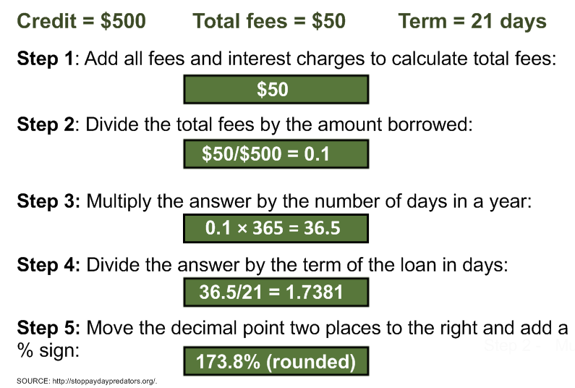

Slide 10
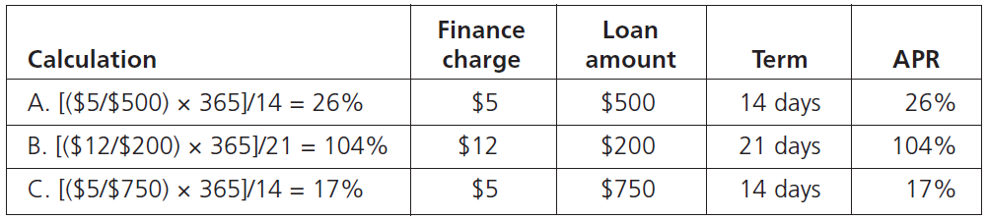
Handout 8.1—Answer Key

Slide 11

Have you or people you know used short-term loans to buy things?
Have you ever heard advertisements for payday loans?

Slide 12
Payday loan – Usually a small, short-term loan intended to cover a borrower's expenses until his or her next payday.
Also called a “paycheck advance” or “payday advance”
Initial term is usually two weeks
Sometimes called “cash advances” (although that term can also refer to cash provided through a prearranged line of credit, such as a credit card)

Slide 13
Payday Loan Facts
The term of a payday loan is usually two weeks—until the next paycheck—and the loan (the amount borrowed plus fees) must be paid back in full at the end of the term.
Lenders charge “rollover fees” when borrowers want to extend the loan beyond the original term.
Annual percentage rates (APRs) are commonly 390 percent to 780 percent when loan fees and rollover fees are included.
A typical payday loan is about $375.

Slide 14
Payday Loan Facts (cont.)
The borrower can give a postdated check to a lender to be held until the next paycheck is deposited.
Approximately 91 percent of borrowers are unable to repay their payday loans at the end of a term.
Approximately 99 percent of payday loans go to repeat borrowers, and government reports conclude that the industry relies on repeat (rollover) borrowers.
Fees paid on payday loans that exceed 90 days amount to approximately $4.2 billion annually.

Slide 15
Payday Loan Facts (cont.)
Currently, 14 states and the District of Columbia prohibit payday loans; nine states allow only low-cost payday loans by severely restricting the interest rate and fees payday loan companies can charge. Many other states in which payday loans are legal restrict some payday lender practices by prohibiting rollover loans or loan refinancing.
Payday lenders have partnered with national banks in some states to avoid state prohibitions and restrictions.
SOURCE: http://www.paydayloaninfo.org/; http://www.pewtrusts.org/en/research-and-analysis/reports/2012/07/19/who-borrows-where-they-borrow-and-why; http://www.responsiblelending.org/; and http://www.stlouisfed.org/publications/br/articles/?id=524.

Slide 16

What is the amount of a typical payday loan?
$375
What fees are charged for a payday loan?
Loan fees and, if the loan extends past the initial term, rollover fees
When rollover fees are included, what is the common range of APRs for payday loans?
About 390 percent to 780 percent, depending on the amount and length (term) of the loan

Slide 17
What percentage of borrowers do not repay their payday loans?
About 91 percent
What percentage of payday loans go to repeat borrowers?
99 percent

Slide 18
Do any states prohibit or greatly restrict payday loans?
Yes—as of 2019, 14 states and the District of Columbia prohibit payday loans; nine states allow only low-cost payday loans by severely restricting the interest rate and fees payday loan companies can charge. Many other states in which payday loans are legal restrict some payday lender practices by prohibiting rollover loans or loan refinancing.
SOURCE: National Conference of State Legislatures, http://www.ncsl.org/default.aspx?tabid=12473; and Consumer Federation of America Payday Loan Consumer Information, http://paydayloaninfo.org/.

Slide 19
Review
What is a loan?
A loan is a sum of money provided temporarily on the condition that the amount borrowed be repaid, usually with interest.
What is interest on a loan?
Interest is the price of using someone else’s money.

Slide 20
Review
What is an APR (annual percentage rate)?
An APR is the percentage cost of credit on an annual basis; it is the total cost of credit a consumer pays per year of a loan. It combines the interest paid over the life of the loan and all fees that are paid up front, which together are called finance charges.

Slide 21
Review
Why is it important for consumers to know what an APR is and be able to calculate it?
An APR is the total cost of credit to the consumer and allows the consumer to compare loan options and to make better-informed decisions.

Slide 22
Review
What help is available online for consumers to determine the APRs of long-term loans such as car loans and mortgages?
APR calculators are available online.
What loan information must a consumer have to use an APR calculator?
The dollar amount of the loan, the length (term) of the loan, and the amount of credit costs (fees and interest charges)

Slide 23
Review
What are the steps for calculating the APR of a short-term loan?
Step 1: Add all fees and interest charges to calculate total fees.
Step 2: Divide the total fees by the amount financed (borrowed).
Step 3: Multiply the answer by the number of days in a year—365.
Step 4: Divide the answer by the term of the loan in days.
Step 5: Move the decimal point two places to the right and add a % sign.

Slide 24
Review
What is a payday loan?
A payday loan is a small, short-term loan intended to cover a borrower’s expenses until his or her next payday.
What are the disadvantages of payday loans?
Disadvantages of payday loans include high APRs, additional fees, and increased debt.

Slide 25
Review
Why do people use payday loans?
People generally use payday loans for emergencies, to buy goods and services they want, or to pay a bill when they don't have enough money to do so.

