Slide 1

How would you obtain goods and services if you did not have any money?

Slide 2
Credit Costs
Katarina Smavern is 18 and wants a new laptop that costs $500. She doesn’t have that much money saved. Her friend tells her, though, about a credit card promotion at a local electronics store. Katarina heads to the store and opens an account; she can buy the laptop and take it home with her that day. She is so excited that she doesn’t give much thought to the 21 percent interest rate. “I have a job now,” she thinks to herself, “So I’ll be able to pay this off in no time. The interest rate doesn’t really matter because the minimum monthly payment isn’t very much.” Katarina buys the laptop, takes it home, and pays only the minimum payment due each month.

Slide 3
Credit Costs (cont.)
What interest rate was Katarina charged for using the credit card? 21 percent
An interest rate is the percentage of the amount of a loan that is charged for the loan.
Once Katerina pays off the laptop, how much interest will she have paid? $197.00 ($697.00 − $500.00 = $197.00)
What could Katarina have done to reduce the amount of interest she paid? Paid more than the minimum payment each month or obtained a lower interest rate

Slide 4
Credit Costs (cont.)
If Katarina had paid only $10 more each month, she would have made only 31 payments. She would have spent only $605 for the $500 laptop.
How might missing a payment affect Katarina’s ability to get credit in the future? Creditors look at credit history, so not paying bills on time could negatively affect Katarina’s ability to get credit in the future.

Slide 5
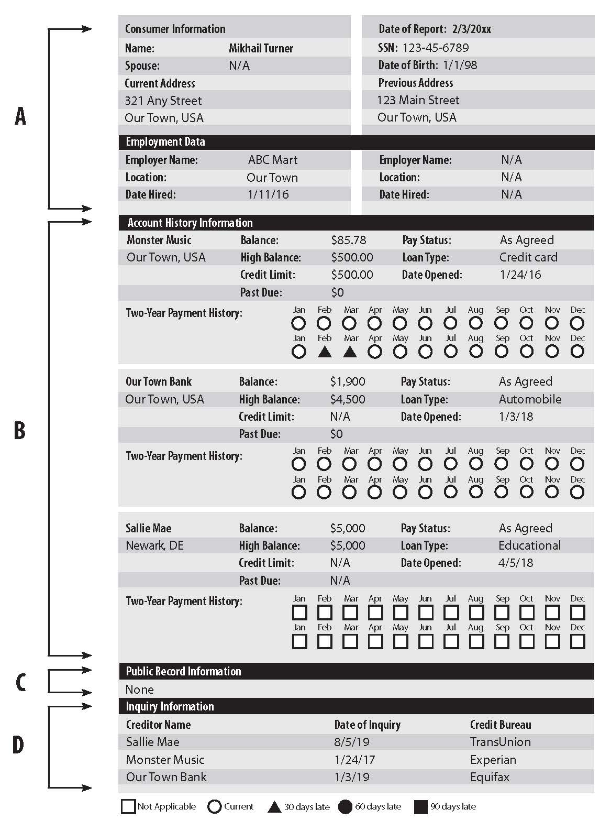

Slide 6
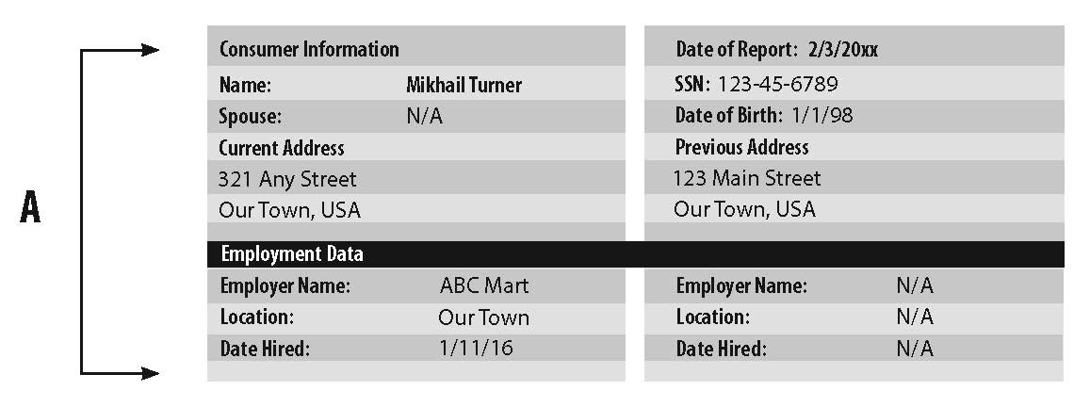

Slide 7
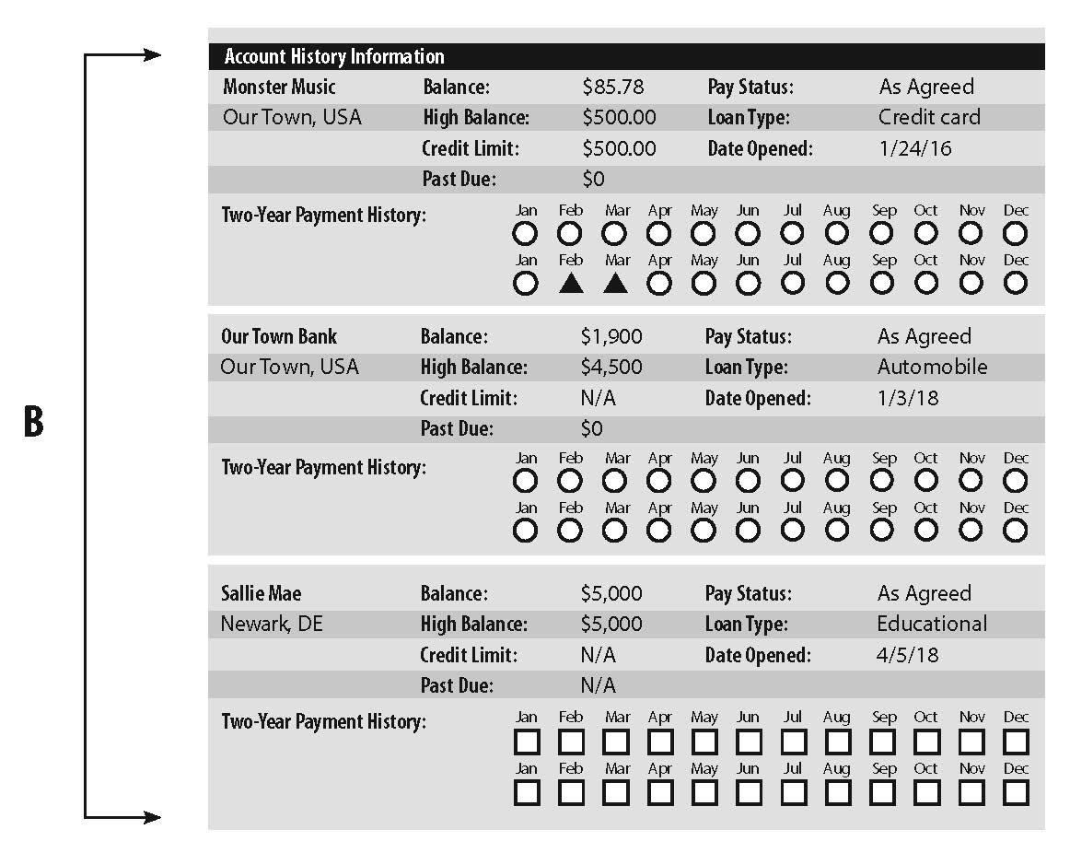

Slide 8
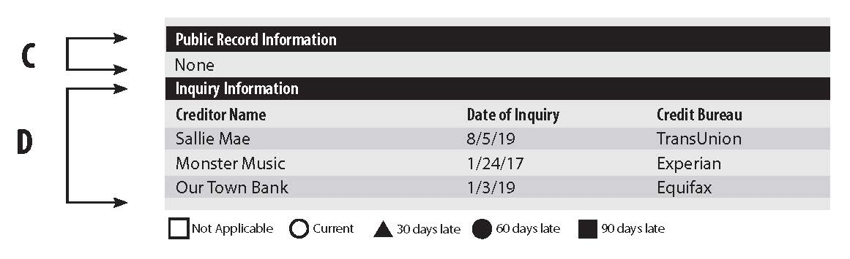

Slide 9
Credit score ‒ A number based on the information provided in a credit report that indicates a person’s credit risk.
Understanding How a FICO Credit Score is Determined
https://www.stlouisfed.org/education/continuing-feducation-video-series/episode-1-understanding-how-a-fico-credit-score-is-determined

Slide 10

Keys to Establishing and Maintaining Credit (and Saving Money)
Establish a credit history.
For example, open a bank account or purchase a cell phone contract.
Pay all your bills on time each month.
Payments 30 days or more late will be noted on your credit records.
You will avoid expensive late fees if you pay your bills on time.

Slide 11
Keys to Establishing and Maintaining Credit (and Saving Money) (cont.)
Pay all your bills in full each month.
The less you owe, the better your credit history will look to potential creditors.
You will avoid interest charges if you pay your bills in full each month.
Don’t open too many credit card accounts.
Every credit card account you have appears on your credit report.
Even if you don't use a credit account that appears on your credit report, creditors will consider how much you could potentially spend if you used all of your accounts.

Slide 12
Keys to Establishing and Maintaining Credit (and Saving Money) (cont.)
Monitor your credit card usage.
Check you monthly credit card statements to make sure that you have not been charged for something you did not purchase. If you have, call the credit card company immediately. Your credit card—or at least your account number—may have been stolen.
Evaluate the interest you are charged each month (if you do not pay your credit cards in full each month) and create a plan so you can pay down your debt and then pay off your cards in full each month.

Slide 13
Keys to Establishing and Maintaining Credit (and Saving Money) (cont.)
Check you credit reports each year.
Request a free copy of your credit report from each of the three credit bureaus annually.
Clear up any inaccuracies on your credit reports.

Slide 14
Keys to Establishing and Maintaining Credit (and Saving Money) (cont.)
A good credit report is key to a good credit score.
Understand what a good credit score means for you.
  You will qualify for lower interest rates when purchasing large items such as a car or a house.
  You will have lower insurance rates.
A good credit score is important because it might help you get a job and rent an apartment.

Slide 15

Review
What is credit?
Credit is the granting of money or something else of value in exchange for a promise of future repayment.
Who are creditors?
Creditors are people, financial institutions, or businesses that lend money.

Slide 16
Review
What is interest?
Interest is the price of using someone else’s money.
What is an interest rate?
An interest rate is the percentage of the amount of a loan that is charged for a loan.

Slide 17
Review
What are some of the advantages of using credit?
Examples include the following:
Convenience
Buying and using things now while paying for them later
Buying more expensive items you couldn’t afford to pay for all at once (e.g., a car or house)
Not having to carry cash
Being able to pay for things in an emergency
Having expenditures tracked
Possibly receiving perks (e.g., cash back)

Slide 18
Review
What are some of the disadvantages of using credit?
Examples include the following:
Spending money you don’t have
Buying more than you can afford
Paying more than you would if you paid cash
Having a greater likelihood of identify theft
If you use credit poorly, the inability to get credit in the future or the loss of opportunities

Slide 19
Review
Why is it best to pay your credit card balance in full each month?
The less you owe, the better your credit history will look to potential creditors. You will avoid paying large amounts of interest.
If you can’t pay the entire balance each month, what should you do?
You should make the largest payment possible to avoid larger interest payments.

Slide 20
Review
What is a credit history?
A credit history is a record of a person’s payment activity or behavior over a period of time.
Why is it important to establish and maintain a good credit history?
Your credit history affects many aspects of your life. A poor credit history results in higher interest and difficulty obtaining credit in the future. It can also prevent you from renting an apartment or even getting a job.

Slide 21
Review
What is a credit report?
A credit report is a loan and bill payment history kept by a credit bureau.
How are credit reports used by financial institutions and other potential creditors?
They review credit reports of potential borrowers to determine the likelihood that a future debt will be repaid and may or may not grant credit.

Slide 22
Review
What is a credit bureau?
A credit bureau is an organization that compiles credit information on individuals and makes it available to businesses for a fee.
What are the three credit bureaus?
Equifax, Experian, and TransUnion

Slide 23
Review
What is a credit score?
A credit score is a number based on information in a credit report that indicates a person’s credit risk.
How can you establish and maintain good credit?
You can establish a credit history, pay your bills on time and in full, not open too many credit card accounts, monitor credit card usage, and check your credit report.

