Slide 1
What does it mean to be a saver?
What do you suppose it means to be a savvy saver?

Slide 2
Saving – Not spending on current consumption or taxes.

Slide 3
Non-interest-bearing account – An account in which no interest is paid on the principal; also called a zero-interest account.
Principal – The original amount of money deposited or invested, excluding any interest.

Slide 4
Interest – The price of using someone else’s money.

Slide 5
Compound interest – Interest paid on the sum of the original principal and accrued (accumulated or earned) interest.

Slide 6
Maria’s Savings Decision
Interest compounded semiannually is added to the principal in an account every six months.
Principal = $1,000
Interest rate = 5% paid semiannually (every 6 months)
Step 1: Convert the annual interest rate to a decimal:
5% = 0.05

Slide 7
Maria’s Savings Decision
Principal = $1,000
Interest rate = 5% paid semiannually (every 6 months)
Step 2: Divide the annual interest rate (as a decimal) by 2 to determine the interest paid every six months:
0.05 ÷ 2 = 0.025

Slide 8
Maria’s Savings Decision
If interest were compounded quarterly, you would divide the interest rate by 4. If interest were compounded every two months, you would divide the rate by 6. If interest were compounded every month, you would divide by 12.

Slide 9
Maria’s Savings Decision
Principal = $1,000
Interest rate = 5% paid semiannually (every 6 months)
Step 3: Multiply the principal by the interest rate to get the amount paid in dollars. Round to the nearest hundredth.
At 6 months: $1,000.00 × 0.025 = $25.00

Slide 10
Maria’s Savings Decision
Principal = $1,000
Interest rate = 5% paid semiannually (every 6 months)
Step 4: Add the principal and interest to get the new principal.
At 6 months: $1,000.00 + $25.00 = $1,025

Slide 11
Maria’s Savings Decision
Principal = $1,000
Interest rate = 5% paid semiannually (every 6 months)
Step 5: Repeat steps 2 and 3 to calculate interest and principal for each six-month time period.

Slide 12
Maria’s Savings Decision
Principal = $1,000
Interest rate = 5% paid semiannually (every 6 months)
Step 3 (repeated): Multiply the principal by the interest rate to get the amount paid in dollars. Round to the nearest hundredth.
At 12 months: $1,025.00 × 0.025 = $25.63

Slide 13
Maria’s Savings Decision
Principal = $1,000
Interest rate = 5% paid semiannually (every 6 months)
Step 4 (repeated): Add the principal and interest to get the new principal.
At 12 months: $1,025.00 + $25.63 = $1,050.63

Slide 14
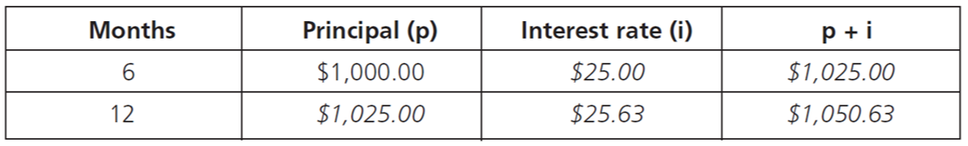
Interest Compounded Semiannually

Slide 15
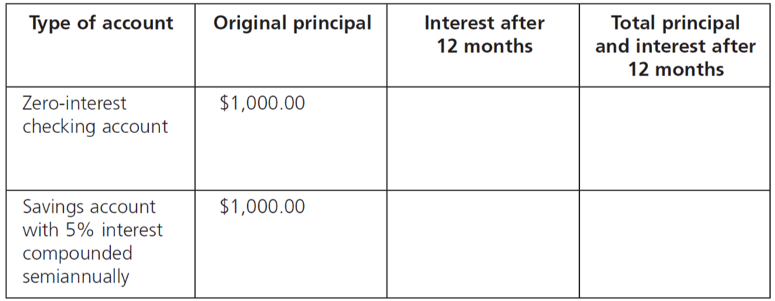
2. Fill in the chart for Maria’s two savings options.

Slide 16
3. Maria lost $_______ by keeping her money in a non-interest-bearing account rather than putting it in an account that paid a 5% interest rate compounded semiannually.

Slide 17
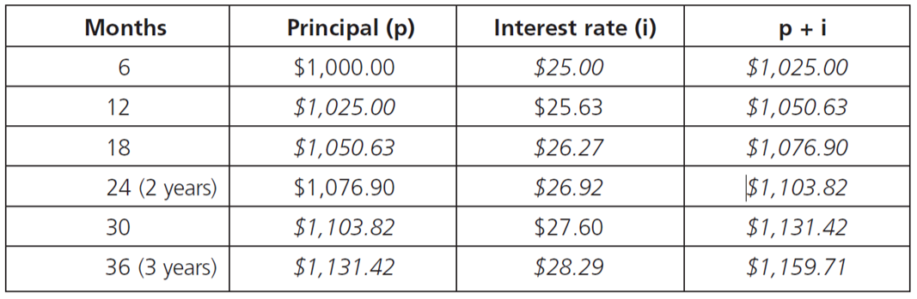
4. Completed chart:

Slide 18


What could Maria have bought with the $50.63 of interest she might have earned on her savings?
Would Maria be classified as a saver or a savvy saver? Why?
Saver. She didn’t invest her money in a way that would give her a return on her investment—that is, an account that would pay her interest on her principal.

Slide 19
Why might Maria have kept her $1,000 in a non-interest-bearing account?
Possibilities: She was financially lazy—not proactive. She may not understand the importance of compound interest.

Slide 20
Imagine that instead of $1,000, Maria’s grandmother had given her $10,000. After three years, how much interest would $10,000 earn at a 5% interest rate compounded semiannually?
$1,596.93

Slide 21
Why is time—that is, the number of months you have your money in an interest-bearing account—a very important factor in accumulating savings?
The sooner you start saving, the sooner you start earning interest—not only on your principal but also on accrued interest. Your money works for you over time.

Slide 22
How long would it take for Maria’s $1,000 to double if she kept the money in a
non-interest-bearing account?
It would never double.
How long do you think it will take Maria’s
$1,000 to double if she puts the money in a savings account that pays compound interest?

Slide 23
The rule of 72 – A method to estimate the number of years it will take for a financial investment (or debt) to double in value at a given annual interest rate.

Slide 24
72 ÷ 5 = 14.4

Slide 25
The rule of 72
assumes people leave their money in an account without taking away from or adding to it,
is not an exact number, and
serves as a good estimate.

Slide 26
How can compound interest help people achieve their financial goals?
Investing savings in accounts that earn compound interest allows savings to grow faster. More savings helps people achieve financial goals.

Slide 27
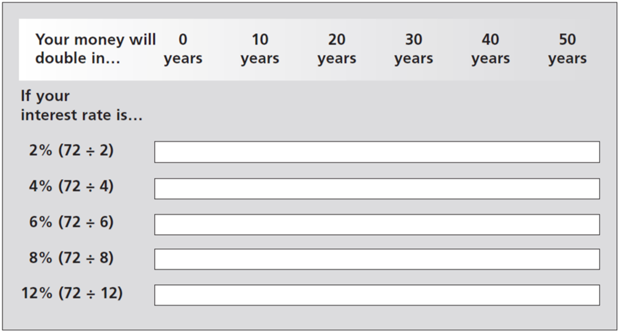
The Rule of 72

Slide 28
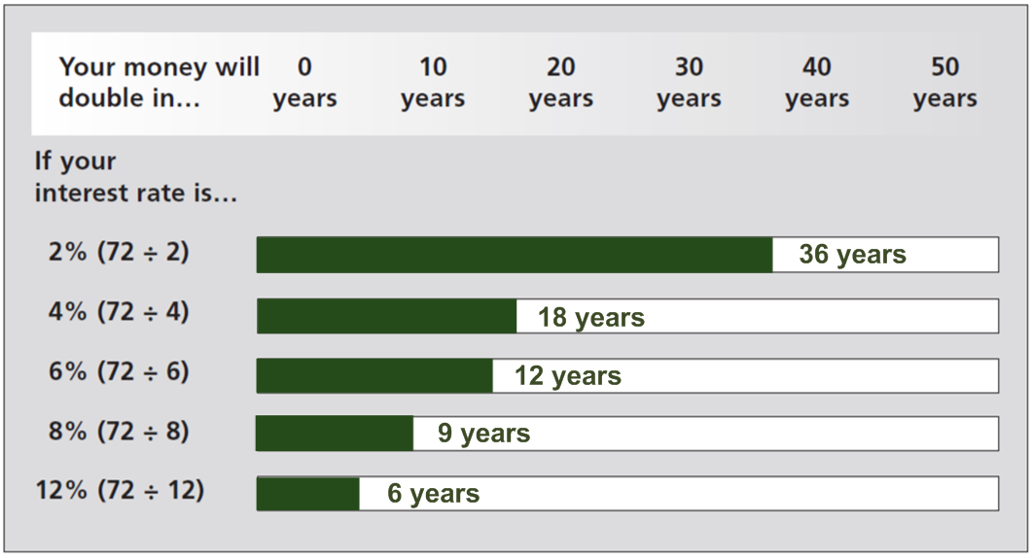
The Rule of 72—Answer Key

Slide 29
Does the amount of interest an account pays have much of an impact on how long it will take for your money to double?
Yes. The higher the interest rate, the less time it will take for your money to double.

Slide 30
The risk-reward relationship – The idea that there is a direct relationship between risk of the loss of principal and the expected rate of return. The higher the risk of loss of principal for an investment, the greater the potential reward. Conversely, the lower the risk of loss of principal for an investment, the lower the potential reward.

Slide 31
What annual interest rate do credit cards charge?
Interest rates on credit cards vary over time and under different financial conditions in the economy, but generally credit cards charge a relatively high interest rate.

Slide 32
If a credit card charges an 18% annual interest rate, approximately how long will it take for your debt to double if you made no payment or only the minimum payment on the debt?
4 years; 72 ÷ 18 = 4

Slide 33
Review
What is a non-interest-bearing account?
A non-interest-bearing account is one that pays zero interest on principal.
What is interest?
Interest is the price of using someone else’s money.

Slide 34
Review
What is compound interest?
Compound interest is interest computed on the original principal and accrued interest.

Slide 35
Review
What interest rate would a savings account or a low-risk investment likely pay—would it be a low, medium, or high interest rate—and why?
They would each pay a low interest rate because of the risk-reward relationship.

Slide 36
Review
What does the rule of 72 estimate?
The rule of 72 estimates the number of years it will take for a financial investment—or debt—to double in value at a given interest rate.

Slide 37
How can compound interest help people achieve their financial goals?
Compound interest allows savings to grow more quickly. This means people have more saving to put toward their financial goals.

Slide 38
Why is time—that is, the number of months you have your money in an interest-bearing account—a very important factor in accumulating savings?
The sooner you start saving, the sooner you start earning interest—not only on your principal but also on accrued interest. Your money works for you over time.

Slide 39
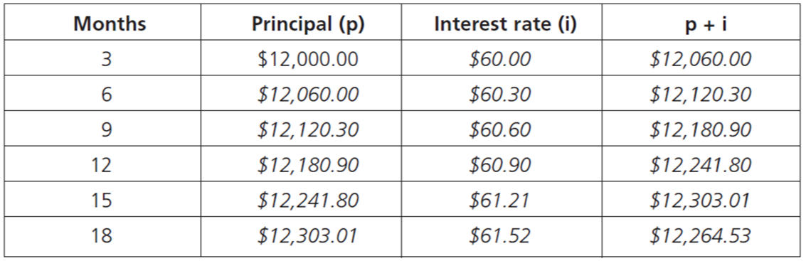
Handout 5.3: Charlie’s Financial Goal—Answer Key

Slide 40
How long will it take Charlie’s money to double with a 2% interest rate compounded quarterly?
36 years (72 ÷ 2 = 36)

Slide 41
How will compound interest help Charlie meet his financial goal?
Even 2% interest compounded quarterly allows Charlie’s savings to grow. He’ll earn interest on the principal in his account and on the interest he earns. He’ll have more money in two years than he would if he had the money in a non-interest-bearing account.

Slide 42
Charlie wants to explain the risk-reward relationship to his nephew, who is a sophomore in high school. If you were Charlie, how would you explain the relationship?

Slide 43
When you invest your money, the higher the risk of losing your principal (the money you deposit) for an investment, the higher the potential reward. So, relatively safe places to put your money—in a savings account at a bank, for example—yield a relatively low reward because the risk of losing your principal is very low.

