Slide 1
The Inflation Rate Is Falling but Prices Are Not
Lesson & Classroom Activity

Slide 2
Compelling Question If the inflation rate is falling, why aren't prices falling?

Slide 3
What was the cost of a McDonald's burger in the 1970s?

Slide 4
Inflation, Deflation
Inflation – A general, sustained upward movement of prices for goods and services in an economy. Average level of prices in an economy is increasing.
Deflation – A general, sustained downward movement of prices for goods and services in an economy. Average level of prices in an economy is decreasing.

Slide 5
Inflation Rate, Price Level
Inflation rate – The percentage increase in the average price level of goods and services over a period of time.
Price level – A weighted average of the prices of goods and services in the economy, such as the consumer price index.

Slide 6
The inflation rate is falling but (the average level of) prices have not.

Slide 7
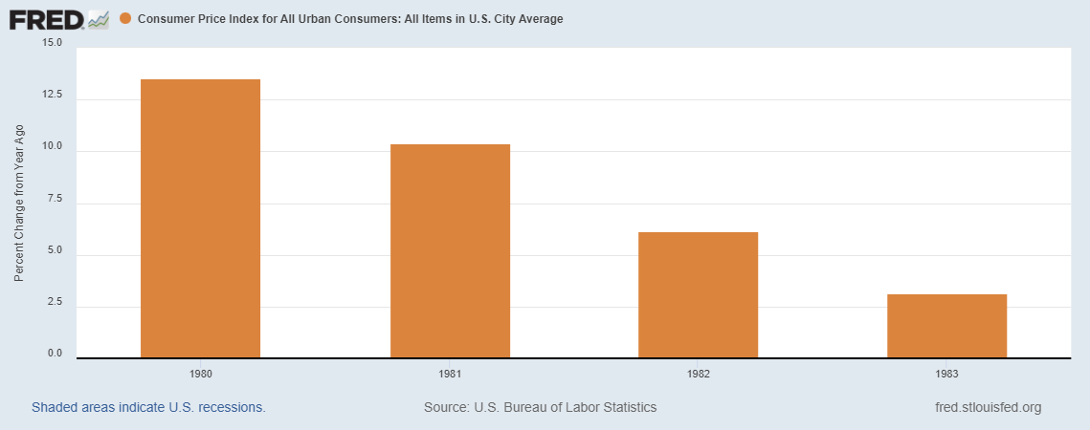
1980-1983
View interactive graph
Inflation Rate

Slide 8
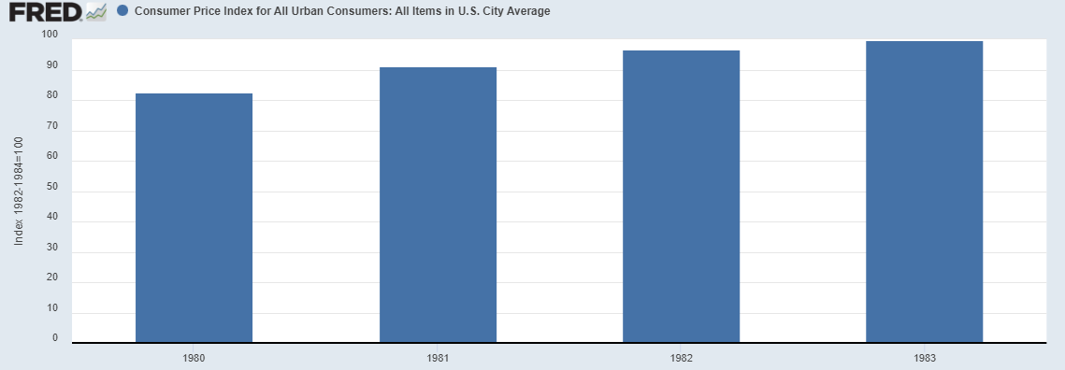
1980-1983
View interactive graph
Inflation Rate
Consumer Price Index
View interactive graph

Slide 9
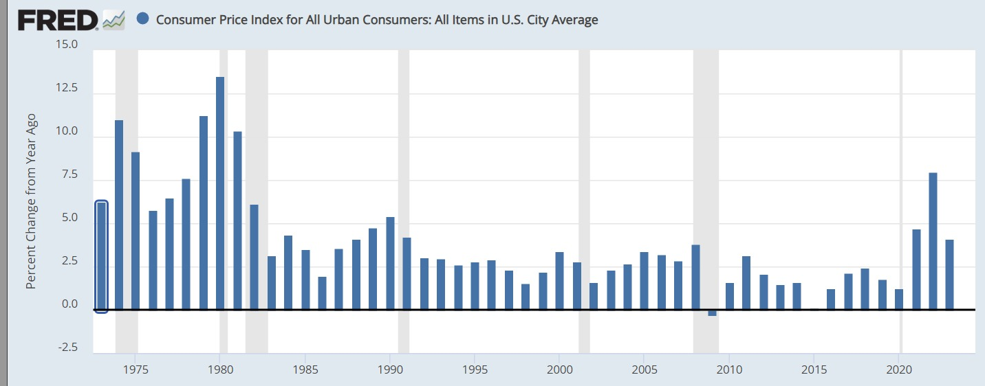
Inflation Rate
View interactive graph

Slide 10
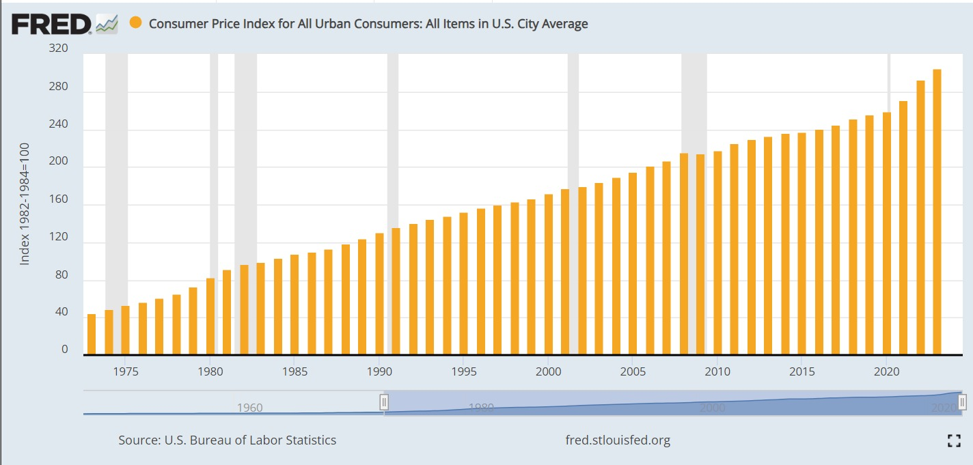
Inflation Rate
View interactive graph
Price Level
View interactive graph

Slide 11
Disinflation vs. Deflation
Disinflation – A decrease in the inflation rate or a slowdown in the upward movement of prices for goods and services in the economy.
Inflation rate is decreasing.
Price index is still increasing.
The rate at which inflation is occurring has slowed.
The growth rate of the price index has decreased.
Deflation – A general, sustained downward movement of prices for goods and services in an economy.
Inflation rate is negative.
Price index is falling.
The growth rate of the price index is negative.

Slide 12
Inflation vs. Disinflation vs. Deflation

Slide 13
Check for understanding!

Slide 14
Closing
What is inflation?
What is deflation?
What is disinflation?
How are the price level and inflation rate related?
How are the price level and inflation rate different?
What is the difference between deflation and disinflation?
FEDERAL RESERVE EDUCATION | FRE.ORG

