Slide 1

Teacher Note
These slides correspond to the visuals noted in the lesson Inflation and the Fall of the Roman Empire.
© Copyright 2018, Federal Reserve Bank of St. Louis.

Slide 2
Inflation and the Fall of the Roman Empire
Compelling Question
How did the economic policies of the Roman emperors cause inflation toward the end of the Roman Empire?

Slide 3
Visual 1: Vocabulary (slide 1 of 2)
Money: Anything widely accepted in exchange for goods and services.
Money supply: The quantity of money available in an economy.
Coin: Money, usually minted from some combination of metals.
Currency: Money, usually made from some type of paper-like material.

Slide 4
Visual 1: Vocabulary (slide 2 of 2)
Debase: To reduce something’s value; for coinage, to reduce the amount of precious metal in the coins but keep the face value constant.
Inflation: A general, sustained upward movement of prices for goods and services in an economy.

Slide 5
Visual 2: Auction Results
 | Round 1 | Round 2
Auction item 1
Auction item 2
Auction item 3
Total

Slide 6
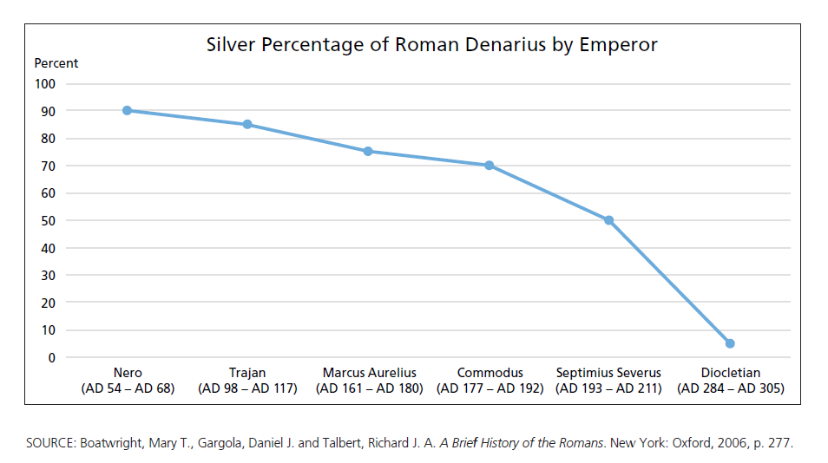
Visual 3: Debasement of Roman Currency

Slide 7
Visual 4: Spending Priorities
Roman emperor Septimius Severus (AD 193-AD 211) said this on his deathbed to his son and successor:
Make the solders rich,
and pay no attention to anyone else.
SOURCE: Martin, Thomas R. Ancient Rome: From Romulus to Justinian. New Haven, CT: Yale University Press, 2012, p. 174.

Slide 8
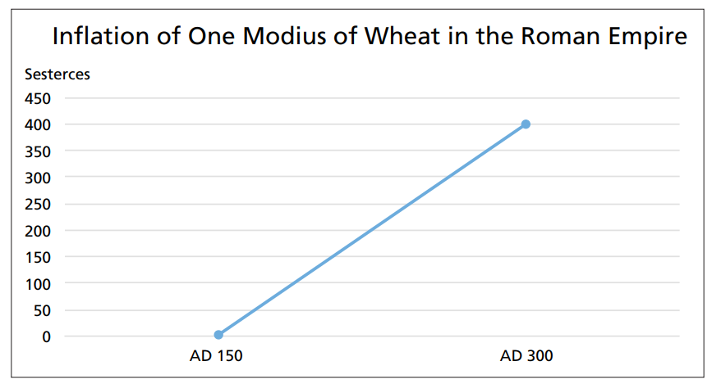
Visual 5: Rising Wheat Prices
NOTE: A sesterces was equal to one-fourth of a denarius.
SOURCE: Boatwright, Mary T., Gargola, Daniel J. and Talbert, Richard J. A. A Brief History of the Romans. New York: Oxford, 2006, p. 277.

Slide 9
Visual 6: Chasing Too Few Goods
Upon hearing that another debasement of coinage was coming, a Roman official wrote this to his servant:
Hurry, spend all my money you have;
buy me any kinds of goods at
whatever prices they are available.
SOURCE: Martin, Thomas R. Ancient Rome: From Romulus to Justinian. New Haven, CT: Yale University Press, 2012, p. 174.

