Slide 1

What is an Entrepreneur?
Lesson

Slide 2

What Is an Entrepreneur?

Slide 3
Instructional Objectives
Students will:
Analyze the function of an entrepreneur in a market economy.
Identify the incentives that motivate entrepreneurs.
Compare innovative and replicative entrepreneurs.
Evaluate the role of government in supporting entrepreneurship.

Slide 4
Entrepreneurs are…

Slide 5


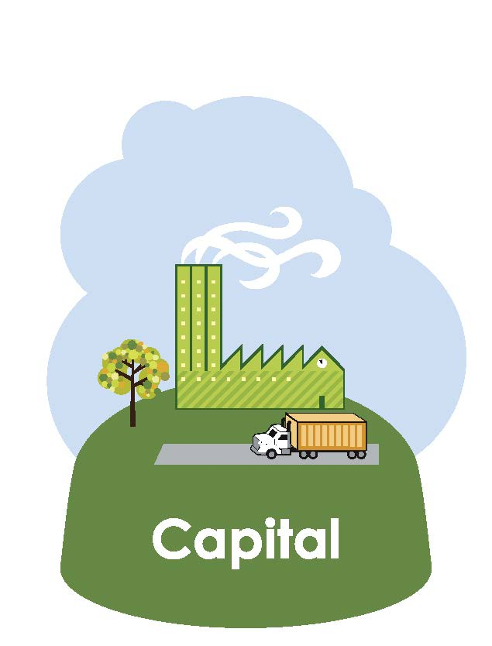
Productive Resources

Slide 6

Bringing Together Resources

Slide 7

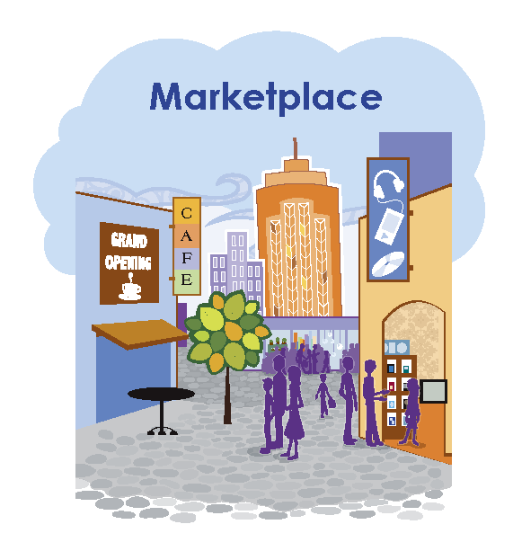

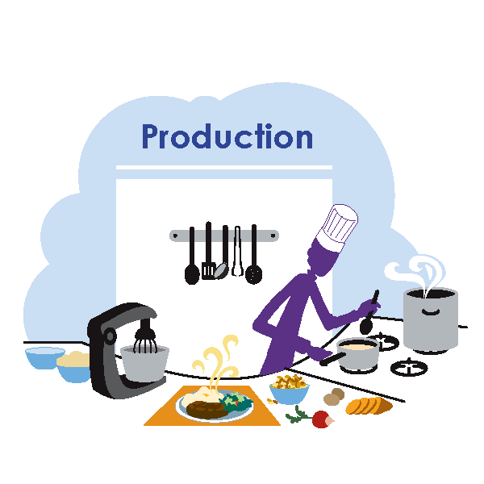
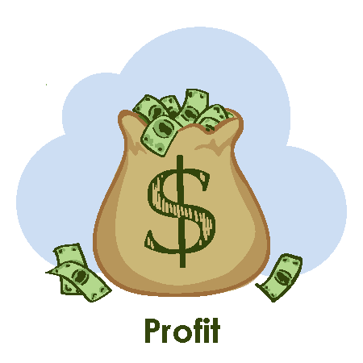
What Is an Entrepreneur? (cont.)

Slide 8

Taking a Product to the Marketplace

Slide 9


Why Take the Risk?

Slide 10

Entrepreneurs and Inventors
An entrepreneur might be an inventor…
but might not be.
An inventor might be an entrepreneur…
but might not be.
You are an entrepreneur if you organize resources to produce a good or service and accept the risk of taking the product to market.

Slide 11
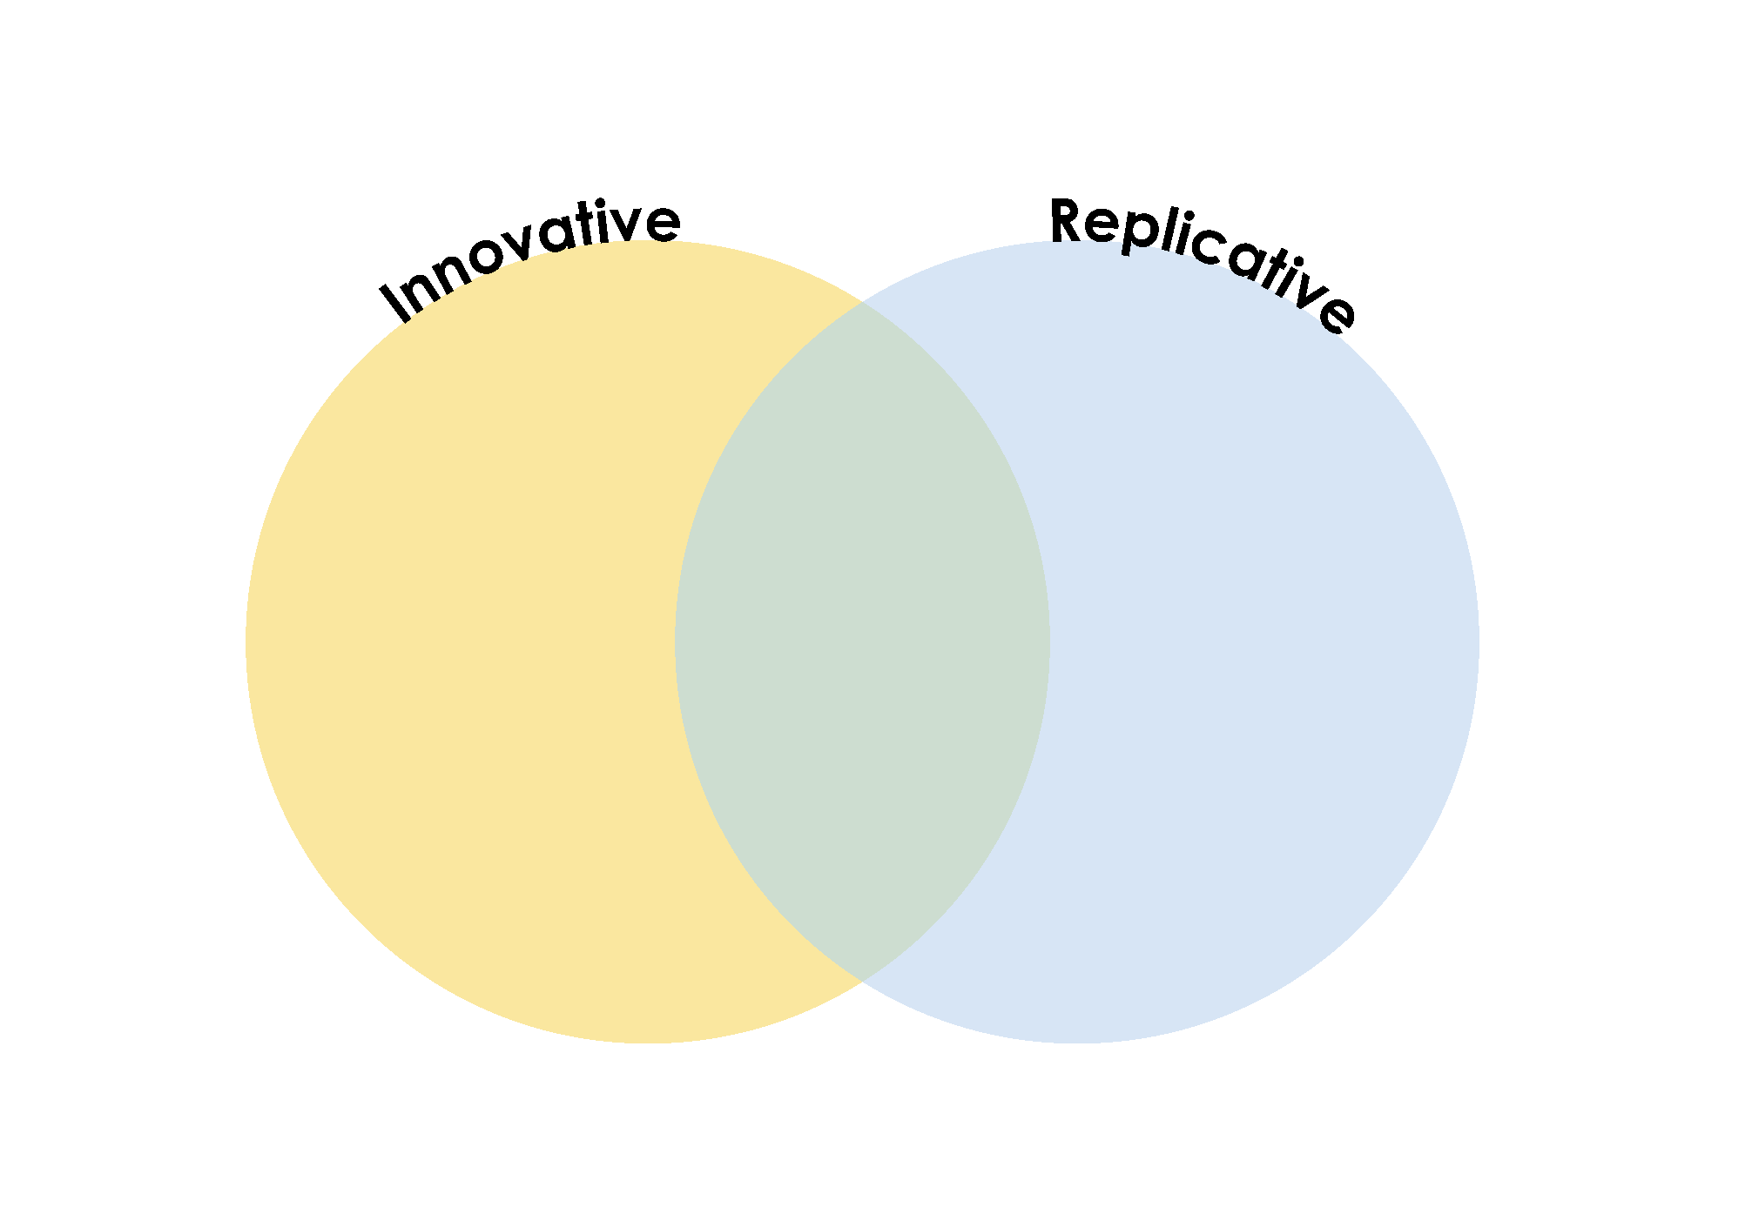



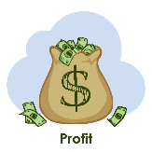
Types of Entrepreneurs

Slide 12
Review and Assessment

Slide 13
Closure
What are productive resources?
What are natural resources/land?
What are some examples of natural resources?
What are capital resources?
What are some examples of capital resources used in this school to produce the service of education?

Slide 14
Closure continued
What are human resources?
What are some examples of human resources at the school who produce the service of education?
What is an entrepreneur?
What are the four actions in which all entrepreneurs engage?
What motivates entrepreneurs?
What is the risk that entrepreneurs take in providing a product or service?
What is the difference between innovative and replicative entrepreneurs?

Slide 15




Linda Alvarado
Linda Alvarado worked her way through college as a laborer with a landscaping company. After working in the construction industry, she founded Alvarado Construction in 1976. Some of her first projects involved building sidewalks and shelters for bus passengers, but as the company grew, the projects increased in scale to hotels, convention centers and sports arenas. When she joined a group of investors to buy the Colorado Rockies, she made history as the first Hispanic and the first woman to buy a Major League Baseball franchise.

Slide 16
Linda Alvarado (cont.)
What was the idea?
What was the product?
What resources did the entrepreneur use?

Slide 17

Bill Gates
What was the idea?
What was the product?
What resources did the entrepreneur use?

Slide 18

Julie Clark
What was the idea?
What was the product?
What resources did the entrepreneur use?

Slide 19

Oprah Winfrey
What was the idea?
What was the product?
What resources did the entrepreneur use?

Slide 20
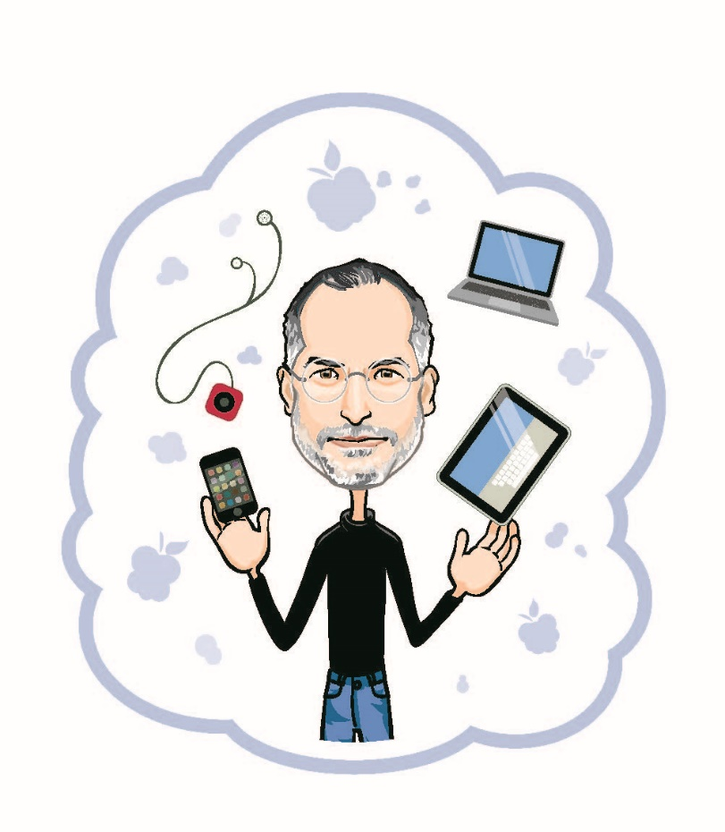
Steve Jobs
What was the idea?
What was the product?
What resources did the entrepreneur use?

Slide 21
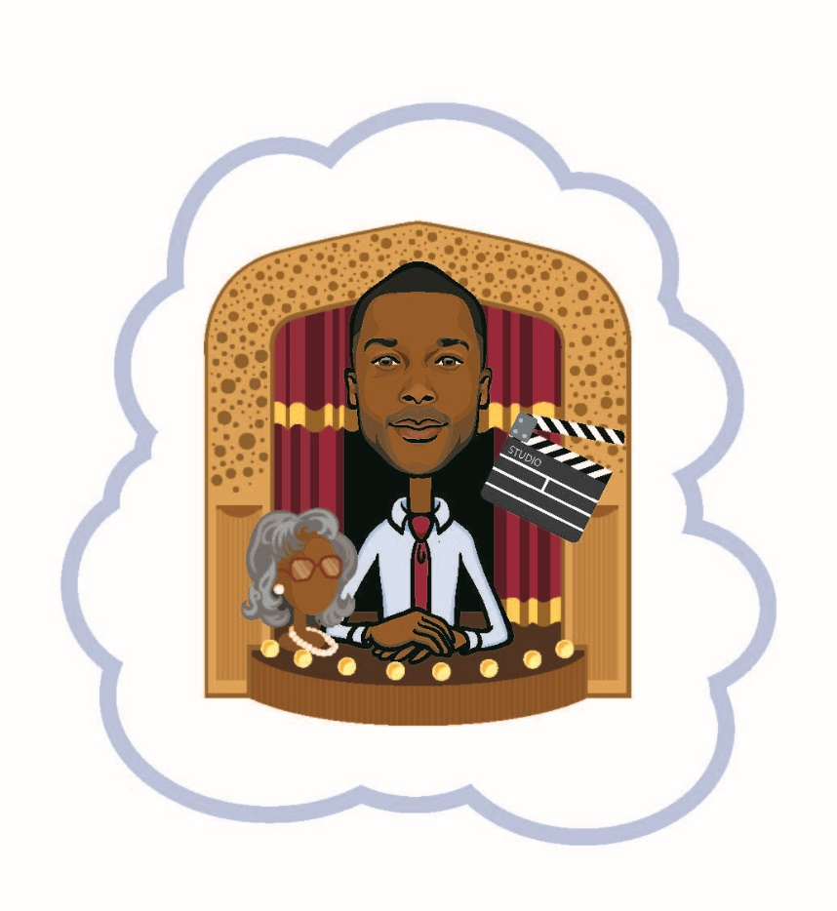
Tyler Perry
What was the idea?
What was the product?
What resources did the entrepreneur use?

Slide 22
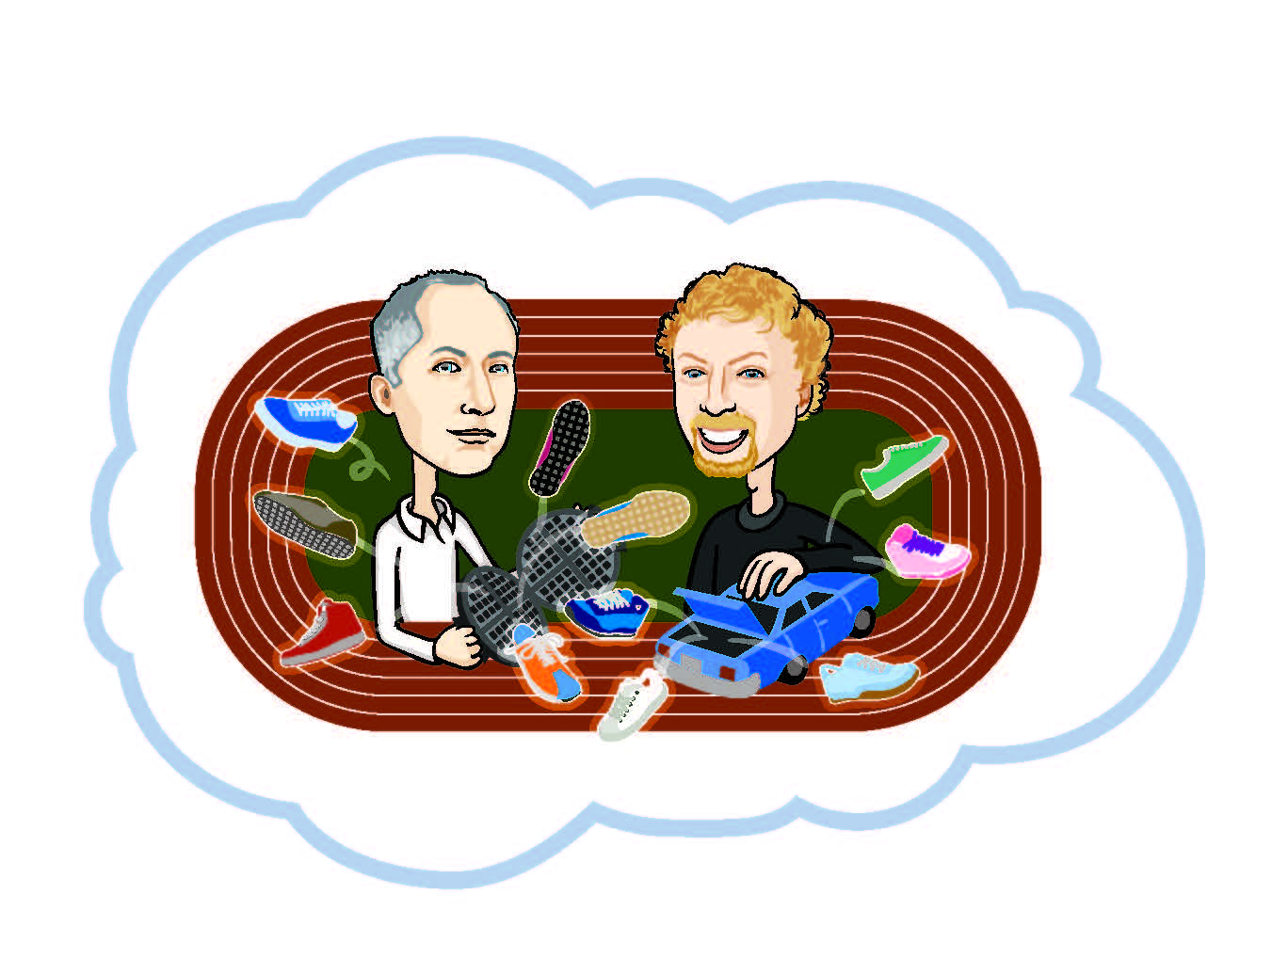
Bill Bowerman and Phil Knight
What was the idea?
What was the product?
What resources did the entrepreneur use?

Slide 23
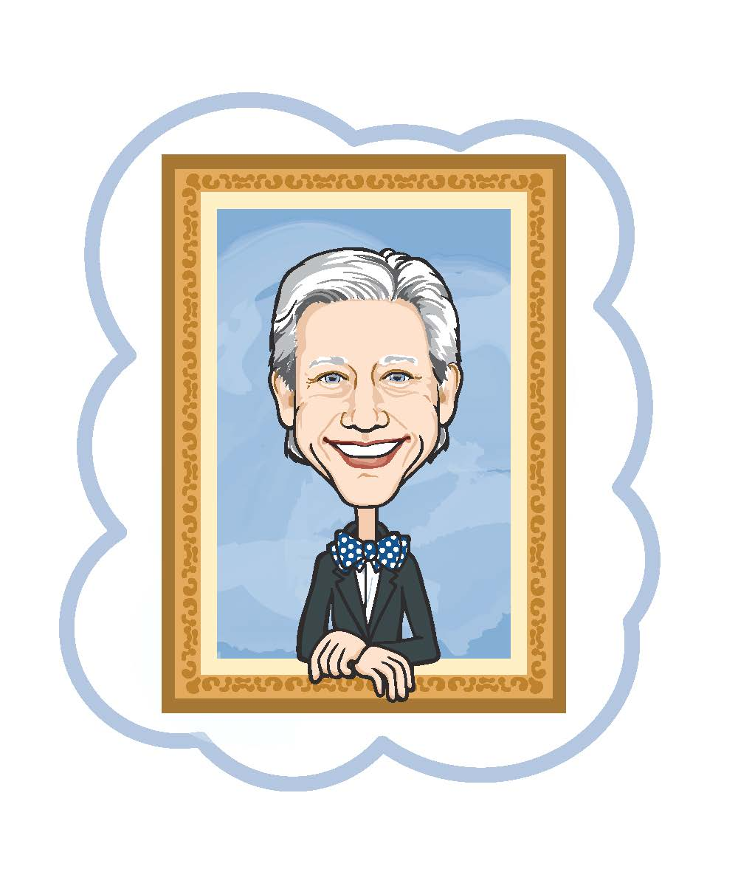
Lionel Sosa
What was the idea?
What was the product?
What resources did the entrepreneur use?

Slide 24
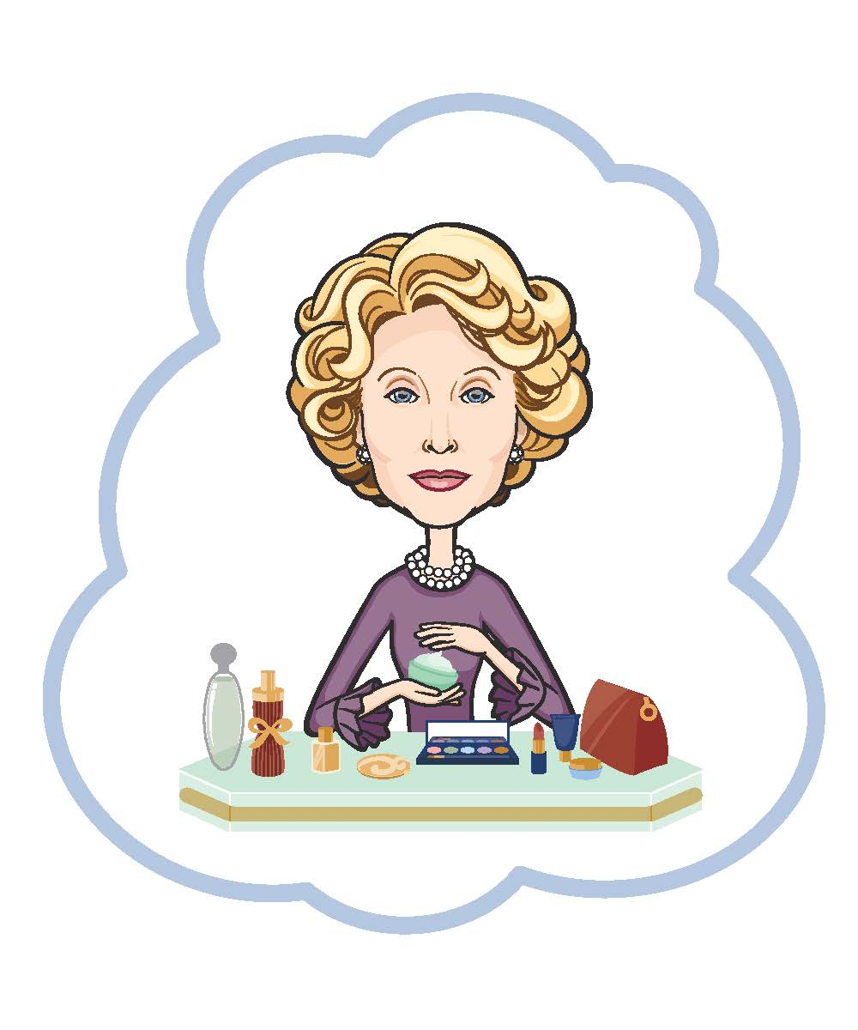
Estee Lauder
What was the idea?
What was the product?
What resources did the entrepreneur use?

Slide 25

Robert Johnson
What was the idea?
What was the product?
What resources did the entrepreneur use?

Slide 26
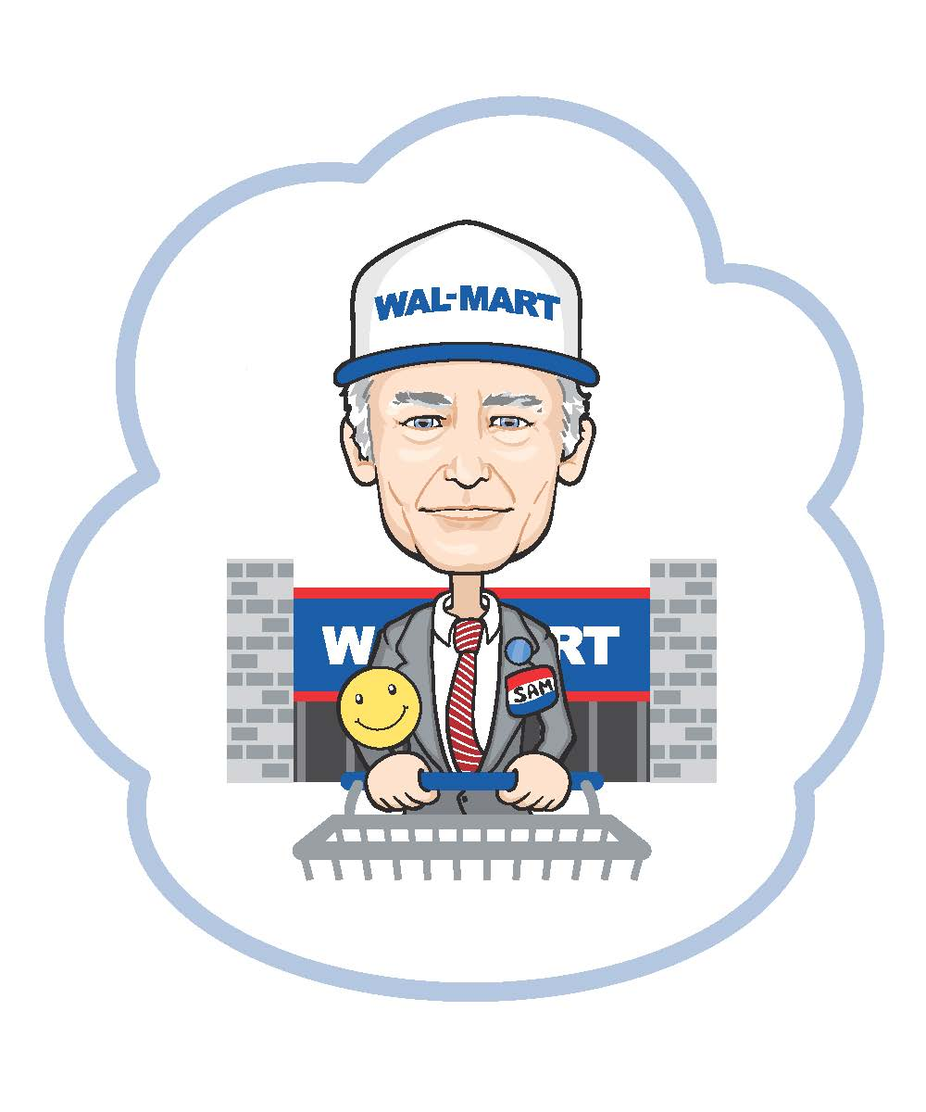
Sam Walton
What was the idea?
What was the product?
What resources did the entrepreneur use?

Slide 27
Questions?

Slide 28
What is an Entrepreneur?
Conclusion

