Slide 1

CPI Market Basket

Slide 2
Bureau of Labor Statistics (BLS)
Bureau of Labor Statistics (BLS) data collectors shop; that is, visit and call stores and doctors’ offices to collect prices on thousands of items.
They check prices of the same items each month and record the prices.

Slide 3
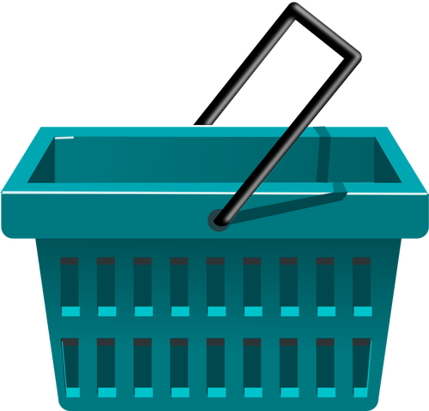
What Does CPI Stand For?
CPI Consumer Price Index
CPI

Slide 4
Vocabulary
What does it mean to be a consumer?
What definition in the list describes the word price?
Index has more than one meaning. In this case, index means a measure of something.
What definition on your list best matches this idea of index?

Slide 5
Vocabulary
Look at the definitions of consumer, price and index on the handout. Based on these, which definition on the handout best matches the term consumer price index?
Which definition best fits the term aggregate?
Which definition best fits the term market basket?

Slide 6
BLS Eight Market Basket Categories
https://bit.ly/bls_market_basket

Slide 7
Vocabulary
What definition refers to tracking prices?
Why do people care if the prices of goods and services change?
What happens to your purchasing power if the prices of goods and services increase?
What happens to your purchasing power if the prices of goods and services decrease?

Slide 8
Price Up, Down, or the Same
Find the recorded past prices for your group’s items on Handout 5.
Record the 2022 prices on Handout 4 in the column labeled “Price January 2022”.
In the column labeled “Price difference +/-”, write a plus or minus sign and the amount of change. If there’s no change, write “no change.”

Slide 9
Price Up, Down, or the Same
Discuss and decide if overall the prices for the goods and services in your part of the market basket went up, went down, or stayed the same.
If your group thinks prices for your box have gone up, group members should stand.
If you think prices for you box stayed the same, members should remain seated.
If you think prices for you box went down, members should kneel or sit on the floor.

Slide 10
Vocabulary
Inflation – a general, sustained upward movement of prices for goods and services in an economy.
If we have inflation, what goes up?
And, when we have inflation, what power goes down?
Why do we care about purchasing power?

Slide 11
Role-Play Scenarios
Scenario 1: Gas Prices
What happened to gas prices?
What was happening to the price of other goods and services?
What is an increase in prices like this a sign of?
How did the change in price affect the behavior of the friends?

Slide 12
Role-Play Scenarios
Scenario 2: Movie Theater
What happened to the price of tickets?
How did this affect the customers’ purchasing power?
How did customers change their behaviors as a result?

Slide 13
Role-Play Scenarios
Scenario 3: Grocery Store
What happened to the price of blueberries?
How did this change the customer’s behavior?
Substitution for a less-expensive option is common when prices increase.

Slide 14
Role-Play Scenarios
Scenario 4: Restaurant
Why did the sandwich shop owner raise the prices on the menu?
What does “There’s no such thing as a free lunch” mean?

Slide 15
Closure
What is a consumer?
What is a price?
What is an index as we used the term today?
What is a measure of the average change over time in prices paid by consumers called?

Slide 16
Closure
What government agency collects information each month about the change in prices of thousands of items?
Why are BLS shoppers checking to see if there has been a change in prices for items?
What is inflation?
What is purchasing power?
Why do people care about inflation?

Slide 17
Closure
What is the connection between inflation and purchasing power?
Give an example of the relationship between inflation and purchasing power.
How does inflation change people’s behavior?

Slide 18
CPI Market Basket

