Slide 1

Comparative Advantage: Trading Pizzas and Brownies

Slide 2

Trade Terminology

Slide 3
Vocabulary: Productivity
Productivity is a measure of how much of a good or service (output) that can be produced with a specific quantity of resources (inputs).

Slide 4

Alpha and Beta
For many years, the people of Alpha and the people of Beta kept to themselves, with almost no contact between the islands.
The two countries looked similar but had different histories. Over time, the two countries developed differently which led to the nations having very different productivity.
However, the people of Alpha and Beta have one thing in common: They all love pizza and brownies. In fact, they spend a great deal of their time producing and eating as many pizzas and brownies as they can.
Alpha
Beta

Slide 5
Production in Alpha
Hours Spent Producing Pizzas | 6 | 5 | 4 | 3 | 2 | 1 | 0
Number of Pizzas Produced | 12 | 10 | 8 | 6 | 4 | 2 | 0
Number of Brownies Produced | 0 | 1 | 2 | 3 | 4 | 5 | 6

Slide 6
Production in Beta
Hours Spent Producing Brownies | 6 | 5 | 4 | 3 | 2 | 1 | 0
Number of Brownies Produced | 6 | 5 | 4 | 3 | 2 | 1 | 0
Number of Pizzas Produced | 0 | .5 | 1 | 1.5 | 2 | 2.5 | 3

Slide 7
Vocabulary: Production Possibilities Table
A production possibilities table shows the possible output combinations that can be produced given an economy’s available resources and technology.

Slide 8
Productivity
Productivity is a measure of how much of a good or service (output) that can be produced with a specific quantity of resources (inputs).
 | Pizzas produced in one hour | Brownies produced in one hour
Alpha
Beta

Slide 9
Absolute Advantage
Absolute advantage is when people in one country are able to produce more goods than people can produce in another country using the same resources.
 | Pizzas produced in one hour | Brownies produced in one hour
Alpha
Beta

Slide 10
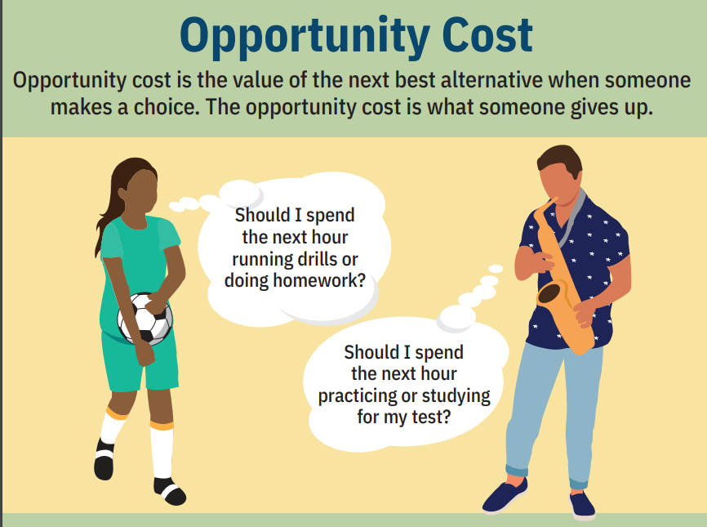
Opportunity Cost

Slide 11

Opportunity Cost (cont.)
Opportunity cost is the value of the next-best alternative when a decision is made; it’s what is given up.
 | Opportunity cost of producing one pizza | Opportunity cost of producing one brownie
Alpha
Beta

Slide 12
Comparative Advantage and Specialization
Comparative advantage is the ability to produce at a lower opportunity cost than another producer.
Specialization is producing one (or fewer) goods and services, rather than producing all goods.
 | Opportunity cost of producing one pizza | Opportunity cost of producing one brownie
Alpha
Beta

Slide 13
Terms of Trade
=
If Alpha produces pizzas and trades for brownies, would a trade of one pizza for one brownie be desirable?
If Beta produces brownies and trades for pizzas, would a trade of one brownie for one pizza be desirable?

Slide 14
Closure
How is productivity measured?
If workers in a country are more productive than workers in another country in producing a good, do they have an absolute or comparative advantage in producing it?
If the opportunity cost of producing a good in one country is lower than in another country, does the first country have an absolute or comparative advantage producing it?
How do people benefit from specialization and trade?

Slide 15
Comparative Advantage: Trading Pizzas and Brownies

