Slide 1

The Perfect Breakfast

Slide 2
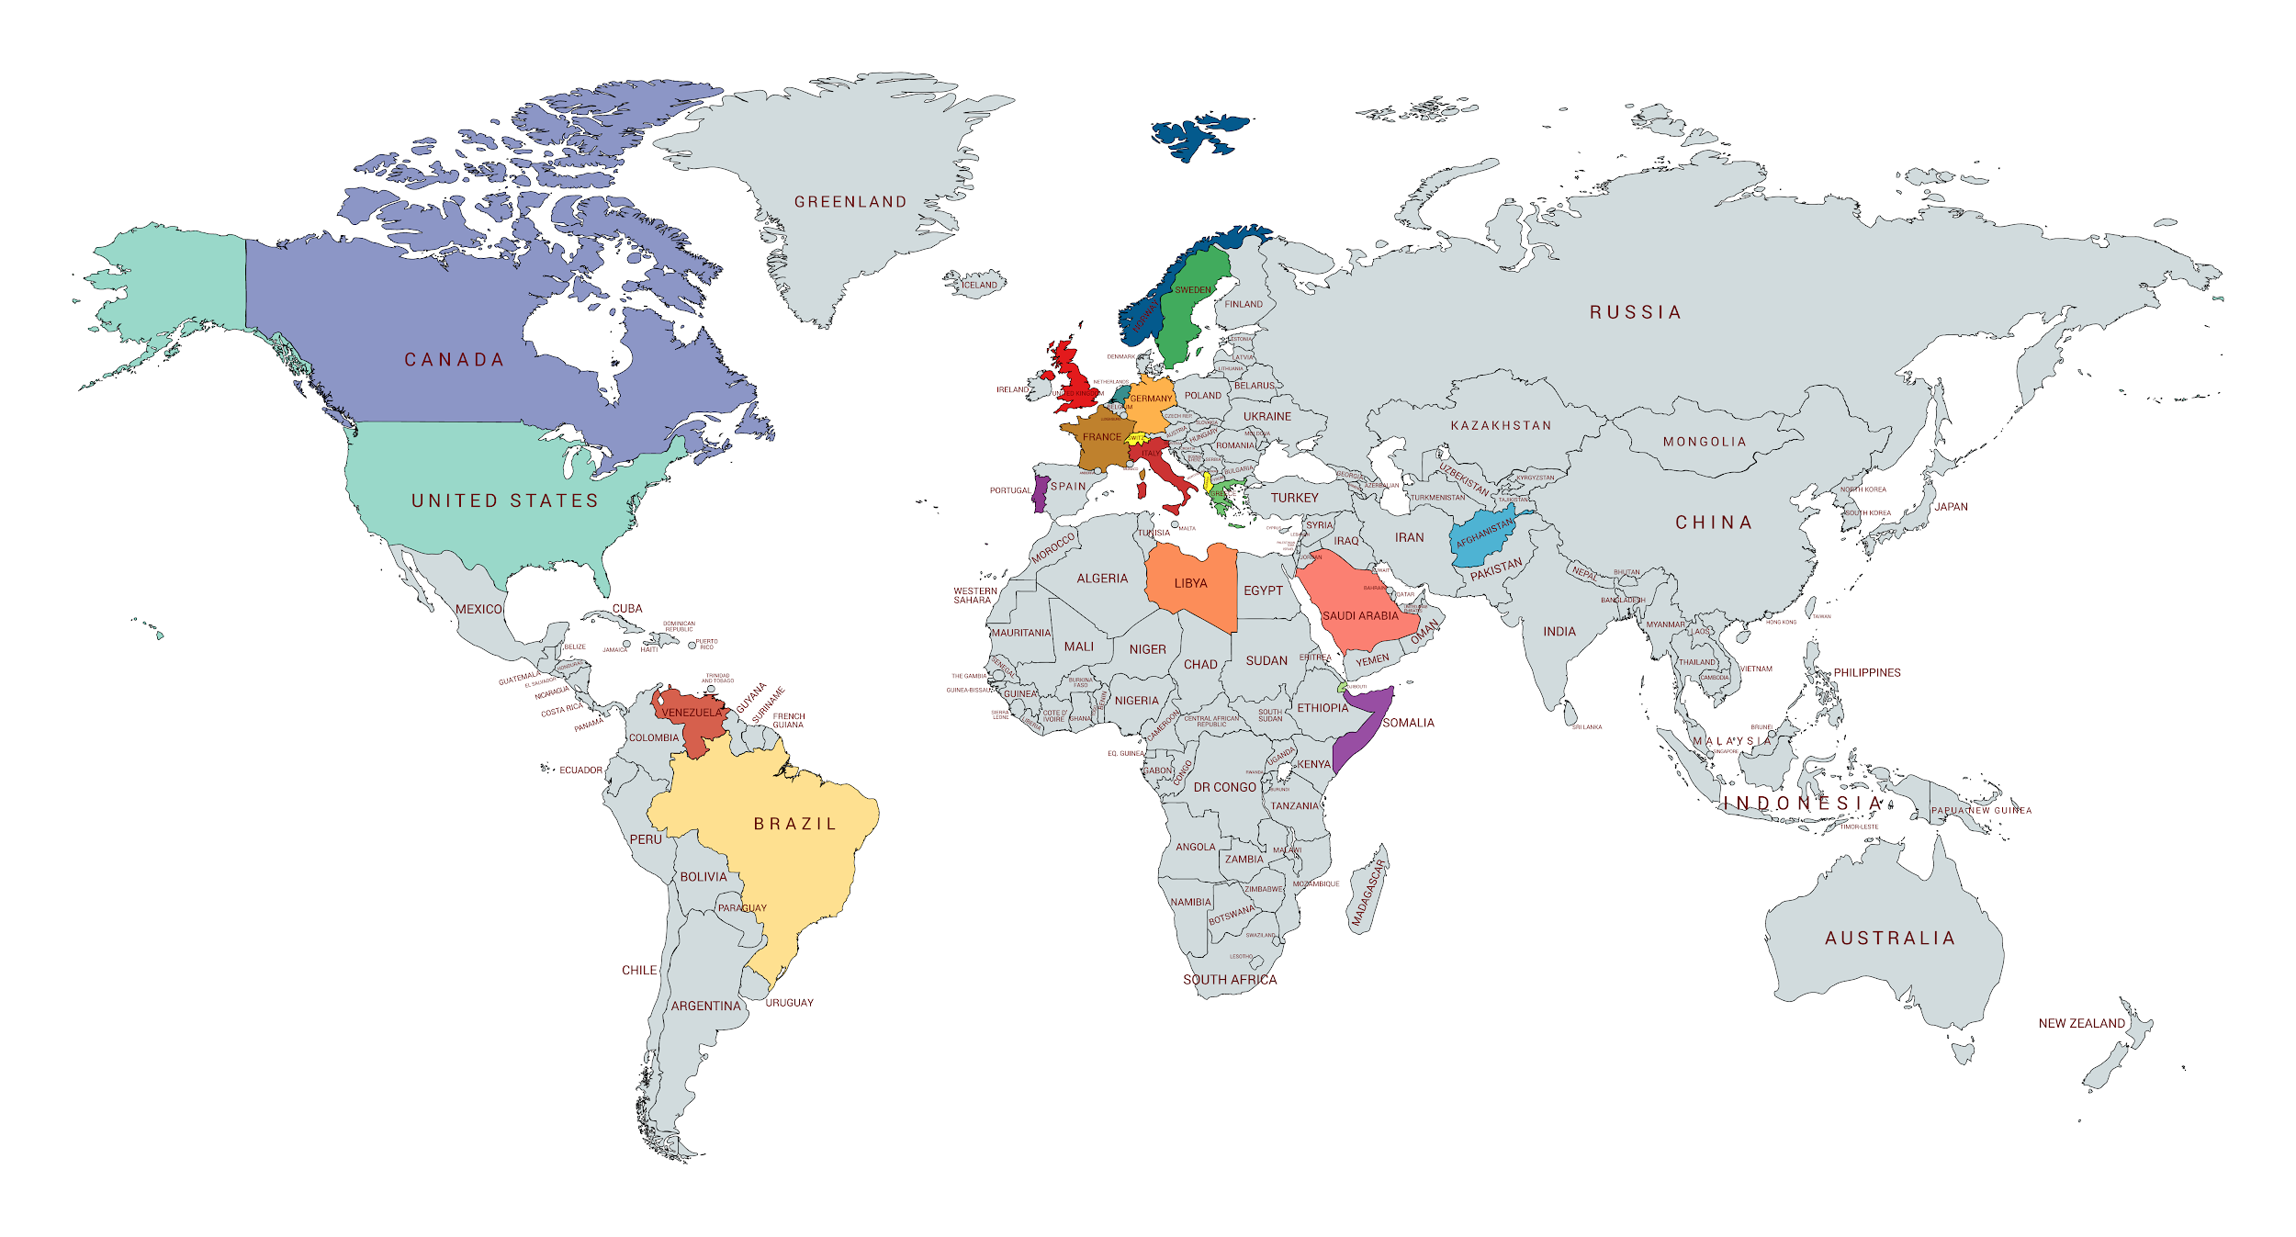
Map of the World

Slide 3

Web Activity Debriefing Questions
What have we made?
What would happen if one person dropped their piece of yarn?
What if Norway couldn’t catch enough fish to sell to Sweden?
How would Norway being unable to sell fish to Sweden affect other countries in the web?

Slide 4
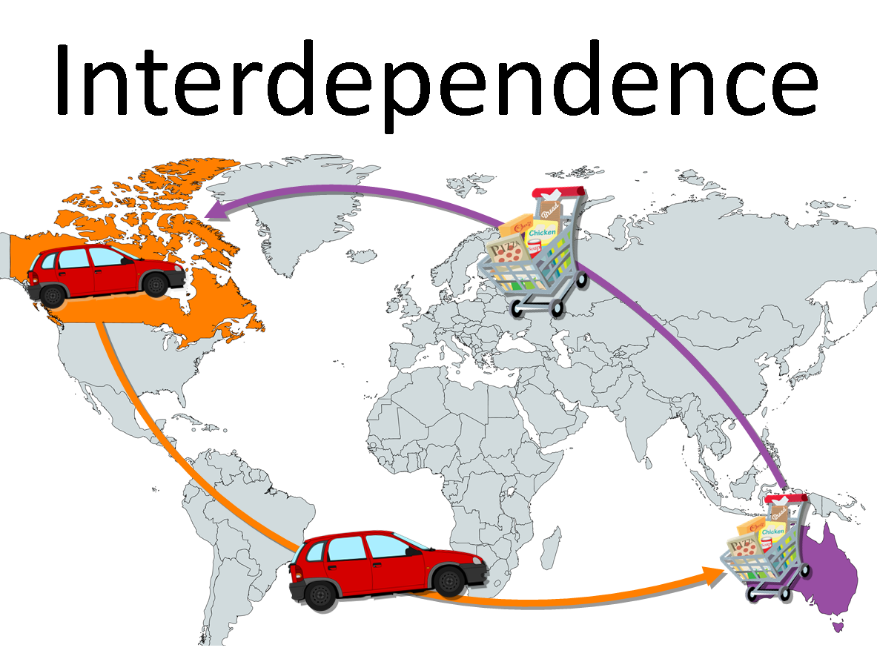
Vocabulary: Interdependence
Interdependence occurs when people, regions, or countries specialize in producing certain goods and services based on the resources and skills available to them, and then trade with other people, regions, or countries to get other goods and services they want.

Slide 5
Vocabulary: Independent
If a country is independent, it doesn’t trade. It has only the goods and services that it can produce with the resources and skills found in that country.

Slide 6
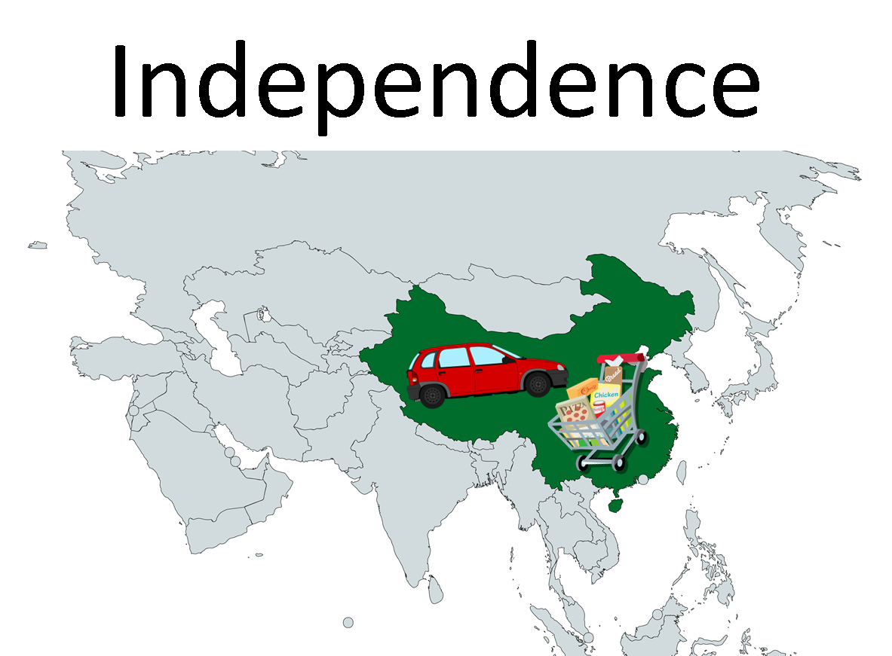
Independent and Interdependent
Independent—no trade
Interdependent—trade

Slide 7
A Perfect Breakfast Video
https://bit.ly/perfect_breakfast

Slide 8
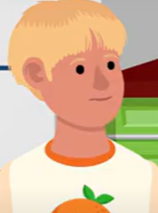
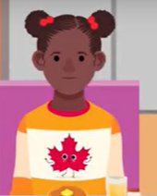
Video Discussion Questions
What was Luke and Jacklyn’s problem?
Why couldn’t they have the breakfast they wanted?
How did they solve their problems?

Slide 9
Vocabulary: Trade
Trade happens when people exchange goods and services for money or for other goods and services.

Slide 10
Trade Involves Exchanges
Trade always involves exchange.
Jacklyn’s grandfather traded bottles of maple syrup for money.
Jacklyn’s grandfather traded money for a box of Luke’s oranges.
Luke traded boxes of oranges for money.
Luke traded money for a bottle of syrup.

Slide 11
Trade Discussion Questions
Was Jacklyn’s grandfather better off after trading his maple syrup for money?
Was he better off after trading his money for oranges?
Was Luke better off after trading his oranges for money?
Was he better off after trading his money for maple syrup?

Slide 12
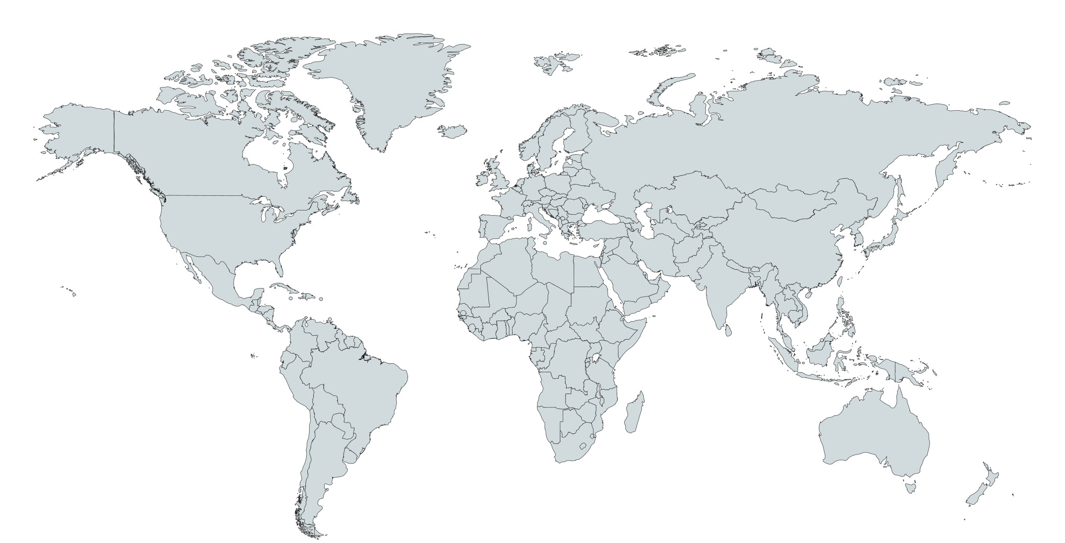


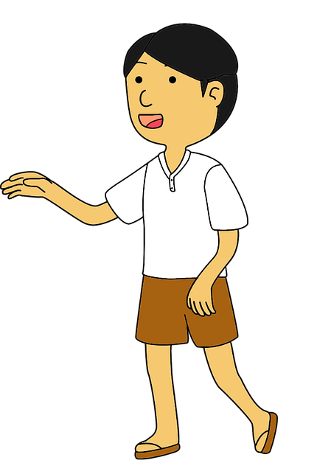





Interdependence
Interdependence happens when people or
countries rely on other people or countries to
get the goods and services they want.
When we trade we become interdependent.
Trade can make people better off.

Slide 13
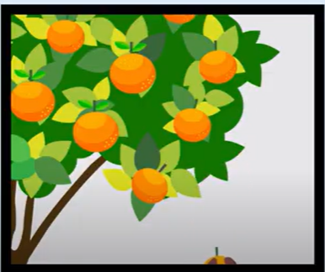
Interdependence Discussion
What would happen if a frost destroyed all of the oranges in Florida?
How would this affect Luke?
How would this affect Jacklyn?

Slide 14
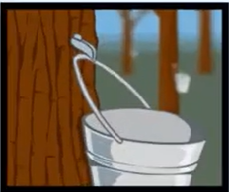
Interdependence Discussion (cont.)
What would happen if the weather in Canada was too warm for the maple trees to produce sap to make maple syrup?
How would this affect Jacklyn?
How would this affect Luke?

Slide 15
Closure
What is trade?
What happens in every trade?
Give an example of a trade you made when you exchanged one good for another good.
Give an example of a trade you made when you exchanged money for a good.

Slide 16
Closure (cont.)
How can trade help people satisfy their wants?
What is interdependence?
When is interdependence helpful and when isn’t it helpful?

Slide 17
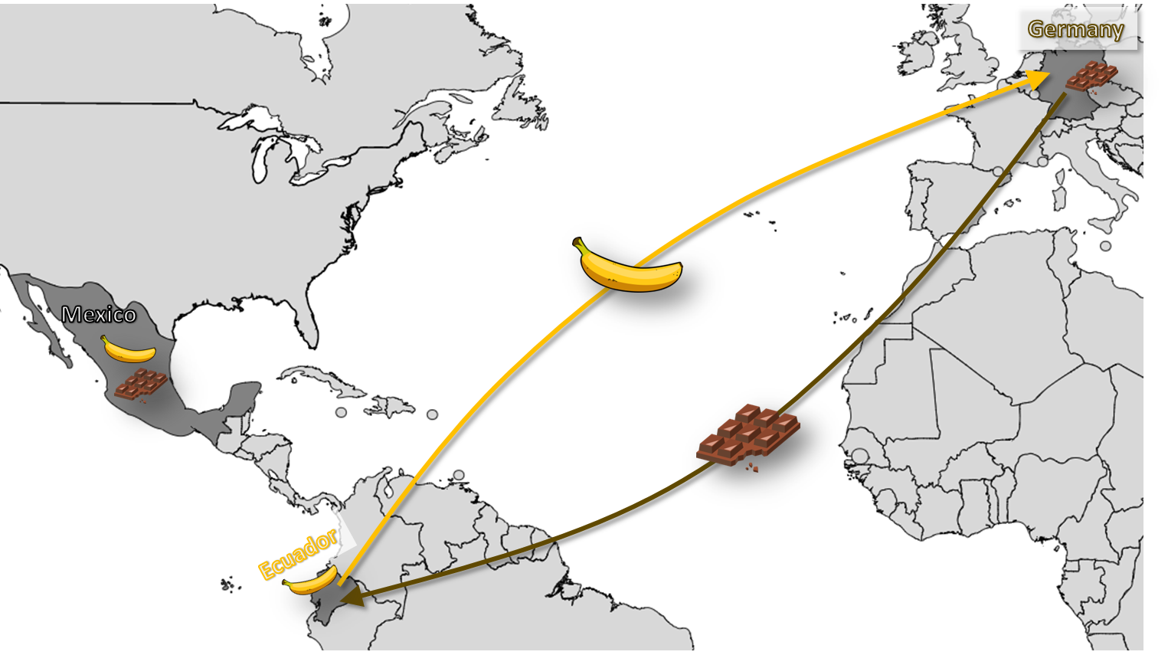
The Perfect Breakfast Assessment

Slide 18
PACED Pretzels
The Perfect Breakfast
Slides

