Slide 1

The Characteristics of Money
What makes something useful as money?

Slide 2
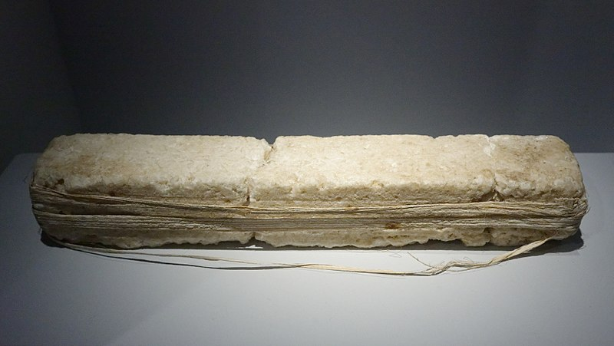
A long time ago people used salt as money.
Did
?
you
know
Today, most people don’t use salt as money. Why do you think most people stopped using salt as money?

Slide 3
What is money?
Money is anything
that is widely
accepted by most people in exchange
for goods
and services.
?
What
is
money

Slide 4
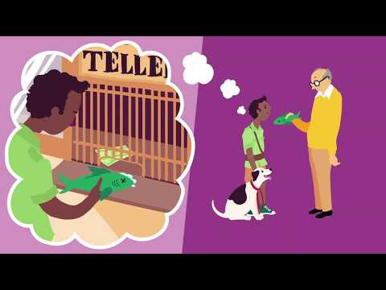
What Makes Something Useful As Money? (pt. 1)
What makes
?
something
useful
as money

Slide 5
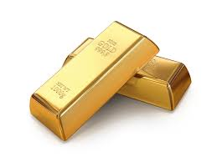
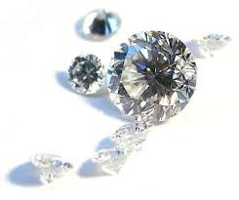
Something is scarce if there is a limited
amount of it available.
What
?
is
scarce
Notes:
Vocabulary slide: scarce

Slide 6
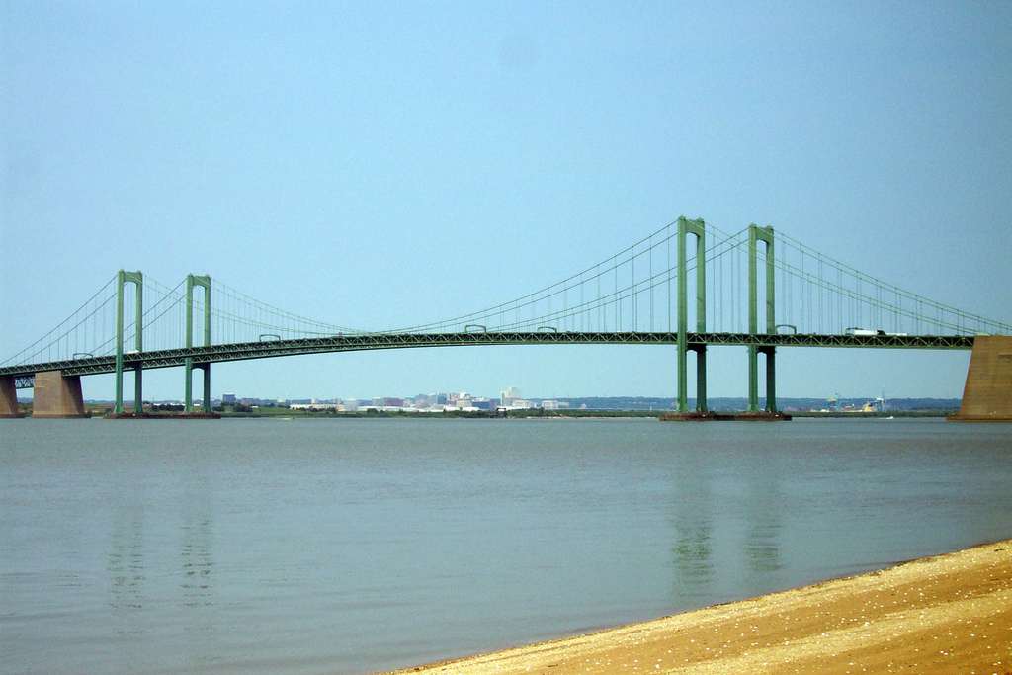
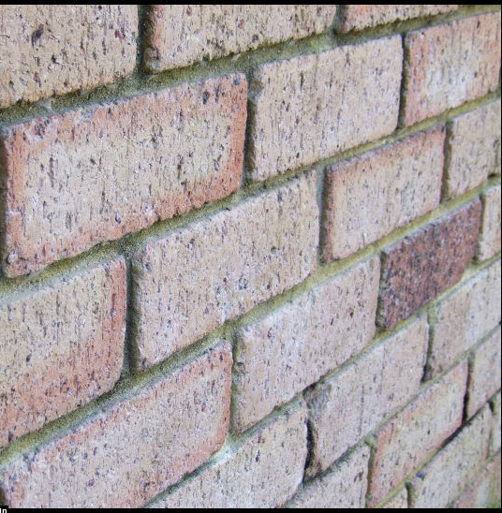
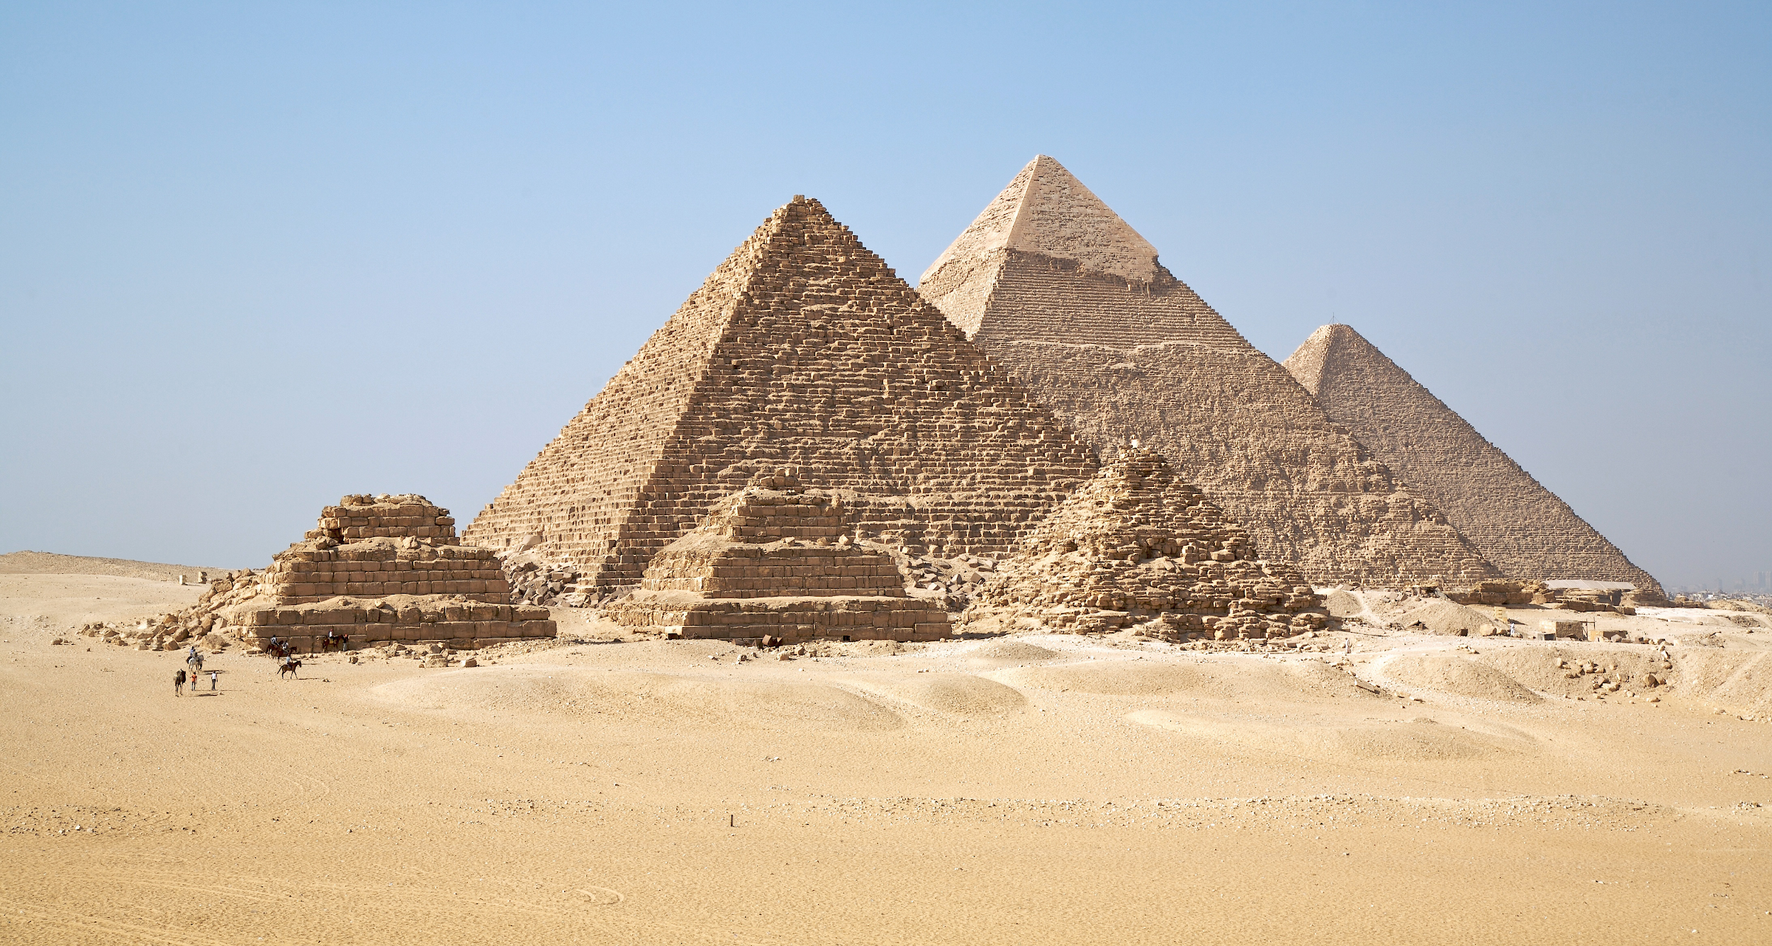
Something is durable if
it can last a long time.
?
What
is
durable
Notes:
Vocabulary slide: durable

Slide 7
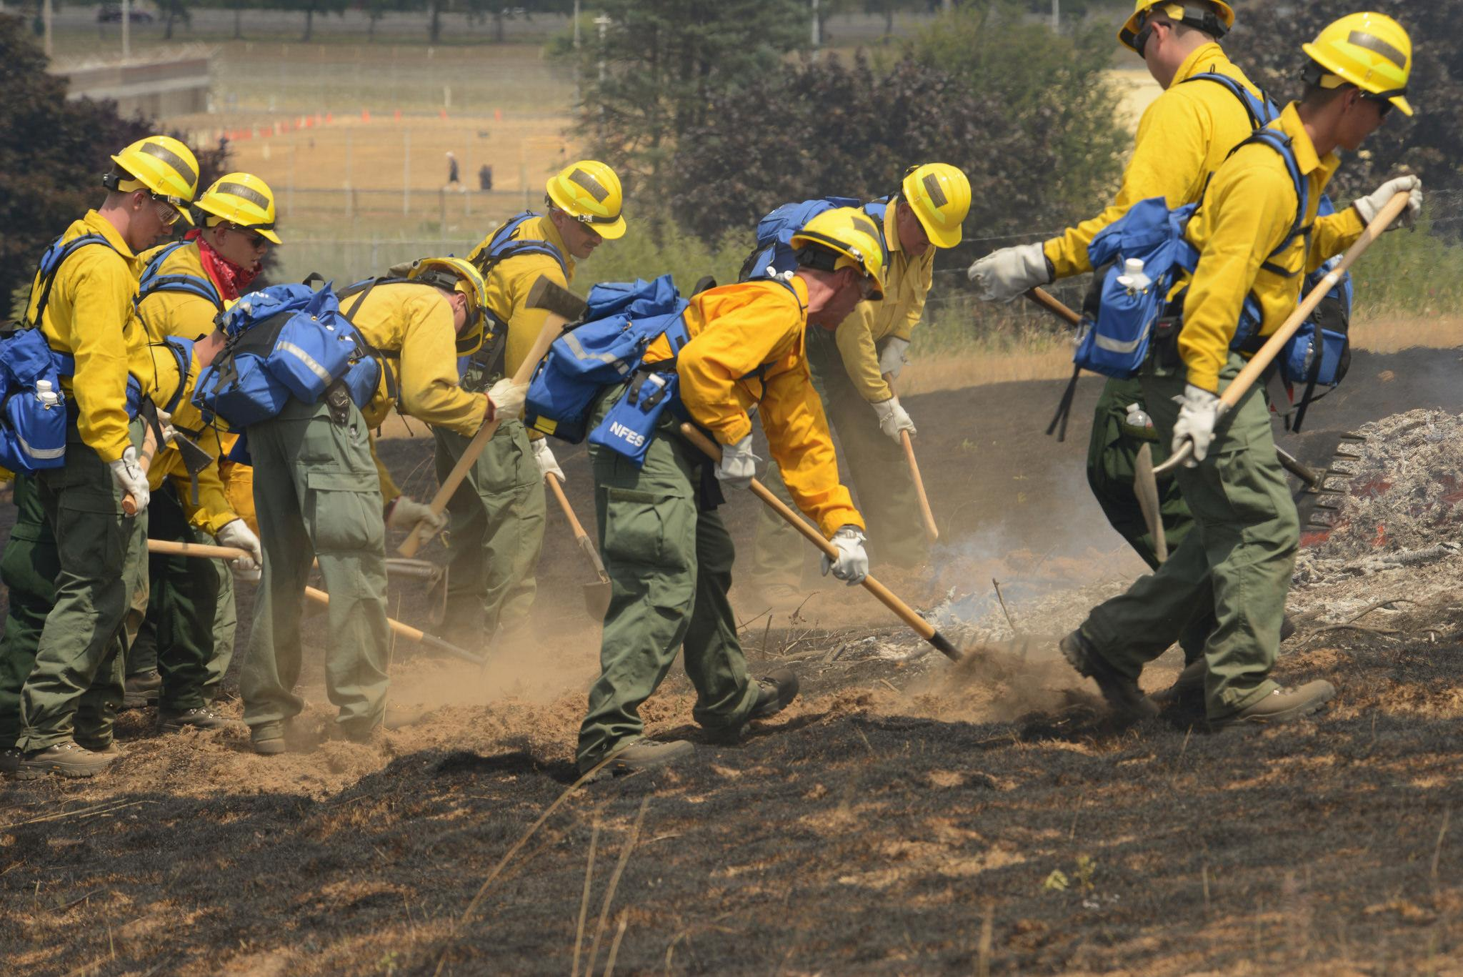
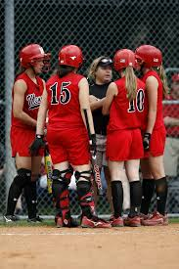
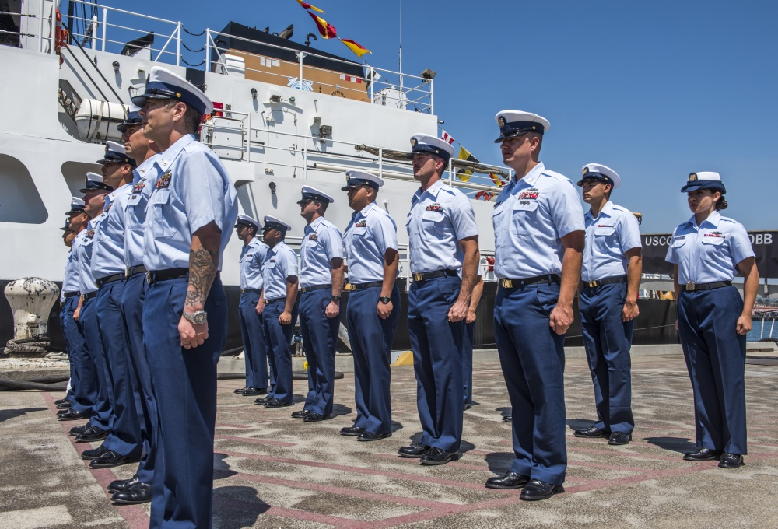
Something is uniform when it is all the same shape and size.
?
What
is
uniform
Notes:
Vocabulary slide: uniform

Slide 8

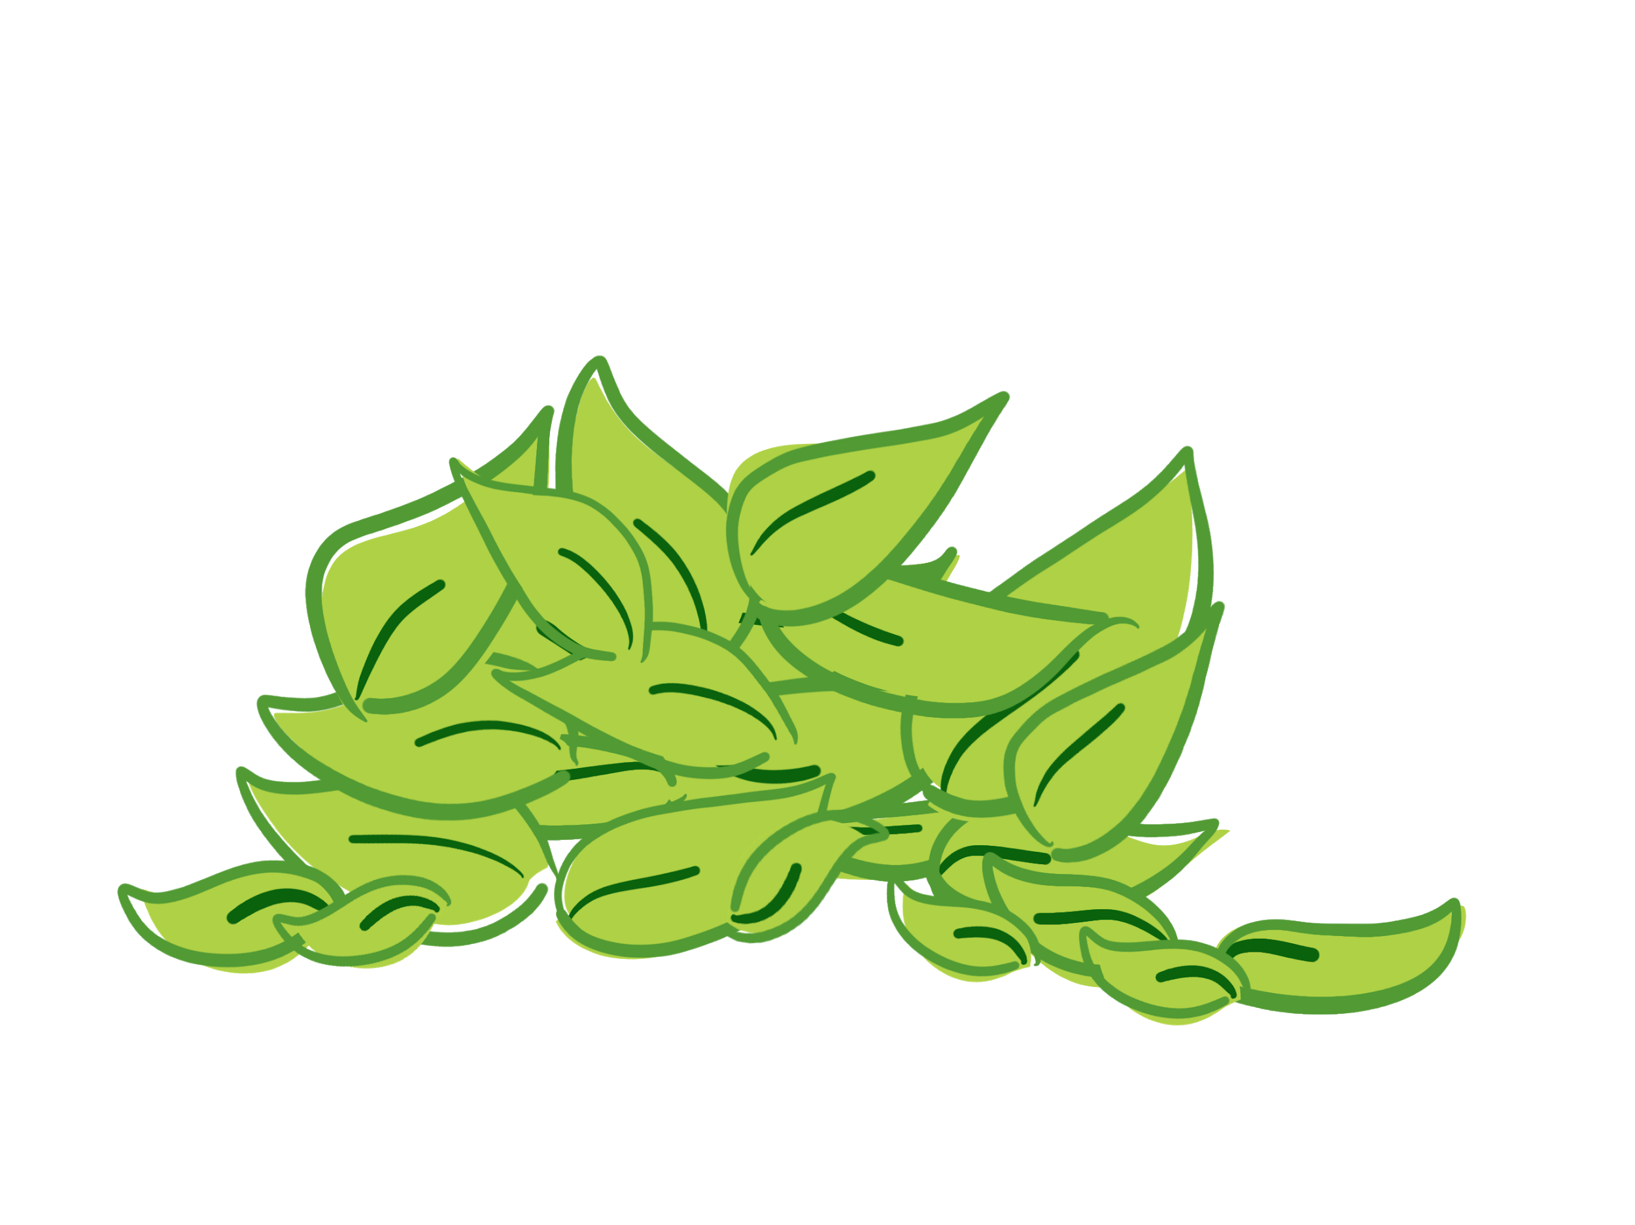
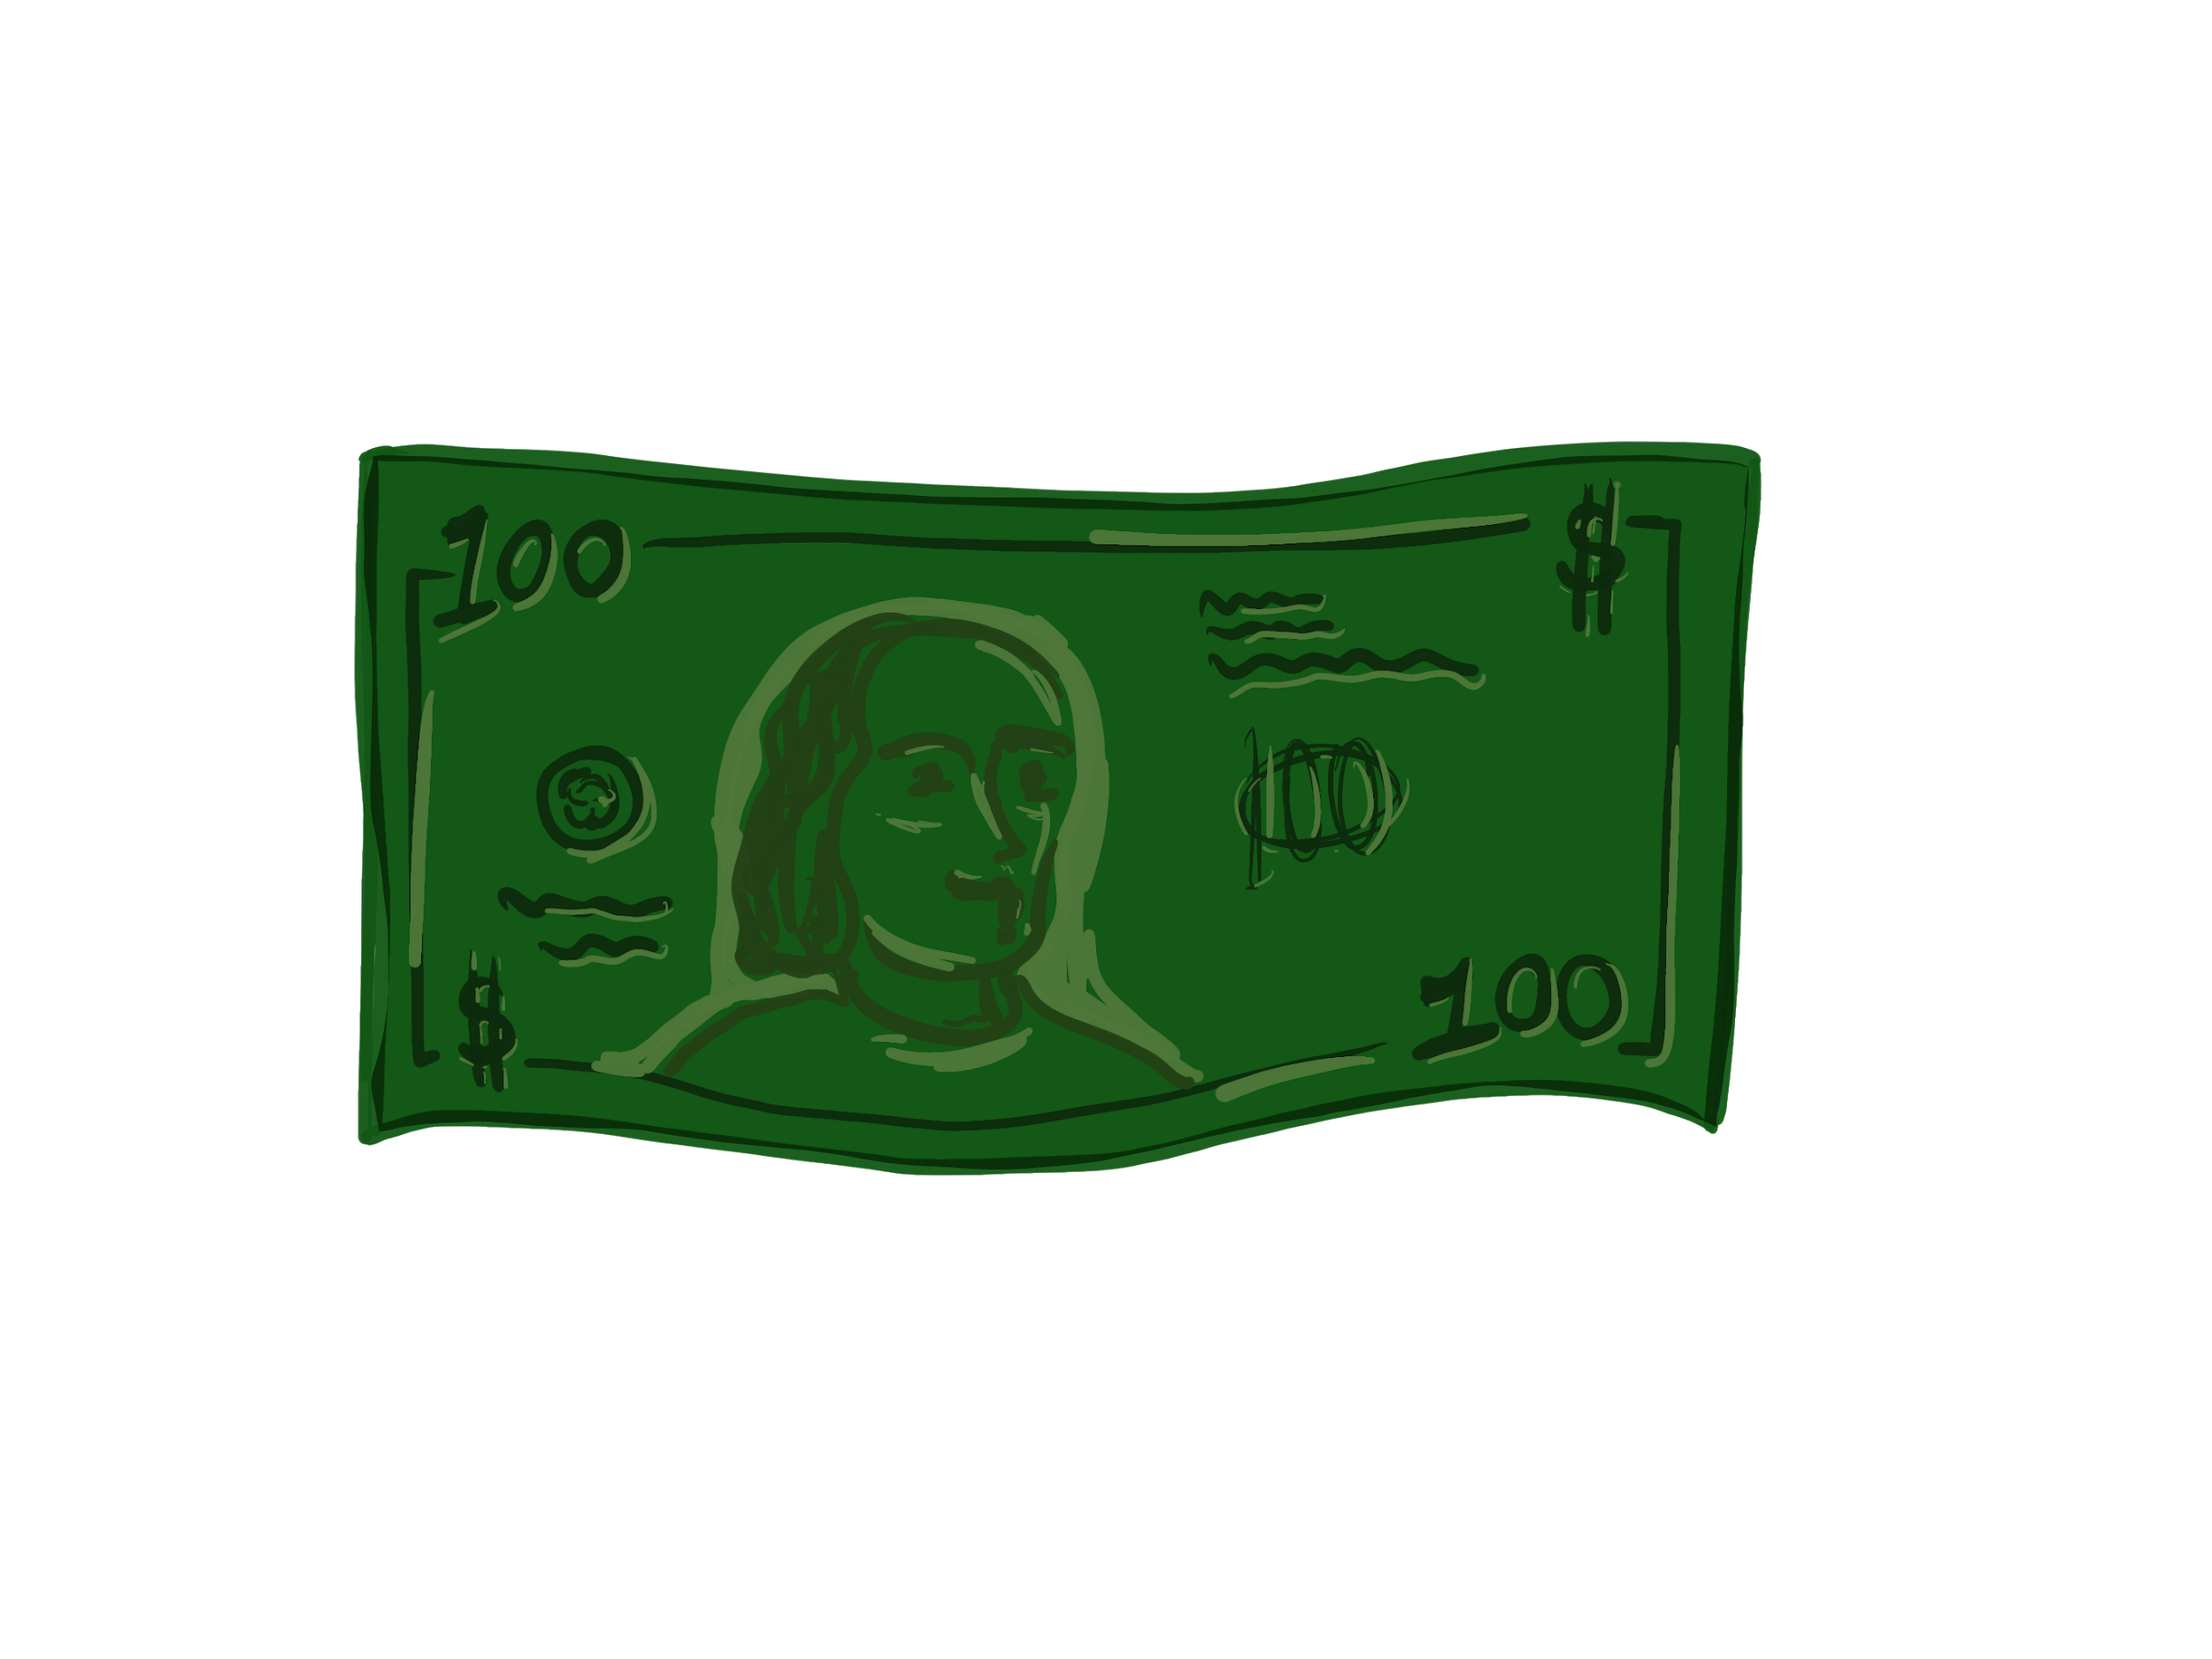
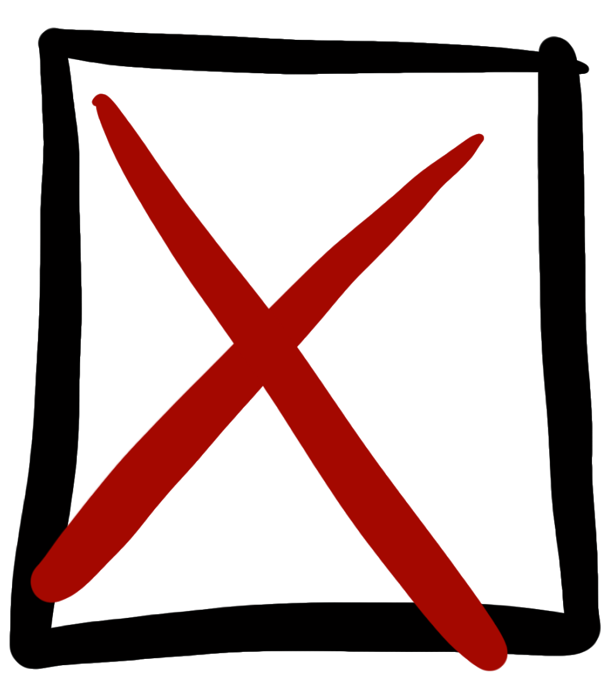
scarce
1. Watch the video a second time.
2. Use the graphic organizer to record each of the characteristics of money.

Slide 9
What Makes Something Useful as Money? (pt. 2)
What makes
?
something
useful
as money

Slide 10
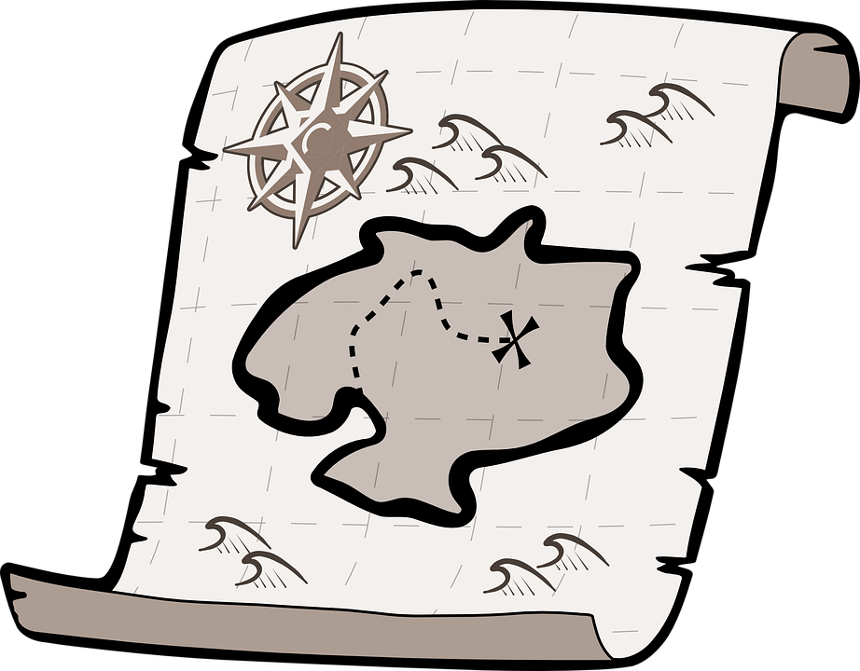
Working for the Money Lab
Working for
the
MONEY LAB
A new island has been discovered.
Newland
You will help the people decide what kind of money to use.

Slide 11
Working for the Money Lab (pt. 2)
Working for
the
MONEY LAB
1.
Read your money card.
2.
Examine your money.
3.
Complete your investigation sheet.

Slide 12
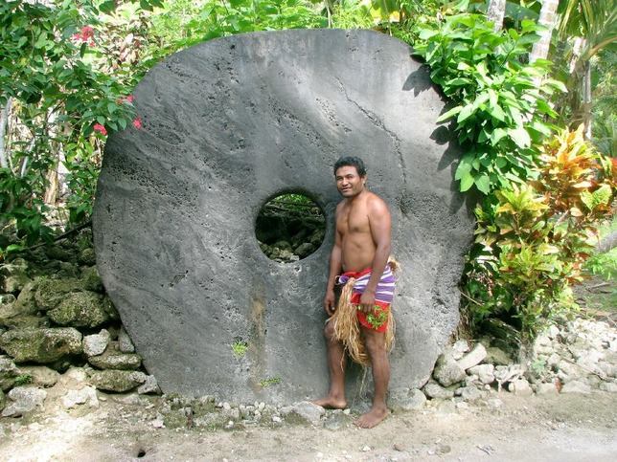
Rai stones
Working for
the
MONEY LAB

Slide 13
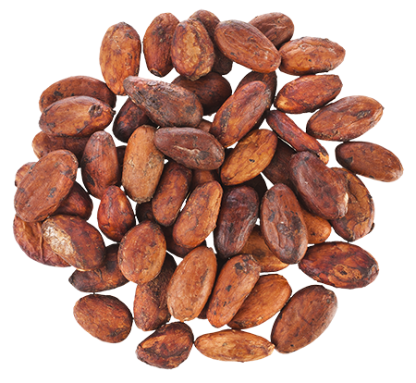
Cocoa beans
Working for
the
MONEY LAB

Slide 14
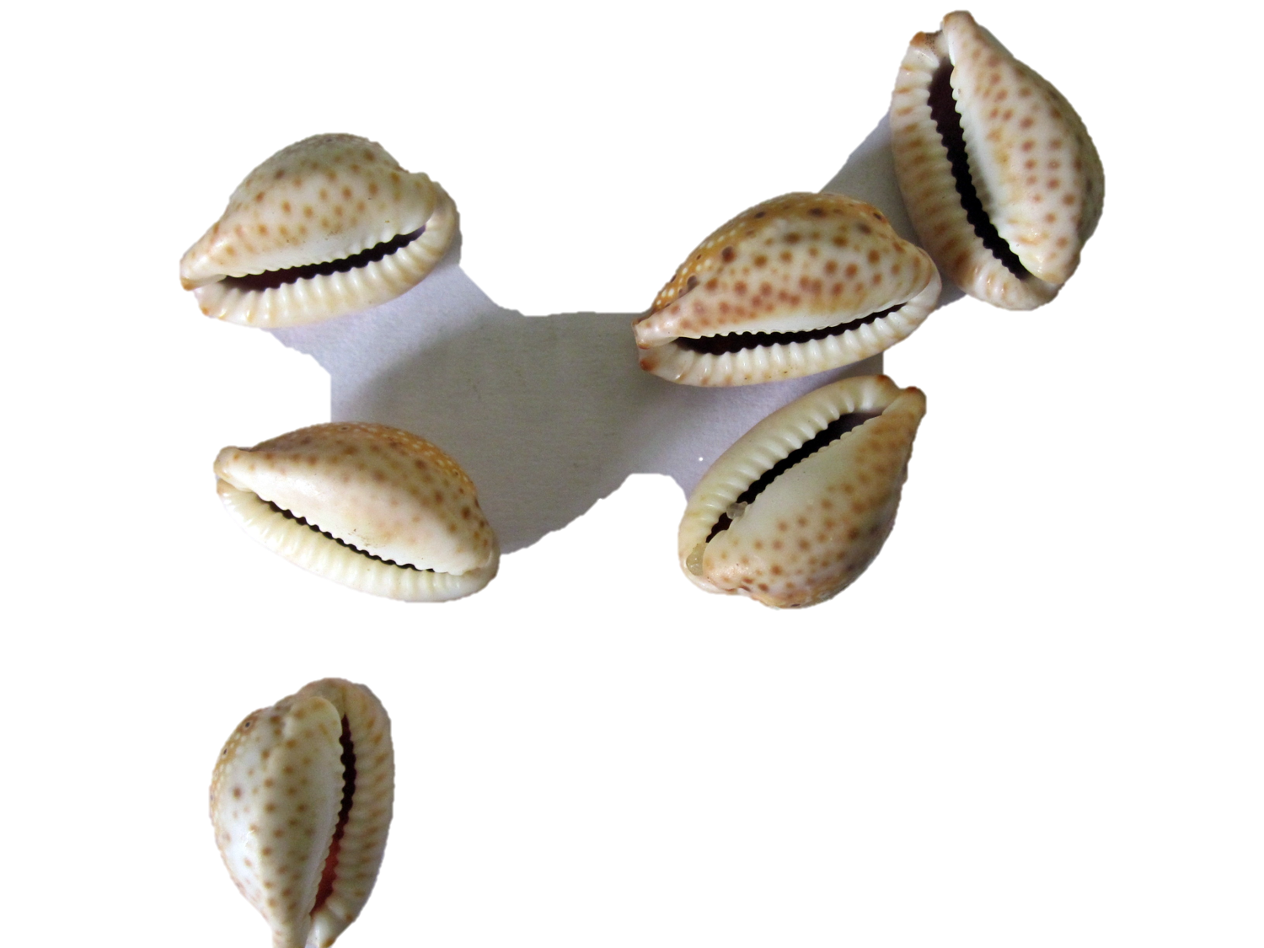
Cowrie shells
Working for
the
MONEY LAB

Slide 15
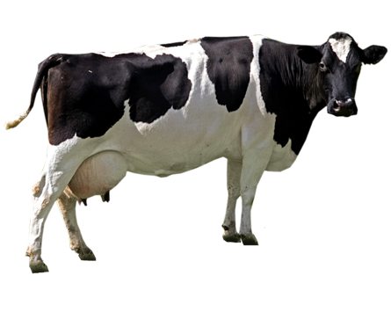
Cattle
Working for
the
MONEY LAB

Slide 16
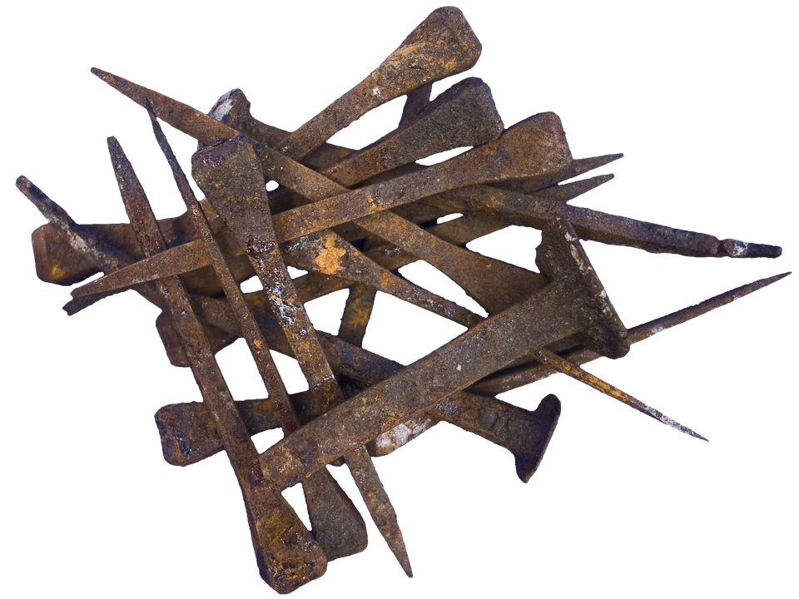
Nails
Working for
the
MONEY LAB

Slide 17
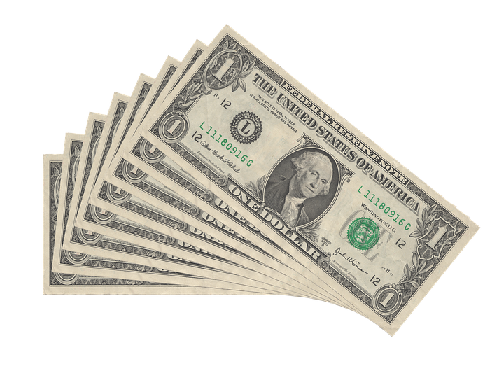
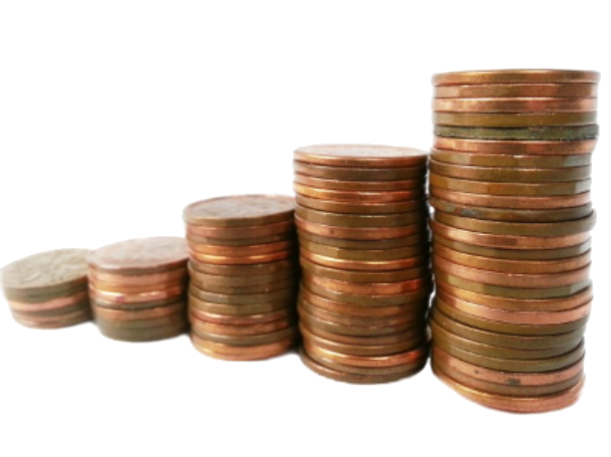
Paper and coins
Working for
the
MONEY LAB

Slide 18
Which type of money should Newland use?
Working for
the
MONEY LAB

Slide 19
Time to Review (pt. 1)
!
Time
to
review
I can last a long time and stay in good condition.
Durable

Slide 20
Time to Review (pt. 2)
!
Time
to
review
I am easy to carry around—not too
heavy, not too big.
Portable

Slide 21
Time to Review (pt. 3)
!
Time
to
review
There is a limited amount of me
available.
Scarce

Slide 22
Time to Review (pt. 4)
!
Time
to
review
I am the same size
and shape.
Uniform

Slide 23
Time to Review (pt. 5)
!
Time
to
review
I can be easily separated to make change.
Divisible

Slide 24
Time to Review (pt. 6)
!
Time
to
review
You can use me
to pay for things.
Accepted

Slide 25
Time to Review (pt. 7)
!
Time
to
review
1.
What is money?
2.
What are the characteristics of money?
3.
What makes something useful as money?

Slide 26
Are bottle caps useful as money in Cameroon?
In Cameroon, a country in Africa, some people are using bottle caps as money. For example, one bottle cap can pay for a taxi ride. People started using the bottle caps as money because some businesses are giving prizes for bottle caps. People buy a drink in a bottle, and when they look under the cap, they can see which prize they have won.

Slide 27
The Characteristics of Money
What makes something useful as money?
Lesson

