Slide 1

PACED Pretzels
Ox-Cart Man
Slides

Slide 2
Vocabulary 1
Word | Definition/Examples | Picture
Natural Resource | Things that occur naturally in or on the earth. Examples: Trees, Land, Water, Sunlight, Oil, Sheep, Cows
Capital Resource | Things people make and use over and over to make other things. Examples: Tools, Buildings, Machines, Desks, Computers
Human Resource | People who work to produce goods and services. Examples: Bus driver, Mechanic, Store Clerk, Teacher, Lawyer, Hair Stylist

Slide 3
Vocabulary 1 (cont.)
Word | Definition/Examples | Picture
Goods | Objects that satisfy people’s wants. Examples: Pencils, Crayons, Books, Food, Candy, Couch
Services | Actions that satisfy people’s wants Examples: House cleaning, Medical care, Bus ride, Food delivery

Slide 4

Mittens

Slide 5

Boy with Cold Hands

Slide 6

Boy with Mittens

Slide 7
Vocabulary 2
Word | Definition/Examples | Picture
Circular Flow of the Economy | A picture that shows how people exchange goods, services, and resources in markets. It includes a market for businesses to buy resources and a market for people to buy goods and services.
Markets | Where buyers and sellers come together to exchange goods, services, and resources. Examples: Supermarket, shoe store, toy store, online stores
Consumers | People who buy and use goods and services. Examples: Students, family members, neighbors, many others

Slide 8
Vocabulary 2 (cont.)
Word | Definition/Examples | Picture
Businesses | Organizations that produces goods and services and sells them to consumers. Examples: McDonalds, Target, Pizza Hut, Car Dealer
Money | Something most people accept as payment for things. Examples: U.S. Dollars and coins in the U.S; Pesos in Mexico, Euros in the European Union
Income | Payment people receive for the resources they sell. Examples: Teachers, doctors, and other workers earn income.

Slide 9

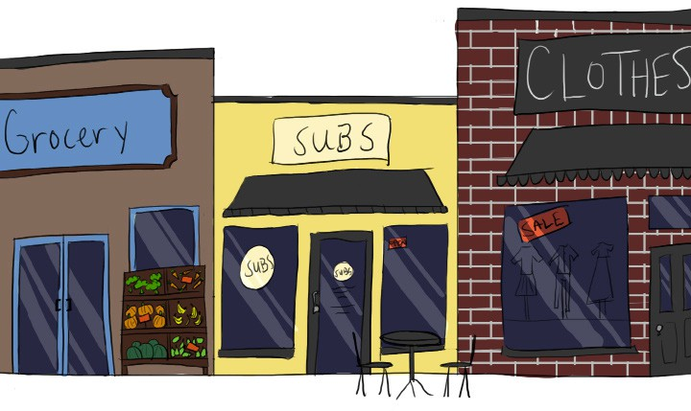
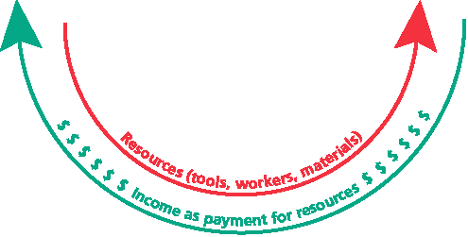
Resource Market

Slide 10
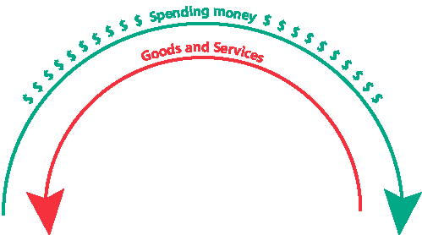
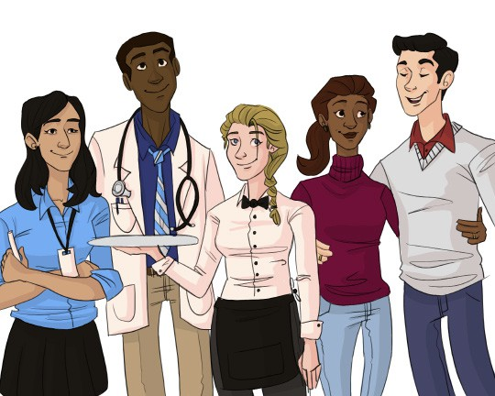
Goods and Services Market

Slide 11
Goods and Services Market (cont.)

Slide 12
Closure
Who are consumers?
Who sells goods and services?
How do consumers and businesses interact in markets?
In which market do people and businesses exchange goods and services and payments (money)?
Who sells resources to businesses?
What do people receive in exchange for the resources they sell?
Where do people and businesses exchange resources and income?
What do we call the picture or diagram that shows how businesses and people exchange goods, services, resources, income, and payments?

Slide 13
Ox-Cart Man Lesson

