Slide 1

Comparative Advantage: Trading Pizzas and Brownies
Curt Anderson, Ph.D., Professor Emeritus, University of Minnesota-Duluth
Scott Wolla, Ph.D., Federal Reserve Bank of St. Louis

Slide 2

For many years, the people of Acca and the people of Dur kept to themselves, rarely venturing across the sea that separates their countries. Over time, the countries developed very differently from each other.
Acca
Dur

Slide 3
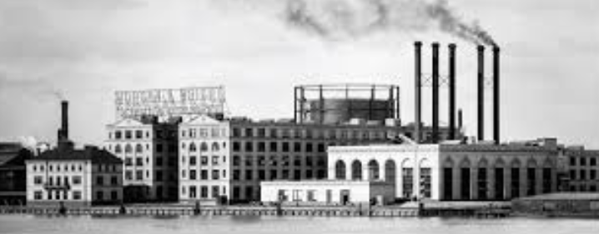
Acca was considerably north of Dur and in a cooler climate, and its people developed energy resources to keep warm. Later they used this energy to fuel the machines that produce the goods they want.
Acca
Dur

Slide 4
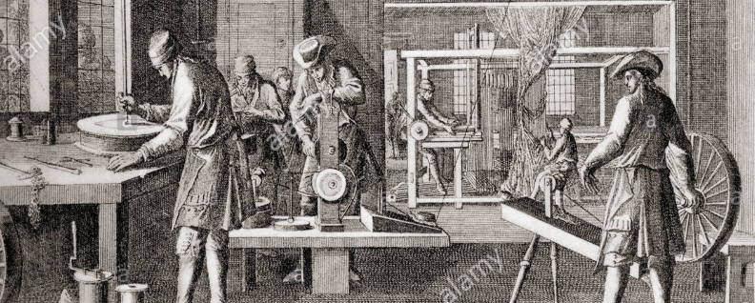
Dur was in warmer climate and did not develop energy resources, so its people have tended to produce most of the goods they want by hand.
Acca
Dur

Slide 5
Despite this difference, however, Accans and Durites have one thing in common: They all love pizza and brownies. In fact, they spend a great deal of their time producing and eating as many pizzas and brownies as they can.
Acca
Dur

Slide 6






Productivity: The number of goods that can be produced in a given amount of time.
 | Pizzas produced in one hour | Brownies produced in one hour
Accans
Durites
= Pizzas
= Brownies

Slide 7




Opportunity cost: The value of the next-best alternative when a decision is made; it’s what is given up.
 | Opportunity cost of producing one pizza | Opportunity cost of producing one brownie
Accans
Durites
= Pizzas
= Brownies

Slide 8
Comparative advantage: The ability to produce at a lower opportunity cost than another producer.
.
 | Opportunity cost of producing one pizza | Opportunity cost of producing one brownie
Accans
Durites
= Pizzas
= Brownies

Slide 9
Terms of Trade
=
If Acca produces pizzas and trades for brownies, would a trade of one pizza for one brownie be desirable?
If Dur produces brownies and trades for pizzas, would a trade of one brownie for one pizza be desirable?

