Slide 1
Beyond the Bet: Weighing Gambling Risks
©2025, Nebraska Council on Economic Education, with funding from the Nebraska Commission on Problem Gambling. Developed in partnership with the Federal Reserve Bank of St. Louis. Permission is granted to reprint or photocopy this lesson in its entirety for educational purposes, provided the user credits the Nebraska Council on Economic Education.

Slide 2
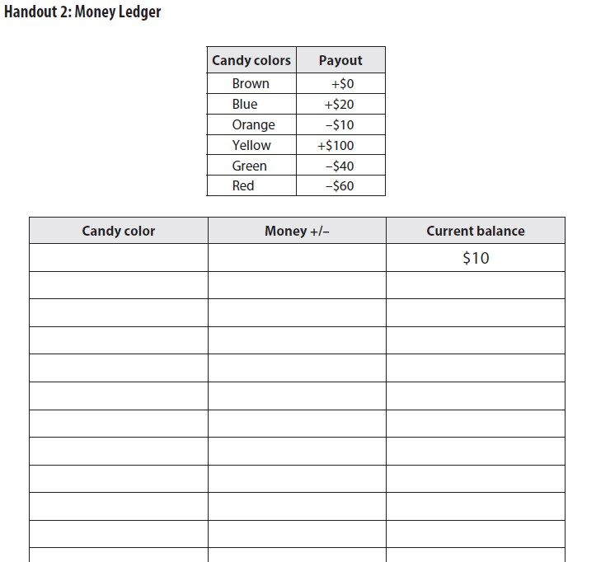
Let’s play a game!
You are going to play in your groups of 3-4.
You will take turns pulling one piece of candy from your bag for the peer to your left (working clockwise).
  Pull the candy without looking.
  The selected candy is going to represent money that the peer will win or lose.
Fill out Handout 2: Money Ledger based on the color of the candy that was drawn for you and collect or put back the amount shown.
  If you go negative, just keep track of the negative amount on your handout.
  Only pull money when you reach positive numbers.

Slide 3
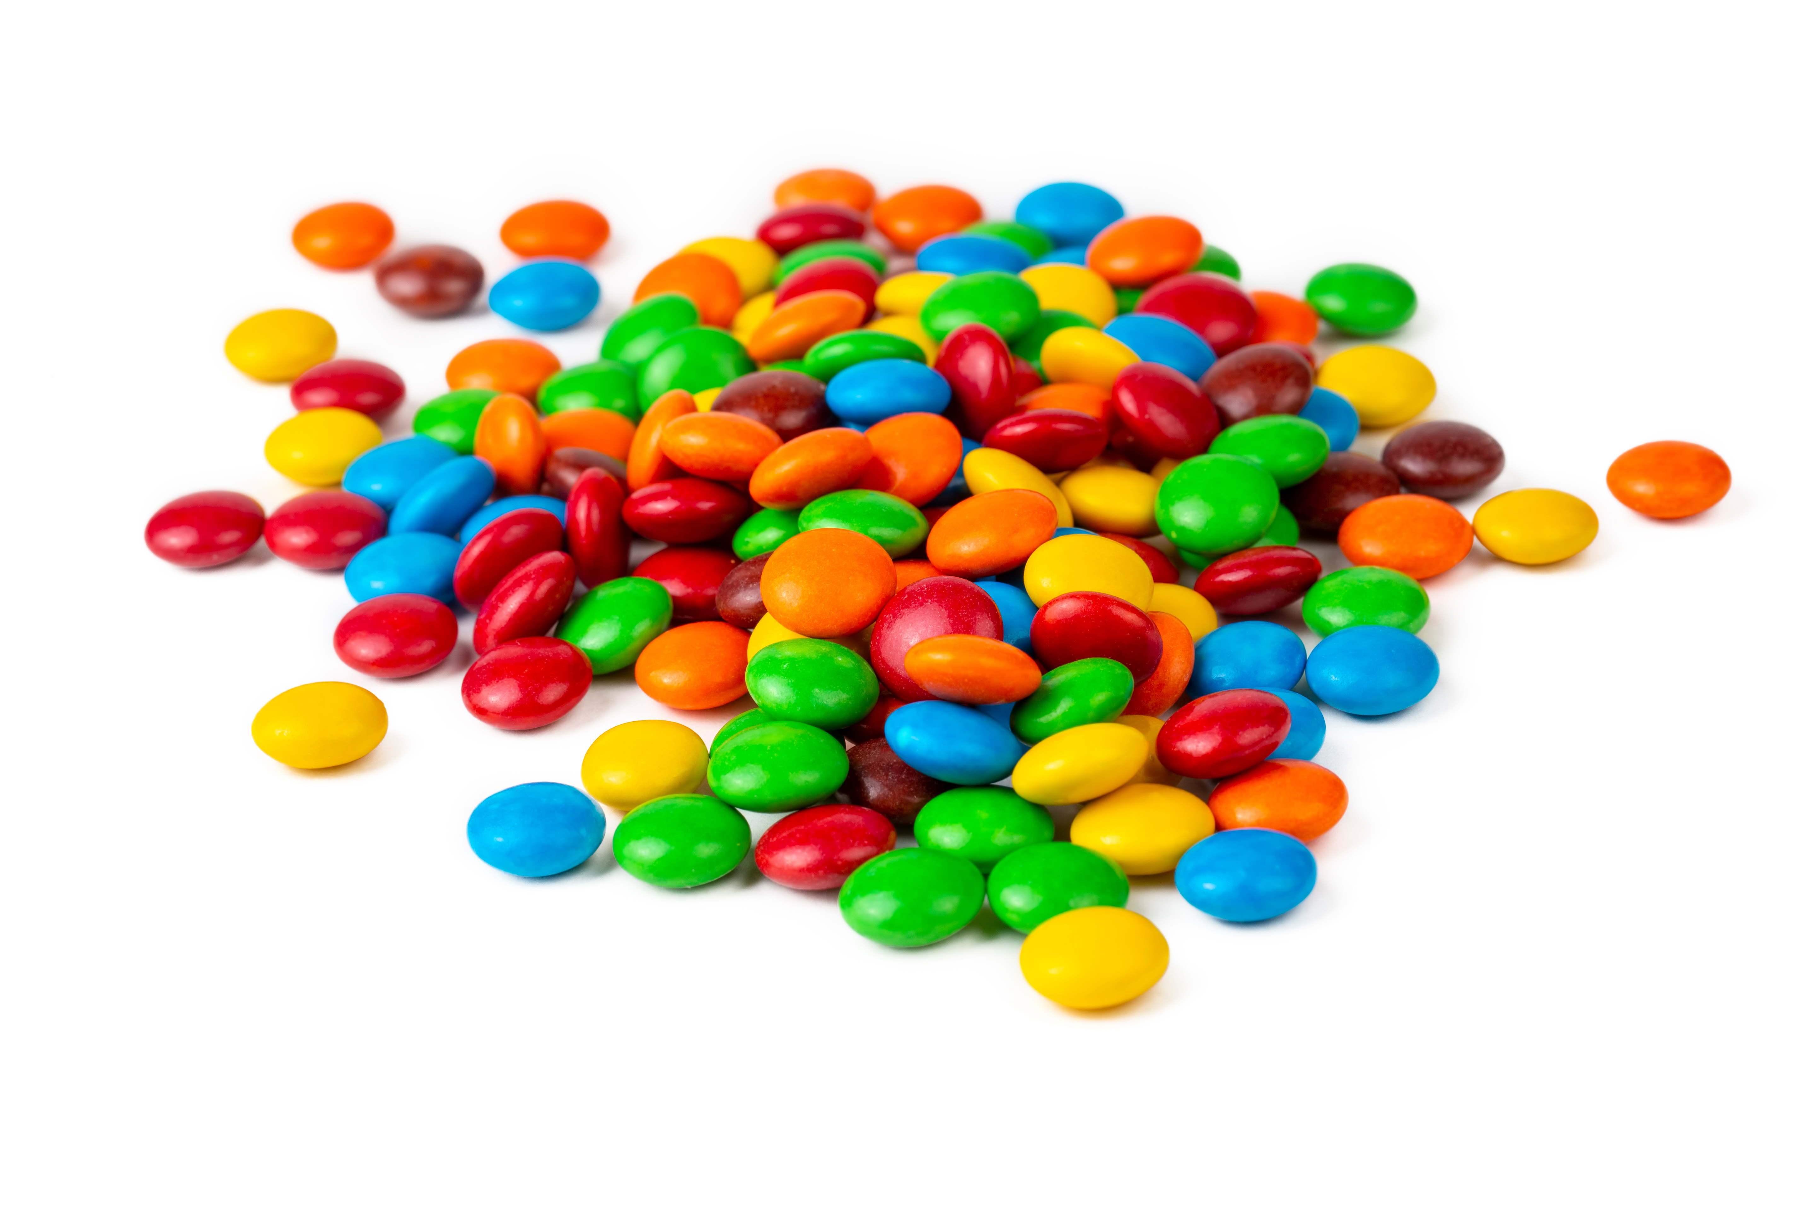
Payouts by candy color
Candy colors | Payout
Brown | +$0
Blue | +$20
Orange | −$10
Yellow | +$100
Green | −$40
Red | −$60

Slide 4
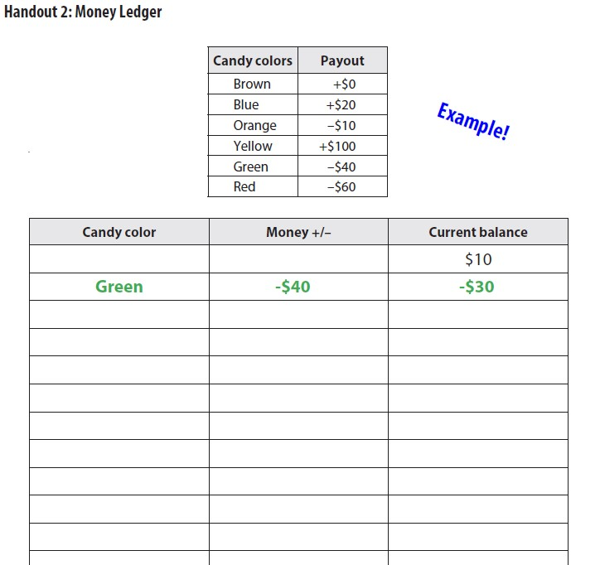
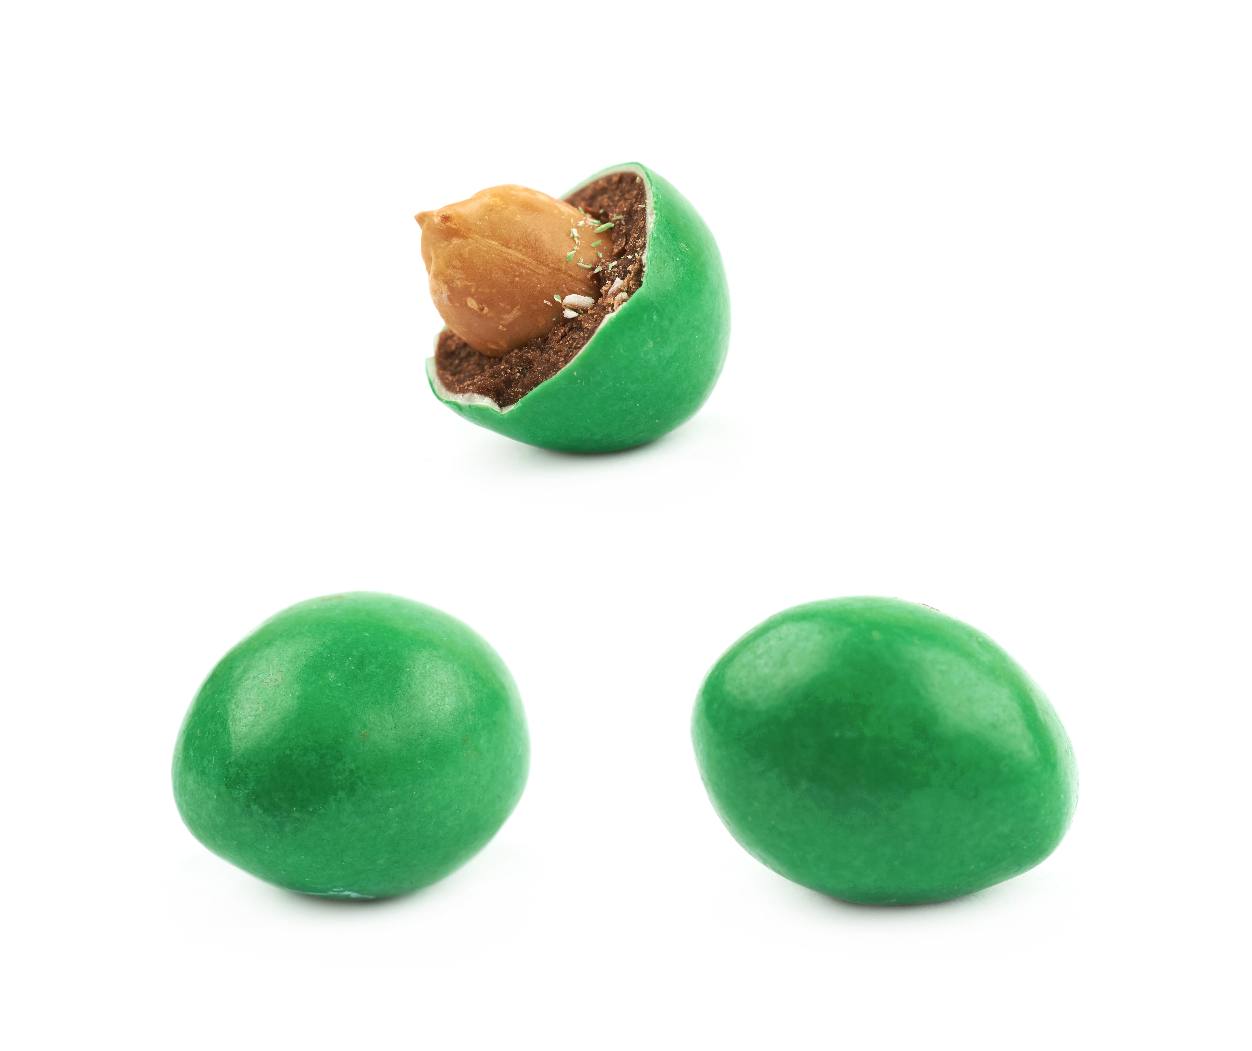
Example
Suppose your classmate pulls out a green candy for you.

Slide 5
Additional instructions
Your goal is to win the most play money during the game!
At any point you can stop, which means you will stick with the amount you have.
  IMPORTANT: Once you stop, you cannot re-enter the game.
The teacher will call “time” when the game is over, and whoever has the most money at that point will win the prize.

Slide 6
Discussion
With a show of hands, who won money?
With a show of hands, who lost money?
Was this fun? Why?
How many of you kept playing even though some were losing money? Why?

Slide 7
What is gambling?
Gambling is risking money on the chance of winning more money.
Gambling involves a lot of decisionmaking; you need to decide whether you want to gamble, what game you might play, how much you are willing to spend or wager, when to stop, etc.
  Economics is the study of choices; because of all the choices that come from participating in gambling, it’s especially important to understand economics when thinking about gambling.

Slide 8
$15.52 Billion
2023 Nevada’s statewide gross gaming revenue (GRR), or the money the state earned in a year from gambling
How can there be so much revenue from gambling?
https://www.statista.com/statistics/187926/gross-gaming-revenue-by-state-us/

Slide 9
House edge
House edge is the average gross profit a casino can expect to make. It’s not set by the casino but based on the games themselves.
  This means that games at a casino are designed so that, in general, the casino will make money while the people playing the games will lose money.

Slide 10
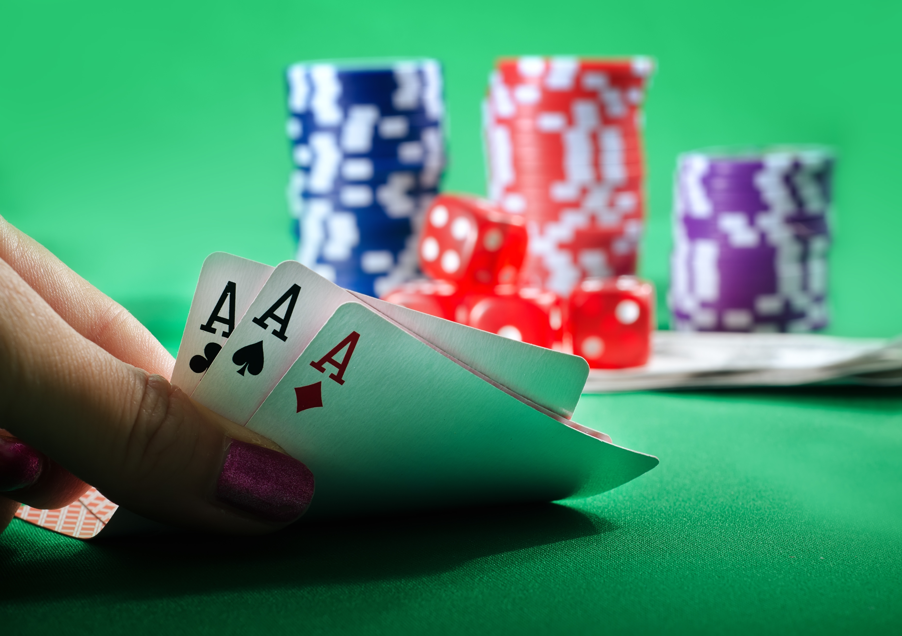
Hold ‘em house edge example
Hold ‘em (aka Texas Hold ‘em) is a type of poker where players are dealt two cards face down and then combine them with five community cards dealt face up in the middle of the table to create the best five-card hand
The house edge is approximately 2.36%
For every $100 you spend on Hold ‘em you can expect to lose about 2.36%, or $2.36.

Slide 11
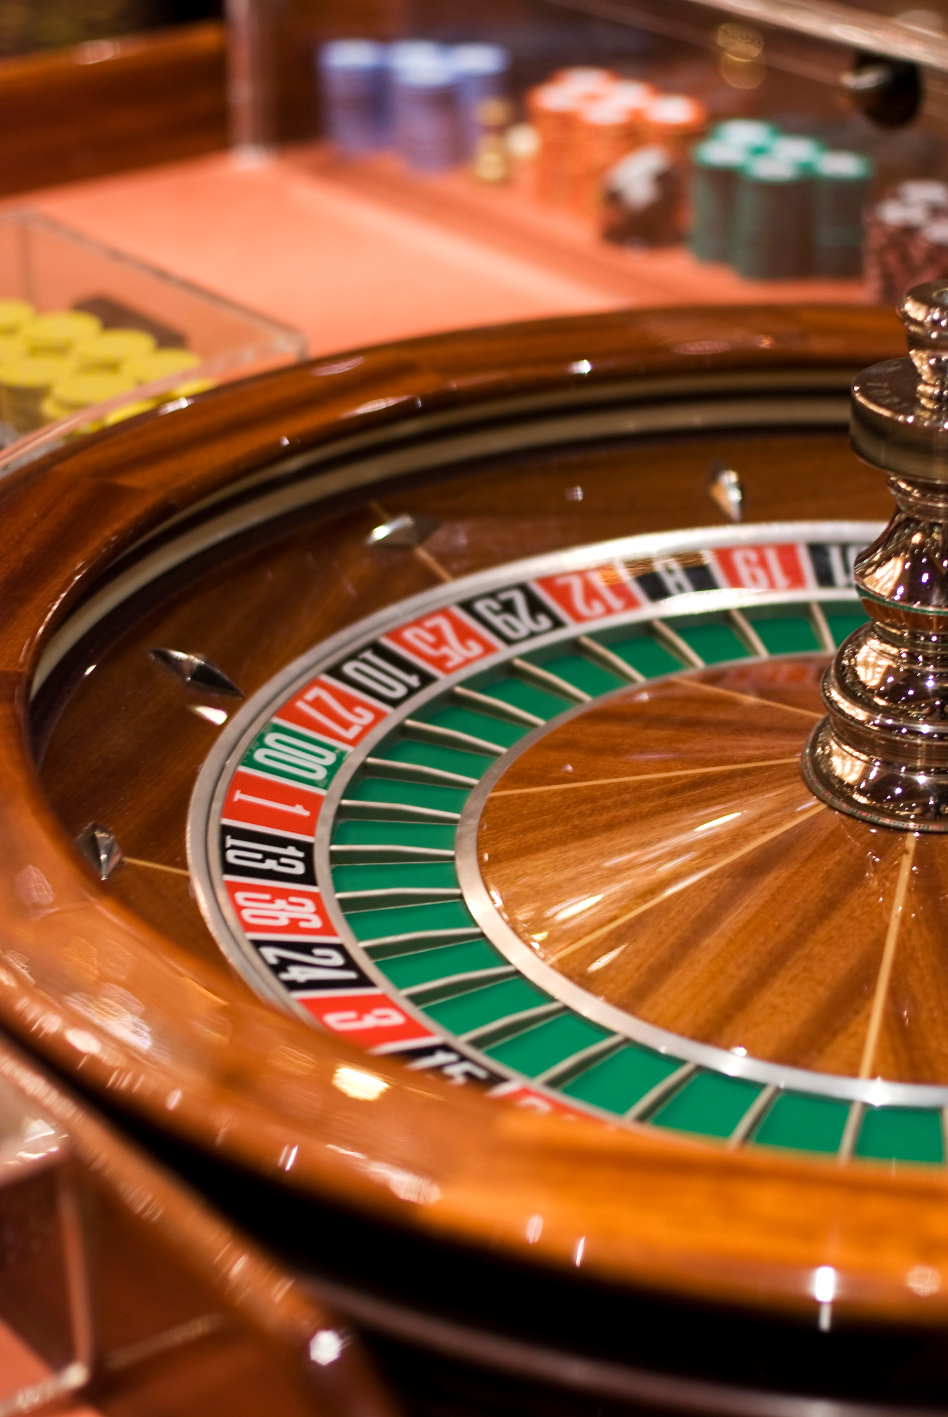
American Roulette
A casino game of chance where players bet on where a small ball will land on a spinning wheel divided into numbered and colored slots.
5.26%

Slide 12
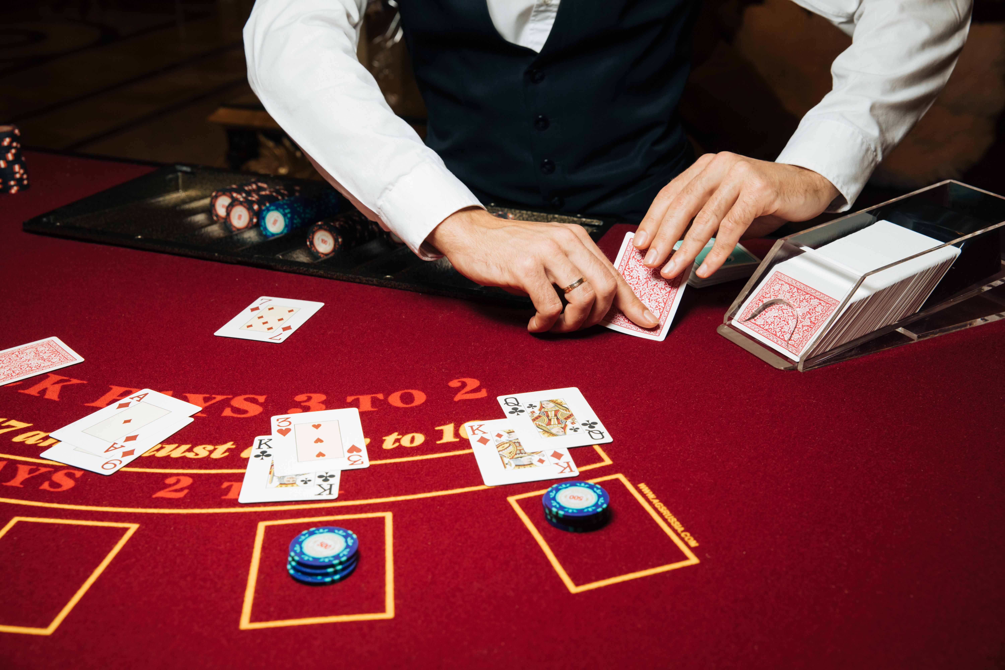
Blackjack
A gambling game in which the object is to obtain from the dealer cards whose values add up to, or close to, 21 but do not exceed it.
0.5%

Slide 13
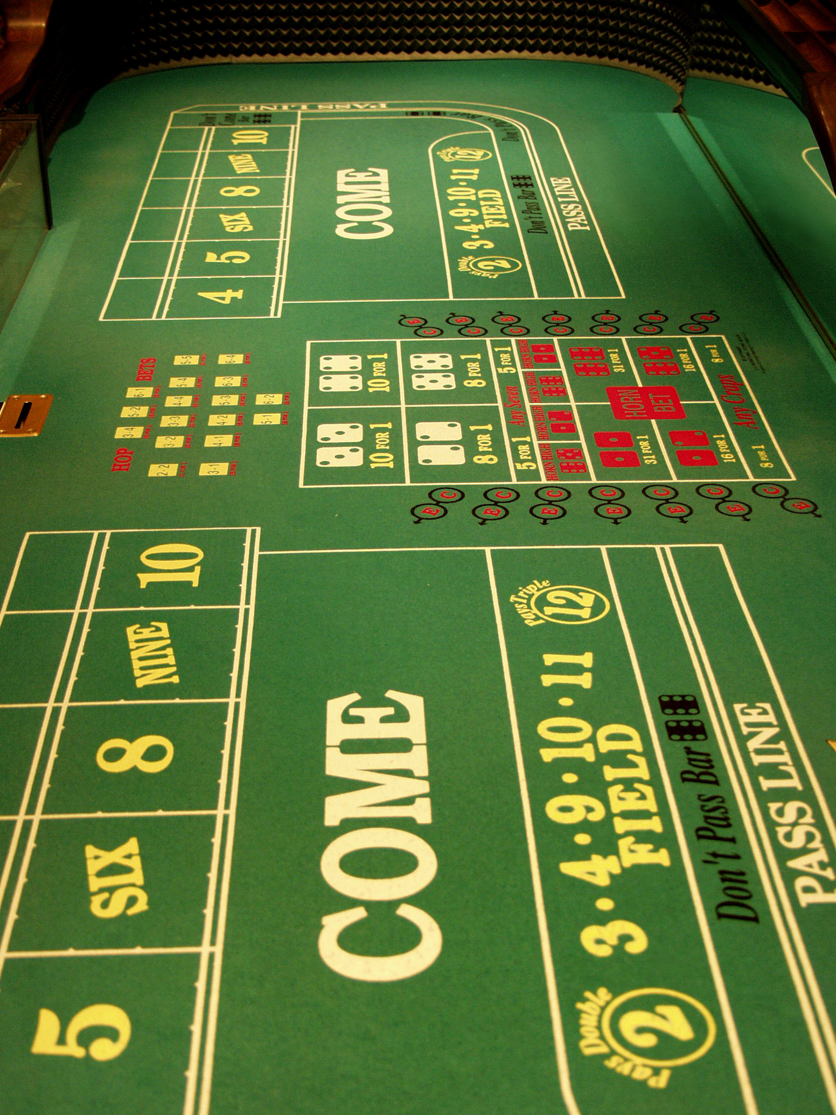
Craps
A dice game in which players bet on the outcomes of the roll of a pair of dice: Players can wager money against a bank in a casino. A player wins the bet if 7 or 11 is thrown first and loses if 2, 3, or 12 is thrown. Any other number that rolls becomes the “point,” and the point must roll again before a 7 to win.
0-16.67%

Slide 14
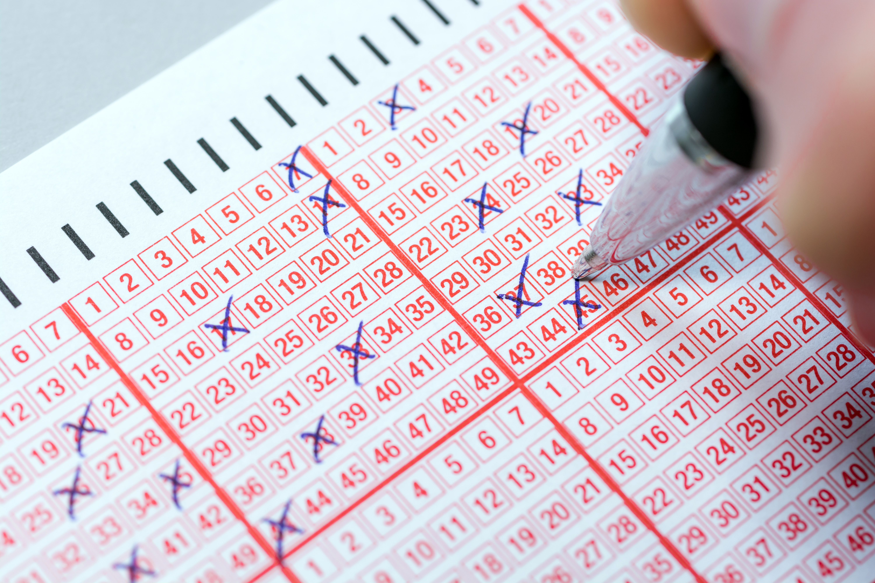
Keno
A gambling game played using cards or tickets with numbers usually from 1-80: Player marks as many of these numbers as they want, up to a permitted maximum. Then the player turns in the card to register it. They win based on how many of the numbers they selected were randomly drawn by a computer.
20-40%

Slide 15
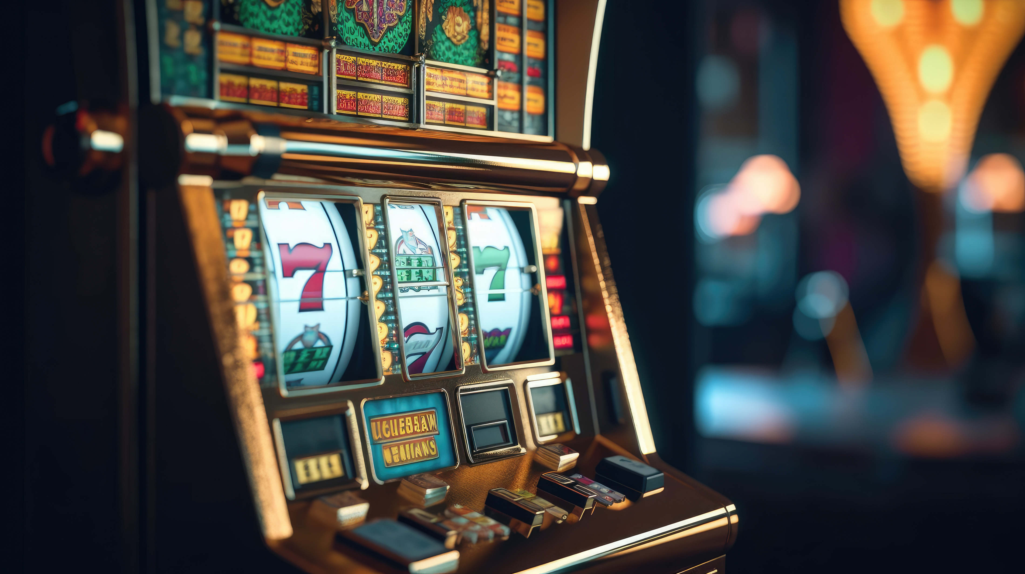
Slots
Also known as a slot machine or gaming machine: It is a gambling device featuring spinning reels adorned with various symbols. The goal is to line up pre-determined symbols across the paylines to win prizes.
2-15%

Slide 16
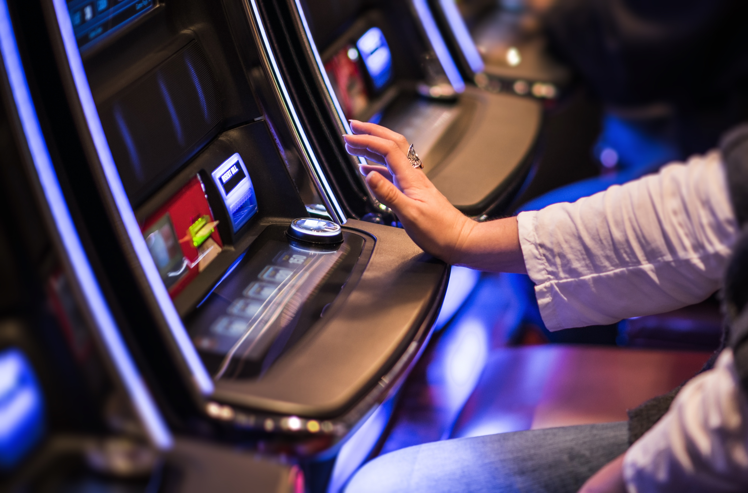
Video Poker
An electronic card game type based on five-card draw poker that is played on a console liminal similar to a slot machine.
0.46%

Slide 17
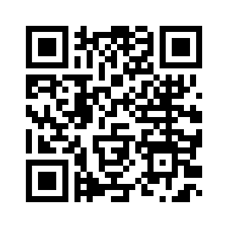
House edge for different casino games
If there is always a house edge, then how do some people win?
Optional: Go to the following website on your devices and read more about the house edge:
Casino games | House edge
American Roulette | 5.26%
Blackjack | 0.5%
Craps | 0-16.67%
Keno | 20-40%
Slots | 2-15%
Video Poker | 0.46%
Hold 'em | 2.36%
https://www.casino.org/features/house-edge/
Notes:
https://www.casino.org/features/house-edge/

Slide 18
Calculating the expected value or house edge of our game
Candy colors | Payout | Probability
Brown | +$0 | 0.17
Blue | +$20 | 0.17
Orange | −$10 | 0.17
Yellow | +$100 | 0.17
Green | −$40 | 0.17
Red | −$60 | 0.17
E(x) = ($0 x 0.17) + ($20 x 0.17) + (−$10 x 0.17) + ($100 x 0.17) + (−$40 x 0.17) + (−$60 x 0.17) = −$3.33

Slide 19
Questions about the house edge
What is your reaction to learning about the house edge?
Does knowing the house edge change your decisionmaking?
If we know about the house edge and that you are more likely to lose money when you gamble, why do you think so many people gamble in Las Vegas and other casinos?

Slide 20
Problem gambling
Problem gambling is when gambling interferes with everyday life; that is, gambling more than you have; experiencing feelings of remorse, compulsivity, or being out of control; or when others question your gambling.
Gambling can be a source of entertainment but can also become problematic, which can cause major financial and personal issues.
Throughout the country there are organizations that assist people who feel like their gambling has become a problem.
Gambling can become addictive (much like drugs or alcohol), and these organizations use various treatment and prevention services to help people who suffer from a gambling addiction.

Slide 21
Nebraska Problem Gamblers Assistance Program’s
2022-23 New Client Data annual report
Total gambling debt: $4.1 million ($36K average per client)
40.3: Average age of all problem gamblers at time of admission
9% of those admitted for assistance from the Nebraska Problem Gamblers Association are between the ages of 18 and 25.
35% of those seeking help with problem gambling report financial problems as their primary motivation.
68% of problem gamblers report gambling debt.
9% of problem gamblers report gambling debt in excess of $100K.
37.6% of problem gamblers report thoughts of suicide before seeking treatment for gambling addiction.
*NOTE* This information is only from people seeking help; there are likely many people who gamble (either recreationally or with an addiction) who are not accounted for in this information.
https://problemgambling.nebraska.gov/storage/link_list_files/NPGAP-Gambler-Intake-Data---Helpline-Urgent-Calls---FY2023---draft-8-11-2023.pdf

Slide 22
Help with gambling addiction
Positive outcome of the Nebraska Problem Gamblers Assistance Program:
85% of clients report decreasing their problem gambling behavior after counseling commenced

Slide 23
Closure
What does it mean to have a house edge?
Does this mean everyone loses?
Does the house edge mean that gambling is bad?
Why do people gamble even if they know they can (and likely will) lose money?

Slide 24
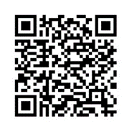
Assessment: How does “money personality” affect gambling?
Navigate to the following website: Nerdwallet’s “What’s Your Money Personality? Take Our Quiz to Find Out” https://www.nerdwallet.com/article/finance/money-personality
What breakdown did you have of each of the four common attitudes toward money?
How did your money personality impact the way you played the candy game? Can you think of another example in your life where your money personality influences your choices?
Do you think people who gamble tend to have a certain type of money personality? What about people who may be problem gamblers? Explain.
In what ways has this lesson affected your personal views on gambling and why?

