Slide 1
Beyond the Bet: Identifying Problem Gambling
©2025, Nebraska Council on Economic Education, with funding from the Nebraska Commission on Problem Gambling. Developed in partnership with the Federal Reserve Bank of St. Louis. Permission is granted to reprint or photocopy this lesson in its entirety for educational purposes, provided the user credits the Nebraska Council on Economic Education.

Slide 2
Gambling by the Numbers Instructions
You’ll receive either a number or a statement.
Goal is to find your match. One number matches one clue.
When you think you have found your partner, move out of the group into the designated area.

Slide 3
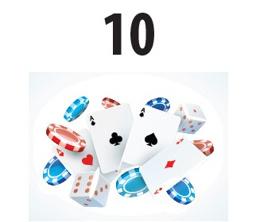
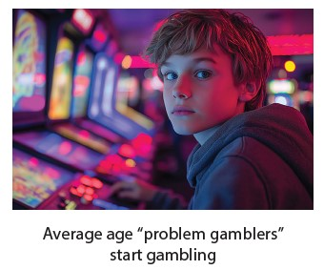

Slide 4
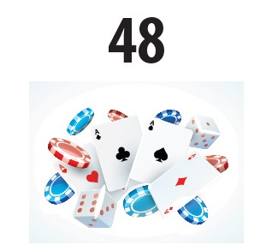
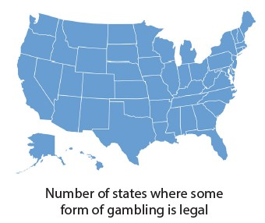

Slide 5
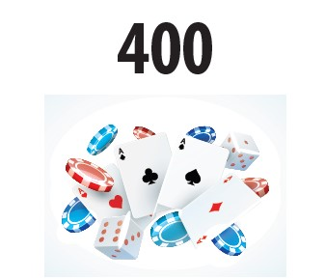
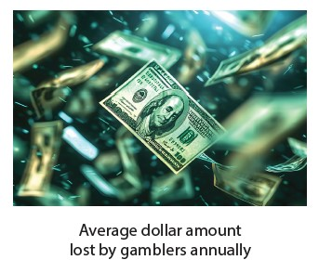

Slide 6
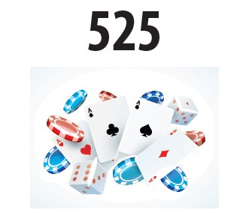
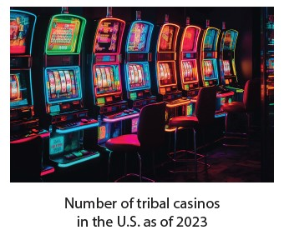

Slide 7
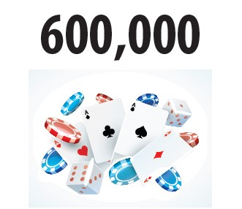
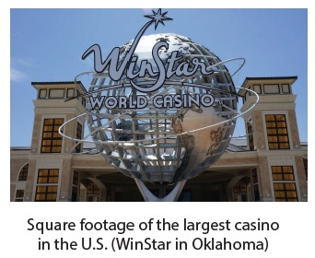

Slide 8
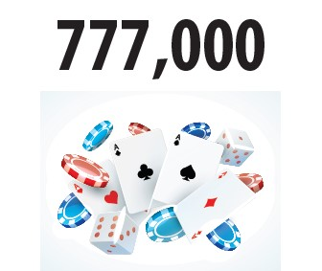
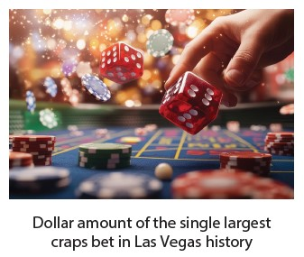

Slide 9
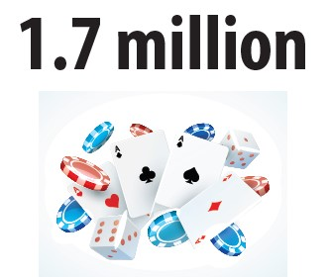
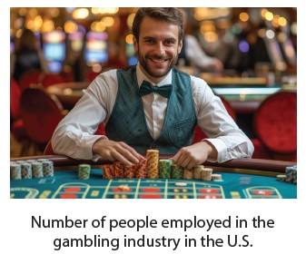
Notes:
NOTE: These numbers are per person - not per coffee drinker.

Slide 10
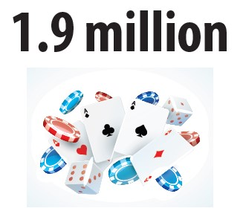
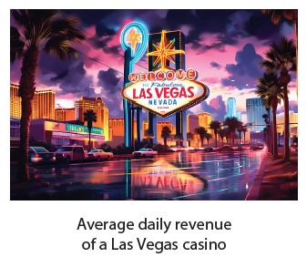

Slide 11
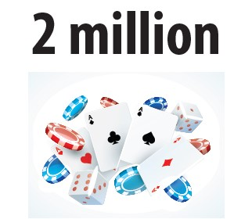
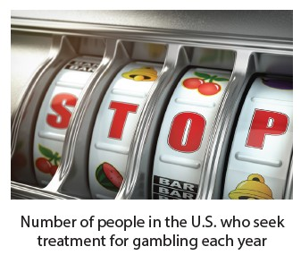

Slide 12
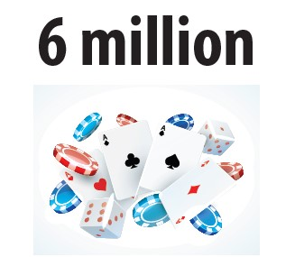
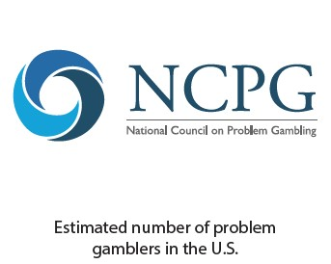

Slide 13
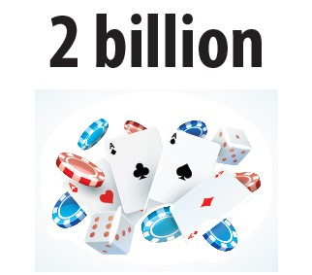
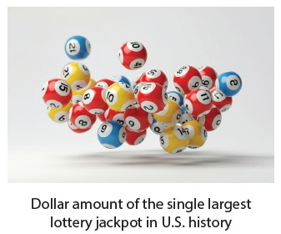

Slide 14
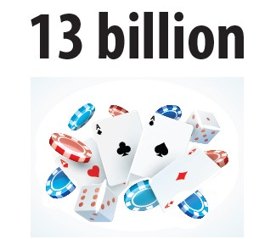
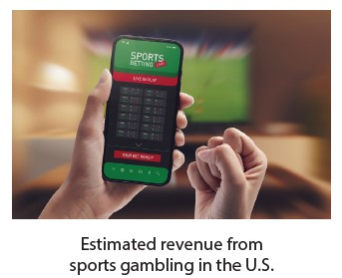

Slide 15
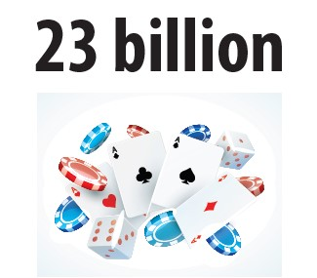
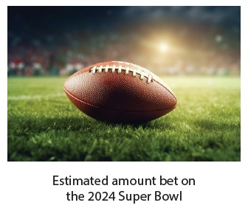

Slide 16
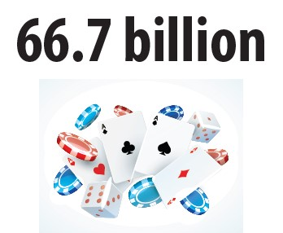
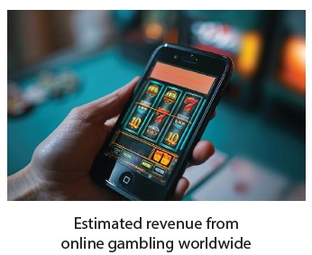
Notes:
NOTE: These numbers are per person - not per coffee drinker.

Slide 17
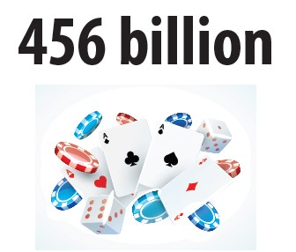
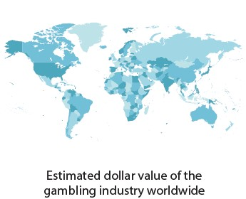

Slide 18
What did you learn?
What was your main takeaway from the Gambling by the Numbers activity?
When money is spent on gambling, that means it is not being spent on something else.
Opportunity cost is the next-best alternative given up when a choice is made.

Slide 19
NOT
GAMBLING
DEFINITELY
GAMBLING

Slide 20
Gambling
Risking money on the chance of winning more money

Slide 21
Problem gambling
When gambling negatively interferes with everyday life; that is, gambling more than you have; experiencing feelings of remorse, compulsivity, or being out of control; or when others question your gambling

Slide 22
SCENARIO A: Monique
Monique has started spending more on raffle tickets, increasing from the occasional $30 to consistently buying them each week, doubling her usual spending on bingo nights.
Monique has borrowed money from friends to cover her bingo expenses or has had to cut back on essential expenses like groceries or bills to continue her bingo habit.
Monique frequently talks about bingo, thinks about it throughout the week, and looks forward to Tuesday nights to the point where it affects her focus on work or school.
Monique feels anxious or irritable if she misses a bingo night, showing signs of withdrawal or an emotional dependence on the activity.

Slide 23
SCENARIO B: Lawrence
Lawrence has accumulated $5,000 in credit card debt due to his high-stakes bets during football season.
Lawrence used some of his winnings to sponsor new jerseys for the local middle school football team, contributing positively to his community.
After losing $500 on a single game, Lawrence often places another bet of equal or greater value to try to recover his losses, leading to more significant financial risks.
Lawrence enjoys the social aspect of his fantasy football leagues and has made several new friends through these activities, enhancing his social network and providing a positive outlet for his competitive spirit.

Slide 24
SCENARIO C: Sanjat
Sanjat’s family does not know about his plans to gamble in Atlantic City, and they generally frown upon gambling, which could lead to familial conflict if they find out.
Casinos are known to be highly vigilant about card counters and often mistreat or ban them. Sanjat could face serious consequences, including being asked to leave or being blacklisted from casinos if caught.
Sanjat has decided to use his winnings to fund his trip to Atlantic City, demonstrating a level of financial planning and using his gambling earnings for further opportunities.
Sanjat's focus on card counting and blackjack could distract him from his academic responsibilities, potentially affecting his high-achieving status at his prestigious university.

Slide 25
SCENARIO D: Daniela
Daniela often hides her online poker playing from her family and friends, and when someone asks her about it, she downplays it by saying she’s just trying it out for the first time, indicating a level of secrecy about her gambling activities.
Daniela has occasionally had to dip into her savings to fund her online poker games when her weekly budget wasn't enough, highlighting a potential financial risk.
Daniela sometimes feels guilty about the amount of time she spends playing poker, which suggests she is aware of the potential negative effects on her life but is struggling to balance her hobby with other responsibilities.
Playing online poker has allowed Daniela to join a community of like-minded individuals and improve her strategic thinking and decisionmaking skills, providing her with intellectual stimulation and a sense of belonging.

Slide 26
Debriefing Questions
How do we define gambling?
How do we define problem gambling?
What economic concepts are at play when discussing gambling and problem gambling?
Thinking about some of the people from the second activity, how would opportunity costs come into play regarding some of their decisions?

