Slide 1
Balance of Payments
AP Macro Lecture Guide

Slide 2
Balance of Payments: Definition
The balance of payments is an accounting system that records a country’s international transactions for a particular time period. It consists of the current account (CA) and the capital and financial account (CFA).
Any transaction that causes money to flow into a country is a credit to its balance of payments account, and any transaction that causes money to flow out is a debit. The sum of all entries, both credit and debit, should equal zero (CA + CFA = 0).

Slide 3
Round 1: The Current Account
The current account (CA) records
net exports,
net income from abroad, and
net unilateral transfers.

Slide 4
Round 1: Transaction 1
Round 1
The United States purchases electronic equipment from Japan for $75.
U.S. Current Account
Transaction | U.S. debit | U.S. credit
1
2
3
Total
Japan’s Current Account
Transaction | Japan’s debit | Japan’s credit
1
2
3
Total

Slide 5
Round 1: Transaction 1 Result
Round 1
The United States purchases electronic equipment from Japan for $75.
U.S. Current Account
Transaction | U.S. debit | U.S. credit
1 Import: electronic equipment | -75
2
3
Total
Japan’s Current Account
Transaction | Japan’s debit | Japan’s credit
1 Export: electronic equipment |  | +75
2
3
Total

Slide 6
Round 1: Transaction 2
Round 1
Japan purchases agriculture products from the United States for $15.
U.S. Current Account
Transaction | U.S. debit | U.S. credit
1 Import: electronic equipment | -75
2
3
Total
Japan’s Current Account
Transaction | Japan’s debit | Japan’s credit
1 Export: electronic equipment |  | +75
2
3
Total

Slide 7
Round 1
Round 1: Transaction 2 Result
Japan purchases agriculture products from the United States for $15.
U.S. Current Account
Transaction | U.S. debit | U.S. credit
1 Import: electronic equipment | -75
2 Export: agriculture products |  | +15
3
Total
Japan’s Current Account
Transaction | Japan’s debit | Japan’s credit
1 Export: electronic equipment |  | +75
2 Import: agriculture products | -15
3
Total

Slide 8
Round 1: Transaction 3
Round 1
A U.S. citizen receives $10 in remittances from a Japanese citizen.
U.S. Current Account
Transaction | U.S. debit | U.S. credit
1 Import: electronic equipment | -75
2 Export: agriculture products |  | +15
3
Total
Japan’s Current Account
Transaction | Japan’s debit | Japan’s credit
1 Export: electronic equipment |  | +75
2 Import: agriculture products | -15
3
Total

Slide 9
Round 1: Transaction 3 Result
Round 1
A U.S. citizen receives $10 in remittances from a Japanese citizen.
U.S. Current Account
Transaction | U.S. debit | U.S. credit
1 Import: electronic equipment | -75
2 Export: agriculture products |  | +15
3 Remittances received |  | +10
Total
Japan’s Current Account
Transaction | Japan’s debit | Japan’s credit
1 Export: electronic equipment |  | +75
2 Import: agriculture products | -15
3 Remittances paid | -10
Total

Slide 10
Round 1: Final Analysis
Calculate the totals for each column.
U.S. Current Account
Transaction | U.S. debit | U.S. credit
1 Import: electronic equipment | -75
2 Export: agriculture products |  | +15
3 Remittances received |  | +10
Total | -75 | +25
Japan’s Current Account
Transaction | Japan’s debit | Japan’s credit
1 Export: electronic equipment |  | +75
2 Import: agriculture products | -15
3 Remittances paid | -10
Total | -25 | +75

Slide 11
What is the Balance of Trade?
The balance of trade is part of a country’s current account. It shows whether a country is selling more to other countries (exports) or buying more from them (imports).
Calculate: Net exports = Exports – Imports
If the result is positive → Trade surplus
If the result is negative → Trade deficit

Slide 12
Wrap up Round 1
Calculate net exports (exports - imports) for the U.S.
Calculate the current account balance.
Is the U.S. current account in a deficit or surplus?
Is the U.S. balance of trade positive or negative? Explain.
How do you think this balance of trade will impact demand for U.S. dollars? Explain.
Calculate net exports (exports - imports) for Japan.
Calculate the current account balance.
Is Japan’s current account in a deficit or surplus?
Is Japan’s balance of trade positive or negative? Explain
How do you think this balance of trade will impact demand for Japanese yen? Explain.

Slide 13
Wrap up Round 1: Answers
Calculate net exports (exports - imports) for the U.S. -75 + 15 = -60
Calculate the current account balance. -60 +10 = -50
Is the U.S. current account in a deficit or surplus? Deficit
Is the U.S. balance of trade positive or negative? Explain. Negative: Since U.S. net exports are negative, the U.S. is running a trade deficit; it is spending more on goods and services from other countries than it is earning from selling (exporting) to them.
How do you think this balance of trade will impact demand for U.S. dollars? Explain. Demand for U.S. dollars will decrease, as yen are needed to pay for the increased imports.
Calculate net exports (exports - imports) for Japan. +75 - 15 = 60
Calculate the current account balance. 60 - 10 = 50
Is Japan’s current account in a deficit or surplus? Surplus
Is Japan’s balance of trade positive or negative? Explain. Positive: Since Japan’s net exports are positive, Japan is running a trade surplus; it is earning more from selling goods and services abroad (exporting) than it is spending.
How do you think this balance of trade will impact demand for Japanese yen? Explain. Demand for yen will increase, as the exports from Japan need to be purchased in yen.

Slide 14
Why Does the Balance of Trade Matter?
The balance of trade affects important parts of the economy.
A trade surplus can increase total spending (aggregate demand).
A trade deficit can decrease aggregate demand.
It can change the demand for a country’s currency in the foreign exchange market.

Slide 15
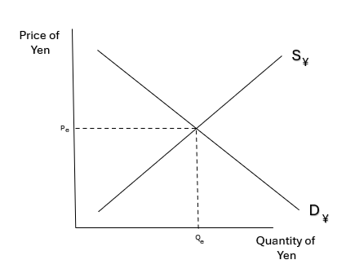
Foreign Exchange Market
The foreign exchange market is where currencies are bought and sold. Because a major driver of supply and demand for currencies is the need to make foreign purchases, transactions in the balance of payments can tell us about potential changes on the foreign exchange market.
If the U.S. needs more yen to purchase the additional imports (remember, the U.S. is in a trade deficit), what would you expect to happen to the demand for yen in the foreign exchange market?

Slide 16
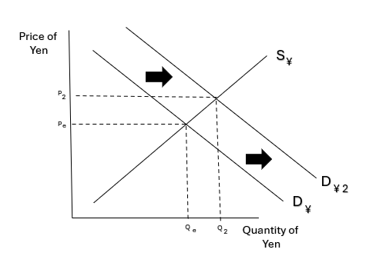
Foreign Exchange Market--Continued
The foreign exchange market is where currencies are bought and sold. Because a major driver of supply and demand for currencies is the need to make foreign purchases, transactions in the balance of payments can tell us about potential changes on the foreign exchange market.
If the U.S. needs more yen to purchase the additional imports (remember, the U.S. is in a trade deficit), what would you expect to happen to the demand for yen in the foreign exchange market? Demand for yen would increase, as more yen are needed to purchase the additional imports.

Slide 17
Round 2: The Capital and Financial Account
The capital and financial account (CFA) records
financial capital transfers and
purchases and sales of assets between countries.
Examples
Real estate purchases
Bond purchases
Money held in savings accounts
Transfer payments

Slide 18
Round 2
Round 2: Transaction 1
The U.S. Treasury sells bonds totaling $35 to Japan.
U.S. Capital and Financial Account
Transaction | U.S. debit | U.S. credit
1
2
3
Total
Japan’s Capital and Financial Account
Transaction | Japan’s debit | Japan’s credit
1
2
3
Total

Slide 19
Round 2: Transaction 1 Result
Round 2
The U.S. Treasury sells bonds totaling $35 to Japan.
U.S. Capital and Financial Account
Transaction | U.S. debit | U.S. credit
1 Bonds sold |  | +35
2
3
Total
Japan’s Capital and Financial Account
Transaction | Japan’s debit | Japan’s credit
1 Bonds purchased | -35
2
3
Total

Slide 20
Round 2: Transaction 2
Round 2
A Japanese company purchases land in the U.S. for $20 to build a new factory.
U.S. Capital and Financial Account
Transaction | U.S. debit | U.S. credit
1 Bonds sold |  | +35
2
3
Total
Japan’s Capital and Financial Account
Transaction | Japan’s debit | Japan’s credit
1 Bonds purchased | -35
2
3
Total

Slide 21
Round 2: Transaction 2 Result
Round 2
A Japanese company purchases land in the U.S. for $20 to build a new factory.
U.S. Capital and Financial Account
Transaction | U.S. debit | U.S. credit
1 Bonds sold |  | +35
2 Land sold |  | +20
3
Total
Japan’s Capital and Financial Account
Transaction | Japan’s debit | Japan’s credit
1 Bonds purchased | -35
2 Land purchased | -20
3
Total

Slide 22
Round 2: Transaction 3
Round 2
A U.S. citizen purchases stock in a Japanese car company for $5.
U.S. Capital and Financial Account
Transaction | U.S. debit | U.S. credit
1 Bonds sold |  | +35
2 Land sold |  | +20
3
Total
Japan’s Capital and Financial Account
Transaction | Japan’s debit | Japan’s credit
1 Bonds purchased | -35
2 Land purchased | -20
3
Total

Slide 23
Round 2: Transaction 3 Result
Round 2
A U.S. citizen purchases stock in a Japanese car company for $5.
U.S. Capital and Financial Account
Transaction | U.S. debit | U.S. credit
1 Bonds sold |  | +35
2 Land sold |  | +20
3 Stock purchased | -5
Total
Japan’s Capital and Financial Account
Transaction | Japan’s debit | Japan’s credit
1 Bonds purchased | -35
2 Land purchased | -20
3 Stock sold |  | +5
Total

Slide 24
Round 2: Final Analysis
Round 2
Calculate the totals for each column.
U.S. Capital and Financial Account
Transaction | U.S. debit | U.S. credit
1 Bonds sold |  | +35
2 Land sold |  | +20
3 Stock purchased | -5
Total | -5 | +55
Japan’s Capital and Financial Account
Transaction | Japan’s debit | Japan’s credit
1 Bonds purchased | -35
2 Land purchased | -20
3 Stock sold |  | +5
Total | -55 | +5

Slide 25
Wrap up Round 2
Calculate the capital and financial account balance for the U.S.
Is the U.S. capital and financial account in a deficit or surplus?
Using your charts from Rounds 1 and 2, calculate the balance of payments for the U.S.
How will the capital and financial account balance impact the loanable funds market in the U.S.?
Calculate the capital and fiancial account balance for Japan.
Is Japan’s capital and financial account in a deficit or surplus?
Using your charts from Rounds 1 and 2, calculate the balance of payments for Japan.
How will the capital and financial account balance impact the loanable funds market in Japan?

Slide 26
Wrap up Round 2: Answers
Calculate the capital and financial account balance for the U.S. +55 - 5 = 50
Is the U.S. capital and financial account in a deficit or surplus? Surplus
Using your charts from Rounds 1 and 2, calculate the balance of payments for the U.S. (CA + CFA = 0) -50 + 50 = 0
How will the capital and financial account balance impact the loanable funds market in the U.S.? The supply of loanable funds will increase, as there are more capital and financial inflows than outflows.
Calculate the capital and financial account balance for Japan. -55 + 5 = -50
Is Japan’s capital and financial account in a deficit or surplus? Deficit
Using your charts from Rounds 1 and 2, calculate the balance of payments for Japan. (CA + CFA = 0) +50 - 50 = 0
How will the capital and financial account balance impact the loanable funds market in Japan? The supply of loanable funds will decrease, as there are more capital and financial outflows than inflows.

Slide 27
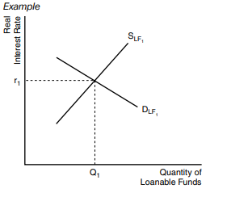
Loanable Funds Market
The loanable funds market shows the supply of funds available for loans or investment and the demand for those funds (borrowers). The capital and financial account records the inflow of financial capital into a country.
If the U.S. has a capital and financial account surplus (inflows > outflows), what would you expect to happen to the supply of loanable funds in the U.S.?

Slide 28
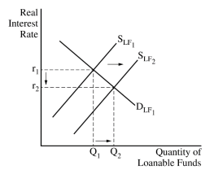
Loanable Funds Market: Continued
The loanable funds market shows the supply of funds available for loans or investment and the demand for those funds (borrowers). The capital and financial account records the inflow of financial capital into a country.
If the U.S. has a capital and financial account surplus (inflows > outflows), what would you expect to happen to the supply of loanable funds in the U.S.? It would increase because the additional inflow from the capital and financial account increases the supply of loanable funds.

Slide 29
Balance of Payments: Review
The balance of payments is an accounting system that records a country’s international transactions for a particular time period. It consists of the current account (CA) and the capital and financial account (CFA).
Any transaction that causes money to flow into a country is a credit to its balance of payments account, and any transaction that causes money to flow out is a debit. The sum of all entries, both credit and debit, should equal zero (CA+CFA=0)

Slide 30
Discussion #1
Why does CA + CFA = 0?

Slide 31
Discussion #1: Answer
Why does CA + CFA = 0?
Money is flowing from one country to another with no leakages. Income from one country is an expenditure by another and vice versa. The money is flowing circularly between the U.S. and Japan in this example.

Slide 32
Discussion #1: Answer—Continued
Why does CA + CFA = 0?
Money is flowing from one country to another with no leakages. Income from one country is an expenditure by another and vice versa. The money is flowing circularly between the U.S. and Japan in this example.
Why does a deficit in one country’s trade account generally create a surplus in the other country’s trade account?
Countries with a trade deficit will have to cover the cost by borrowing (often from other countries), which will cause financial inflows to that country.

Slide 33
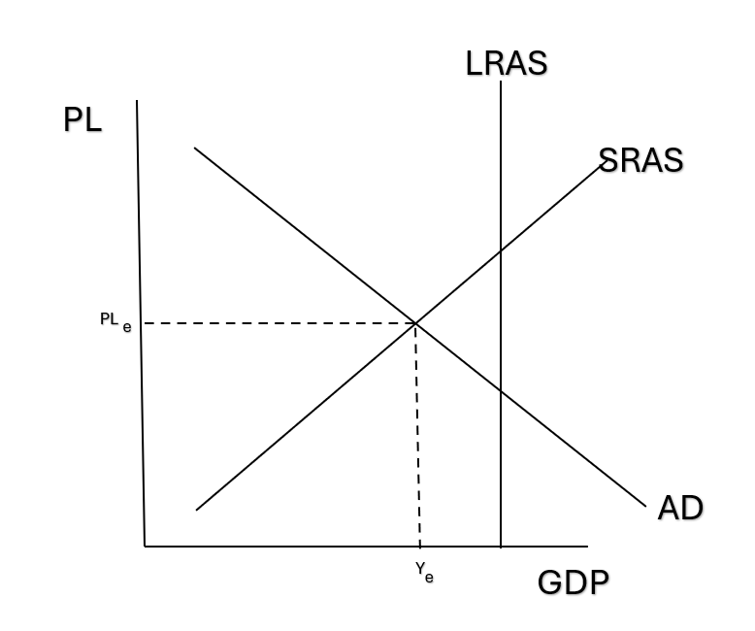
Let’s Graph!
Based on the information from your charts in Round 1, show the impact of the change in net exports on an AD/AS model for the U.S. (Assume that the U.S. is currently operating at an equilibrium below full employment.)

Slide 34
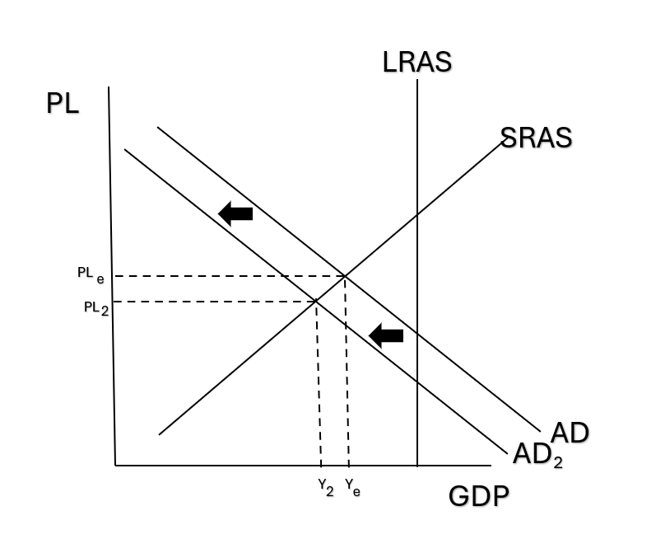
Let’s Graph! (Answer)
Based on the information from your charts in Round 1, show the impact of the change in net exports on an AD/AS model for the U.S. (Assume that the U.S. is currently operating at an equilibrium below full employment.)

Slide 35
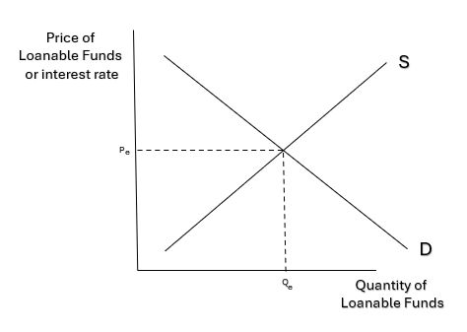
Let’s Graph! (Part 2)
Based on the information from your charts in Round 2, show the impact of capital inflows on the loanable funds graph for the U.S.

Slide 36
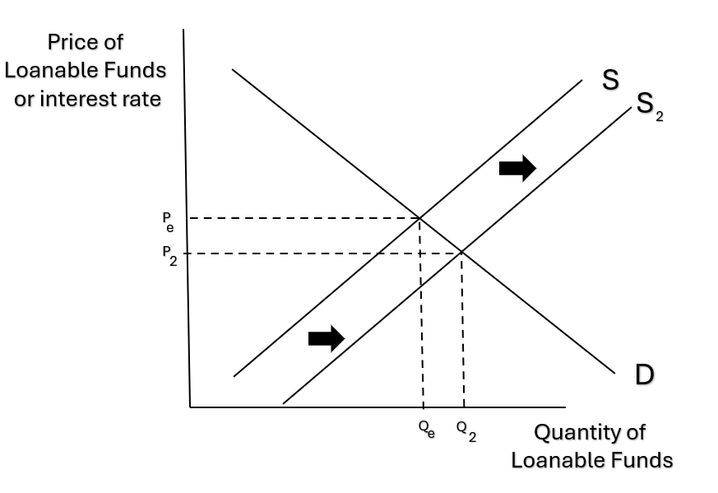
Let’s Graph! (Part 2 Answer)
Based on the information from your charts in Round 2, show the impact of capital inflows on the loanable funds graph for the U.S.

Slide 37
Closure
What types of transactions are recorded in the current account?
What types of transactions are recorded in the capital and financial account?
How is balance of payments different from balance of trade?
Why does the balance of payments (CA + CFA) equal zero?
How does the balance of trade potentially impact the value of foreign currencies on the foreign exchange market?
What can the capital and financial account balance tell us about the loanable funds market?

