Slide 1
The Arsenal of Democracy:
The United States in WWII

Slide 2
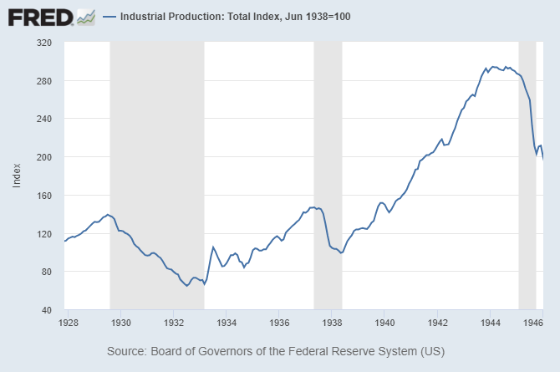
Slide 2: U.S. Industrial Production, 1928-1946
SOURCE: Board of Governors of the Federal Reserve System. Federal Reserve Bank of St. Louis FRED®; https://fred.stlouisfed.org/graph/?g=1eB18 .
Slide 2

Slide 3

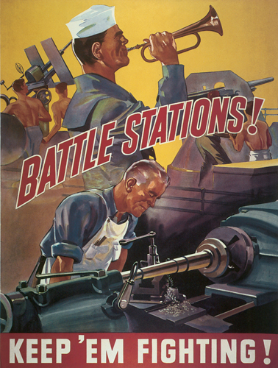
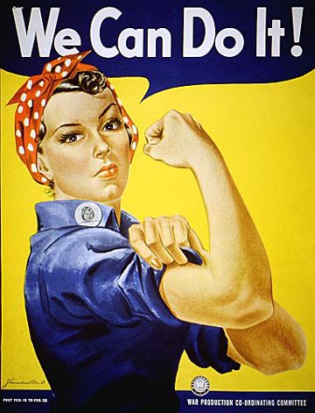
Slide 3: WWII Propaganda Posters (Group 1)
Image 1
Image 2
Image 3
SOURCE:
National Archives: We Can Do It! and I Want You; http://www.archives.gov.
National WWII Museum: Battle Stations; http://www.nationalww2museum.org/.
Slide 3

Slide 4

Slide 4: Franklin Roosevelt Quote
We must be the great arsenal of democracy. For us this is an emergency as serious as war itself. We must apply ourselves to our task with the same resolution, the same sense of urgency, the same spirit of patriotism and sacrifice as we would show were we at war.
—President Franklin Delano Roosevelt
December 29, 1940
Audio from the National Archives & Record Administration courtesy of the Miller Center at the University of Virginia
www.millercenter.org
Slide 4

Slide 5
Slide 5: Glossary of Terms
Land (natural resources) – Things that occur naturally in and on the earth that are used to produce goods and services.
Labor – The quantity and quality of human effort directed toward producing goods and services. Also known as human resources.
Capital resources – Goods that have been produced and are used to produce other goods and services. They are used over and over again in the production process. Also called capital goods and physical capital.
Scarcity – The condition that exists because there are not enough resources to produce everyone’s wants.
Trade-off – Giving up some of one thing to gain some of something else.
Opportunity cost – The value of the next-best alternative when a decision is made; it’s what is given up.
Slide 5

Slide 6
Slide 6: Propaganda Terms
Propaganda – Communication meant to influence the attitude of the people toward some cause or position.
Appealing to fear – Building support by instilling anxieties and panic in the general population.
Flag waving (patriotism) – Justifying an action on the grounds that doing so will make one more patriotic, or in some way benefit a country, group, or idea the targeted audience supports.
Jumping on the bandwagon – Promoting involvement based on the idea that “everyone else is doing it, and so should you.”
Slide 6

Slide 7
Slide 7: WWII Propaganda Posters (Group 2)
Image 1
Image 2
Image 3
SOURCE: National Archives http://www.archives.gov.
Slide 7

Slide 8
Slide 8: Guns vs. Butter Quotes
We can do without butter, but, despite all our love of peace, not without arms. One cannot shoot with butter, but with guns.
—Joseph Goebbels (Minister of Propaganda, Nazi Germany), 1936
Guns will make us powerful; butter will only make us fat.
—Hermann Goering (Nazi Party leader), 1936
Slide 8

Slide 9
Slide 9: Dwight Eisenhower Quote
Every gun that is made, every warship launched, every rocket fired signifies,
in the final sense, a theft from those who hunger and are not fed, those who are cold and are not clothed. This world in arms is not spending money alone. It is spending the sweat of its labors, the genius of its scientists, the hopes of its children.
—President Dwight D. Eisenhower, 1953
Audio from the National Archives & Record Administration courtesy of the Miller Center at the University of Virginia
www.millercenter.org
Slide 9

Slide 10
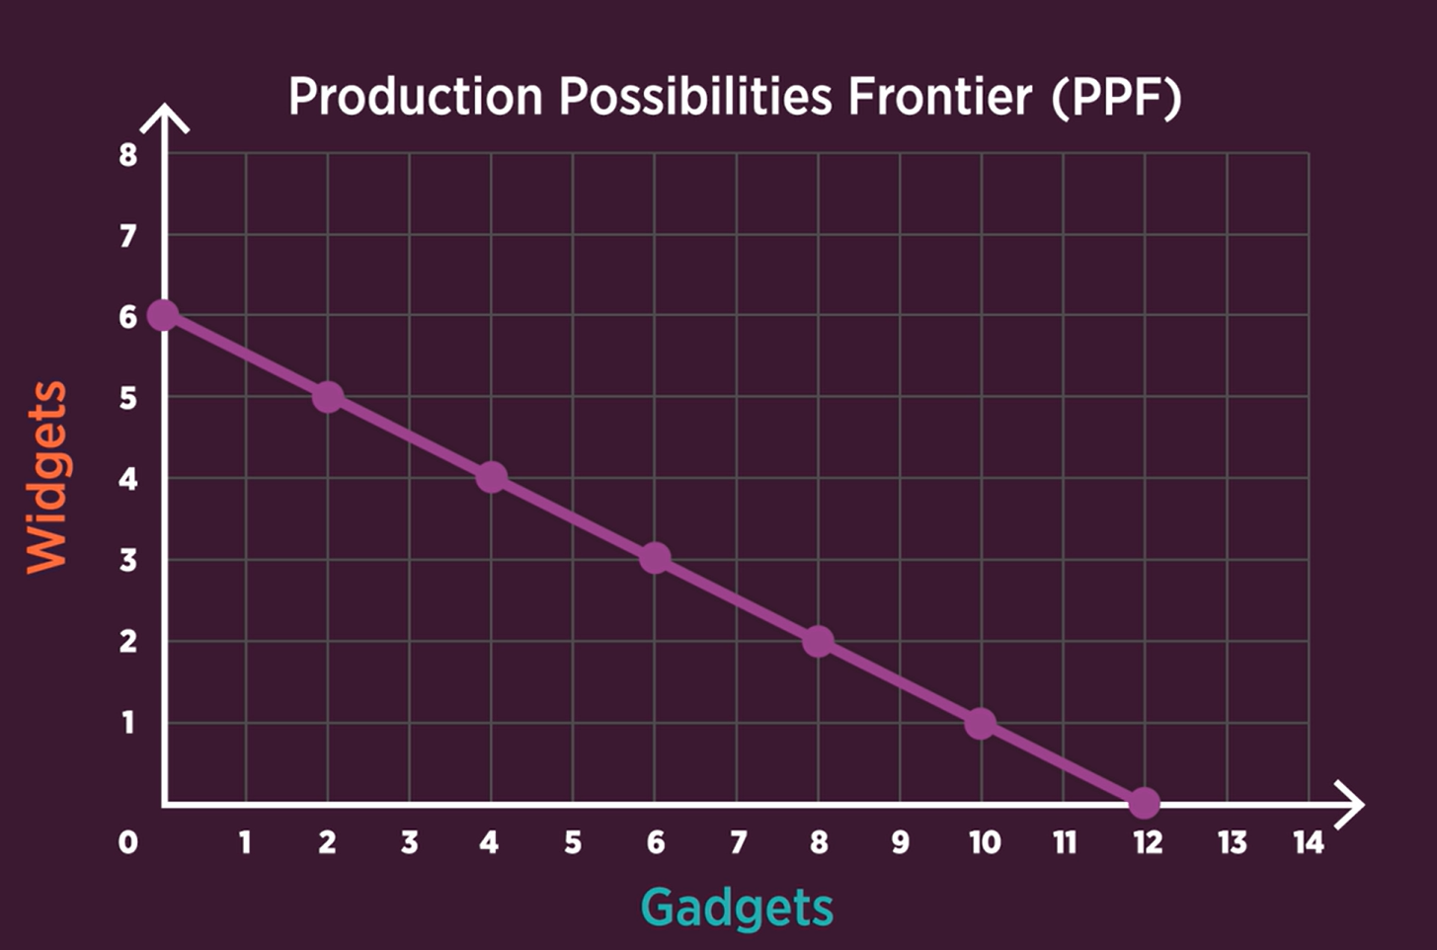
Slide 10: Production Possibilities Frontier
Production possibilities frontier (PPF) – A graphic representation of output combinations that can be produced given an economy’s available resources and technology.
Slide 10

Slide 11
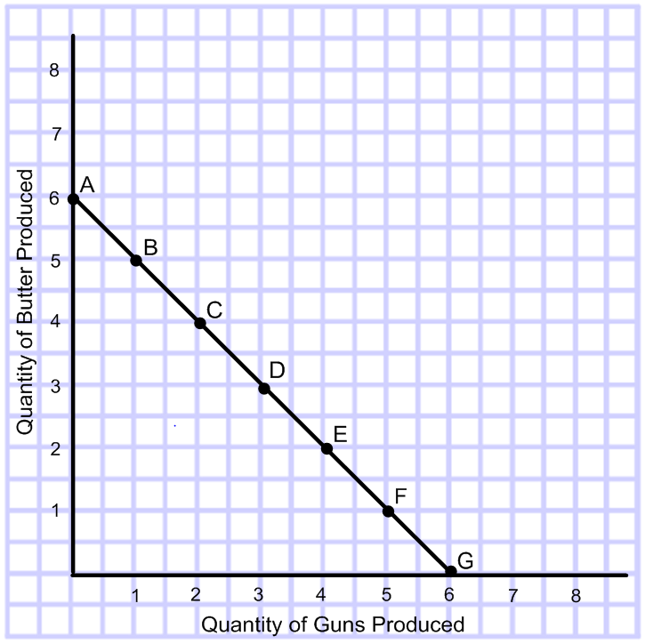
Slide 11: Production Possibilities Frontier Graph 1
Slide 11

Slide 12
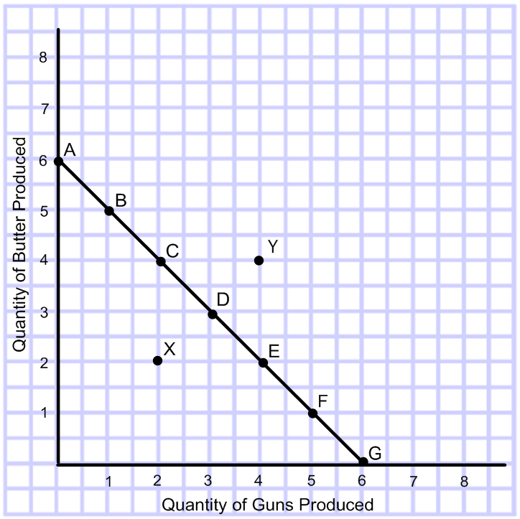
Slide 12: Production Possibilities Frontier Graph 1
Underutilized – Using fewer resources than an economy is capable of using, or not using resources to their fullest potential.
Productivity – The ratio of output per worker per unit of time.
Slide 12

Slide 13
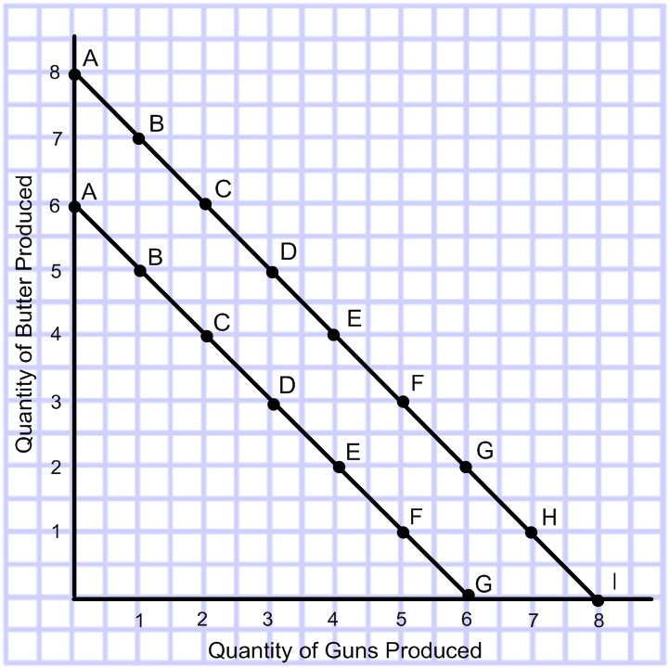
Slide 13: Production Possibilities Frontier Graph 2
Slide 13

Slide 14
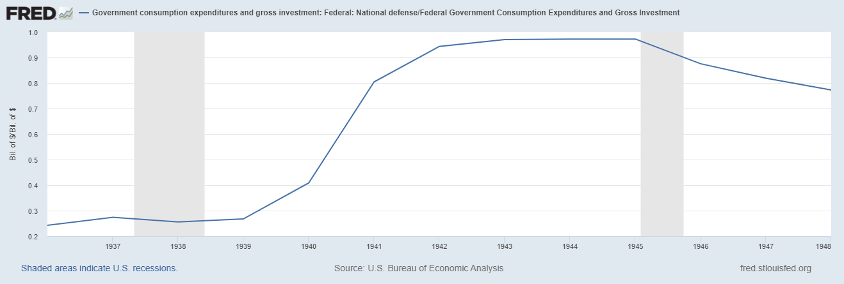
Slide 14: Defense Spending as a Proportion of Govt. Spending
SOURCE: Federal Reserve Bank of St. Louis FRED®; https://fred.stlouisfed.org/graph/?g=1eATU .
Slide 14

Slide 15
Slide 15: U.S. Spending on Guns vs. Butter: 1929-1950
 | 1 | 2 | 3 | 4 | 5
Year | Total gross national production (GNP)* | Spending on guns† | Guns as a % of GNP | Spending on butter‡ | Butter as a % of GNP
1929 | $709.6 | $18.3 | 2.58 | $691.3 | 97.42
1939 | $716.6 | $53.8 | 7.51 | $662.8 | 92.49
1940 | $772.9 | $63.6 | 8.23 | $709.3 | 91.77
1941 | $909.4 | $153.0 | 16.82 | $756.4 | 83.18
1942 | $1,080.3 | $407.1 | 37.68 | $673.2 | 62.32
1943 | $1,276.2 | $638.1 | 50.00 | $638.1 | 50.00
1944 | $1,380.6 | $722.5 | 52.33 | $658.1 | 47.67
1945 | $1,354.8 | $634.0 | 46.80 | $720.8 | 53.20
1946 | $1,096.9 | $159.3 | 14.52 | $937.6 | 85.48
1950 | $1,203.7 | $116.7 | 9.70 | $1,087.0 | 90.30
NOTE: *In billions of 1982 dollars. †Total federal purchases of goods and services. ‡Total civilian purchases of goods and services.
SOURCE: Walton, Gary M. and Rockoff, Hugh. History of the American Economy. Eleventh Edition. Mason, OH: South-western Cengage Learning, 2010.

Slide 16
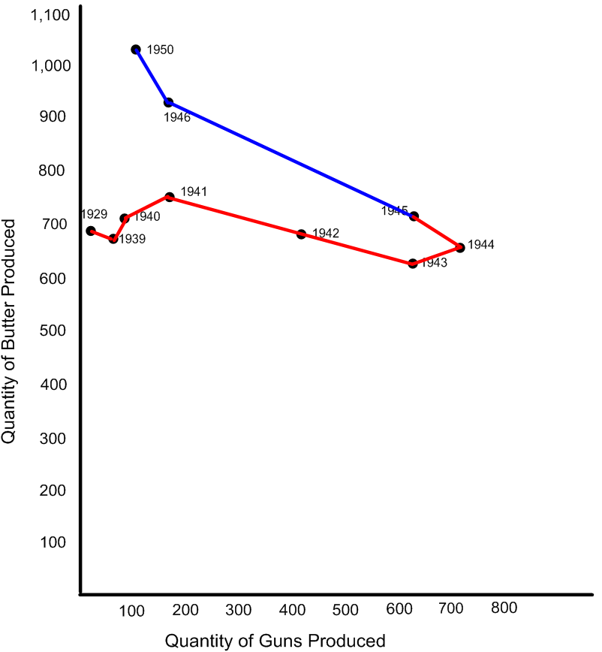
Slide 16: U.S. Spending on Guns vs. Butter (1929-50) Graph 1
Slide 16

Slide 17
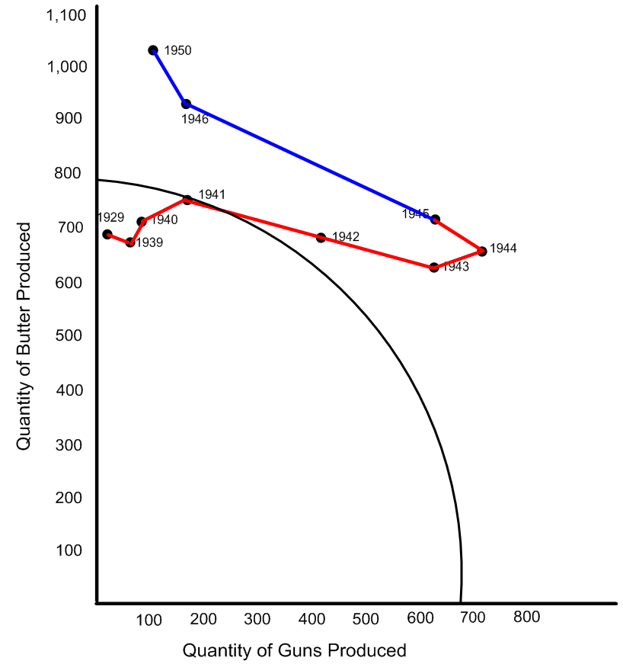
Slide 17: U.S. Spending on Guns vs. Butter (1929-50) Graph 2
Slide 17

Slide 18
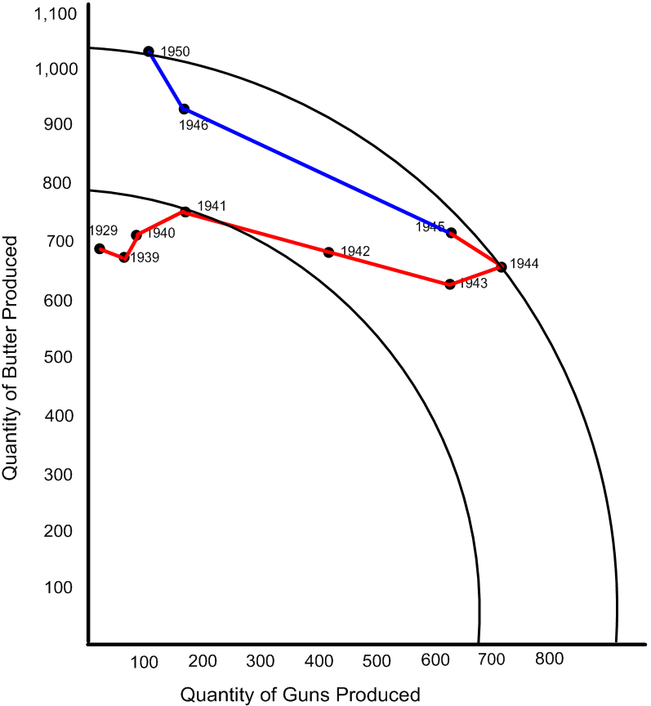
Slide 18: U.S. Spending on Guns vs. Butter (1929-50) Graph 3
Slide 18

