Slide 1
AP Micro Lecture Guide: The Deadweight Loss Plan
© 2025 Federal Reserve Bank of St. Louis. Permission is granted to reprint or photocopy this lesson in its entirety for educational purposes, provided the user credits the Federal Reserve Bank of St. Louis, https://www.federalreserveeducation.org.

Slide 2

Introduction
There are 250 cookie bakeries. Each bakery bakes 100 chocolate chip cookies to sell at $1.00 per cookie.
There are 25,000 customers in the market, and each customer purchases one cookie for $1.00.
Is this market efficient?

Slide 3
Cookie Market Scenario 1
Supply = Marginal Cost (MC)
At market equilibrium:
Bakeries are willing to produce 25,000 cookies to sell at $1.00 per cookie.
Consumers are willing to buy 25,000 cookies at $1.00 per cookie.
The market is allocatively efficient when supply (MC) = demand (MB).
Consumer surplus and producer surplus are maximized.
Price
$2.00
Consumer
Surplus
$1.00
Producer
Surplus
Demand = Marginal Benefit (MB)
Quantity
0
25,000

Slide 4
Deadweight Loss and Market Power

Slide 5
Cookie Market Scenario 2
With market power, the monopolist will produce 16,667 cookies and charge $1.33 per cookie, instead of producing the market equilibrium quantity of 25,000 cookies and charging $1.00 per cookie.
There were 8,333 cookies lost because of the monopoly.
The market is inefficient because MB > MC at 16,667 cookies.
Consumer surplus decreases because of lost production and is partially transferred to producer surplus.
Deadweight loss (DWL) is created and is equal to the lost consumer surplus and the lost producer surplus because of the decrease in production and the moving away from competitive market equilibrium.
Price
Supply
MC
$2.00
Consumer
Surplus
DWL
$1.33
Producer
Surplus
$1.00
$0.67
Demand
MB
MR
0
16,667
25,000

Slide 6
Deadweight Loss and Government Intervention

Slide 7
Government Intervention—Price Ceiling
Price
Supply
A law is passed that states cookie prices cannot be higher than $0.60 per cookie.
Consequence: Only 15,000 cookies are produced.
Consequence: 10,000 cookies are not produced or purchased.
Consequence: Deadweight loss exists.
This is the net loss of consumer surplus and producer surplus.
Consequence: Consumer surplus and producer surplus are reduced.
$2.00
Consumer
Surplus
$1.00
DWL
$0.60
Price Ceiling
Producer
Surplus
Demand
Quantity
15,000
25,000

Slide 8
Government Intervention—Price Floor
Price
Supply
A law is passed that states cookie prices cannot be lower than $1.60 per cookie.
Consequence: More than 25,000 cookies would be produced, and fewer cookies would be purchased.
There will be 10,000 cookies demanded while 40,000 will be supplied.
Consequence: 30,000 cookies are not produced or purchased.
Consequence: Deadweight loss exists.
This is the net loss of consumer surplus and producer surplus.
Consequence: Consumer surplus is reduced.
Consumer Surplus
$1.60
Price Floor
DWL
$1.00
Producer
Surplus
Demand
Quantity
10,000
25,000
40,000

Slide 9
Deadweight Loss and Externalities

Slide 10
Negative Production Externality
Price
Marginal Social Cost (MSC)
Supply = Marginal Private Cost (MPC)
$12
$10
DWL
$8
Demand = Marginal Private Benefit (MPB)
Marginal Social Benefit (MSB)
Quantity
500
600

Slide 11
Deadweight Loss Calculation Practice

Slide 12
Situation 1: Colaville’s Efficient Market
Consumer Surplus
$112,500
(½ of 75,000 gallons) x $3.00
Producer Surplus
$112,500
(½ of 75,000 gallons) x $3.00
Total Economic Surplus
$225,000
($112,500 + $112,500)
Consumer
Surplus
Producer
Surplus

Slide 13
Situation 1: Colaville’s Market After Tax
Consumer Surplus
$50,000
(½ of 50,000 gallons) x $2.00
Producer Surplus
$50,000
(½ of 50,000 gallons) x $2.00
Tax Revenue
$100,000
(50,000 x $2.00)
Deadweight Loss
$25,000
(½ of 25,000 gallons) x $2.00
Consumer
Surplus
Tax
Revenue
DWL
Producer
Surplus
Demand
Check your work: TES before tax = (CS+PS+TR+DWL) after tax

Slide 14
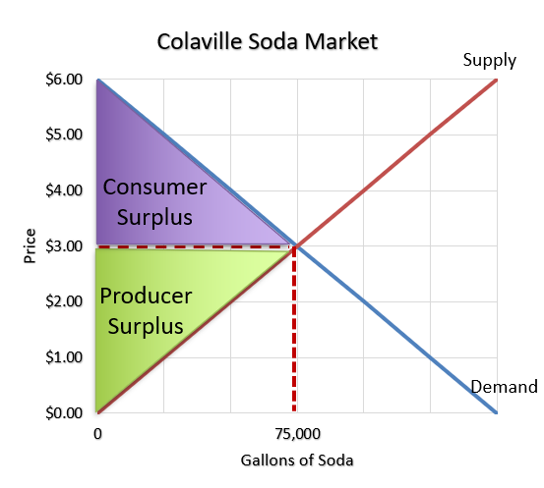
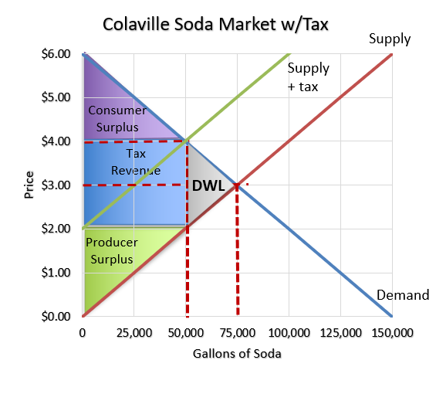
Situation 1: Change in Total Economic Surplus
 | Before Tax | After Tax | Change
Consumer Surplus
Producer Surplus
Tax Revenue
Total Economic Surplus
$112,500
$50,000
-$62,500
$112,500
$50,000
-$62,500
$0
$100,000
$100,000
$225,000
$200,000
-$25,000 = DWL

Slide 15
Deadweight Loss and International Trade

Slide 16
Situation 2: Guess the Domestic Jeans Market
Consumer Surplus
$125,000
(½ of 5,000 units) x $50
Producer Surplus
$125,000
(½ of 5,000 units) x $50
Total Economic Surplus
$250,000
($125,000 + $125,000)
Domestic
Supply
Consumer
Surplus
Producer
Surplus
Domestic
Demand

Slide 17
Situation 2: Guess the Total Surplus Jeans Market
A new agreement opens the domestic market to international trade.
World Price < Domestic Price
Imported jeans enter the market:
Trade is conducted at the world price of $20.
What happens to quantity demanded?
It increases from 5,000 to 8,000 units.
Domestic
Supply
$20.00
World Price

Slide 18
Situation 2: Guess the Total Surplus Jeans Market
Calculate the new consumer surplus and producer surplus.
Consumer Surplus ↑
$320,000 (1/2 of 8,000 units) x $80
Producer Surplus ↓
$20,000 (1/2 of 2,000 units) x $20
Total Economic Surplus ↑
$340,000 ($320,000 + $20,000)
Deadweight Loss
$0
Domestic
Supply
Consumer
Surplus
$20.00
PS
Domestic
Demand
2,000
8,000

Slide 19
Situation 2: Guess the Tariff Impact in the Jeans Market
Shade/calculate the new consumer surplus and producer surplus with a $5 tariff.
Tariff Revenue
$25,000 = 5,000 units x $5
Consumer Surplus
$281,250 = (1/2 of 7,500 units) x $75
Producer Surplus
$31,250 = (1/2 of 2,500 units) x $25
Deadweight Loss
$2,500 = (1/2 of 500 units) x $5 x 2
Domestic
Supply
Consumer
Surplus
Producer
Surplus
Tariff Revenue
Price w/ tariff
$20.00
World Price
Domestic
Demand
2,000
2,500
7,500
8,000
Check your work: TES before tariff = (TR+CS+PS+DWL) after tariff
Deadweight loss

Slide 20
Check out fre.org for free, ready to use economics and personal finance resources!

