Slide 1
AP Macro Lecture Guide:
How the Federal Reserve Implements Monetary Policy
How does a central bank conduct monetary policy to achieve price stability and full employment?
The Fed’s Toolbox

Slide 2
The Fed’s Toolbox
Dual mandate – The Federal Reserve’s responsibility to use monetary policy to promote maximum employment and price stability.
Maximum employment – The highest level of employment that an economy can sustain while maintaining low and stable inflation.
The Fed’s policy decision is informed by its assessments of the shortfalls of employment from its maximum level.
Price stability – A low and stable rate of inflation maintained over an extended period of time. The Fed seeks to achieve an inflation rate that averages 2 percent over time.

Slide 3
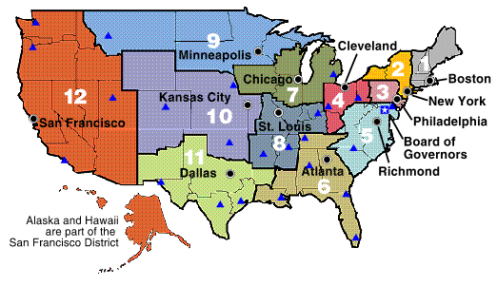
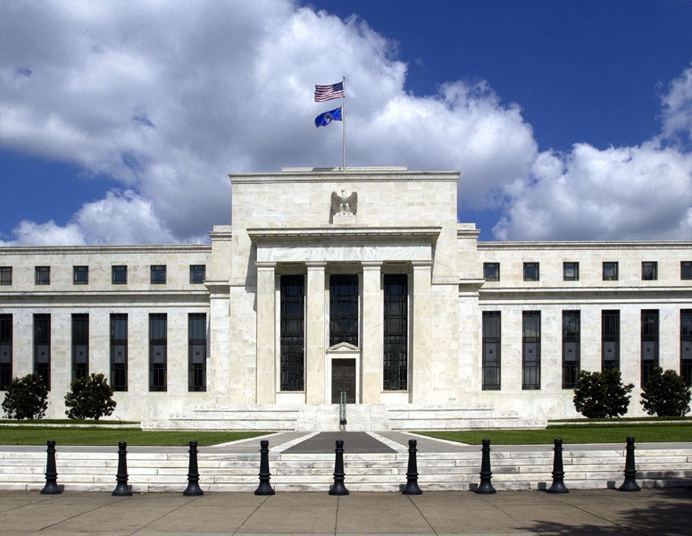
Federal Open Market Committee (FOMC)
The Fed’s Toolbox
Committee = 12 Reserve Bank Presidents + 7 Governors = 19
Voting = 5 Reserve Bank Presidents + 7 Governors = 12

Slide 4

The Fed’s Toolbox
FOMC meeting at the Federal Reserve Board of Governors in Washington, D.C.

Slide 5
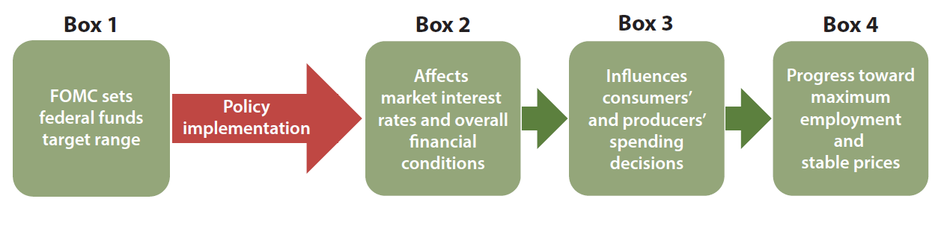
The Fed’s Toolbox
Summary of path from the FOMC policy rate target to the Fed’s dual mandate:
  The FOMC sets the target range for the federal funds rate.
  This affects market interest rates and overall financial conditions.
  This also influences the decisions of households and businesses.
  It ultimately affects employment and inflation.

Slide 6
The Fed’s Toolbox
The Federal Funds Rate is the Fed’s Policy Rate
Banks hold cash in their “checking accounts” at the Fed, called reserve balance accounts.
Banks that need funds can borrow from banks that have excess funds.
The transfer of funds from one bank’s reserve account to another bank’s reserve account is termed a federal funds transaction, and the agreed interest rate in this transaction is the federal funds rate (FFR).
The FOMC sets a target range for the FFR, which is the Fed’s policy rate.

Slide 7
The Fed’s Toolbox
The Federal Funds Rate is the Fed’s Policy Rate
The federal funds market is where banks that need reserves go to borrow cash from banks that have excess reserves.
For each transaction, reserves are transferred from the lender’s reserve account at the Fed to the borrower’s reserve account.
The federal funds rate is market-determined by the borrowers and lenders. The Fed does not set the federal funds rate.

Slide 8
The Fed’s Toolbox
The Federal Funds Rate is the Fed’s Policy Rate
The Fed sets a target range for the FFR, which is where it wants federal funds transactions to take place.
The FFR influences other interest rates in the economy, as well as the spending and investing decisions made by consumers and producers.

Slide 9
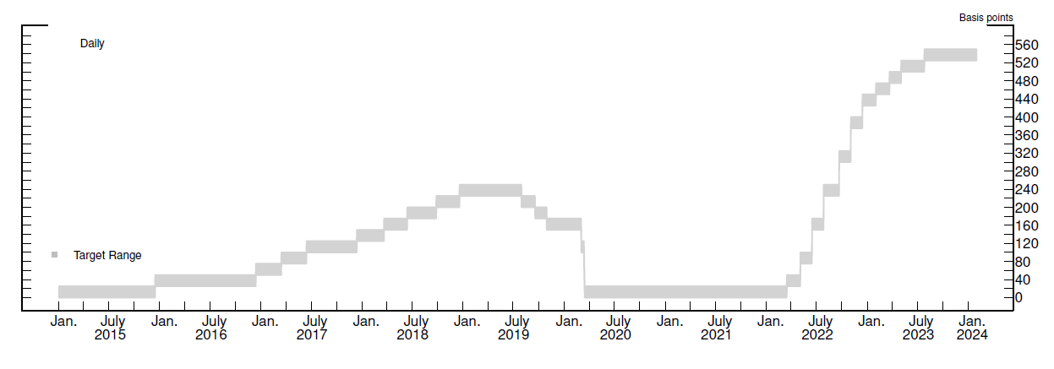
The Fed’s Toolbox
The FOMC Target Range, 2015-2023
The FOMC sets a target range for the FFR;
this range has been 25 basis points (or 0.25%) wide.

Slide 10
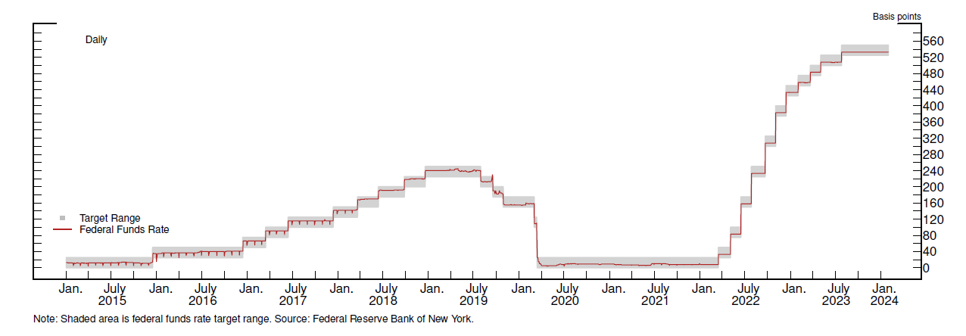
The Fed’s Toolbox
The FFR Is In the FOMC’s Target Range
The Fed uses its monetary policy implementation tools to ensure
that the federal funds rate stays within the target range.

Slide 11
The Fed’s Toolbox
Question: How does the Fed ensure its target range for the federal funds rate transmits to market interest rates?
Answer: The Fed implements the FOMC’s policy decisions using its administered interest rates.

Slide 12
The Fed’s Toolbox
The Fed’s Toolbox
Policy Implementation Tools
Interest on reserve balances
Discount window
Open market operations
Administered Rates
Interest on reserve balances rate
Discount rate

Slide 13
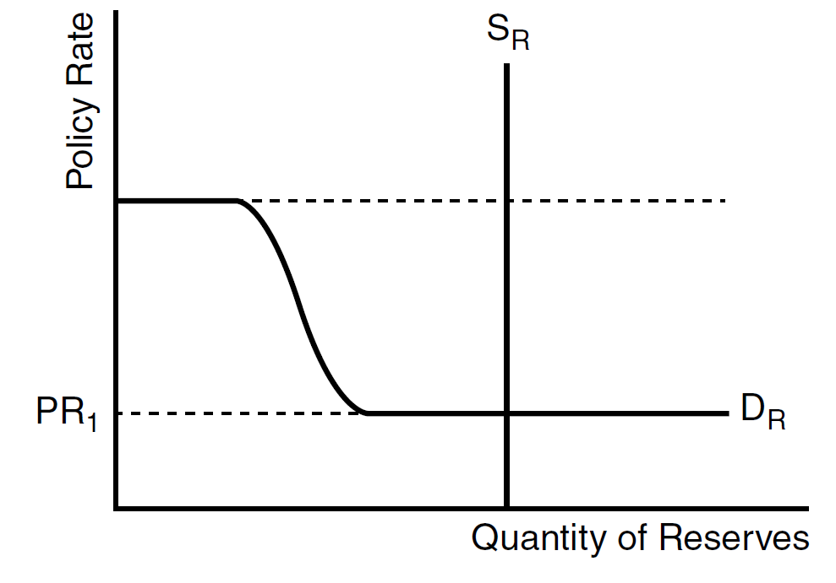
The Fed’s Toolbox
Monetary Policy with Ample Reserves
“Ample reserves” means the supply curve intersects the demand curve where small changes in the supply of reserves will not affect the policy rate;
this occurs on the flat part of the demand curve.

Slide 14
The Policy Rate
Policy rate: The interest rate that a central bank sets a target for; it is used to communicate its monetary policy stance (or position).
The policy rate is determined by supply and demand

Slide 15
The Supply Curve
Supply curve in the ample reserves (horizontal) part of the demand curve
The supply curve is vertical because the central bank ultimately determines the supply reserves.

Slide 16
The Demand Curve
Downward sloping demand curve
The demand curve slopes down because as the cost of borrowing decreases, banks are willing to borrow more funds to increase their holdings of reserves.

Slide 17
Tool #1: Interest on reserves is the primary tool.
The interest on reserves rate is the interest rate that banks earn from the central bank on the funds they deposit in their reserve accounts.
The interest on reserves rate steers the policy rate into the central bank’s target range.
Administered Rate #1
Interest on Reserves (indicated by the dotted line), serves as the “lower bound” (or floor) of the demand curve.

Slide 18
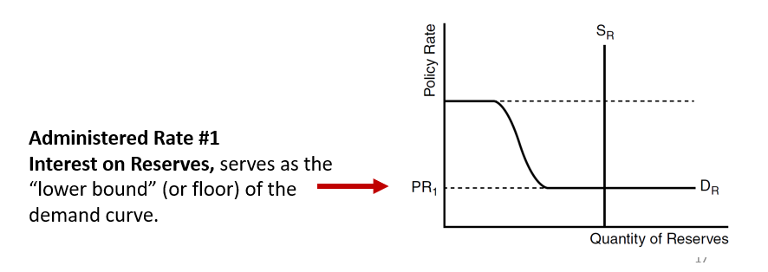
Interest on reserves relies on two concepts.
1. Reservation rate
Reservation rate: The lowest rate that banks are likely willing to accept for lending out their funds.

Slide 19
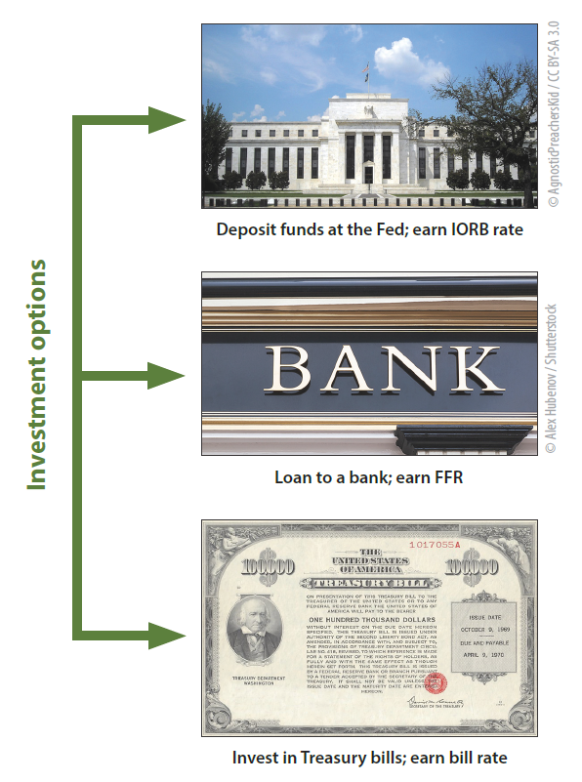
Banks seek to earn a return on their money,
and they have several options.
Deposit excess funds at their central bank and earn the interest on reserves rate.
Lend the excess funds out in the reserves market and earn the policy rate.
Invest the funds in Treasury bills and earn the given Treasury bill rate.

Slide 20
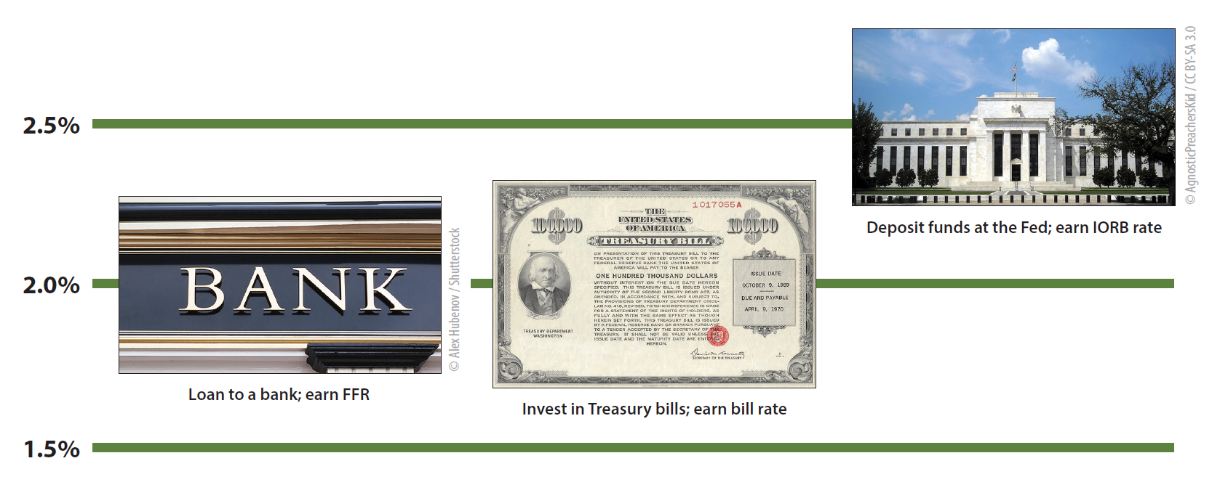
What would a bank do with excess funds if the central bank’s interest on reserves rate is higher than market rates?
IOR is a risk-free investment option that is always available to banks.

Slide 21
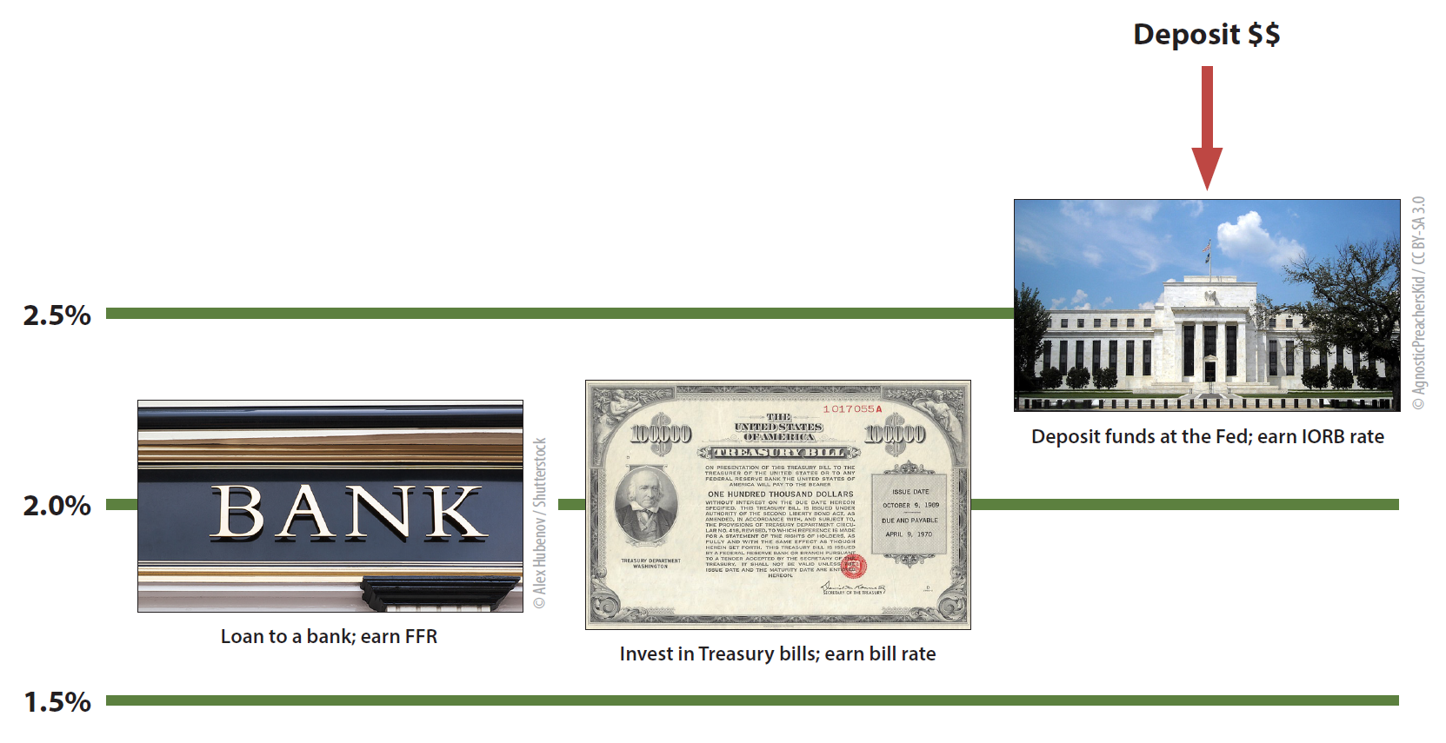
What would a bank do with excess funds if the central bank’s interest on reserves rate is higher than market rates?
IOR is a risk-free investment option that is always available to banks.

Slide 22
Interest on reserves relies on two concepts.
2. Arbitrage
Arbitrage: The simultaneous purchase and sale of funds (or goods) in order to profit from a difference in price.

Slide 23
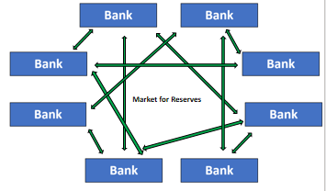
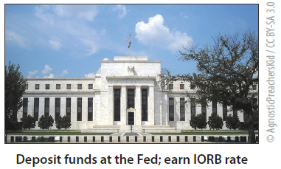
Market for bank reserves
The central bank pays
interest on reserves (IOR)
2.5%
Reserves
2.0%
Reserves
Bank

Slide 24
Market for bank reserves
The central bank pays
interest on reserves (IOR)
2.5%
Reserves
2.0%
Reserves
Borrow at 2.0%
Bank
Deposit at 2.5%
Profit = 50 basis points

Slide 25
Market for bank reserves
The central bank pays
interest on reserves (IOR)
2.5%
Reserves
2.5%
Reserves
Increase in demand for borrowing
reserves in the reserves market
2.0%
Reserves
Borrow at 2.0%
Bank
Deposit at 2.5%
Other banks also see the opportunity to earn profits by borrowing in the reserves market, which drives up the cost of borrowing in the reserves market, and profits go to zero.

Slide 26
Market for bank reserves
The central bank pays
interest on reserves (IOR)
3.0%
Reserves
2.5%
Reserves
Bank
How will a bank invest its funds with these interest rates?

Slide 27
Market for bank reserves
The central bank pays
interest on reserves (IOR)
3.0%
Reserves
2.5%
Reserves
Lend at 3.0%
Bank
Withdraw from
reserve account
Profit = 50 basis points

Slide 28
Market for bank reserves
The central bank pays
interest on reserves (IOR)
3.0%
Reserves
Increase in supply of reserves
2.5%
Reserves
2.5%
Reserves
Lend at 3.0%
Bank
Withdraw from
reserve account
Other banks also see the opportunity to lend in the reserves market, which reduces the cost of borrowing in the reserves market, and profits from arbitrage go to zero.

Slide 29
Administered Rate #2: The Discount Rate
The discount rate is an administered rate that is set above the central bank’s target range, with the intention to serve as a ceiling for the PR (FFR).
Administered Rate #2
Discount rate
Serves as the “upper bound” (or ceiling) of the demand curve.

Slide 30
When the central bank sets the target for the policy rate, it also chooses the level for the administered interest rates that will encourage the policy rate to move toward the target.
When the central bank raises the target for the policy rate, it also raises the administered interest rates, which moves the policy rate up into the new target range. | When the central bank lowers the target for the policy rate, it also lowers the administered interest rates, which moves the policy rate down into the new target range.

Slide 31
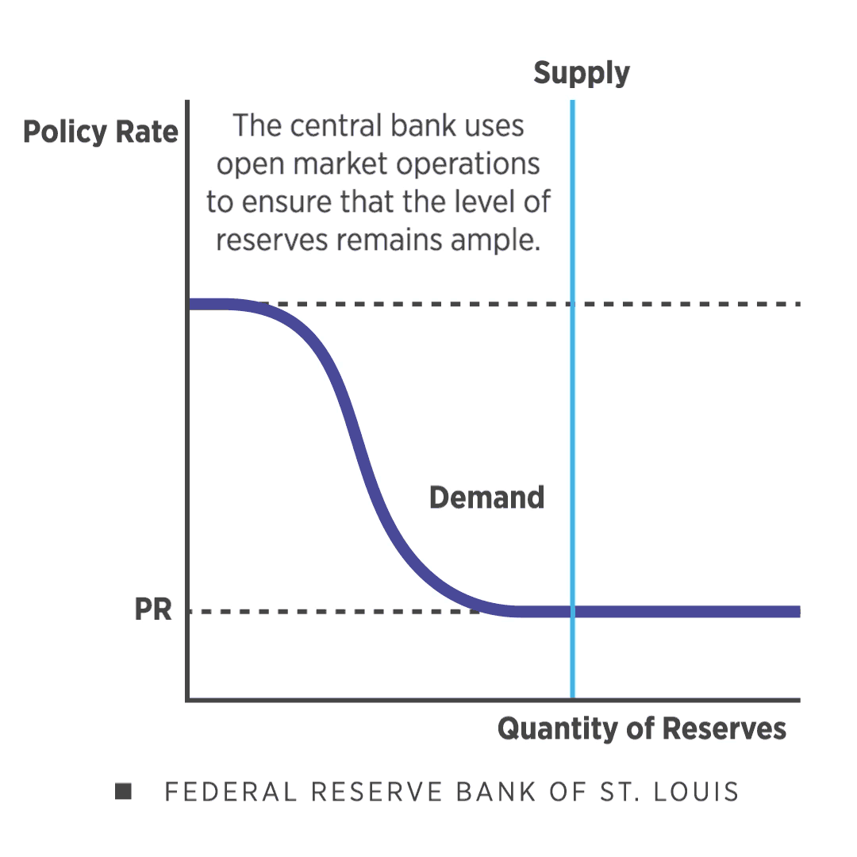
Supporting Tool: Open Market Operations
Open market operations are conducted periodically to maintain ample reserves, or to conduct large scale asset purchases (i.e. quantitative easing).
To shift the supply curve to the right, the central bank purchases securities and pays for them by adding reserves to the banking system.

Slide 32
The central bank uses the administered rates to steer the policy rate
Discount rate
Policy rate
Interest on reserves rate

Slide 33
Problem: In a banking system with ample reserves, and the economy in recession, the central bank wishes to use policy to reduce unemployment.
How can the central bank use its monetary policy tools to achieve full employment?

Slide 34
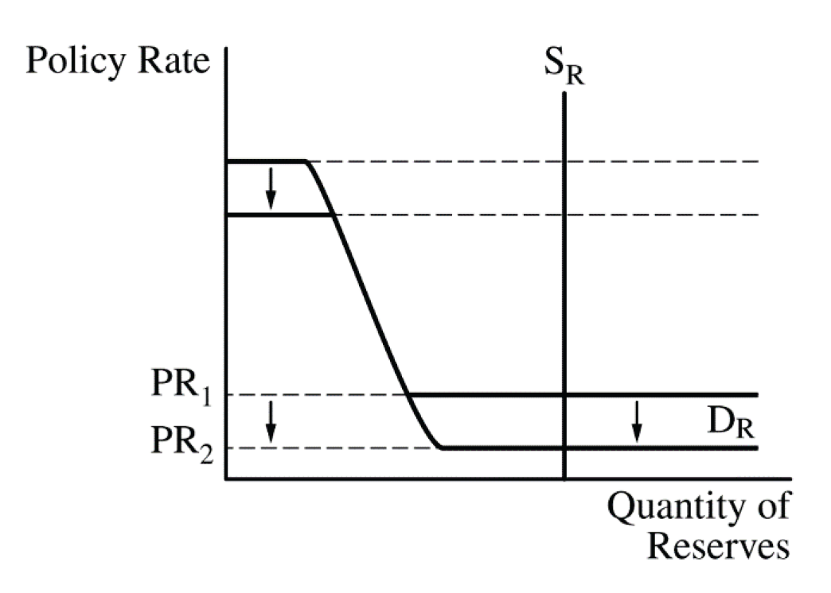
Problem: In a banking system with ample reserves, and the economy in recession, the central bank wishes to use policy to reduce unemployment.
The central bank lowers the administered rates to steer the policy rate lower.
Decrease in the
administered rates
Decrease in the policy rate

Slide 35
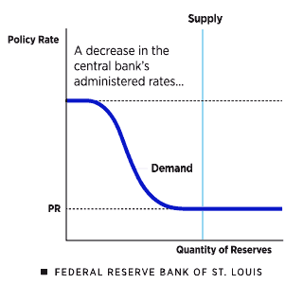
The central bank lowers the policy rate
by decreasing its administered rates.
The central bank ensures the policy rate moves higher or lower by moving the administered interest rates higher or lower.

Slide 37
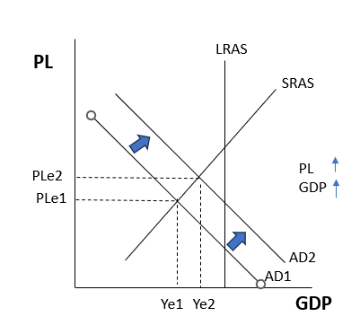
Problem: In a banking system with ample reserves, and the economy in recession, the central bank wishes to use policy to reduce unemployment.
 | Market interest rates
 | Consumer spending / business investment (interest sensitive consumption)
 | Aggregate demand
 | Real output
 | Price level

Slide 38
Problem: In a banking system with ample reserves, inflation has exceeded the central bank’s inflation target.
How can the central bank use its monetary policy tools to achieve price stability?

Slide 39
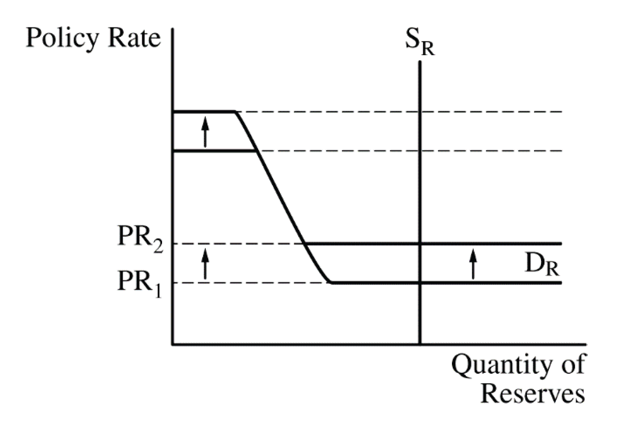
Problem: In a banking system with ample reserves, inflation has exceeded the central bank’s inflation target.
The central bank raises the administered rates to steer the policy rate higher.
Increase in the
administered rates
Increase in the policy rate

Slide 40
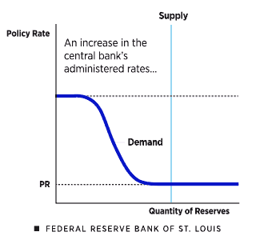
The central bank raises the policy rate
by increasing its administered rates.
The central bank ensures the policy rate moves higher or lower by moving the administered interest rates higher or lower.

Slide 41
Policymakers set a target for the policy rate

Slide 42
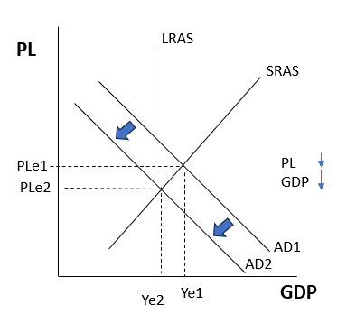
Problem: In a banking system with ample reserves, inflation has exceeded the central bank’s inflation target.
 | Market interest rates
 | Consumer spending / business investment (interest sensitive consumption)
 | Aggregate demand
 | Real output
 | Price level

Slide 43
Key Features | Description (AP Macro model) | In Practice in the U.S. (Federal Reserve)
Policy rate | The interest rate that is used by a central bank to set and communicate its monetary policy stance (or position). | The FOMC sets a target range for the FFR, which is the Fed’s policy rate.
Interest on reserves | Interest paid on funds that banks hold in their reserve accounts at a central bank. A key administered interest rate. | IORB is the Fed’s primary tool for guiding the FFR; it serves as a floor for the policy rate.
Discount rate | The central bank’s lending to banks (the "discount window") at the discount rate. A key administered interest rate. | The discount window helps put a ceiling on the policy rate (FFR).
Open market operations | The buying and selling of government securities by the central bank | Open market operations are an important tool for ensuring that reserves remain ample and for quantitative easing.

Slide 44
The Fed’s Toolbox
Review Questions
How does the interest on reserves rate serves as a reservation rate?
How does arbitrage ensure that the policy rate does not fall far below the interest on reserves rate?
What is the discount rate?
How does the discount rate act a ceiling for federal funds rate?
How does a central bank use open market operations in an ample reserves framework?

