Slide 1
Allocation Decisions and Competitive Balance in the FIFA World Cup
Slides

Slide 2
Allocation Methods
Authority
Contest
First-come/ first-served
Force
Lottery
Majority rule
Personal characteristics
Price
Sharing equally

Slide 3
Positive Incentive
A reward that encourages people to behave in a certain way

Slide 4
Negative Incentive
A penalty that discourages people from behaving in a certain way

Slide 5
Qualifying for the World Cup
FIFA grants direct slots with consideration to the relative strength and number of countries in the confederation. These are the teams that make the World Cup tournament.
Countries play in confederation tournaments (each confederation makes up their own rules for qualification).
Each World Cup, the number of automatic slots per confederation is determined by FIFA, with additional slots based on inter-confederation playoffs.

Slide 6
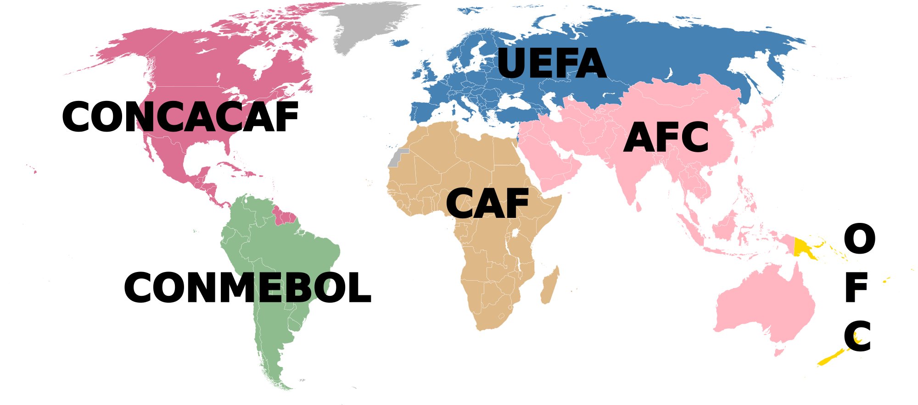
Confederations and Allocation of 2022 World Cup Slots
Confederation | Guaranteed Slots | Full Member Associations | Ranked Top 50
AFC: Asian Football Confederation | 5 | 47 | 5
CAF: Confederation of African Football | 5 | 54 | 7
CONCACAF: Confederation of North, Central American and Caribbean Association Football | 3 | 41 | 5
CONMEBOL: Confederación Sudamericana de Fútbol | 4 | 10 | 7
OFC: Oceania Football Confederation | 0 | 11 | 0
UEFA: Union European Football Associations | 13 | 55 | 26

Slide 7
2022 World Cup Format
Thirty-two teams played in the 2022 FIFA World Cup.
Four teams played in each of eight groups.
Each country played the three other counties in their group in a round-robin schedule, where they earned points to advance to the knockout stage of the tournament.
Three points were given to the winners of matches, and one point was awarded to teams that tie. The top two teams in the group advanced to the knockout stage.

Slide 8
Competitive Balance
The measurement of how the probability of winning is distributed across teams in a league, tournament, or other sporting event.
A league that is dominated by a few successful teams would indicate competitive imbalance.

Slide 9
World Cup Winners
Country | Confederation | Number of Championships | Years
Argentina | CONMEBOL | 3 | 1978, 1986, 2022
Brazil | CONMEBOL | 5 | 1958, 1962, 1970, 1994, 2002
England | UEFA | 1 | 1966
France | UEFA | 2 | 1998, 2018
Germany | UEFA | 4 | 1954, 1974, 1990, 2014
Italy | UEFA | 4 | 1934, 1938, 1982, 2006
Spain | UEFA | 1 | 2010
Uruguay | CONMEBOL | 2 | 1930, 1950
The finals of the World Cup have only ever included CONMEBOL and UEFA teams. Three teams from other confederations have made it to the semifinals: Morocco (2022), South Korea (2002), and the United States (1930).

Slide 10
Allocation Methods Revisited
Authority
Contest
First-come/ first-served
Force
Lottery
Majority rule
Personal characteristics
Price
Sharing equally

Slide 11
Confederations and Allocation of 2026 World Cup Slots
Confederation | Guaranteed Slots | Full Member Associations | Ranked Top 50
AFC: Asian Football Confederation | 8 | 47 | 5
CAF: Confederation of African Football | 9 | 54 | 7
CONCACAF: Confederation of North, Central American and Caribbean Association Football | 6 | 41 | 5
CONMEBOL: Confederación Sudamericana de Fútbol | 6 | 10 | 7
OFC: Oceania Football Confederation | 1 | 11 | 0
UEFA: Union European Football Associations | 16 | 55 | 26

Slide 12
2026 World Cup Format
Forty-eight teams will play in the 2026 FIFA World Cup.
Four teams will play in each of 12 groups.
Each country plays the three other counties in their group in a round-robin schedule, where they earn points to advance to the knock-out stage of the tournament.
Three points are given to the winners of matches, and one point is awarded to teams that tie. The top two teams in the group advance to the knock-out stage. Additionally, the 8 best third-place teams also advance to the knock-out stage of the tournament.

