Slide 1
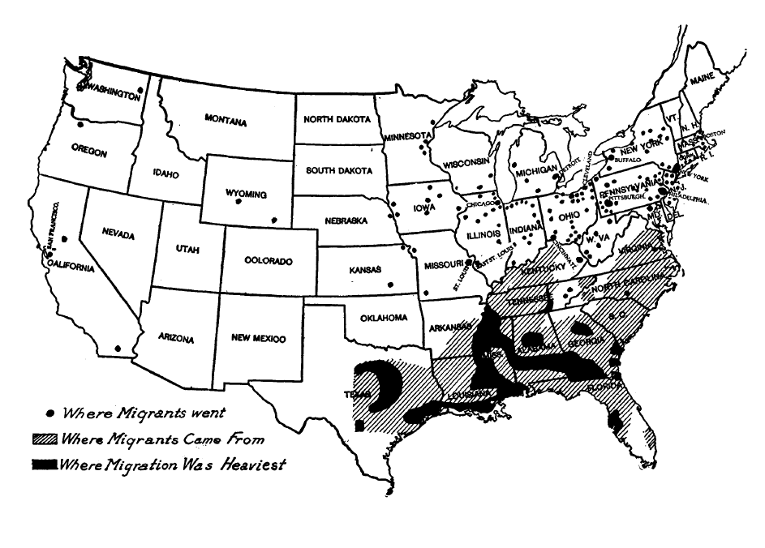
The Acceleration of the Great Migration-
1916-17
Map Source: Scott, Emmett J. Negro Migration During the War. Oxford: Oxford Press, 1920
Notes:
Great Migration 1910-1970 loosely according to most texts. Compelling question- Why did it accelerate between 1916-17?

Slide 2
Period Language
“I shall throughout this study use the term ‘Negro’ to designate all persons of Negro descent, although the appellation is to some extent illogical. I shall, moreover, capitalize the word, because I believe that eight million Americans are entitled to a capital letter.”
  W.E.B. DuBois page 1 Philadelphia Negro
Notes:
.The surveys that were conducted and the text was written by African American males. **Period language is used. DuBois case studies were conducted in the late 1890s and early 1900s a timeframe generally considered to before the onset of the Great Migration, therefore, I did not include his work in this lesson. Case studies by DuBois are available on FRASER®.

Slide 3
Objectives
Students will-
identify point of view using primary source documents regarding the Great Migration,
describe how groups differed in their view of the Great Migration,
analyze the Great Migration using a PACED decision-making model,
analyze changes in the North and the South stirred by the Great Migration,
recognize economic and social factors that contributed to the Great Migration, and
apply economic concepts to the Great Migration.
Notes:
.

Slide 4
Perspectives
Northern
Southern
Industrialist
Immigrant Worker
Agent
Migrant
Farmer
Planter
Notes:
.

Slide 5
Southern Perspective Questions
What caused a surplus of labor in the South?
What factors contributed to the balancing of the supply of labor in the South & shortage of labor in the North?
What changes in conditions are evident in the South after the Great Migration for those who stayed behind?
Notes:
.Answered by migrant, farmer and planter * Migrate has a 4th question- What changes in conditions were evident for migrants in the North after the acceleration of the Great Migration?

Slide 6
Northern Perspective Questions
What factors caused a shortage in the supply of labor in the North?
What factors contributed to the balancing of the surplus of labor in the South and shortage of labor in the North?
What impact did the Great Migration have on the supply of workers in the North?
Notes:
.Answered by the industrialist, immigrant worker and agent

Slide 7
Lesson Description
Today you will-
Work in groups assuming 1 of 6 perspectives
Decide who will do assigned roles
Read excerpts from primary source docs
Make “Perspectives Page” on butcher paper
Do a gallery walk to read other perspectives
Discuss economic concepts
Use PACED decision making model
Notes:
.

Slide 8
Discussion Questions
What does the term migration mean?
Why do some birds migrate from North to South each winter?
What comes to mind when you think of the Great Migration?
What would make you want to move to a different part of the country?
What would keep you from wanting to move?
Notes:
See procedures page 3 for possible answers.

Slide 9
Review of Vocabulary
Factors of Production-
Natural Resources-Things that occur naturally in and on the earth that are used to produce goods and services.
Labor- The quantity and quality of human effort directed toward producing goods and services. Also known as human resources.
Capital resources- Goods that have been produced and are used to produce other goods and services. They are used over and over again in the production process. Also called capital goods and physical capital.

Slide 10
Economic Terms to Know-
Scarcity- Not enough resources to produce goods and services to satisfy everyone’s wants
Supply- Quantity of goods & services producers are willing and able to sell at all prices during a certain time period
Demand- Quantity of goods & services consumers are willing and able to buy at all possible prices during a certain time period
Notes:
These terms will help you understand the Great Migration. They can be found in each group fold of documents.

Slide 11
Economic Terms to Know-
Shortage- When the quantity demanded of a good exceeds the quantity supplied
Surplus- When the quantity supplied of a good exceeds the quantity demanded
Human Capital- The knowledge and skills that people get from education, experience, & training
Opportunity cost- The value of the next best alternative when a decision is made; it’s what is given up
Notes:
These terms will help you understand the Great Migration. They can be found in each group fold of documents.

Slide 12
What is the PACED Model?
PACED Decisionmaking Model
Step 1: Define the Problem
Step 2: List the Alternatives
Step 3: Choose Criteria
Step 4: Evaluate the Alternatives
Step 5: Make a Decision
Notes:
.

Slide 13
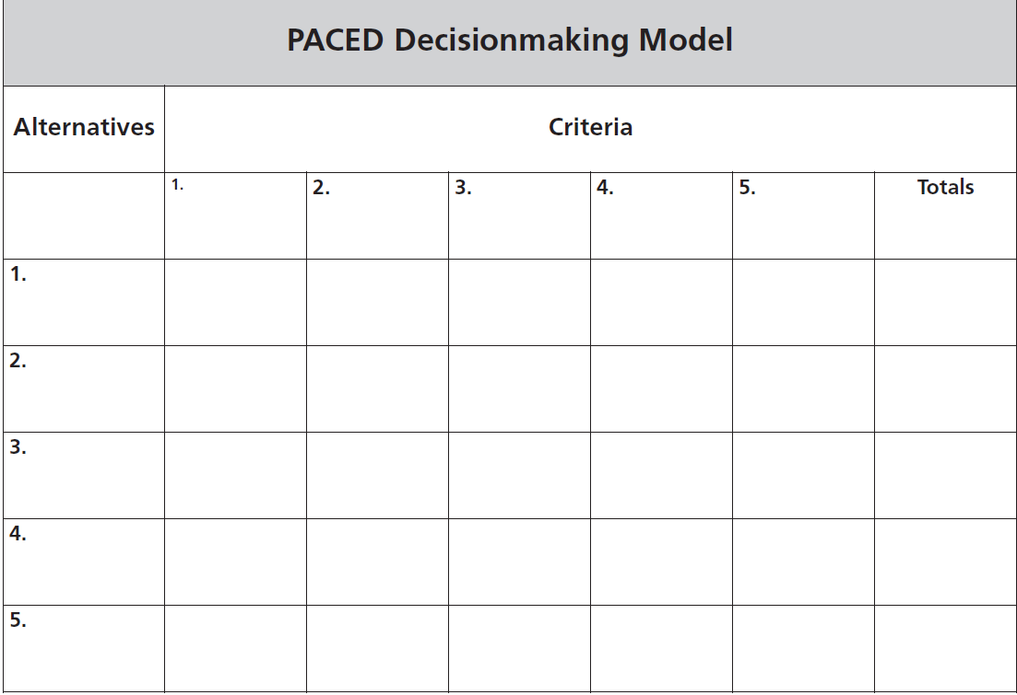
Defining the problem- “Should I stay or should I go?”
Notes:
.page 12

Slide 14
Where are the documents from?
Collected from one-on-one surveys
Conducted by college educated Negros
Compiled in two books-
Scott, Emmet J. Negro Migration During the War.
Oxford: Oxford Press, 1920
U.S. Department of Labor, Division of Negro Economics- Negro Migration In 1916-17. Washington, D.C.: Government Printing Office
Notes:
Isabelle Wilkerson author of Warmth of Other Suns, references Emmett Scott’s Negro Migration During the War book. Negro Migration in 1916-17 were reports compiled by George E. Haynes Ph.D. Director of Division of Negro Economics. The reports were written by R.H. Leavell, T.R. Snavely, T.J. Woofter, Jr. W.T. B. Williams and Francis D. Tyson. All were African Americans. Scott had served as a close advisor to Booker T. Washington and Special Assistant to the Secretary of the Navy During Woodrow Wilson’s administration. That was the highest post held by any African American.

Slide 15


What’s in each folder..
Group Assignment
Directions- List of all group jobs
Questions to be answered by the group
Vocabulary list
PACED Decisionmaking Model
Document Excerpts

Slide 16
It’s 1917-
Imagine that you are a member of the group you have been assigned.
Decide who will do each job in your group.
Review the questions and make sure you understand what you are looking for.
Look at the documents to find the answers to the questions.
Discuss in your group.
Record your answers.
Complete the PACED guide.

Slide 17
Gallery Walk

Slide 18
Gallery Walk Discussion Questions
As the Great Migration accelerated, how did the perspectives vary from group to group?
What can be gained by looking at a historical event from different points of view?
How difficult was it for you to assume the perspective of your group in the 1917 time period?
How did competition for jobs influence race relations?
How did labor surpluses and shortages influence the Great Migration?
Notes:
Page 7

Slide 19
PACED Debrief

Slide 20
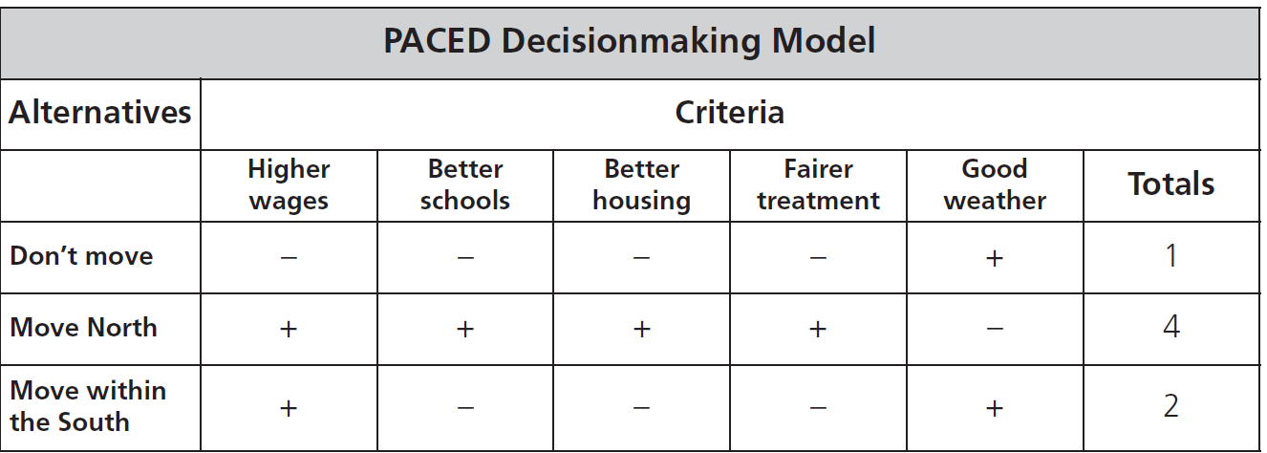
Opportunity Cost- The next best alternative- what was given up
What was the opportunity cost for the migrants?
Notes:
Next best alternative for migrants was to move within the South.

